Slide 1

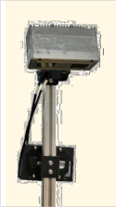
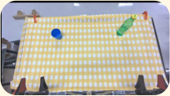
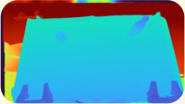















System Interfaces
Task Structuring Agent
Recovery Orchestration Agent
Execution Compilation Agent
Synthesize directed task
Augment graph with recovery
Compile graph
via
Task Instruction
branches
constrained solvers
graph
Pour water from bottle to
cup using dual arms.
Possible semantic sub-goal
Recovery-augmented sub-goals
Solved sub-goals
Skill
Proprio.
Perception
Geometric
Candidate edges
Recovery transition branch
Solved transition flow (edge)
Library
Config
Module
Functions
Activated recovery branch
Action Execution
Failure detection and recovery
Failure detection and recovery
failure detected
trigger
failure detected
trigger
Notes:
{
"paper_title": "From Reaction to Anticipation: Proactive Failure Recovery through Agentic Task Graph for Robotic Manipulation (AgentChord)",
"paper_url": "https://arxiv.org/pdf/2605.11951v1",
"figure": "Figure 2",
"license": "unverified",
"notes": "Original task-graph structuring, recovery orchestration and execution compilation architecture. Native graphs, flow arrows and mathematical labels; ordinary prose remains live text with Arial substituted for unavailable source Chalkboard. Nineteen original interface icons/robot observations remain separate raster objects.",
"page": 4,
"status": "figure_recreation",
"source_sha256": "56a1a3c839b5850c82f072eea2cbc0f5c7b2da4da864a5b16f8e821d188d6757",
"source_crop_pdf_points": [
48,
54,
561,
303
],
"extraction_review": "pending; native geometry extraction is not visual fidelity approval",
"font_substitutions": "Arial or Courier New; source fonts recorded per text object",
"outlined_font_families": [
"DejaVuMath"
],
"outlined_math_limit": "Selected source mathematical fonts preserved as editable glyph outlines, not live equation/text objects.",
"extraction_warnings": [
"7 source clipping groups intersect crop; extracted paths require explicit clipping review",
"path crosses crop boundary: 0",
"path partially intersects raster inset: 2",
"path partially intersects raster inset: 163"
],
"ignored_invisible_text_spans": 0,
"path_repairs": "Reviewed arrow compounds split to preserve open heads without fill-parity seams; two lower execution braces redrawn as equivalent native stroked polylines.",
"text_repairs": "Live ordinary labels use fitted Arial instead of unavailable Chalkboard; mathematical source glyphs remain native vector outlines. This changes letterform style but preserves source wording, placement, color, diagram geometry and photographs."
}

