Slide 1
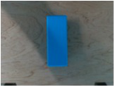
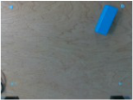
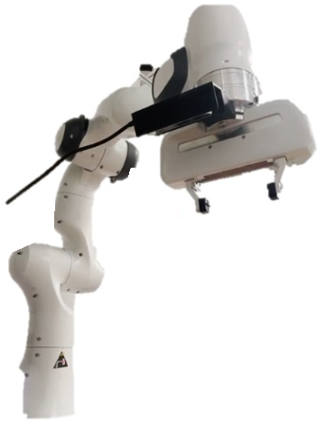
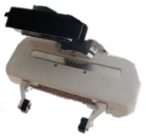


ΔT
cam
Source
Target
u
u
Notes:
{
"paper_title": "Annotation-Free One-Shot Imitation Learning for Multi-Step Manipulation Tasks",
"paper_url": "https://arxiv.org/abs/2509.24972v1",
"pdf_url": "https://arxiv.org/pdf/2509.24972v1",
"figure": "Figure 1",
"page": 2,
"license": "unverified Private user-requested adaptation; no public redistribution permission implied.",
"status": "figure_recreation",
"notes": "Manually reconstructed from the inspected original flattened PDF figure. Ordinary labels are live typeable text; panels, graph geometry and arrows are native editable shapes or paths. Source layout and contents retained; font metrics, line widths and decorative effects approximated. Source is flattened. Ordinary labels, motion arrows and divider manually recreated as live text/native paths. Six isolated photographic details retain original pixels. The robot silhouette photo is reused at the two original diagram positions.",
"source_sha256": "09d5f8a6ab5241357e07c48d838af7d0fc6d4968c3f6b8a11422f5f31367915b",
"source_crop_pdf_points": [
311,
391,
559,
504
],
"survey_crop_correction": true,
"visual_inspection": "Original PDF figure inspected before source-layout reconstruction on 2026-10-09; independent application QA pending.",
"raster_details": [
{
"id": "source-observation",
"bounds_source_pixels": [
11,
22,
165,
138
],
"detail": "Original source RGB camera view"
},
{
"id": "target-observation",
"bounds_source_pixels": [
545,
22,
699,
138
],
"detail": "Original target RGB camera view"
},
{
"id": "source-robot",
"bounds_source_pixels": [
40,
69,
400,
538
],
"detail": "Original isolated robot photograph silhouette"
},
{
"id": "target-robot",
"bounds_source_pixels": [
570,
69,
930,
538
],
"detail": "Original isolated robot photograph silhouette"
},
{
"id": "adapted-gripper",
"bounds_source_pixels": [
1004,
127,
1200,
310
],
"detail": "Original isolated transformed gripper photograph"
},
{
"id": "source-final-object",
"bounds_source_pixels": [
313,
459,
418,
541
],
"detail": "Original blue object photograph"
},
{
"id": "target-final-object",
"bounds_source_pixels": [
918,
459,
1027,
542
],
"detail": "Original blue object photograph"
}
]
}

