Slide 1







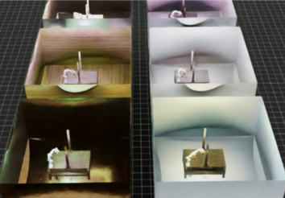
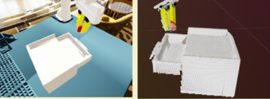
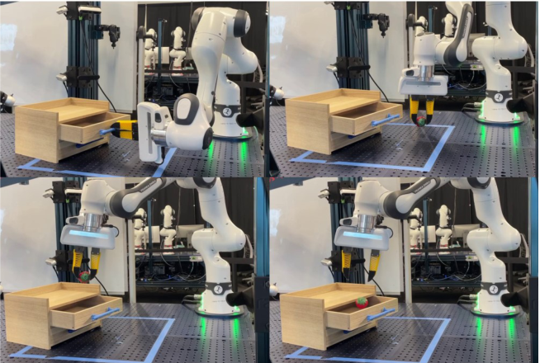

Data
Collection
(Sim2Real)
Policy
Code
Simulation
VLM+LLM
Raw Assets
Object Database
Scene Generation/
reset()
High-level Task
“put the item into the drawer”
Scenario
Task Generator
Table-top, Franka robot, workspace
check_success()
• Agents
ViPR
ViPR Eureka
ViPR RL
• Data
RGB
Point Cloud
Dense language
annotation
Object List
Task Description
scripted_policy()
• Parallelized Sim
• Domain
Randomization
“open the drawer, pick up the strawberry,
and put it into the drawer”
reward_function()
Lighting
Texture
Material
Object pose
Joint state
Simulation APIs
Simulation
Generator
compose_state()
Environment APIs
Robot Skill APIs
Notes:
{
"paper_title": "AnyTask: An Automated Task and Data Generation Framework for Advancing Sim-to-Real Policy Learning",
"paper_url": "https://arxiv.org/abs/2512.17853v2",
"figure": "Figure 2",
"page": 2,
"license": "http://arxiv.org/licenses/nonexclusive-distrib/1.0/",
"status": "figure_recreation",
"source_sha256": "511df38af5995725333fbcce983419388c9a747955be1b20bfc52af5ae029741",
"source_crop_pdf_points": [
70,
62,
551,
196
],
"notes": "Manually reconstructed after inspecting actual source pixels. Original source is a flattened raster. Layout, native panels, labels and connecting geometry are recreated; no whole-figure raster backdrop. Font metrics and curve/arrow geometry approximated. Small original mathematical/photo details retained only where explicitly noted. Independent target-application QA pending. Manually reconstructed stacked stage panels, stage routes, labels and monospaced code names. Only ten bounded photographic/icon assets remain raster; code and ordinary labels typeable."
}

