Slide 1




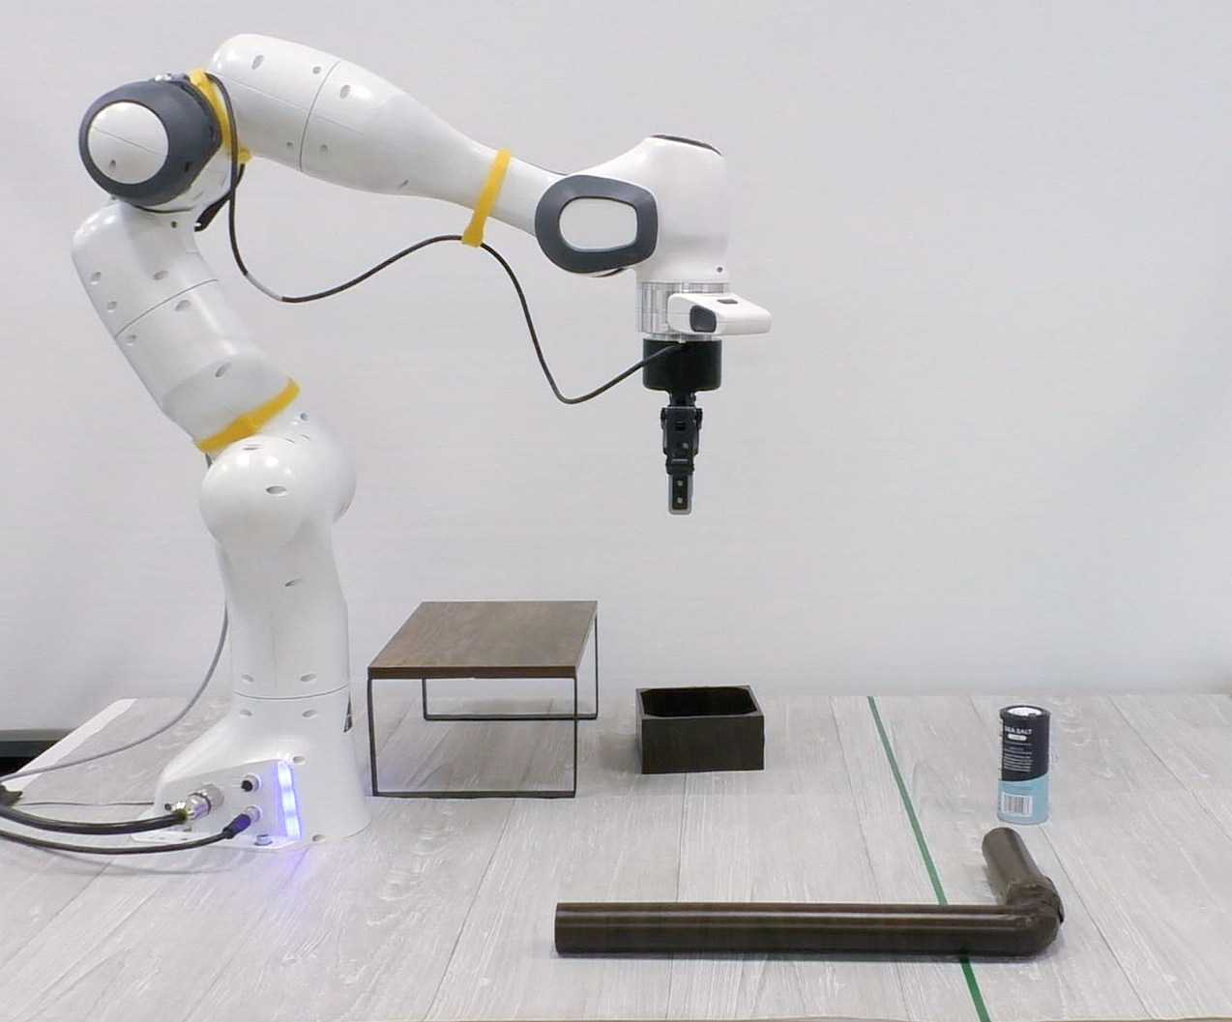
Training
successful
tasks
task
parameter
environment
task
sampler
failed
tasks
skill
policy
task space
return
Testing
state
task plan
goal:
in(salt, ctr) and
under(container, rack)
1
pull-with
(salt, hook)
task
planner
2
place-onto
(salt, container)
skill
policies
3
push-under
(container, rack)
action
Notes:
{
"paper_title": "Active Task Randomization: Learning Robust Skills via Unsupervised Generation of Diverse and Feasible Tasks",
"paper_url": "https://arxiv.org/abs/2211.06134v2",
"pdf_url": "https://arxiv.org/pdf/2211.06134v2",
"figure": "Figure 1",
"page": 1,
"license": "unverified Private user-requested adaptation; no public redistribution permission implied.",
"status": "figure_recreation",
"notes": "Manually reconstructed from the inspected original flattened PDF figure. Ordinary labels are live typeable text; panels, graph geometry and arrows are native editable shapes or paths. Source layout and contents retained; font metrics, line widths and decorative effects approximated. Source ordinary labels were outlines, so they are manually replaced by native typeable text. Four original robot/task photos plus the small globe icon remain raster. All task-space dots, links, modules, plans and arrows are native; source layout retained.",
"source_sha256": "c13ef30ae59aad2323d16791e9cfbaf22ad416aeaceb5062d054e93e9fe0556c",
"source_crop_pdf_points": [
311,
146,
559,
380
],
"survey_crop_correction": false,
"visual_inspection": "Original PDF figure inspected before source-layout reconstruction on 2026-10-09; independent application QA pending.",
"raster_details": [
{
"id": "success-one",
"bounds_source_pixels": [
20,
52,
160,
148
],
"detail": "Original training-task robot rendering; internal task objects remain raster"
},
{
"id": "success-two",
"bounds_source_pixels": [
20,
152,
160,
248
],
"detail": "Original training-task robot rendering; internal task objects remain raster"
},
{
"id": "failure",
"bounds_source_pixels": [
20,
252,
160,
348
],
"detail": "Original training-task robot rendering; internal task objects remain raster"
},
{
"id": "earth",
"bounds_source_pixels": [
634,
76,
696,
139
],
"detail": "Original small globe/environment icon"
},
{
"id": "testing-photo",
"bounds_source_pixels": [
20.87999999999994,
411.40919999999994,
293.805,
631.7763
],
"detail": "Original real-robot testing photograph; native caption overlay is separate"
}
]
}

