Slide 1
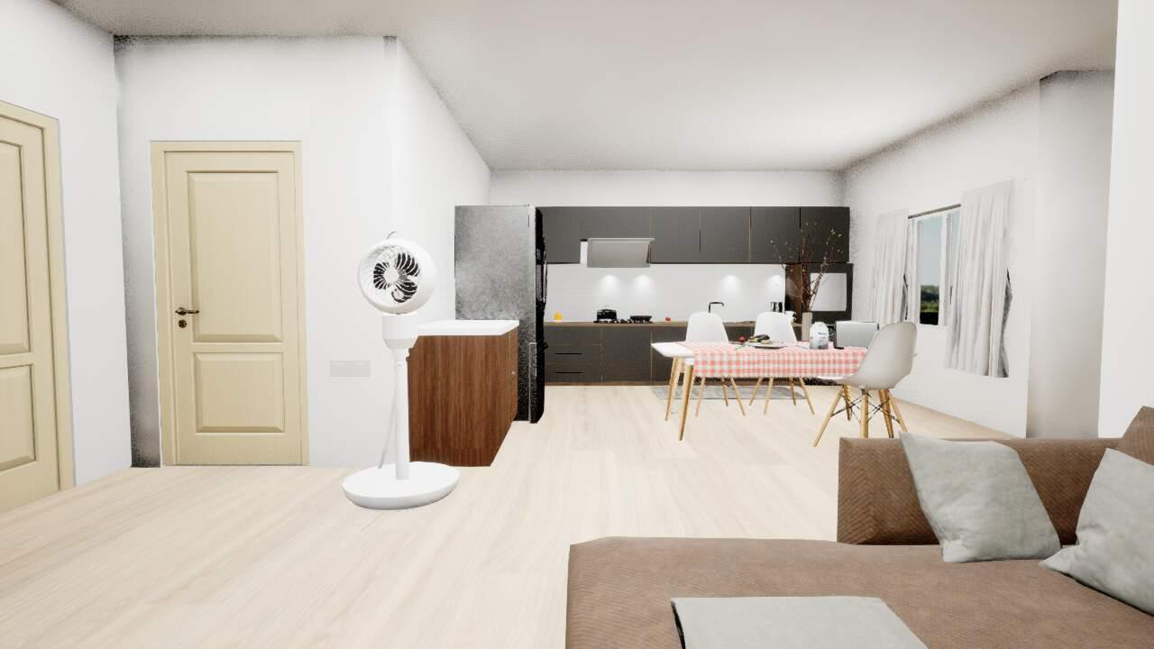
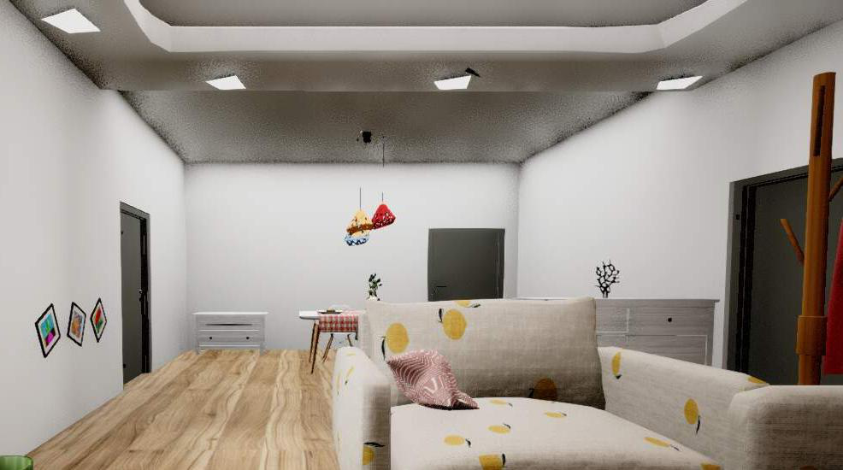
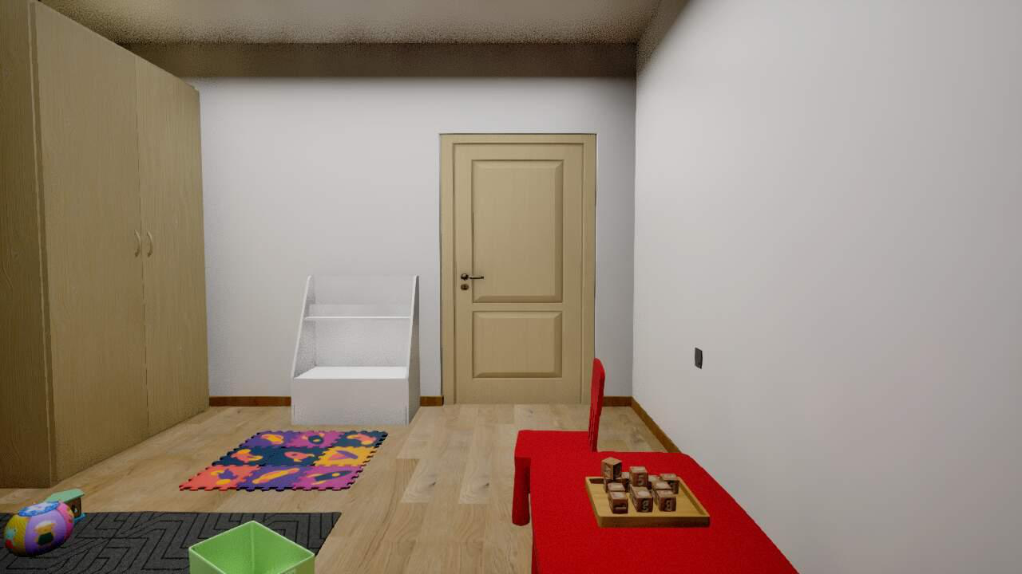
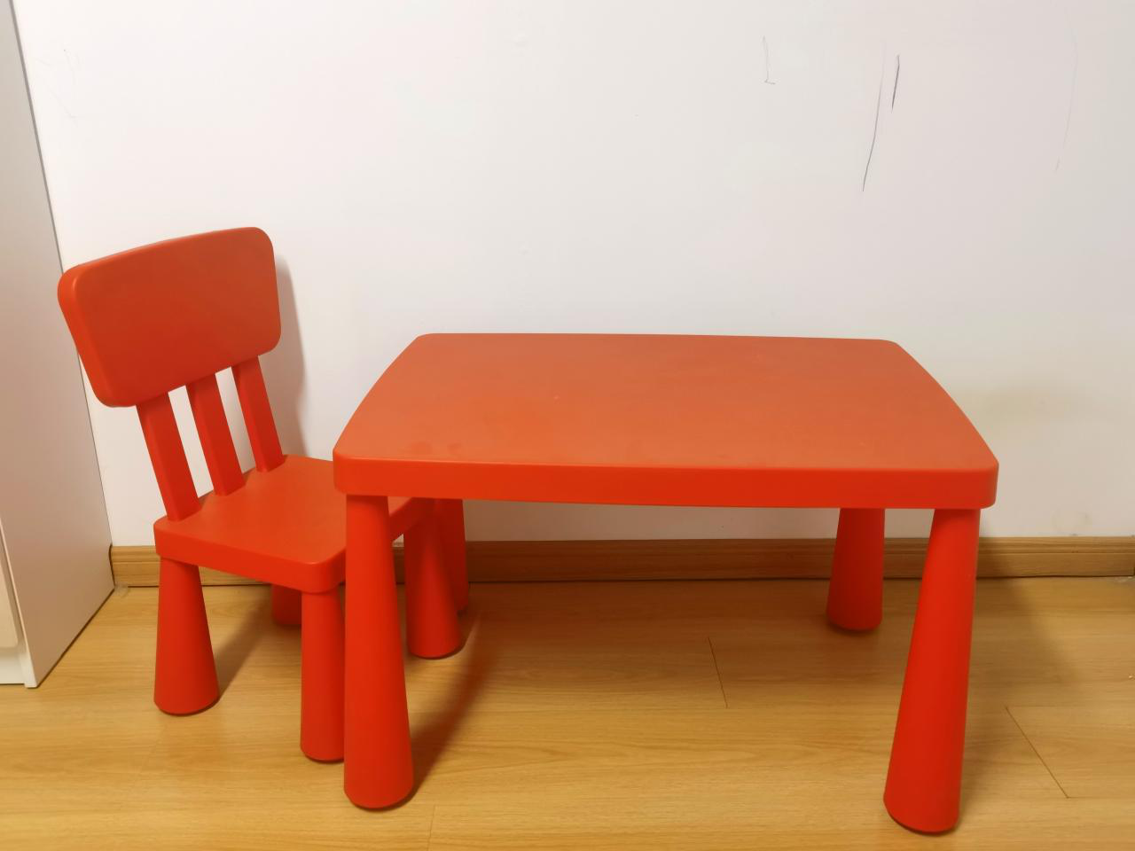
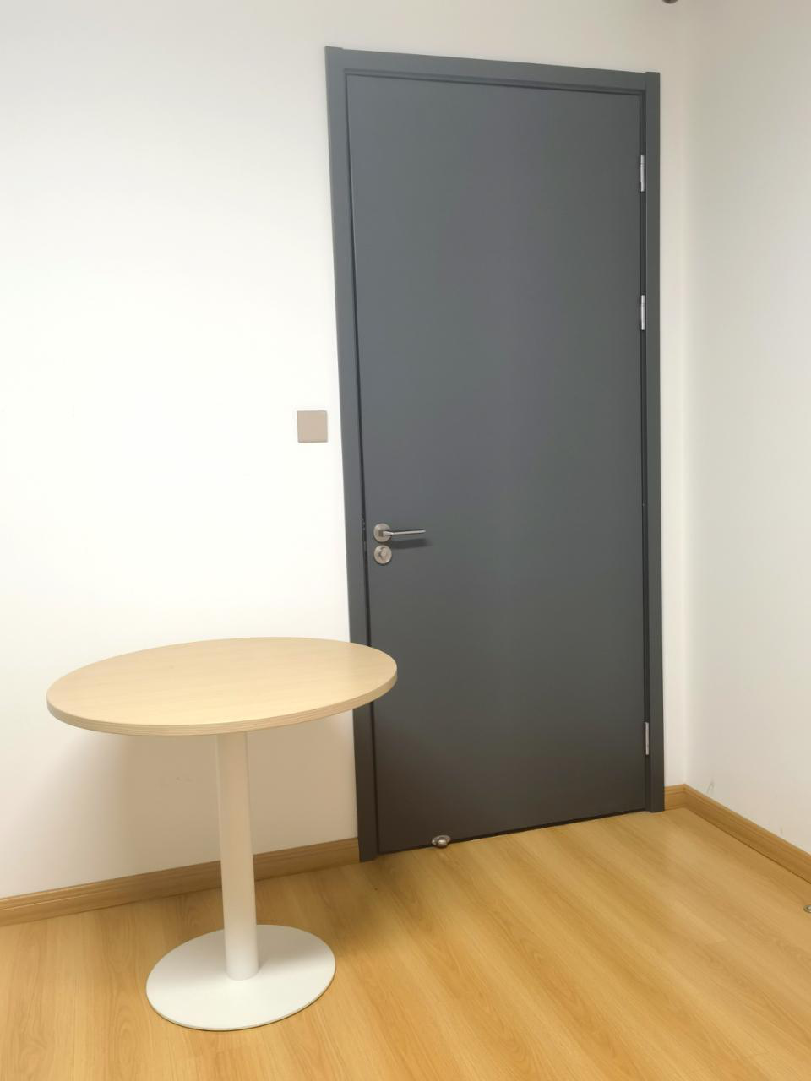
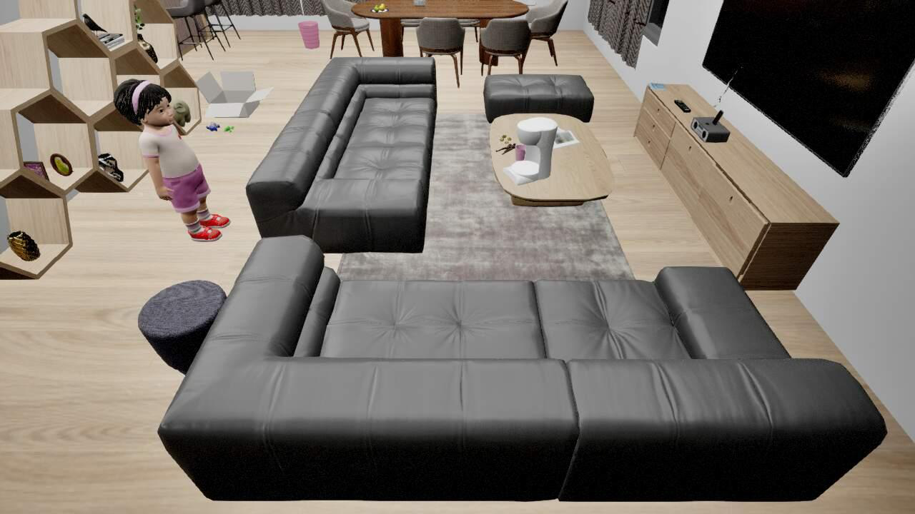


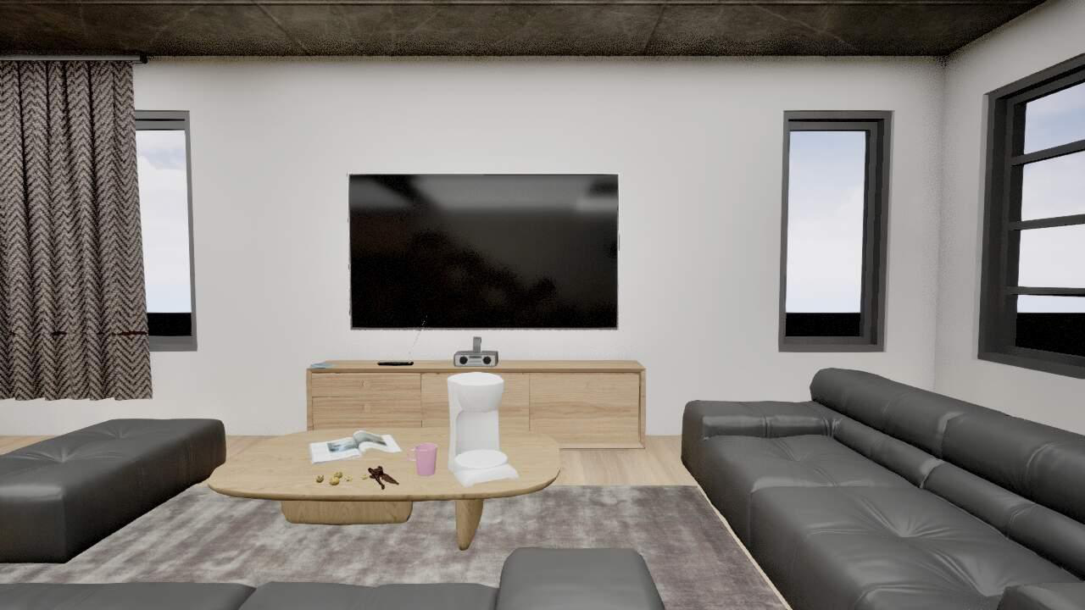



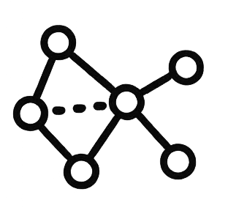



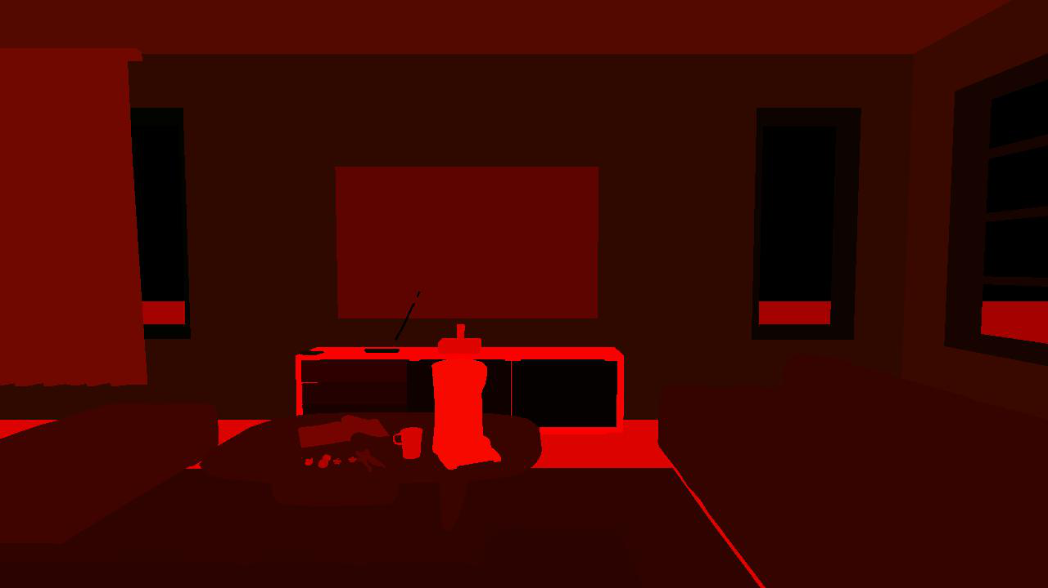




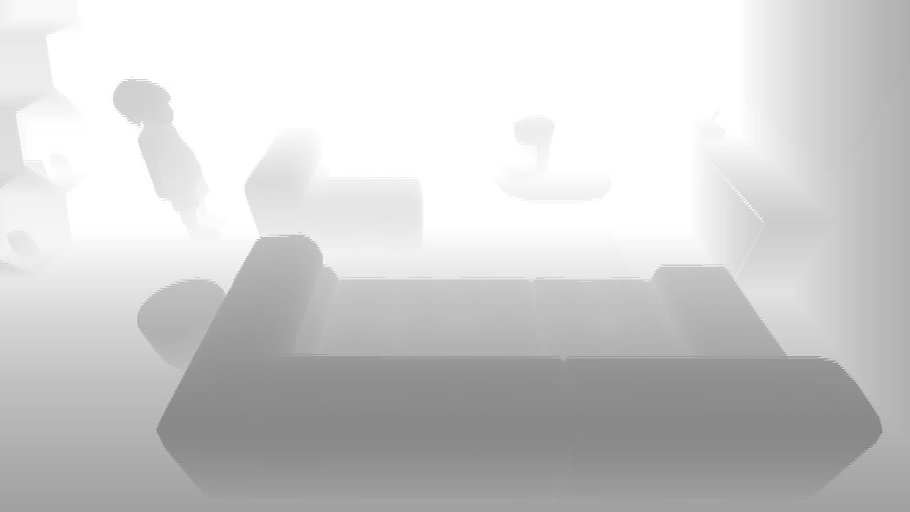

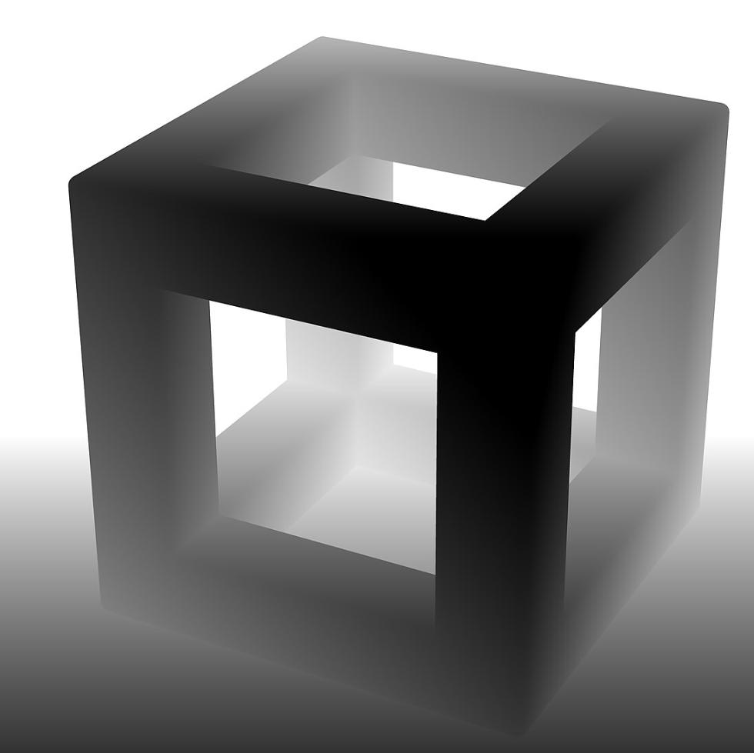
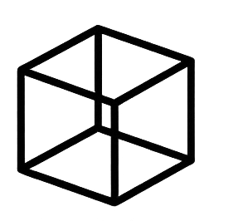
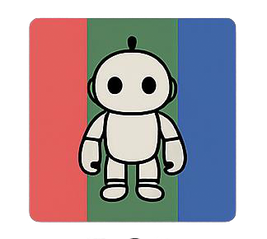

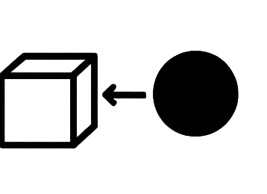
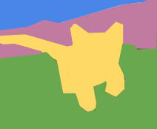
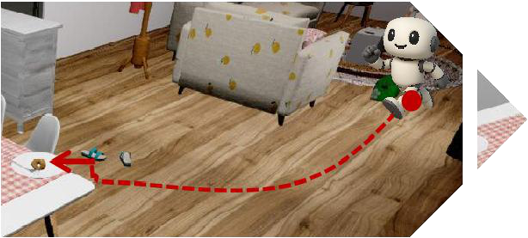
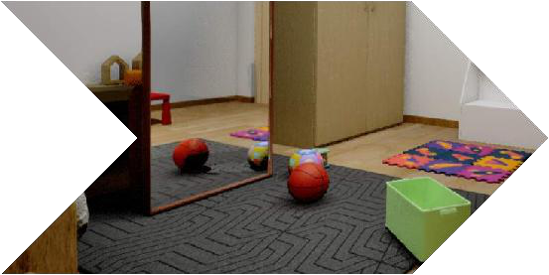
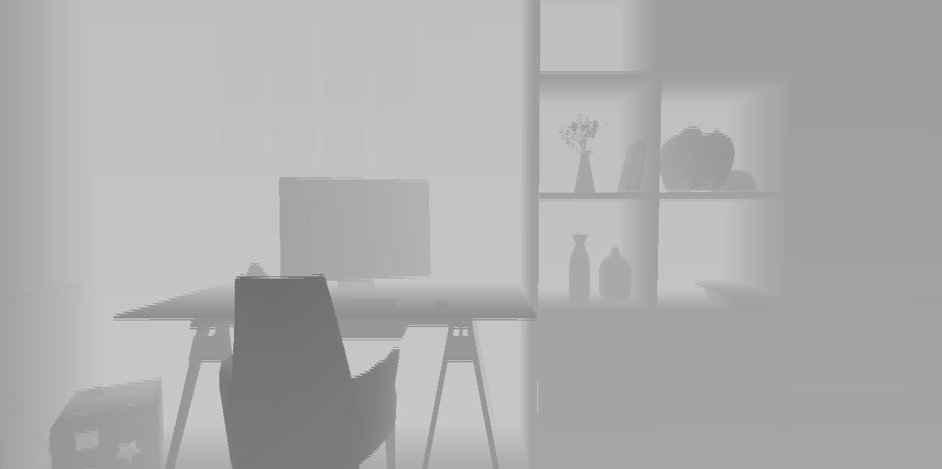
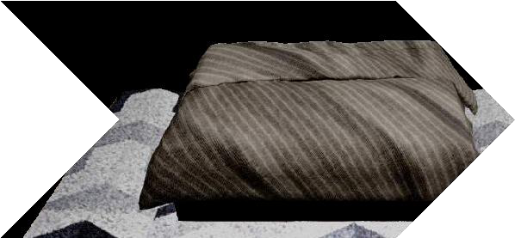
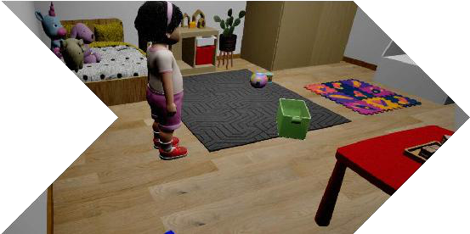
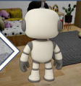
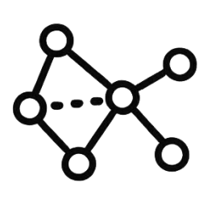



a
Scenes (Unreal Engine)
Real World
Data
...
b
task filter
ε -
Task Execution
Initial Tasks Evolved Tasks
segment (ego)
initial & evolved tasks
Recombination:
a
c
1
a
c
1
c
1
b
c
1
b
data recorder
initial tasks
Reuse:
a
a
Task Generation
c
1
c
2
c
2
c
1
Agent–Environment Interaction
Task Evolution
c
......
Hunger-Driven Navigation
Ball Counting: 2 mirror reflections,
Depth Estimation
Contact Relationship
Object In-View Check:
4 visual patterns, 2 physical objects
red table not in view
Different Tasks:
a
b
c
1
c
(different attributes:
different
1
depth
3D box
RGB
label
contact
segment
Spectral Clustering
MIR
Image Encoder
Text Encoder
colors; instances: a, b, c1, c2)
Notes:
{
"paper_title": "Automatic Cognitive Task Generation for In-Situ Evaluation of Embodied Agents",
"paper_url": "https://arxiv.org/pdf/2602.05249v1",
"figure": "Figure 1",
"license": "http://arxiv.org/licenses/nonexclusive-distrib/1.0/",
"notes": "Native extracted geometry and ordinary live text; source raster photos/icons are separately preserved. Source clipping and cross-format QA pending. Two rectangular source bitmap background panels reconstructed natively; broad gradient shadows omitted. Source sensor/photo examples remain separate raster images.",
"page": 2,
"status": "figure_recreation",
"source_sha256": "5ce5e9d22cc3bb50b1119408d319cf6b5cf2107e824579f33d542f7db9609747",
"source_crop_pdf_points": [
80,
70,
532,
332
],
"extraction_review": "pending; native geometry extraction is not visual fidelity approval",
"font_substitutions": "Arial or Courier New; source fonts recorded per text object",
"outlined_font_families": [
"CMM",
"CMSY",
"CMEX",
"CambriaMath"
],
"outlined_math_limit": "Selected source mathematical fonts preserved as editable glyph outlines, not live equation/text objects.",
"extraction_warnings": [
"5 source clipping groups intersect crop; extracted paths require explicit clipping review",
"path crosses crop boundary: 0",
"path partially intersects raster inset: 51",
"unhandled image/shading at seq 3: [292.20050048828125, 152.9122772216797, 461.3046875, 324.00091552734375]; requires reviewed raster region",
"unhandled image/shading at seq 4: [82.93467712402344, 153.36119079589844, 293.736083984375, 323.5520935058594]; requires reviewed raster region"
],
"ignored_invisible_text_spans": 0
}

