Slide 1
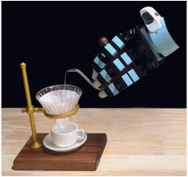
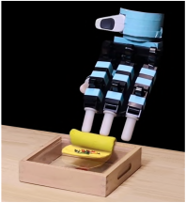
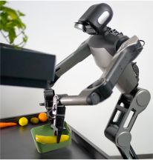
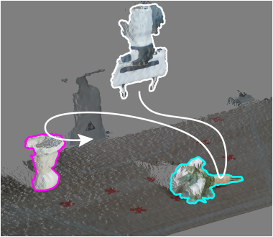
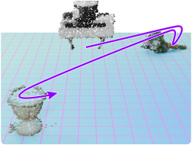
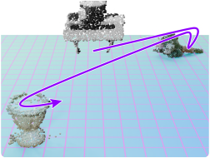

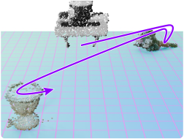
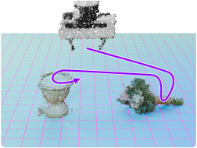
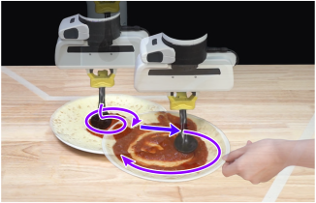
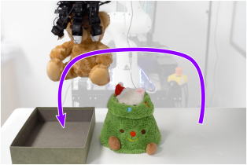
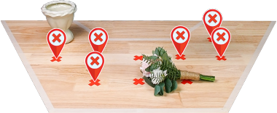
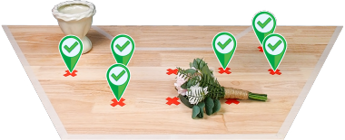
"One-Shot" Imitation
Versatile Skills & Platforms
One Human-Collected Demo
DemoGen:
100x Synthetic Demos
Dexterous Hands
Deformable
Bimanual
Extended O.O.D. Capabilities
Poor Generalization
Strong Generalization
Disturbance Resistance
Obstacle Avoidance
Notes:
{
"paper_title": "DemoGen: Synthetic Demonstration Generation for Data-Efficient Visuomotor Policy Learning",
"paper_url": "https://arxiv.org/pdf/2502.16932v1",
"figure": "Figure 1",
"license": "http://arxiv.org/licenses/nonexclusive-distrib/1.0/",
"notes": "Source-layout reconstruction using native PDF paths and live ordinary labels. Each source photograph, illustration or mathematical bitmap is an isolated insert with original clipping. No whole-figure raster backdrop. Native paths are not semantically attached connectors.",
"page": 1,
"status": "figure_recreation",
"source_sha256": "310448233ee36cd4d5637725228450194b6d6443e1518007dbc051115b557e83",
"source_crop_pdf_points": [
49,
181,
562,
397
],
"extraction_review": "pending; native geometry extraction is not visual fidelity approval",
"font_substitutions": "Arial or Courier New; source fonts recorded per text object",
"outlined_font_families": [
"CMM",
"CMSY",
"CMEX",
"CambriaMath"
],
"outlined_math_limit": "Selected source mathematical fonts preserved as editable glyph outlines, not live equation/text objects.",
"dash_fidelity": "PPTX uses the closest supported native preset, not exact PDF dash lengths. Draw.io retains interval lengths; PDF phase/caps are not preserved; zero intervals become 0.001 scene units.",
"extraction_warnings": [
"21 source clipping groups intersect crop; extracted paths require explicit clipping review",
"unhandled image/shading at seq 5: [54.36238479614258, 216.16439819335938, 180.966796875, 325.66961669921875]; requires reviewed raster region",
"unhandled image/shading at seq 6: [341.0804443359375, 201.2905731201172, 417.28326416015625, 273.08050537109375]; requires reviewed raster region",
"unhandled image/shading at seq 7: [419.8420104980469, 201.0966796875, 485.7850036621094, 273.1496276855469]; requires reviewed raster region",
"unhandled image/shading at seq 8: [341.1630859375, 312.98492431640625, 449.82965087890625, 383.1336364746094]; requires reviewed raster region",
"unhandled image/shading at seq 9: [452.8039855957031, 312.9899597167969, 557.3878173828125, 383.14068603515625]; requires reviewed raster region",
"unhandled image/shading at seq 11: [197.7828826904297, 216.1676483154297, 281.6719970703125, 279.6007385253906]; requires reviewed raster region",
"unhandled image/shading at seq 13: [54.32200622558594, 330.8839111328125, 181.01434326171875, 382.8766174316406]; requires reviewed raster region",
"unhandled image/shading at seq 14: [197.75506591796875, 331.16278076171875, 324.3875427246094, 382.9390563964844]; requires reviewed raster region",
"unhandled image/shading at seq 15: [229.696044921875, 250.09803771972656, 313.58514404296875, 313.5311279296875]; requires reviewed raster region",
"unhandled image/shading at seq 17: [233.27880859375, 253.95533752441406, 317.16790771484375, 317.388427734375]; requires reviewed raster region",
"unhandled image/shading at seq 21: [236.86431884765625, 258.0924377441406, 320.75341796875, 321.5255126953125]; requires reviewed raster region",
"unhandled image/shading at seq 24: [240.4558563232422, 262.2347717285156, 324.344970703125, 325.6678466796875]; requires reviewed raster region",
"unhandled image/shading at seq 55: [488.72174072265625, 201.0841522216797, 557.3883056640625, 273.15313720703125]; requires reviewed raster region"
],
"ignored_invisible_text_spans": 0,
"extraction_warnings_reviewed": [
"Raster warnings resolved by independently isolated source SVG image instances with original masks/clips and source paint order. Native source clipping and preview compared against original pixels. Rotated ordinary labels restored as native rotated text. Full-figure crop-crossing white backgrounds intentionally omitted. PDF dash lengths approximate nearest native PowerPoint preset."
],
"text_editability": "Ordinary source labels are live text; selected mathematical fonts are native outlines. Source image inserts retain internal raster pixels.",
"image_reconstruction": "Each source raster instance is isolated with complete source SVG ancestry, source clipping, mask and paint order. No full-figure image is used."
}

