Slide 1
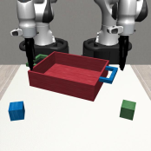
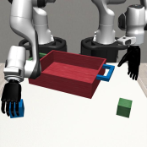
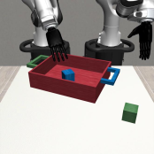
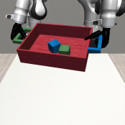

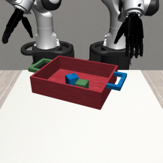
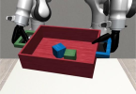
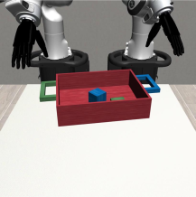
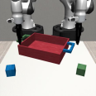
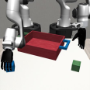

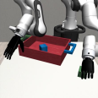
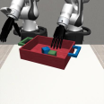
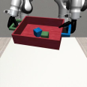

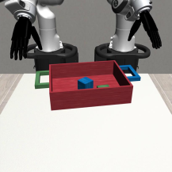
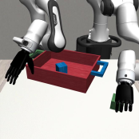


Source demo segmentation
Source demo segmentation
New trajectory generation and execution
New trajectory generation and execution
pick cube
place cube
Coordination:
Parallel:
Coordination:
lift tray
Parallel:
Parallel:
Parallel:
Reference
Reference
blue cube
Ref object:
tray
tray
Ref object:
Ref object:
Ref object:
Ref object:
Ref object:
Subtask
Trajectory
Left arm
Right arm
Right
Two
-
arm coordination
Arm
Current
Observation
Full
Object
-
Centric
Demo
Trajectory Transformation
Left
Arm
pick cube
place cube
Coordination:
Parallel:
Coordination:
lift tray
Executed
Generated
Parallel:
Parallel:
Parallel:
Ref object:
green cube
tray
tray
Ref object:
Ref object:
Ref object:
Ref object:
Ref object:
Trajectory
Trajectory
Notes:
{
"paper_title": "DexMimicGen: Automated Data Generation for Bimanual Dexterous Manipulation via Imitation Learning",
"paper_url": "https://arxiv.org/pdf/2410.24185v2",
"figure": "Figure 3",
"license": "http://arxiv.org/licenses/nonexclusive-distrib/1.0/",
"notes": "Source-layout reconstruction using native PDF paths and live ordinary labels. Each source photograph, illustration or mathematical bitmap is an isolated insert with original clipping. No whole-figure raster backdrop. Native paths are not semantically attached connectors.",
"page": 4,
"status": "figure_recreation",
"source_sha256": "96349aac2708b5637bbbefa9964067b5ed7eac0fb51ba0248b8d8dcbe49352a2",
"source_crop_pdf_points": [
52,
52,
559,
294
],
"extraction_review": "pending; native geometry extraction is not visual fidelity approval",
"font_substitutions": "Arial or Courier New; source fonts recorded per text object",
"outlined_font_families": [
"CMM",
"CMSY",
"CMEX",
"CambriaMath"
],
"outlined_math_limit": "Selected source mathematical fonts preserved as editable glyph outlines, not live equation/text objects.",
"dash_fidelity": "PPTX uses the closest supported native preset, not exact PDF dash lengths. Draw.io retains interval lengths; PDF phase/caps are not preserved; zero intervals become 0.001 scene units.",
"extraction_warnings": [
"90 source clipping groups intersect crop; extracted paths require explicit clipping review",
"unhandled image/shading at seq 1: [73.1826400756836, 158.87744140625, 111.9517593383789, 197.65194702148438]; requires reviewed raster region",
"unhandled image/shading at seq 2: [116.59597778320312, 158.87744140625, 155.36509704589844, 197.65194702148438]; requires reviewed raster region",
"unhandled image/shading at seq 3: [159.80740356445312, 158.87744140625, 198.57652282714844, 197.65194702148438]; requires reviewed raster region",
"unhandled image/shading at seq 4: [203.01881408691406, 158.87744140625, 241.78793334960938, 197.65194702148438]; requires reviewed raster region",
"unhandled image/shading at seq 5: [289.6435546875, 158.87744140625, 328.41265869140625, 197.65194702148438]; requires reviewed raster region",
"unhandled image/shading at seq 6: [246.43214416503906, 158.87744140625, 285.2012634277344, 197.65194702148438]; requires reviewed raster region",
"unhandled image/shading at seq 8: [75.605712890625, 83.75151062011719, 133.7593994140625, 141.91326904296875]; requires reviewed raster region",
"unhandled image/shading at seq 9: [136.78823852539062, 83.75151062011719, 194.94192504882812, 141.91326904296875]; requires reviewed raster region",
"unhandled image/shading at seq 11: [202.81689453125, 83.75151062011719, 260.9705810546875, 141.91326904296875]; requires reviewed raster region",
"unhandled image/shading at seq 13: [268.2397766113281, 83.75151062011719, 326.3934631347656, 141.91326904296875]; requires reviewed raster region",
"unhandled image/shading at seq 15: [75.605712890625, 215.8263397216797, 133.7593994140625, 273.98809814453125]; requires reviewed raster region",
"unhandled image/shading at seq 16: [136.78823852539062, 215.8263397216797, 194.94192504882812, 273.98809814453125]; requires reviewed raster region",
"unhandled image/shading at seq 18: [203.01881408691406, 215.8263397216797, 261.1724853515625, 273.98809814453125]; requires reviewed raster region",
"unhandled image/shading at seq 20: [268.2397766113281, 215.8263397216797, 326.3934631347656, 273.98809814453125]; requires reviewed raster region",
"unhandled image/shading at seq 98: [424.5278015136719, 126.36253356933594, 472.78729248046875, 159.6851348876953]; requires reviewed raster region",
"unhandled image/shading at seq 99: [424.5278015136719, 87.38343048095703, 472.78729248046875, 120.50410461425781]; requires reviewed raster region",
"unhandled image/shading at seq 101: [424.5278015136719, 199.06271362304688, 472.78729248046875, 232.18338012695312]; requires reviewed raster region",
"unhandled image/shading at seq 102: [424.5278015136719, 238.24215698242188, 472.78729248046875, 271.3628234863281]; requires reviewed raster region",
"unhandled image/shading at seq 103: [484.296875, 87.3861083984375, 556.5851440429688, 159.6851348876953]; requires reviewed raster region",
"unhandled image/shading at seq 107: [484.296875, 199.0637969970703, 556.5851440429688, 271.3628234863281]; requires reviewed raster region",
"unhandled image/shading at seq 124: [342.1434020996094, 142.92019653320312, 414.431640625, 215.421142578125]; requires reviewed raster region"
],
"ignored_invisible_text_spans": 0,
"text_editability": "Ordinary source labels are live text; selected mathematical fonts are native outlines. Source image inserts retain internal raster pixels.",
"image_reconstruction": "Each source raster instance is isolated with complete source SVG ancestry, source clipping, mask and paint order. No full-figure image is used.",
"extraction_warnings_reviewed": [
"Source image/shading warnings resolved by isolated source SVG inserts preserving alpha, clip and paint order. Source pixels and final reconstruction preview inspected side by side; original native paths retained. Rotated ordinary labels restored as single native text boxes. Source clipping is preserved for images; crop-crossing background paths omitted. PowerPoint dash length/cap rendering uses closest native preset."
]
}

