Slide 1
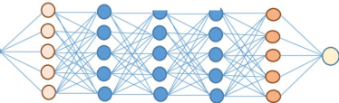



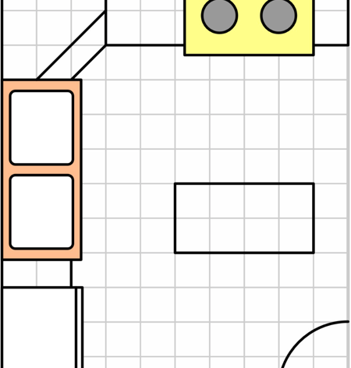
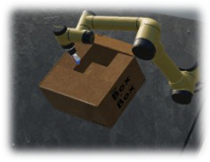
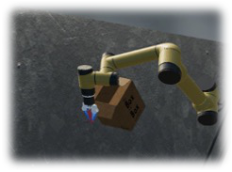
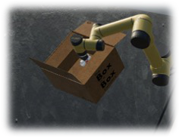
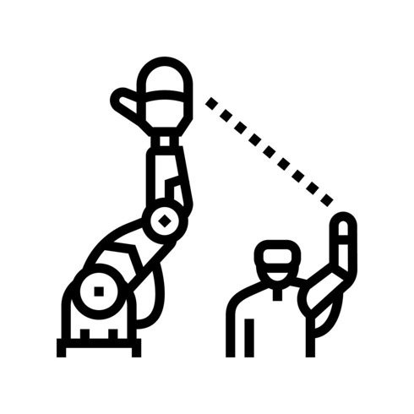
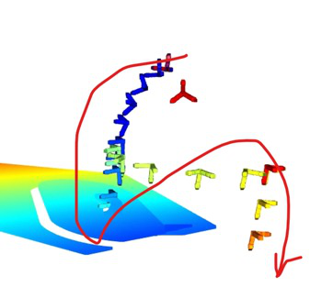


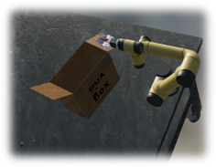
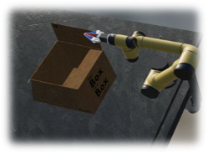
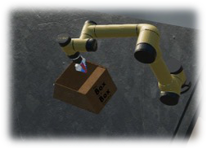
Heterogeneous Data
Environment Simulation
Sim2Real Data Scaling
Sim2Real Deployment
Projection
Deployable model
Objects
Layouts
Image
Video
Read Config
Pro-
LLM
ject
DR Features Ranking
Imitate
#1
#2
…
#N
Obs.-Action Trajectories
Tele-
Action
operation
Trajectory
Actions
Scene
AIDR
Auto.
DR
SADR
DA
…
Feedback
Reinforcement Learning, Trajectory Optimization, and Motion Planning
Policy Fine-Tuning
Notes:
{
"paper_title": "DexScale: Automating Data Scaling for Sim2Real Generalizable Robot Control",
"paper_url": "https://raw.githubusercontent.com/mlresearch/v267/main/assets/liu25k/liu25k.pdf",
"figure": "Figure 2",
"license": "Official PMLR source; specific reuse license not independently verified",
"notes": "Original four-stage data engine pipeline. Native editable panels, decision/ranking boxes, control paths and ordinary labels. Fifteen original icons/scene/trajectory inserts remain separate raster objects; internal details of the neural-network icon remain raster.",
"page": 4,
"status": "figure_recreation",
"source_sha256": "62ca03103d51755623b6a1fd23e777f22186c29c679650621b0a8c3bea579c67",
"source_crop_pdf_points": [
77,
66,
518,
227
],
"extraction_review": "pending; native geometry extraction is not visual fidelity approval",
"font_substitutions": "Arial or Courier New; source fonts recorded per text object",
"dash_fidelity": "PPTX uses the closest supported native preset, not exact PDF dash lengths. Draw.io retains interval lengths; PDF phase/caps are not preserved; zero intervals become 0.001 scene units.",
"extraction_warnings": [
"14 source clipping groups intersect crop; extracted paths require explicit clipping review",
"path partially intersects raster inset: 3",
"path partially intersects raster inset: 83",
"path partially intersects raster inset: 108"
],
"ignored_invisible_text_spans": 0,
"text_repairs": "Source Aptos fragments merged into live complete labels and fitted Arial metrics. Raw source image objects replace rendered crops to avoid baking duplicate portions of adjacent native labels."
}

