Slide 1
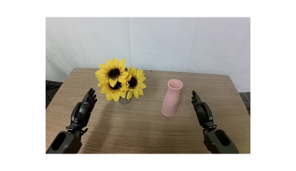
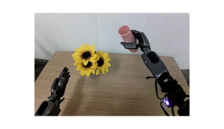
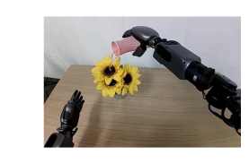
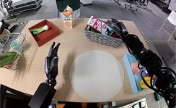
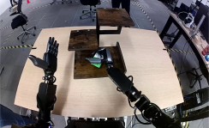
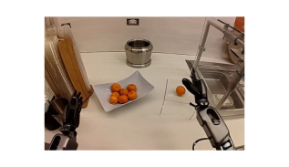
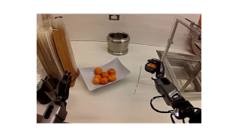
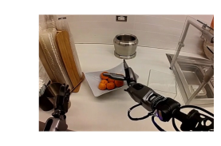
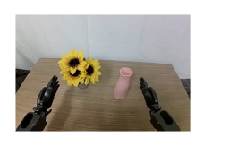
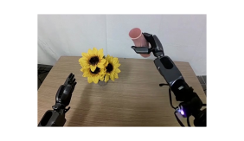
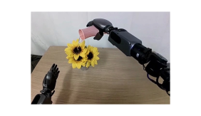



Step 1. Finetune Video World Model
Step 2. Rollout Video World Model
Human teleoperation data
Water the flowers
“Water the flowers”
“Pick up the tangerine”
Step 3. Label Pseudo Actions
Step 4. Visuomotor Policy Training
Step 3. Label Pseudo Actions
Pseudo-labeled
neural trajectories
Automatically Labeled Pseudo Actions
Notes:
{
"paper_title": "DreamGen: Unlocking Generalization in Robot Learning through Video World Models",
"paper_url": "https://arxiv.org/pdf/2505.12705v2",
"figure": "Figure 2",
"license": "unverified",
"notes": "Source-layout reconstruction using native PDF paths and live ordinary labels. Each source photograph, illustration or mathematical bitmap is an isolated insert with original clipping. No whole-figure raster backdrop. Native paths are not semantically attached connectors.",
"page": 2,
"status": "figure_recreation",
"source_sha256": "e4e2c5c9e664d9331adb49c230053a76cf5bb4c3501341f4d9b372ecc585684c",
"source_crop_pdf_points": [
74,
54,
537,
315
],
"extraction_review": "pending; native geometry extraction is not visual fidelity approval",
"font_substitutions": "Arial or Courier New; source fonts recorded per text object",
"outlined_font_families": [
"CMM",
"CMSY",
"CMEX",
"CambriaMath",
"STIXGeneral"
],
"outlined_math_limit": "Selected source mathematical fonts preserved as editable glyph outlines, not live equation/text objects.",
"extraction_warnings": [
"33 source clipping groups intersect crop; extracted paths require explicit clipping review",
"path crosses crop boundary: 0",
"unhandled image/shading at seq 1: [330.2056579589844, 222.95042419433594, 424.132080078125, 277.1387634277344]; requires reviewed raster region",
"unhandled image/shading at seq 12: [93.78872680664062, 93.30175018310547, 175.07122802734375, 142.97439575195312]; requires reviewed raster region",
"unhandled image/shading at seq 14: [208.10165405273438, 93.30175018310547, 289.3841552734375, 142.97439575195312]; requires reviewed raster region",
"unhandled image/shading at seq 21: [287.2608947753906, 132.56936645507812, 392.9281311035156, 193.53123474121094]; requires reviewed raster region",
"unhandled image/shading at seq 23: [371.5855407714844, 132.56936645507812, 477.2527770996094, 193.53123474121094]; requires reviewed raster region",
"unhandled image/shading at seq 24: [444.58013916015625, 132.56936645507812, 550.2473754882812, 193.53123474121094]; requires reviewed raster region",
"unhandled image/shading at seq 25: [287.494384765625, 75.59538269042969, 393.16162109375, 136.5572509765625]; requires reviewed raster region",
"unhandled image/shading at seq 27: [371.991943359375, 75.59538269042969, 477.6591796875, 136.5572509765625]; requires reviewed raster region",
"unhandled image/shading at seq 28: [444.58013916015625, 75.57295227050781, 550.2473754882812, 136.53482055664062]; requires reviewed raster region",
"unhandled image/shading at seq 33: [65.36756134033203, 220.3266143798828, 159.29400634765625, 274.51495361328125]; requires reviewed raster region",
"unhandled image/shading at seq 34: [138.70355224609375, 220.42579650878906, 232.62998962402344, 274.6141357421875]; requires reviewed raster region",
"unhandled image/shading at seq 35: [211.38165283203125, 220.3266143798828, 305.30810546875, 274.51495361328125]; requires reviewed raster region",
"unhandled image/shading at seq 36: [126.1360092163086, 269.22314453125, 168.38954162597656, 276.3911437988281]; requires reviewed raster region",
"unhandled image/shading at seq 37: [200.83755493164062, 269.22314453125, 243.09109497070312, 276.3911437988281]; requires reviewed raster region",
"unhandled image/shading at seq 59: [319.4759216308594, 229.7719268798828, 413.40234375, 283.96026611328125]; requires reviewed raster region",
"unhandled image/shading at seq 61: [307.38507080078125, 235.6960906982422, 401.3115234375, 289.8844299316406]; requires reviewed raster region",
"unhandled image/shading at seq 72: [462.3894348144531, 243.22628784179688, 494.9024353027344, 273.780029296875]; requires reviewed raster region",
"unhandled image/shading at seq 73: [462.3894348144531, 243.22628784179688, 494.9024353027344, 273.780029296875]; requires reviewed raster region"
],
"ignored_invisible_text_spans": 0,
"extraction_warnings_reviewed": [
"Raster warnings resolved by independently isolated source SVG image instances with original masks/clips and source paint order. Native source clipping and preview compared against original pixels. Rotated ordinary labels restored as native rotated text. Full-figure crop-crossing white backgrounds intentionally omitted. PDF dash lengths approximate nearest native PowerPoint preset."
],
"text_editability": "Ordinary source labels are live text; selected mathematical fonts are native outlines. Source image inserts retain internal raster pixels.",
"image_reconstruction": "Each source raster instance is isolated with complete source SVG ancestry, source clipping, mask and paint order. No full-figure image is used."
}

