Slide 1





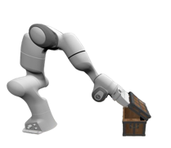
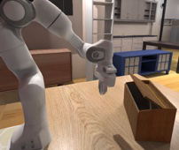
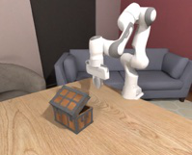
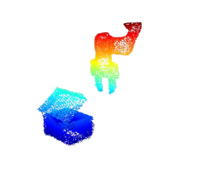

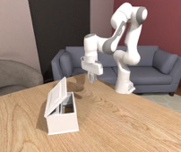
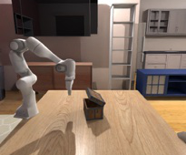




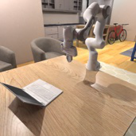
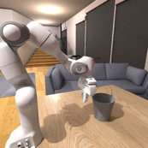
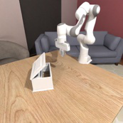
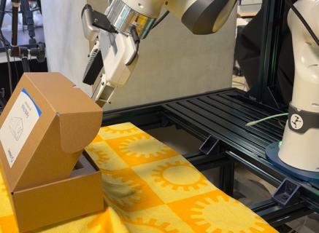


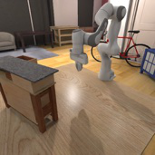
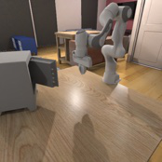
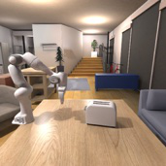



Task Proposal
Data
Generation
Multi
-
Task Training
Evaluation
&
Transfer
Asset
&
Task
Library
kPAM Motion Planner
Demonstration
Collection
Spatial & Object Level
Generalization
MLLM
MLLM
Constraints:
LLM
(p1, p2),
LLM
(v1, v2, align),
Simulation
…
assets
assets
env code
task description
env code
task description
MLLM
MLLM
“put a ball
,
in a box”
,
“open box”
Pre
-
actuation
Post
-
actuation
LLM
motions
motions
LLM
Multi
-
Task Policy Training
Sim2Real Transfer
Sub
-
task 1
Sub
-
task 2
Sub
-
task 3
RL Policy Learner
MLLM
“...”
“...”
MLLM
“...”
PPO
Reward
PPO
Reward
Training
Task Decomposition
Training
Notes:
{
"paper_title": "GenSim2: Scaling Robot Data Generation with Multi-Modal and Reasoning LLMs",
"paper_url": "https://arxiv.org/abs/2410.03645v1",
"figure": "Figure 2",
"license": "unverified; private user-requested adaptation, no public redistribution authorization.",
"notes": "Source-native figure paths and typeable labels reconstructed from the inspected original PDF; source photo/icon details remain separate raster subassets. Independent target-application QA pending. Original source image transparency and reviewed rectangular clips retained; CMYK photos converted to RGB.",
"page": 4,
"status": "figure_recreation",
"source_sha256": "f42d44427b8c7e4a4027bc6057d432e8c2a9dc72e7cba3e57629562d211d7ddb",
"source_crop_pdf_points": [
106,
70,
506,
242
],
"extraction_review": "pending; native geometry extraction is not visual fidelity approval",
"font_substitutions": "Arial or Courier New; source fonts recorded per text object",
"dash_fidelity": "PPTX uses the closest supported native preset, not exact PDF dash lengths. Draw.io retains interval lengths; PDF phase/caps are not preserved; zero intervals become 0.001 scene units.",
"extraction_warnings": [
"45 source clipping groups intersect crop; extracted paths require explicit clipping review"
],
"ignored_invisible_text_spans": 0,
"original_extraction_warnings": [
"45 source clipping groups intersect crop; extracted paths require explicit clipping review",
"unhandled image/shading at seq 10: [118.04462432861328, 98.86024475097656, 134.3557586669922, 115.17862701416016]; requires reviewed raster region",
"unhandled image/shading at seq 15: [135.5445098876953, 97.9964599609375, 152.65859985351562, 115.11006164550781]; requires reviewed raster region",
"unhandled image/shading at seq 16: [175.6427764892578, 99.13024139404297, 190.20523071289062, 113.57250213623047]; requires reviewed raster region",
"unhandled image/shading at seq 17: [152.8060302734375, 96.4190902709961, 173.6457977294922, 117.31314849853516]; requires reviewed raster region",
"unhandled image/shading at seq 52: [175.4023895263672, 144.61636352539062, 193.16050720214844, 164.04159545898438]; requires reviewed raster region",
"unhandled image/shading at seq 54: [114.126220703125, 105.33032989501953, 188.65806579589844, 180.2018280029297]; requires reviewed raster region",
"unhandled image/shading at seq 72: [127.92655944824219, 218.98309326171875, 137.42172241210938, 229.34805297851562]; requires reviewed raster region",
"unhandled image/shading at seq 73: [148.511474609375, 143.16671752929688, 156.5570068359375, 151.21224975585938]; requires reviewed raster region",
"unhandled image/shading at seq 74: [150.541015625, 208.25572204589844, 158.94894409179688, 216.66366577148438]; requires reviewed raster region",
"unhandled image/shading at seq 75: [149.88865661621094, 219.1280517578125, 159.38381958007812, 229.56549072265625]; requires reviewed raster region",
"unhandled image/shading at seq 76: [172.14071655273438, 218.91061401367188, 181.63587951660156, 229.27557373046875]; requires reviewed raster region",
"unhandled image/shading at seq 77: [101.12966918945312, 178.1029052734375, 151.7550506591797, 228.812744140625]; requires reviewed raster region",
"unhandled image/shading at seq 78: [143.8217010498047, 177.53201293945312, 194.44708251953125, 227.9435577392578]; requires reviewed raster region",
"unhandled image/shading at seq 82: [341.3140869140625, 95.03852844238281, 372.408935546875, 126.13338470458984]; requires reviewed raster region",
"unhandled image/shading at seq 102: [218.09439086914062, 106.92559814453125, 252.8133544921875, 145.27403259277344]; requires reviewed raster region",
"unhandled image/shading at seq 124: [261.438720703125, 203.61685180664062, 284.1981201171875, 223.62193298339844]; requires reviewed raster region",
"unhandled image/shading at seq 125: [227.0821990966797, 214.41671752929688, 242.1584930419922, 226.88363647460938]; requires reviewed raster region",
"unhandled image/shading at seq 134: [305.58038330078125, 130.11990356445312, 348.4173583984375, 169.47775268554688]; requires reviewed raster region",
"unhandled image/shading at seq 135: [342.54632568359375, 140.26718139648438, 369.7271423339844, 167.92764282226562]; requires reviewed raster region",
"unhandled image/shading at seq 144: [313.04608154296875, 176.6534881591797, 341.53155517578125, 205.13897705078125]; requires reviewed raster region",
"unhandled image/shading at seq 145: [341.8215026855469, 176.21856689453125, 370.596923828125, 205.0664825439453]; requires reviewed raster region",
"unhandled image/shading at seq 146: [370.4519348144531, 176.21856689453125, 399.22735595703125, 205.0664825439453]; requires reviewed raster region",
"unhandled image/shading at seq 147: [313.04608154296875, 205.3564453125, 341.53155517578125, 234.34933471679688]; requires reviewed raster region",
"unhandled image/shading at seq 148: [341.676513671875, 205.3564453125, 370.596923828125, 234.34933471679688]; requires reviewed raster region",
"unhandled image/shading at seq 149: [370.6694030761719, 205.28395080566406, 399.0823974609375, 234.56674194335938]; requires reviewed raster region",
"unhandled image/shading at seq 166: [459.677490234375, 130.51669311523438, 493.7441101074219, 164.57533264160156]; requires reviewed raster region",
"unhandled image/shading at seq 167: [422.7840576171875, 98.26129150390625, 456.4158020019531, 131.93197631835938]; requires reviewed raster region",
"unhandled image/shading at seq 168: [423.073974609375, 134.39637756347656, 456.7057189941406, 168.0670623779297]; requires reviewed raster region",
"unhandled image/shading at seq 169: [460.1123962402344, 104.02633666992188, 493.30926513671875, 138.3891143798828]; requires reviewed raster region",
"unhandled image/shading at seq 172: [370.6694030761719, 128.74276733398438, 399.3723449707031, 154.9813232421875]; requires reviewed raster region",
"unhandled image/shading at seq 173: [403.1483459472656, 179.48028564453125, 499.8002624511719, 232.68222045898438]; requires reviewed raster region"
],
"manual_image_review": "All displayed source images handled explicitly using isolated alpha assets and reviewed clips; source versus generated preview inspected."
}

