Slide 1















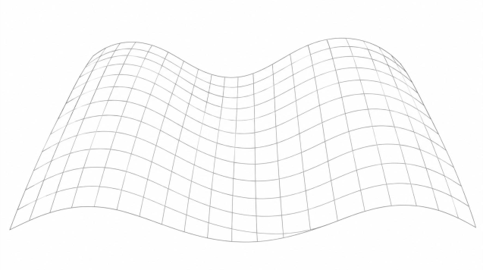


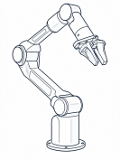









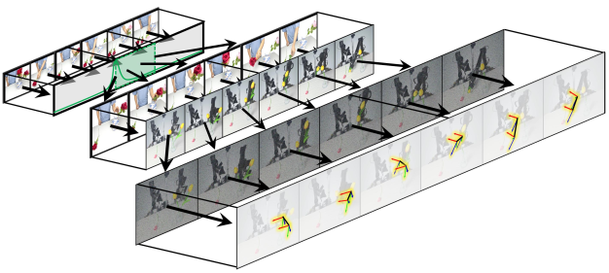
























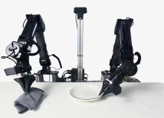
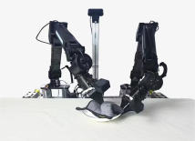










A
Coupling Prediction Targets to the Demonstration
B
Resolving
Execution
through
Self
-
grounded
Prediction
Action
Input
‘
Place
Flowers
’
Context
Observation
Vis
ual/Action
Target
1
Localization
2
Vision
3
Action
T
S
O
H
Progress
Future
Progression
Input
‘
Place
Flowers
’
Context
Human Video
Observation
Instruction
Loss formulation
Predict
ion
Target
Progress
Visual Target
Action
C
Skill
Acquisition
from
a Single
Human
Video
Encoder
H
O
S
T
Human Video
Instruction
E
Localization
Vision
Action
Observation
E
Robot Execution
Notes:
{
"paper_title": "Robots Acquire Manipulation Skills in Seconds from a Single Human Video (HOST)",
"paper_url": "https://arxiv.org/pdf/2607.20033v4",
"figure": "Figure 2",
"license": "http://arxiv.org/licenses/nonexclusive-distrib/1.0/",
"notes": "Source-layout reconstruction using native PDF paths and live ordinary labels. Each source photograph, illustration or mathematical bitmap is an isolated insert with original clipping. No whole-figure raster backdrop. Native paths are not semantically attached connectors.",
"page": 4,
"status": "figure_recreation",
"source_sha256": "630fa9c51170d37768f35d8febd31f2ae28185865271314c884ab1a5f8f0786b",
"source_crop_pdf_points": [
76,
80,
520,
532
],
"extraction_review": "pending; native geometry extraction is not visual fidelity approval",
"font_substitutions": "Arial or Courier New; source fonts recorded per text object",
"outlined_font_families": [
"CMM",
"CMSY",
"CMEX",
"CambriaMath"
],
"outlined_math_limit": "Selected source mathematical fonts preserved as editable glyph outlines, not live equation/text objects.",
"extraction_warnings": [
"195 source clipping groups intersect crop; extracted paths require explicit clipping review",
"rotated text needs manual reconstruction: E",
"rotated text needs manual reconstruction: n",
"rotated text needs manual reconstruction: c",
"rotated text needs manual reconstruction: o",
"rotated text needs manual reconstruction: d",
"rotated text needs manual reconstruction: e",
"rotated text needs manual reconstruction: r",
"rotated text needs manual reconstruction: E",
"rotated text needs manual reconstruction: E",
"rotated text needs manual reconstruction: H",
"rotated text needs manual reconstruction: O",
"rotated text needs manual reconstruction: S",
"rotated text needs manual reconstruction: T",
"unhandled image/shading at seq 0: [305.9432373046875, 233.37844848632812, 514.6152954101562, 327.099609375]; requires reviewed raster region",
"unhandled image/shading at seq 2: [96.19853210449219, 420.533935546875, 158.36990356445312, 452.1567687988281]; requires reviewed raster region",
"unhandled image/shading at seq 14: [79.9206771850586, 151.5606689453125, 292.1064453125, 270.23590087890625]; requires reviewed raster region",
"unhandled image/shading at seq 218: [419.5356750488281, 148.3338623046875, 439.685791015625, 181.10400390625]; requires reviewed raster region",
"unhandled image/shading at seq 219: [421.39410400390625, 177.1601104736328, 442.9783935546875, 212.58340454101562]; requires reviewed raster region",
"unhandled image/shading at seq 355: [472.163818359375, 151.5606689453125, 516.4080200195312, 210.57559204101562]; requires reviewed raster region",
"unhandled image/shading at seq 374: [490.67840576171875, 163.13900756835938, 521.7700805664062, 192.17080688476562]; requires reviewed raster region",
"unhandled image/shading at seq 375: [250.22564697265625, 355.9258728027344, 276.255859375, 379.3023681640625]; requires reviewed raster region",
"unhandled image/shading at seq 379: [362.8798828125, 484.2074279785156, 396.51123046875, 514.3961181640625]; requires reviewed raster region",
"unhandled image/shading at seq 420: [134.92417907714844, 323.8727722167969, 165.6871795654297, 342.6600341796875]; requires reviewed raster region",
"unhandled image/shading at seq 443: [430.5010986328125, 413.79345703125, 501.8511657714844, 465.4942626953125]; requires reviewed raster region",
"unhandled image/shading at seq 444: [430.5010986328125, 465.49188232421875, 501.77947998046875, 517.1926879882812]; requires reviewed raster region",
"unhandled image/shading at seq 465: [258.3287353515625, 279.91632080078125, 290.5259094238281, 308.0255126953125]; requires reviewed raster region",
"unhandled image/shading at seq 467: [225.56385803222656, 279.91632080078125, 257.7610168457031, 308.0255126953125]; requires reviewed raster region",
"unhandled image/shading at seq 469: [127.10494232177734, 279.91632080078125, 159.30210876464844, 308.0255126953125]; requires reviewed raster region",
"unhandled image/shading at seq 471: [94.3341064453125, 279.91632080078125, 126.53128051757812, 308.0255126953125]; requires reviewed raster region",
"unhandled image/shading at seq 473: [159.95046997070312, 279.91632080078125, 192.14764404296875, 308.0255126953125]; requires reviewed raster region",
"unhandled image/shading at seq 475: [192.7213134765625, 279.91632080078125, 224.91848754882812, 308.0255126953125]; requires reviewed raster region",
"unhandled image/shading at seq 484: [191.573974609375, 116.13738250732422, 222.05014038085938, 140.51779174804688]; requires reviewed raster region",
"unhandled image/shading at seq 485: [130.90550231933594, 116.13738250732422, 161.3816680908203, 140.51779174804688]; requires reviewed raster region",
"unhandled image/shading at seq 486: [85.94419860839844, 116.13738250732422, 130.97720336914062, 140.51779174804688]; requires reviewed raster region",
"unhandled image/shading at seq 487: [161.24124145507812, 116.13738250732422, 191.7174072265625, 140.51779174804688]; requires reviewed raster region",
"unhandled image/shading at seq 488: [252.23348999023438, 116.13738250732422, 282.7813720703125, 140.51779174804688]; requires reviewed raster region",
"unhandled image/shading at seq 489: [221.90672302246094, 116.13738250732422, 252.3828887939453, 140.51779174804688]; requires reviewed raster region",
"unhandled image/shading at seq 511: [111.18563842773438, 101.15057373046875, 121.15313720703125, 115.85052490234375]; requires reviewed raster region",
"unhandled image/shading at seq 512: [112.69151306152344, 103.5169448852539, 124.73856353759766, 119.9378662109375]; requires reviewed raster region",
"unhandled image/shading at seq 516: [141.37794494628906, 101.65254974365234, 153.13815307617188, 112.05007934570312]; requires reviewed raster region",
"unhandled image/shading at seq 517: [139.01156616210938, 106.24179077148438, 149.76785278320312, 115.99395751953125]; requires reviewed raster region",
"unhandled image/shading at seq 519: [173.50341796875, 103.80375671386719, 185.12020874023438, 113.62762451171875]; requires reviewed raster region",
"unhandled image/shading at seq 520: [174.57904052734375, 106.60033416748047, 188.63392639160156, 117.21298217773438]; requires reviewed raster region",
"unhandled image/shading at seq 522: [206.63278198242188, 106.81544494628906, 219.68374633789062, 116.9261474609375]; requires reviewed raster region",
"unhandled image/shading at seq 524: [233.45181274414062, 100.21839141845703, 246.50277709960938, 114.057861328125]; requires reviewed raster region",
"unhandled image/shading at seq 525: [234.81427001953125, 104.7359390258789, 249.0125732421875, 119.72271728515625]; requires reviewed raster region",
"unhandled image/shading at seq 527: [260.04974365234375, 100.00325012207031, 272.3119201660156, 110.83102416992188]; requires reviewed raster region",
"unhandled image/shading at seq 528: [260.98193359375, 106.60032653808594, 272.1684875488281, 116.71102905273438]; requires reviewed raster region",
"unhandled image/shading at seq 530: [203.76443481445312, 100.29012298583984, 216.88711547851562, 110.18569946289062]; requires reviewed raster region",
"unhandled image/shading at seq 535: [213.37339782714844, 353.6312561035156, 236.82211303710938, 378.01165771484375]; requires reviewed raster region",
"unhandled image/shading at seq 536: [205.4137420654297, 353.6312561035156, 228.86245727539062, 378.01165771484375]; requires reviewed raster region",
"unhandled image/shading at seq 537: [197.3823699951172, 353.6312561035156, 220.83108520507812, 378.01165771484375]; requires reviewed raster region",
"unhandled image/shading at seq 538: [189.4227294921875, 353.6312561035156, 212.87144470214844, 378.01165771484375]; requires reviewed raster region",
"unhandled image/shading at seq 539: [181.391357421875, 353.6312561035156, 204.84007263183594, 378.01165771484375]; requires reviewed raster region",
"unhandled image/shading at seq 540: [358.6490783691406, 104.16230773925781, 393.3560485839844, 125.38760375976562]; requires reviewed raster region",
"unhandled image/shading at seq 563: [254.0321807861328, 495.03521728515625, 267.2265625, 509.8785705566406]; requires reviewed raster region",
"unhandled image/shading at seq 564: [246.00082397460938, 495.03521728515625, 259.26690673828125, 509.8785705566406]; requires reviewed raster region",
"unhandled image/shading at seq 565: [237.96945190429688, 495.03521728515625, 251.2355499267578, 509.8785705566406]; requires reviewed raster region",
"unhandled image/shading at seq 566: [229.93809509277344, 495.03521728515625, 243.20419311523438, 509.8785705566406]; requires reviewed raster region",
"unhandled image/shading at seq 568: [230.00381469726562, 485.2113342285156, 269.44354248046875, 499.76788330078125]; requires reviewed raster region",
"unhandled image/shading at seq 570: [314.1240234375, 486.5020751953125, 337.6444396972656, 510.23712158203125]; requires reviewed raster region",
"unhandled image/shading at seq 571: [306.80377197265625, 486.5020751953125, 330.25250244140625, 510.23712158203125]; requires reviewed raster region",
"unhandled image/shading at seq 572: [299.4237365722656, 486.5020751953125, 322.94415283203125, 510.23712158203125]; requires reviewed raster region",
"unhandled image/shading at seq 573: [292.1094665527344, 486.5020751953125, 315.5581970214844, 510.23712158203125]; requires reviewed raster region",
"unhandled image/shading at seq 574: [208.49720764160156, 320.0722961425781, 231.9459228515625, 344.45269775390625]; requires reviewed raster region",
"unhandled image/shading at seq 575: [194.72915649414062, 320.0722961425781, 218.2495880126953, 344.45269775390625]; requires reviewed raster region",
"unhandled image/shading at seq 576: [180.96109008789062, 320.2157287597656, 204.4815216064453, 344.59613037109375]; requires reviewed raster region",
"unhandled image/shading at seq 577: [432.5806579589844, 102.4413070678711, 456.0293884277344, 126.82171630859375]; requires reviewed raster region",
"unhandled image/shading at seq 578: [418.8125915527344, 102.4413070678711, 442.2613220214844, 126.82171630859375]; requires reviewed raster region",
"unhandled image/shading at seq 579: [405.0445556640625, 102.58470916748047, 428.4932861328125, 126.96511840820312]; requires reviewed raster region",
"unhandled image/shading at seq 580: [393.14093017578125, 161.31283569335938, 411.4266357421875, 187.62933349609375]; requires reviewed raster region",
"unhandled image/shading at seq 581: [388.1272888183594, 165.90206909179688, 406.4129943847656, 192.21856689453125]; requires reviewed raster region",
"unhandled image/shading at seq 582: [383.0299987792969, 170.49131774902344, 401.38739013671875, 196.73611450195312]; requires reviewed raster region",
"unhandled image/shading at seq 583: [378.0104064941406, 175.00888061523438, 396.2961120605469, 201.32537841796875]; requires reviewed raster region",
"unhandled image/shading at seq 584: [372.99078369140625, 179.59814453125, 391.2764892578125, 205.91464233398438]; requires reviewed raster region",
"unhandled image/shading at seq 585: [367.9771728515625, 184.18739318847656, 386.26287841796875, 210.43218994140625]; requires reviewed raster region",
"unhandled image/shading at seq 589: [371.4132080078125, 157.29722595214844, 412.86077880859375, 194.6566162109375]; requires reviewed raster region",
"unhandled image/shading at seq 592: [154.07037353515625, 364.1721496582031, 167.5515899658203, 379.23065185546875]; requires reviewed raster region",
"unhandled image/shading at seq 593: [146.32583618164062, 364.1721496582031, 159.8070526123047, 379.23065185546875]; requires reviewed raster region",
"unhandled image/shading at seq 594: [138.581298828125, 364.1721496582031, 152.06251525878906, 379.23065185546875]; requires reviewed raster region",
"unhandled image/shading at seq 595: [130.83380126953125, 364.1721496582031, 144.24331665039062, 379.23065185546875]; requires reviewed raster region",
"unhandled image/shading at seq 597: [129.90158081054688, 353.4161071777344, 170.13011169433594, 368.25946044921875]; requires reviewed raster region"
],
"ignored_invisible_text_spans": 0,
"text_editability": "Ordinary source labels are live text; selected mathematical fonts are native outlines. Source image inserts retain internal raster pixels.",
"image_reconstruction": "Each source raster instance is isolated with complete source SVG ancestry, source clipping, mask and paint order. No full-figure image is used.",
"extraction_warnings_reviewed": [
"Source image/shading warnings resolved by isolated source SVG inserts preserving alpha, clip and paint order. Source pixels and final reconstruction preview inspected side by side; original native paths retained. Rotated ordinary labels restored as single native text boxes. Source clipping is preserved for images; crop-crossing background paths omitted. PowerPoint dash length/cap rendering uses closest native preset."
]
}

