Slide 1
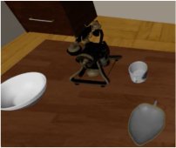
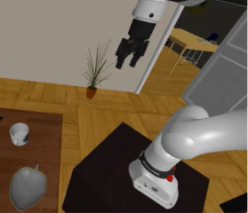
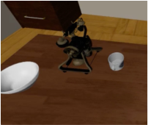
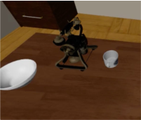



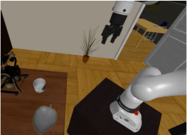
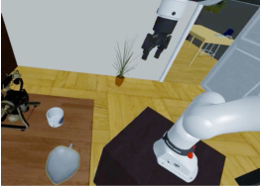
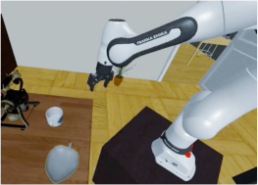
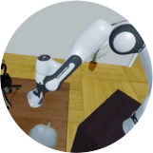



Environment Construction
pick & place
add placement receptacles
pick
MolmoSpaces scene
sample target object
place robot in scene
Randomization
Data Generation
plan
trajectory
execute
fi
nd grasps
sample camera pose
randomize scene
randomize robot joint angles
retry/done
Notes:
{
"paper_title": "MolmoB0T: Large-Scale Simulation Enables Zero-Shot Manipulation",
"paper_url": "https://arxiv.org/abs/2603.16861v2",
"figure": "Figure 2",
"license": "http://arxiv.org/licenses/nonexclusive-distrib/1.0/; private user-requested adaptation only.",
"notes": "Faithful native extraction from independently inspected original source figure. Ordinary labels remain live editable text; source photo details are separate raster assets. Original raster assets isolated with their exact original alpha, clipping and affine transforms; no full-figure raster backdrop.",
"page": 5,
"status": "figure_recreation",
"source_sha256": "55fbccef55184f5a1a257fc8dd497290f63e1b2a10de2e992b3d1c4535821fdf",
"source_crop_pdf_points": [
69,
61,
543,
279
],
"extraction_review": "pending; native geometry extraction is not visual fidelity approval",
"font_substitutions": "Arial or Courier New; source fonts recorded per text object",
"extraction_warnings": [
"12 source clipping groups intersect crop; extracted paths require explicit clipping review",
"path crosses crop boundary: 0",
"path crosses crop boundary: 38"
],
"ignored_invisible_text_spans": 0,
"original_extraction_warnings": [
"12 source clipping groups intersect crop; extracted paths require explicit clipping review",
"path crosses crop boundary: 0",
"path crosses crop boundary: 38",
"unhandled image/shading at seq 28: [84.0764389038086, 91.8140869140625, 151.31219482421875, 148.4768829345703]; requires reviewed raster region",
"unhandled image/shading at seq 34: [185.88818359375, 91.80986022949219, 253.17335510253906, 148.47265625]; requires reviewed raster region",
"unhandled image/shading at seq 35: [229.23133850097656, 109.5745849609375, 248.42689514160156, 129.59133911132812]; requires reviewed raster region",
"unhandled image/shading at seq 36: [234.85693359375, 115.30659484863281, 242.3788604736328, 123.92919921875]; requires reviewed raster region",
"unhandled image/shading at seq 39: [341.5899963378906, 68.12553405761719, 408.72308349609375, 124.37773132324219]; requires reviewed raster region",
"unhandled image/shading at seq 40: [381.9765930175781, 99.01908111572266, 408.56292724609375, 124.57893371582031]; requires reviewed raster region",
"unhandled image/shading at seq 41: [390.0859375, 106.30723571777344, 404.6622314453125, 124.1683349609375]; requires reviewed raster region",
"unhandled image/shading at seq 43: [183.23593139648438, 198.6534423828125, 270.4884338378906, 261.3725891113281]; requires reviewed raster region",
"unhandled image/shading at seq 44: [183.23593139648438, 228.8762664794922, 214.64683532714844, 261.41632080078125]; requires reviewed raster region",
"unhandled image/shading at seq 50: [290.2311096191406, 198.86550903320312, 377.4836120605469, 261.58465576171875]; requires reviewed raster region",
"unhandled image/shading at seq 51: [290.2311096191406, 229.0883331298828, 321.6419982910156, 261.6283874511719]; requires reviewed raster region",
"unhandled image/shading at seq 57: [441.9611511230469, 68.31442260742188, 534.9620361328125, 148.3814239501953]; requires reviewed raster region",
"unhandled image/shading at seq 59: [76.14006042480469, 198.6534423828125, 163.4213409423828, 261.3275146484375]; requires reviewed raster region",
"unhandled image/shading at seq 70: [446.74053955078125, 209.85379028320312, 500.22119140625, 263.3344421386719]; requires reviewed raster region",
"unhandled image/shading at seq 71: [446.74053955078125, 236.8818359375, 470.9659423828125, 263.36553955078125]; requires reviewed raster region"
],
"raster_boundaries": [
{
"id": "source-raster-0",
"bounds_canvas": [
45,
92,
202,
170
],
"detail": "Isolated original photo/rendering/icon/shading asset; original source transparency and clip retained; internal pixels remain raster"
},
{
"id": "source-raster-1",
"bounds_canvas": [
351,
92,
201,
170
],
"detail": "Isolated original photo/rendering/icon/shading asset; original source transparency and clip retained; internal pixels remain raster"
},
{
"id": "source-raster-2",
"bounds_canvas": [
481,
146,
57,
60
],
"detail": "Isolated original photo/rendering/icon/shading asset; original source transparency and clip retained; internal pixels remain raster"
},
{
"id": "source-raster-3",
"bounds_canvas": [
497,
163,
23,
26
],
"detail": "Isolated original photo/rendering/icon/shading asset; original source transparency and clip retained; internal pixels remain raster"
},
{
"id": "source-raster-4",
"bounds_canvas": [
817,
21,
202,
170
],
"detail": "Isolated original photo/rendering/icon/shading asset; original source transparency and clip retained; internal pixels remain raster"
},
{
"id": "source-raster-5",
"bounds_canvas": [
939,
114,
80,
77
],
"detail": "Isolated original photo/rendering/icon/shading asset; original source transparency and clip retained; internal pixels remain raster"
},
{
"id": "source-raster-6",
"bounds_canvas": [
963,
136,
44,
54
],
"detail": "Isolated original photo/rendering/icon/shading asset; original source transparency and clip retained; internal pixels remain raster"
},
{
"id": "source-raster-7",
"bounds_canvas": [
342,
413,
263,
188
],
"detail": "Isolated original photo/rendering/icon/shading asset; original source transparency and clip retained; internal pixels remain raster"
},
{
"id": "source-raster-8",
"bounds_canvas": [
342,
503,
95,
98
],
"detail": "Isolated original photo/rendering/icon/shading asset; original source transparency and clip retained; internal pixels remain raster"
},
{
"id": "source-raster-9",
"bounds_canvas": [
663,
413,
263,
189
],
"detail": "Isolated original photo/rendering/icon/shading asset; original source transparency and clip retained; internal pixels remain raster"
},
{
"id": "source-raster-10",
"bounds_canvas": [
663,
504,
95,
98
],
"detail": "Isolated original photo/rendering/icon/shading asset; original source transparency and clip retained; internal pixels remain raster"
},
{
"id": "source-raster-11",
"bounds_canvas": [
1119,
22,
279,
240
],
"detail": "Isolated original photo/rendering/icon/shading asset; original source transparency and clip retained; internal pixels remain raster"
},
{
"id": "source-raster-12",
"bounds_canvas": [
21,
412,
263,
189
],
"detail": "Isolated original photo/rendering/icon/shading asset; original source transparency and clip retained; internal pixels remain raster"
},
{
"id": "source-raster-13",
"bounds_canvas": [
1133,
446,
161,
161
],
"detail": "Isolated original photo/rendering/icon/shading asset; original source transparency and clip retained; internal pixels remain raster"
},
{
"id": "source-raster-14",
"bounds_canvas": [
1139,
527,
67,
79
],
"detail": "Isolated original photo/rendering/icon/shading asset; original source transparency and clip retained; internal pixels remain raster"
}
]
}

