Slide 1






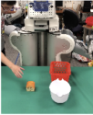
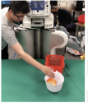
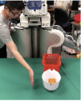
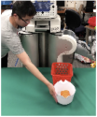
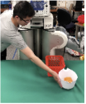




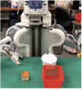
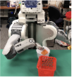
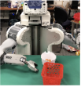
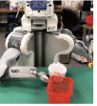
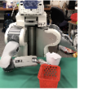

Learning Phase Predictors
One-Shot Skill Composition
provide video of human performing compound task
segment video into primitives w/
phase predictor φₕ
LSTM phase predictor φₕ
LSTM phase predictor φᵣ
Collect Demos of
t=0.1
t=1.0
t=2.0
t=0.5
t=3.0
t=7.0
Primitive Skills
(with training objects)
Domain-Adaptive Meta-Learning
learn robot policies
human primitives
robot primitives
advance robot policy w/
phase predictor φᵣ
meta-training time
meta-test time
learn how to
learn a policy
from one human primitive
Notes:
{
"paper_title": "One-Shot Hierarchical Imitation Learning of Compound Visuomotor Tasks",
"paper_url": "https://arxiv.org/pdf/1810.11043v1",
"figure": "Figure 2",
"page": 3,
"license": "http://arxiv.org/licenses/nonexclusive-distrib/1.0/",
"status": "figure_recreation",
"source_sha256": "458a9e3e434729981304b09de9eb4fa97f6a79e918b6914755cea77db8dc66ff",
"source_crop_pdf_points": [
66,
48,
544,
224
],
"notes": "Manual faithful-layout reconstruction from a flattened source figure. All ordinary labels, phase arrows, dividers and three network mini-diagrams are native. Twenty individual video frames and the compact meta-learning objective remain raster. Network wireframes, fonts, shadows and curved arrows approximate source; freeform edges are not semantically attached. Bottom margin expanded by 12 pixels to retain the curved transition arrow."
}

