Slide 1


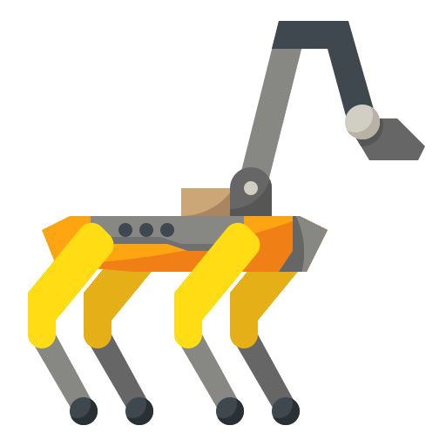
Sim Env
Control Signal
Habitat 3.0
Control Signal
Low-Level
Low-Level
Skill
Skill
Human
Robot
Obs
Obs
Low-Level
Perception
Low-Level
Skill
Skill
World Graph
High-Level
High-Level
Policy (LLM)
Policy (LLM)
Task
Description
Notes:
{
"paper_title": "PARTNR: A Benchmark for Planning and Reasoning in Embodied Multi-Agent Tasks",
"paper_url": "https://arxiv.org/abs/2411.00081v1",
"figure": "Figure 5",
"license": "http://arxiv.org/licenses/nonexclusive-distrib/1.0/; private user-requested adaptation, no public redistribution authorization.",
"notes": "Source-native figure paths and typeable labels reconstructed from the inspected original PDF; source photo/icon details remain separate raster subassets. Independent target-application QA pending. Original source image transparency and reviewed rectangular clips retained; CMYK photos converted to RGB. World Graph gradient reconstructed as70 native colored strips with rounded outer contours; its label remains live text.",
"page": 7,
"status": "figure_recreation",
"source_sha256": "7da62f6f2b031d78908d6f063d44b6eaeb491bb31d03536218f6ee61dd300efd",
"source_crop_pdf_points": [
258,
381,
542,
647
],
"extraction_review": "pending; native geometry extraction is not visual fidelity approval",
"font_substitutions": "Arial or Courier New; source fonts recorded per text object",
"extraction_warnings": [
"9 source clipping groups intersect crop; extracted paths require explicit clipping review",
"path crosses crop boundary: 16",
"path crosses crop boundary: 61",
"path crosses crop boundary: 74",
"path crosses crop boundary: 77"
],
"ignored_invisible_text_spans": 0,
"original_extraction_warnings": [
"9 source clipping groups intersect crop; extracted paths require explicit clipping review",
"path crosses crop boundary: 16",
"path crosses crop boundary: 61",
"path crosses crop boundary: 74",
"path crosses crop boundary: 77",
"unhandled image/shading at seq 36: [381.4630432128906, 409.9186096191406, 417.6460266113281, 446.9493103027344]; requires reviewed raster region",
"unhandled image/shading at seq 94: [290.2120056152344, 598.2156372070312, 333.9737854003906, 641.9774169921875]; requires reviewed raster region",
"unhandled image/shading at seq 96: [471.666748046875, 594.0494995117188, 522.2464599609375, 644.6292114257812]; requires reviewed raster region"
],
"manual_image_review": "All displayed source images handled explicitly using isolated alpha assets and reviewed clips; source versus generated preview inspected."
}

