Slide 1
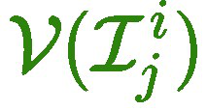
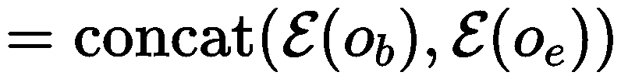
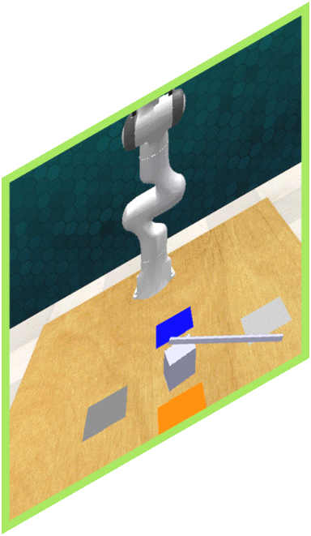
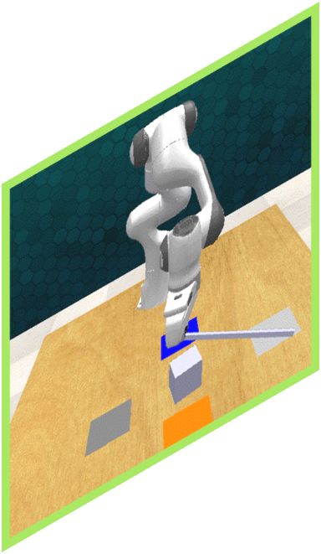
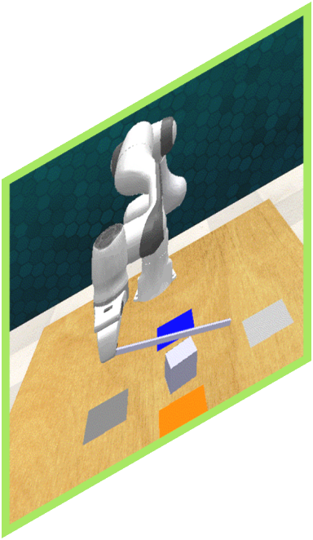
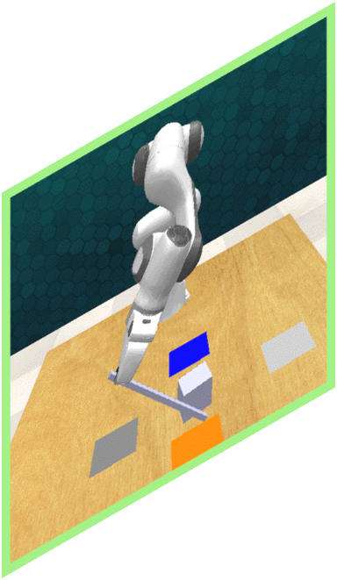
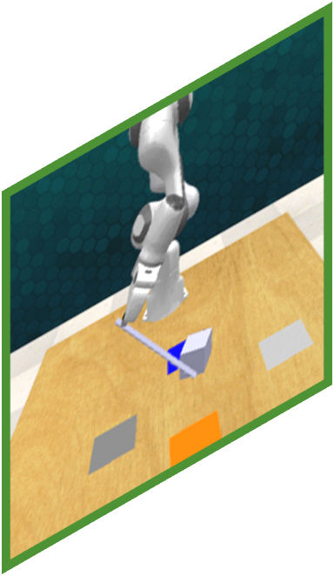



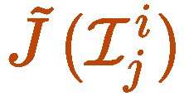
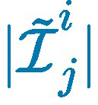


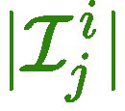




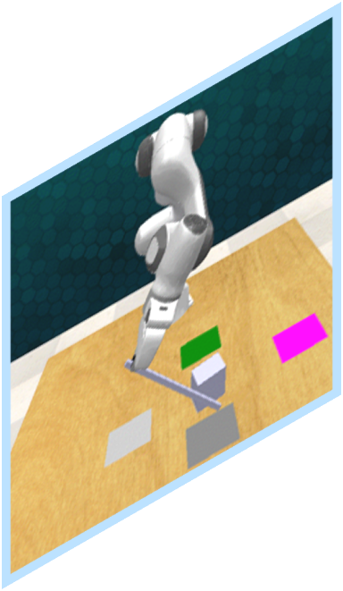
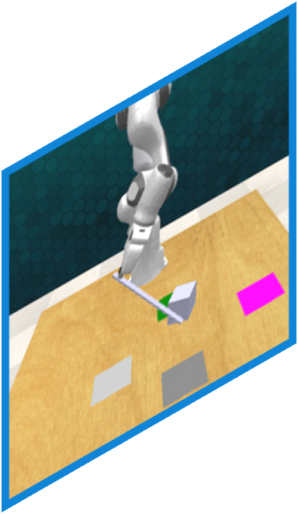

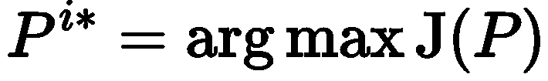
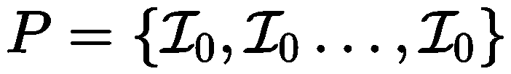



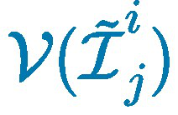
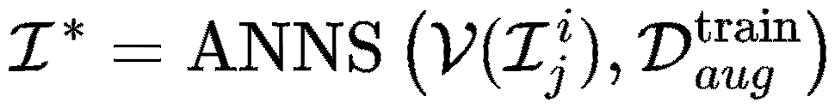
Eq.3.5
Eq.3.2
Eq.3.3
Eq.3.6
Visuomotor
Policy
Training Set
Eq.3.1
Solve with
Dynamic Programing
Retrieve with ANNS
Notes:
{
"paper_title": "RDD: Retrieval-Based Demonstration Decomposer for Planner Alignment in Long-Horizon Tasks",
"paper_url": "https://arxiv.org/pdf/2510.14968v1",
"figure": "Figure 2",
"license": "http://arxiv.org/licenses/nonexclusive-distrib/1.0/",
"notes": "Original retrieval-based demonstration partition architecture. Source arrows, braces, encoder outlines and ordinary prose labels remain native. Seven projected robot observation images, two icons, and source mathematical formula/symbol assets remain individually raster; formulas are not live equations. Native freeform connectors do not have semantic endpoint attachment.",
"page": 4,
"status": "figure_recreation",
"source_sha256": "f3e2f02817b13118305ca649ff31713bc04d1c6be4374ebb104acaca4156daf3",
"source_crop_pdf_points": [
122,
69,
482,
274
],
"extraction_review": "pending; native geometry extraction is not visual fidelity approval",
"font_substitutions": "Arial or Courier New; source fonts recorded per text object",
"extraction_warnings": [
"126 source clipping groups intersect crop; extracted paths require explicit clipping review",
"path crosses crop boundary: 0"
],
"ignored_invisible_text_spans": 0
}

