Slide 1
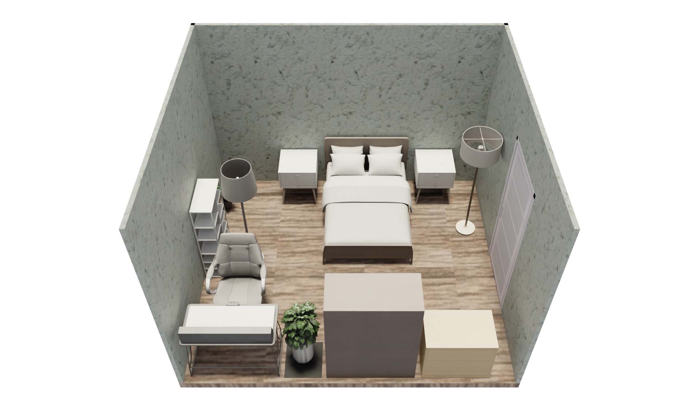


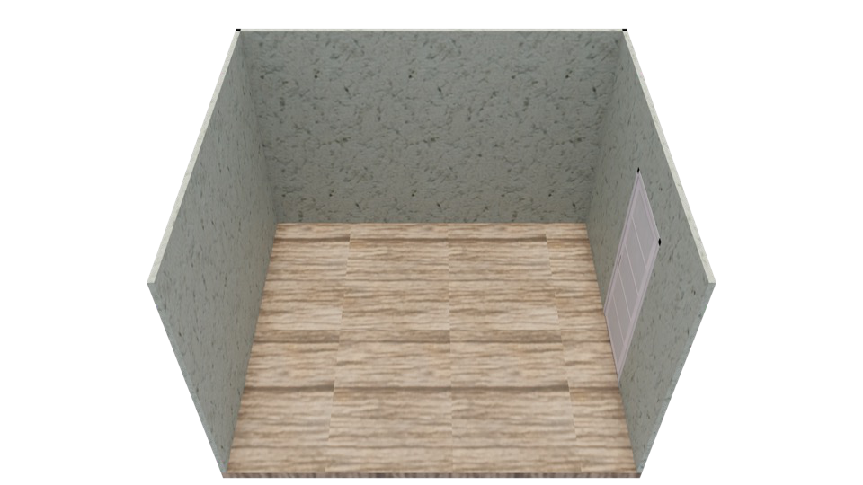



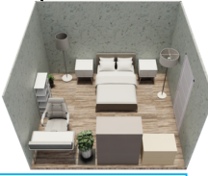
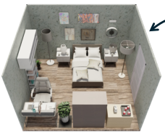

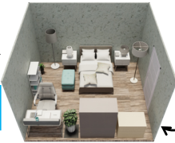



Physics
I will add those
Physics
Object Proposals
Object Proposals
objects as proposed.
+
The floor lamp is blocking
the bookshelf access.
Can you generate
some
Visual
Scene
Asset
bedrooms
to train a
Asset
policy on the task of …?
Init
Placer
I will move the floor
Placer
lamp to the corner.
Input O
pen
-
vocabulary
T
ext
Agent
Physics
Physics
Asset
Critic
Mover
Generator
Critic
Generator
End
Scene Init
Scene Init
Asset Mover
Asset Mover
Visual
Visual
Asset Placer
Asset Placer
Asset Remover
Asset Remover
Physics
Physics
Asset
Remover
Visual
Physics
Physics
I’ll remove
Visual
Asset
The room lacks details and
Output 3D
Scene
the ottoman.
Placer
needs to be complete.
The scene is complete
The ottoman makes the
I will add more floor objects
now, let me end it.
layout look overcrowded.
and small objects on top.
Notes:
{
"paper_title": "SAGE: Scalable Agentic 3D Scene Generation for Embodied AI",
"paper_url": "https://arxiv.org/pdf/2602.10116v2",
"figure": "Figure 2",
"license": "unverified",
"notes": "Native extracted geometry and ordinary live text; source raster photos/icons are separately preserved. Source clipping and cross-format QA pending. Rotated labels reconstructed as native typeable text, duplicated PDF fill/stroke spans deduplicated. Four clipped room/photo insets restored at reviewed source-visible bounds. Photographic interiors and illustrated avatars remain raster assets.",
"page": 3,
"status": "figure_recreation",
"source_sha256": "d4a338d1778121a83866eeea8e9f8b035da05ecc50d94fd7db30f111d4484d67",
"source_crop_pdf_points": [
64,
70,
545,
248
],
"extraction_review": "pending; native geometry extraction is not visual fidelity approval",
"font_substitutions": "Arial or Courier New; source fonts recorded per text object",
"outlined_font_families": [
"CMM",
"CMSY",
"CMEX",
"CambriaMath"
],
"outlined_math_limit": "Selected source mathematical fonts preserved as editable glyph outlines, not live equation/text objects.",
"dash_fidelity": "PPTX uses the closest supported native preset, not exact PDF dash lengths. Draw.io retains interval lengths; PDF phase/caps are not preserved; zero intervals become 0.001 scene units.",
"extraction_warnings": [
"29 source clipping groups intersect crop; extracted paths require explicit clipping review",
"path crosses crop boundary: 0",
"path partially intersects raster inset: 8",
"path partially intersects raster inset: 13",
"path partially intersects raster inset: 108",
"path partially intersects raster inset: 112",
"path partially intersects raster inset: 137",
"path partially intersects raster inset: 138",
"path partially intersects raster inset: 145",
"path partially intersects raster inset: 146",
"path partially intersects raster inset: 173",
"rotated text needs manual reconstruction: V",
"rotated text needs manual reconstruction: isu",
"rotated text needs manual reconstruction: a",
"rotated text needs manual reconstruction: l",
"rotated text needs manual reconstruction: V",
"rotated text needs manual reconstruction: isu",
"rotated text needs manual reconstruction: a",
"rotated text needs manual reconstruction: l",
"rotated text needs manual reconstruction: A",
"rotated text needs manual reconstruction: s",
"rotated text needs manual reconstruction: s",
"rotated text needs manual reconstruction: e",
"rotated text needs manual reconstruction: t",
"rotated text needs manual reconstruction: A",
"rotated text needs manual reconstruction: s",
"rotated text needs manual reconstruction: s",
"rotated text needs manual reconstruction: e",
"rotated text needs manual reconstruction: t",
"rotated text needs manual reconstruction: P",
"rotated text needs manual reconstruction: la",
"rotated text needs manual reconstruction: c",
"rotated text needs manual reconstruction: e",
"rotated text needs manual reconstruction: r",
"rotated text needs manual reconstruction: P",
"rotated text needs manual reconstruction: la",
"rotated text needs manual reconstruction: c",
"rotated text needs manual reconstruction: e",
"rotated text needs manual reconstruction: r",
"rotated text needs manual reconstruction: V",
"rotated text needs manual reconstruction: is",
"rotated text needs manual reconstruction: u",
"rotated text needs manual reconstruction: a",
"rotated text needs manual reconstruction: l",
"rotated text needs manual reconstruction: V",
"rotated text needs manual reconstruction: is",
"rotated text needs manual reconstruction: u",
"rotated text needs manual reconstruction: a",
"rotated text needs manual reconstruction: l",
"rotated text needs manual reconstruction: A",
"rotated text needs manual reconstruction: s",
"rotated text needs manual reconstruction: s",
"rotated text needs manual reconstruction: e",
"rotated text needs manual reconstruction: t",
"rotated text needs manual reconstruction: A",
"rotated text needs manual reconstruction: s",
"rotated text needs manual reconstruction: s",
"rotated text needs manual reconstruction: e",
"rotated text needs manual reconstruction: t",
"rotated text needs manual reconstruction: M",
"rotated text needs manual reconstruction: o",
"rotated text needs manual reconstruction: v",
"rotated text needs manual reconstruction: e",
"rotated text needs manual reconstruction: r",
"rotated text needs manual reconstruction: M",
"rotated text needs manual reconstruction: o",
"rotated text needs manual reconstruction: v",
"rotated text needs manual reconstruction: e",
"rotated text needs manual reconstruction: r",
"rotated text needs manual reconstruction: S",
"rotated text needs manual reconstruction: c",
"rotated text needs manual reconstruction: e",
"rotated text needs manual reconstruction: n",
"rotated text needs manual reconstruction: e",
"rotated text needs manual reconstruction: S",
"rotated text needs manual reconstruction: c",
"rotated text needs manual reconstruction: e",
"rotated text needs manual reconstruction: n",
"rotated text needs manual reconstruction: e",
"rotated text needs manual reconstruction: I",
"rotated text needs manual reconstruction: n",
"rotated text needs manual reconstruction: i",
"rotated text needs manual reconstruction: t",
"rotated text needs manual reconstruction: I",
"rotated text needs manual reconstruction: n",
"rotated text needs manual reconstruction: i",
"rotated text needs manual reconstruction: t",
"rotated text needs manual reconstruction: V",
"rotated text needs manual reconstruction: is",
"rotated text needs manual reconstruction: u",
"rotated text needs manual reconstruction: a",
"rotated text needs manual reconstruction: l",
"rotated text needs manual reconstruction: V",
"rotated text needs manual reconstruction: is",
"rotated text needs manual reconstruction: u",
"rotated text needs manual reconstruction: a",
"rotated text needs manual reconstruction: l",
"rotated text needs manual reconstruction: A",
"rotated text needs manual reconstruction: s",
"rotated text needs manual reconstruction: s",
"rotated text needs manual reconstruction: e",
"rotated text needs manual reconstruction: t",
"rotated text needs manual reconstruction: A",
"rotated text needs manual reconstruction: s",
"rotated text needs manual reconstruction: s",
"rotated text needs manual reconstruction: e",
"rotated text needs manual reconstruction: t",
"rotated text needs manual reconstruction: R",
"rotated text needs manual reconstruction: e",
"rotated text needs manual reconstruction: m",
"rotated text needs manual reconstruction: o",
"rotated text needs manual reconstruction: v",
"rotated text needs manual reconstruction: e",
"rotated text needs manual reconstruction: r",
"rotated text needs manual reconstruction: R",
"rotated text needs manual reconstruction: e",
"rotated text needs manual reconstruction: m",
"rotated text needs manual reconstruction: o",
"rotated text needs manual reconstruction: v",
"rotated text needs manual reconstruction: e",
"rotated text needs manual reconstruction: r",
"unhandled image/shading at seq 2: [454.826904296875, 139.8607177734375, 566.0752563476562, 202.35289001464844]; requires reviewed raster region",
"unhandled image/shading at seq 3: [254.4501953125, 184.58998107910156, 365.68035888671875, 247.0821990966797]; requires reviewed raster region",
"unhandled image/shading at seq 6: [350.0499572753906, 205.08326721191406, 378.58099365234375, 240.33291625976562]; requires reviewed raster region",
"unhandled image/shading at seq 7: [282.3961486816406, 178.78121948242188, 435.5364990234375, 264.87457275390625]; requires reviewed raster region",
"unhandled image/shading at seq 9: [45.757694244384766, 145.38282775878906, 157.0401153564453, 207.967041015625]; requires reviewed raster region"
],
"ignored_invisible_text_spans": 0
}

