Slide 1
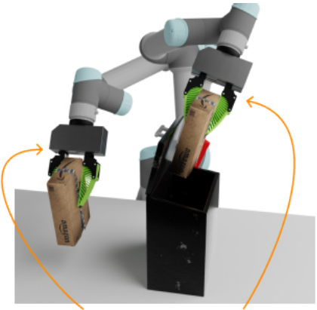
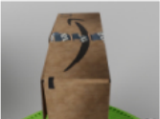

task desc
CLIP
text enc
“send the package
for return”
vision
Resnet18
concatenate
Resnet18
global
wrist
Diffusion
Policy
proprioception
aₜ
aₜ₊₁
aₜ₊₂
aₜ₊₃
aₜ₊₄
···
gripper pose & command
a) Inputs
b) Networks
c) Action Sequence
Notes:
{
"paper_title": "Scaling Up and Distilling Down: Language-Guided Robot Skill Acquisition",
"paper_url": "https://arxiv.org/pdf/2307.14535v2",
"figure": "Figure 4",
"page": 5,
"license": "unverified",
"notes": "Native source-layout reconstruction of flattened original. Ordinary labels and code are typeable. Diagram shapes and logical arrows are native. Explicitly bounded source photographs, icons and mathematical formula inserts retain raster pixels. Font metrics and path coordinates are measured approximations. Figure4 is the paper’s policy-distillation architecture. Two observation image assets stop above their name strips; the observation labels exist only as native text and cannot leave hidden original lettering. The robot action illustration includes internal motion annotations as raster; all architecture arrows are native.",
"status": "figure_recreation",
"source_sha256": "ef8689b7632897425bb0e537c33cd3999fc3d8cc1126fccf65b8e0d612233dce",
"source_crop_pdf_points": [
305,
535,
505,
626
],
"raster_details": [
{
"id": "global-observation",
"source_pixels": [
18,
201,
184,
294
],
"detail": "Original global camera observation, retaining visual content only"
},
{
"id": "wrist-observation",
"source_pixels": [
192,
170,
359,
294
],
"detail": "Original wrist camera observation, retaining visual content only"
},
{
"id": "robot-action-visualization",
"source_pixels": [
775,
3,
1195,
414
],
"detail": "Original robot action illustration, including internal curved orange motion annotations; photo content is raster"
}
]
}

