Slide 1
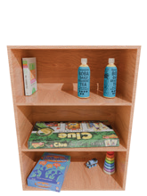
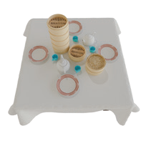
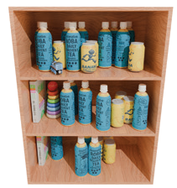
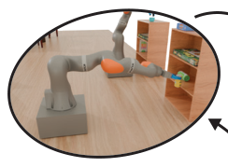
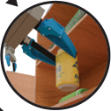
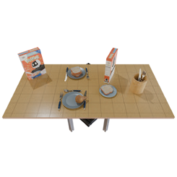
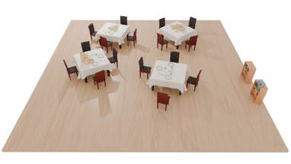
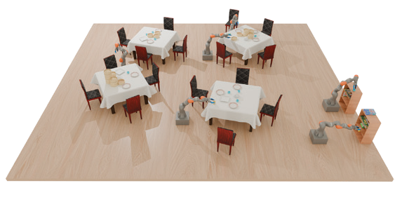
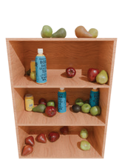

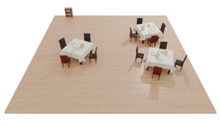
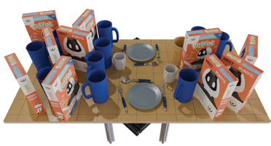
Procedurally Generated
Flexible Scene Generation via
Robot Data Collection
Training Scenes
(Sec. 2.1)
Model Steering
(Sec. 2.4)
in Simulation
i
n
i
n
g
T
r
a
o
s
t
P
w
a
r
d
)
R
L
R
e
t
e
r
l
u
t
(
C
SE(3) Scene
Generative
Conditioning
Model
(Sec. 2.2)
“A scene with four tables,
(
two shelves, and ...”
C
M
l
C
u
t
T
S
t
e
r
O
b
Fully Interactable, Simulatable
j
e
c
t
i
v
e
)
SE(3) Scene
Notes:
{
"paper_title": "Steerable Scene Generation with Post Training and Inference-Time Search",
"paper_url": "https://arxiv.org/abs/2505.04831v2",
"figure": "Figure 1",
"license": "http://arxiv.org/licenses/nonexclusive-distrib/1.0/; private user-requested adaptation, no public redistribution authorization.",
"notes": "Source-native figure paths and typeable labels reconstructed from the inspected original PDF; source photo/icon details remain separate raster subassets. Independent target-application QA pending. Original source image transparency and reviewed rectangular clips retained; CMYK photos converted to RGB. Reviewed source text rotation preserved as native rotated text; curved wording remains separate typeable characters at source positions.",
"page": 1,
"status": "figure_recreation",
"source_sha256": "1be87c7dfc90c7e831ff530934aa81295833e9b151bd327658e413b73c8149b6",
"source_crop_pdf_points": [
107,
200,
507,
390
],
"extraction_review": "pending; native geometry extraction is not visual fidelity approval",
"font_substitutions": "Arial or Courier New; source fonts recorded per text object",
"extraction_warnings": [
"18 source clipping groups intersect crop; extracted paths require explicit clipping review",
"path partially intersects raster inset: 30",
"path partially intersects raster inset: 31",
"path partially intersects raster inset: 57"
],
"ignored_invisible_text_spans": 0,
"original_extraction_warnings": [
"18 source clipping groups intersect crop; extracted paths require explicit clipping review",
"path partially intersects raster inset: 30",
"path partially intersects raster inset: 31",
"path partially intersects raster inset: 57",
"rotated text needs manual reconstruction: R",
"rotated text needs manual reconstruction: L",
"rotated text needs manual reconstruction: P",
"rotated text needs manual reconstruction: o",
"rotated text needs manual reconstruction: s",
"rotated text needs manual reconstruction: t",
"rotated text needs manual reconstruction: T",
"rotated text needs manual reconstruction: r",
"rotated text needs manual reconstruction: a",
"rotated text needs manual reconstruction: i",
"rotated text needs manual reconstruction: n",
"rotated text needs manual reconstruction: i",
"rotated text needs manual reconstruction: n",
"rotated text needs manual reconstruction: g",
"rotated text needs manual reconstruction: (",
"rotated text needs manual reconstruction: C",
"rotated text needs manual reconstruction: l",
"rotated text needs manual reconstruction: u",
"rotated text needs manual reconstruction: t",
"rotated text needs manual reconstruction: t",
"rotated text needs manual reconstruction: e",
"rotated text needs manual reconstruction: r",
"rotated text needs manual reconstruction: R",
"rotated text needs manual reconstruction: e",
"rotated text needs manual reconstruction: w",
"rotated text needs manual reconstruction: a",
"rotated text needs manual reconstruction: r",
"rotated text needs manual reconstruction: d",
"rotated text needs manual reconstruction: )",
"rotated text needs manual reconstruction: M",
"rotated text needs manual reconstruction: C",
"rotated text needs manual reconstruction: T",
"rotated text needs manual reconstruction: S",
"rotated text needs manual reconstruction: (",
"rotated text needs manual reconstruction: C",
"rotated text needs manual reconstruction: l",
"rotated text needs manual reconstruction: u",
"rotated text needs manual reconstruction: t",
"rotated text needs manual reconstruction: t",
"rotated text needs manual reconstruction: e",
"rotated text needs manual reconstruction: r",
"rotated text needs manual reconstruction: O",
"rotated text needs manual reconstruction: b",
"rotated text needs manual reconstruction: j",
"rotated text needs manual reconstruction: e",
"rotated text needs manual reconstruction: c",
"rotated text needs manual reconstruction: t",
"rotated text needs manual reconstruction: i",
"rotated text needs manual reconstruction: v",
"rotated text needs manual reconstruction: e",
"rotated text needs manual reconstruction: )",
"unhandled image/shading at seq 1: [368.9147033691406, 288.0768127441406, 503.9979248046875, 364.1679992675781]; requires reviewed raster region",
"unhandled image/shading at seq 2: [282.78363037109375, 340.6026306152344, 371.89154052734375, 388.67401123046875]; requires reviewed raster region",
"unhandled image/shading at seq 3: [141.85308837890625, 341.2420654296875, 203.76278686523438, 376.0662841796875]; requires reviewed raster region",
"unhandled image/shading at seq 4: [280.30950927734375, 280.3716125488281, 371.83026123046875, 331.85205078125]; requires reviewed raster region",
"unhandled image/shading at seq 5: [436.0189208984375, 224.37008666992188, 514.5173950195312, 302.8685607910156]; requires reviewed raster region",
"unhandled image/shading at seq 7: [367.2444152832031, 217.9186248779297, 455.94622802734375, 306.62042236328125]; requires reviewed raster region",
"unhandled image/shading at seq 9: [108.66935729980469, 265.8834533691406, 167.4164581298828, 324.63055419921875]; requires reviewed raster region",
"unhandled image/shading at seq 10: [150.10997009277344, 223.31324768066406, 198.89102172851562, 272.09429931640625]; requires reviewed raster region",
"unhandled image/shading at seq 11: [108.0, 224.88519287109375, 147.5980224609375, 277.68255615234375]; requires reviewed raster region",
"unhandled image/shading at seq 12: [108.0, 304.429931640625, 147.5980224609375, 357.227294921875]; requires reviewed raster region",
"unhandled image/shading at seq 15: [304.049072265625, 223.02825927734375, 354.4465637207031, 276.6418762207031]; requires reviewed raster region",
"unhandled image/shading at seq 20: [277.96319580078125, 312.28338623046875, 375.1583251953125, 345.1617431640625]; requires reviewed raster region"
],
"manual_image_review": "All displayed source images handled explicitly using isolated alpha assets and reviewed clips; source versus generated preview inspected."
}

