Slide 1


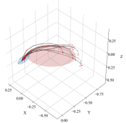
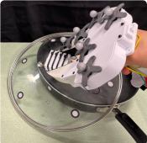
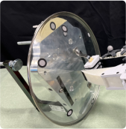
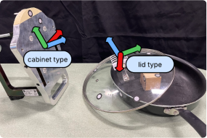
Segmentation
Predicate Learning
Operator Learning
Policy Learning
PreMotion
Motion
Operator 1: Place Lid
Pre: RelPose(
)
Eff: RelPose(
)
Maintain: RelPose(
)
PreMotion
Skill:
Place Lid SE(3) Policy
Motion
Selection
cabinet type
lid type
Pose & Type
Operator 0: Pick Lid
Operator 1: Place Lid
Auto Skill Recovery
A*
Symbolic
Pick Lid SE(3) Policy
Place Lid SE(3) Policy
Obstacle Avoidance
Goal
Planner
RelPose(
)
Complete
Executing
Attractor Resampling
Symbolic Monitoring
Replanning
Notes:
{
"paper_title": "SymSkill: Symbol and Skill Co-Invention for Data-Efficient and Reactive Long-Horizon Manipulation",
"paper_url": "https://arxiv.org/abs/2510.01661v3",
"figure": "Figure 2",
"license": "http://arxiv.org/licenses/nonexclusive-distrib/1.0/",
"notes": "Source-native SymSkill geometry and typeable ordinary labels with separately isolated source photos/icons/plots. Three mathematical raster labels become editable glyph contours; Gemini logo remains original raster branding.",
"page": 2,
"status": "figure_recreation",
"source_sha256": "29492416ae5fba07b1bf04b89c04234ac675132fe5374bbc34f510ac41638997",
"source_crop_pdf_points": [
52,
49,
560,
233
],
"extraction_review": "Source inspected; generated preview and independent editor QA pending.",
"font_substitutions": "Source Helvetica/accessibility labels use width-fitted Arial; visible Replanning heading restored with its source bold appearance.",
"extraction_warnings": [
"90 source clipping groups intersect crop; extracted paths require explicit clipping review",
"unhandled image/shading at seq 136: [15.714431762695312, -68.68087768554688, 428.7880859375, 177.11077880859375]; requires reviewed raster region",
"unhandled image/shading at seq 496: [84.98480224609375, 41.700172424316406, 153.94442749023438, 110.65980529785156]; requires reviewed raster region",
"unhandled image/shading at seq 517: [37.27180099487305, 107.12486267089844, 154.010009765625, 170.75360107421875]; requires reviewed raster region",
"unhandled image/shading at seq 556: [210.76272583007812, 110.15522003173828, 232.3343505859375, 118.13732147216797]; requires reviewed raster region",
"unhandled image/shading at seq 557: [215.5234832763672, 118.21428680419922, 227.92138671875, 124.81377410888672]; requires reviewed raster region",
"unhandled image/shading at seq 558: [205.40335083007812, 54.30047607421875, 310.62451171875, 133.209228515625]; requires reviewed raster region",
"unhandled image/shading at seq 561: [266.35235595703125, 97.03321838378906, 284.3634033203125, 104.3739013671875]; requires reviewed raster region",
"unhandled image/shading at seq 562: [317.1895446777344, 70.12213897705078, 414.65667724609375, 143.21536254882812]; requires reviewed raster region",
"unhandled image/shading at seq 565: [333.0314025878906, 97.68888854980469, 353.00946044921875, 105.02386474609375]; requires reviewed raster region",
"unhandled image/shading at seq 611: [476.00787353515625, 62.197059631347656, 563.4403686523438, 135.06222534179688]; requires reviewed raster region"
],
"ignored_invisible_text_spans": 40,
"text_editability": "Ordinary source labels, including cabinet type and lid type callouts, are typeable text. Three raster math labels are point-editable native contours, not live equations. Source plot and remaining photo-internal annotations remain raster.",
"dash_fidelity": "Source custom dashed boundaries expanded into native solid segments with <=0.4 scene-pixel chord sampling.",
"extraction_warnings_reviewed": [
"Ten source image instances reviewed. Three formula rasters traced to native glyph paths; seven images isolated with exact source transforms, masks and clips, then transparent extents trimmed. The segmentation chart is absent from get_text image blocks but recovered from source image_info and source SVG. Two plots retain source internal data pixels, without invented native plot data."
]
}

