Slide 1
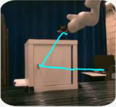
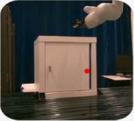
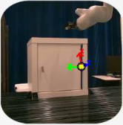
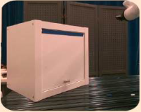
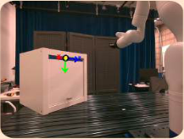
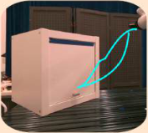
Single Demonstration
(Trajectory + RGB-D Frame)
Inferred Influence Point
Task-Relevant Frame
VLM
DMP
Learned in
Task-
Relevant
Fame
Influence
Point
Detection
Semantic
Grounding
Input
Grounded-
SAM
Minimum Assumption
No
Pretraining
No CAD
Model
No Human
Label
DMP Reparameterization to OOD Scenes
RGB-D Image
OOD Frame Extraction
DMP
Reparameterization
VLM
Semantic
Grounding
Roll Out
Input
Grounded-
SAM
Robust Generalization
Semantic
Anchoring
Unified Pose
Adaptation
Notes:
{
"paper_title": "TReF-6: Inferring Task-Relevant Frames from a Single Demonstration for One-Shot Skill Generalization",
"paper_url": "https://arxiv.org/abs/2509.00310v2",
"pdf_url": "https://arxiv.org/pdf/2509.00310v2",
"figure": "Figure 1",
"page": 2,
"license": "unverified Private user-requested adaptation; no public redistribution permission implied.",
"status": "figure_recreation",
"notes": "Manually reconstructed from the inspected original flattened PDF figure. Ordinary labels are live typeable text; panels, graph geometry and arrows are native editable shapes or paths. Source layout and contents retained; font metrics, line widths and decorative effects approximated. Flattened source reconstructed with native panels, arrows and all ordinary live text. Six isolated source RGB-D photographs retain internal camera/trajectory/coordinate details. Original arrow gradients approximated with solid editable colors.",
"source_sha256": "22207c5626b7940b09259125921a5d7cb70f22807eba55488b22a6204aeee009",
"source_crop_pdf_points": [
111,
75,
499,
303
],
"survey_crop_correction": false,
"visual_inspection": "Original PDF figure inspected before source-layout reconstruction on 2026-10-09; independent application QA pending.",
"raster_details": [
{
"id": "single-demo-photo",
"bounds_source_pixels": [
56,
80,
216,
228
],
"detail": "Discrete original RGB-D photograph/rendering; internal scene, camera and trajectory overlays remain raster"
},
{
"id": "influence-photo",
"bounds_source_pixels": [
441,
79,
612,
233
],
"detail": "Discrete original RGB-D photograph/rendering; internal scene, camera and trajectory overlays remain raster"
},
{
"id": "task-frame-photo",
"bounds_source_pixels": [
814,
79,
980,
247
],
"detail": "Discrete original RGB-D photograph/rendering; internal scene, camera and trajectory overlays remain raster"
},
{
"id": "ood-rgbd-photo",
"bounds_source_pixels": [
61,
417,
263,
577
],
"detail": "Discrete original RGB-D photograph/rendering; internal scene, camera and trajectory overlays remain raster"
},
{
"id": "ood-frame-photo",
"bounds_source_pixels": [
507,
417,
724,
581
],
"detail": "Discrete original RGB-D photograph/rendering; internal scene, camera and trajectory overlays remain raster"
},
{
"id": "rollout-photo",
"bounds_source_pixels": [
803,
480,
980,
639
],
"detail": "Discrete original RGB-D photograph/rendering; internal scene, camera and trajectory overlays remain raster"
}
]
}

