Slide 1
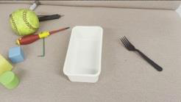
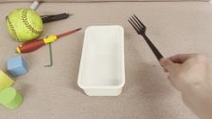


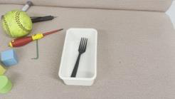
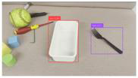
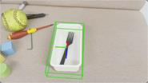


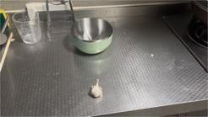
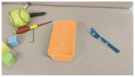
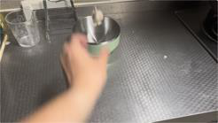
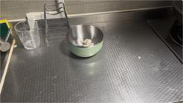




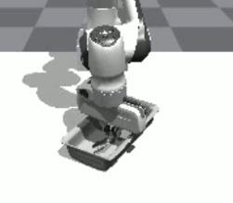
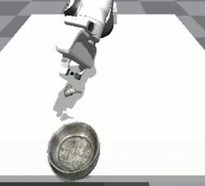
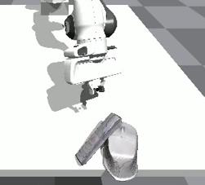
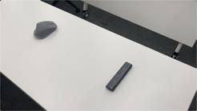
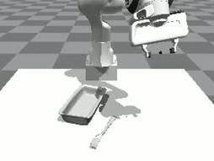
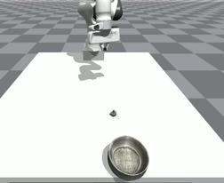
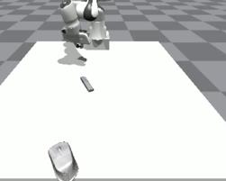
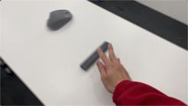
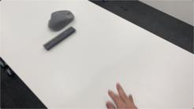


Object
Fine
-
tune reward functions
Scaling up
Object
Object
6D Pos
Expert
Insert …
Grounding
Reconstruction
Tracking
Reinforcement
Trajectory
Learning
VLM
Feedback from logs
N Iterations
Observations,
Task generation
Actions,
Throw …
Data engine!
...
Imitation Learning
Slide …
…
…
Insert …
Throw …
Slide …
…
Diverse behaviors
Scene Generation
Policy Learning
Image
-
based
…
Generalist
…
Policy!
Internet Videos
Video2Policy
Notes:
{
"paper_title": "Video2Policy: Scaling up Manipulation Tasks in Simulation through Internet Videos",
"paper_url": "https://arxiv.org/abs/2502.09886v1",
"figure": "Figure 1",
"license": "http://arxiv.org/licenses/nonexclusive-distrib/1.0/; private user-requested adaptation, no public redistribution authorization.",
"notes": "Source-native figure paths and typeable labels reconstructed from the inspected original PDF; source photo/icon details remain separate raster subassets. Independent target-application QA pending. Reviewed source text rotation preserved as native rotated text; curved wording remains separate typeable characters at source positions.",
"page": 2,
"status": "figure_recreation",
"source_sha256": "780490cdf94fb207440f0552ef753929142dd61a3fbda60921e708dfcad1e257",
"source_crop_pdf_points": [
78,
61,
519,
237
],
"extraction_review": "pending; native geometry extraction is not visual fidelity approval",
"font_substitutions": "Arial or Courier New; source fonts recorded per text object",
"dash_fidelity": "PPTX uses the closest supported native preset, not exact PDF dash lengths. Draw.io retains interval lengths; PDF phase/caps are not preserved; zero intervals become 0.001 scene units.",
"extraction_warnings": [
"85 source clipping groups intersect crop; extracted paths require explicit clipping review",
"path crosses crop boundary: 2",
"rotated text needs manual reconstruction: …",
"rotated text needs manual reconstruction: …",
"rotated text needs manual reconstruction: …",
"rotated text needs manual reconstruction: …",
"rotated text needs manual reconstruction: …"
],
"ignored_invisible_text_spans": 0
}

