Slide 1
DTG Bus Stop algorithm
선문대학교 컴퓨터공학부-박규민
2023.04.26(수)

Slide 2
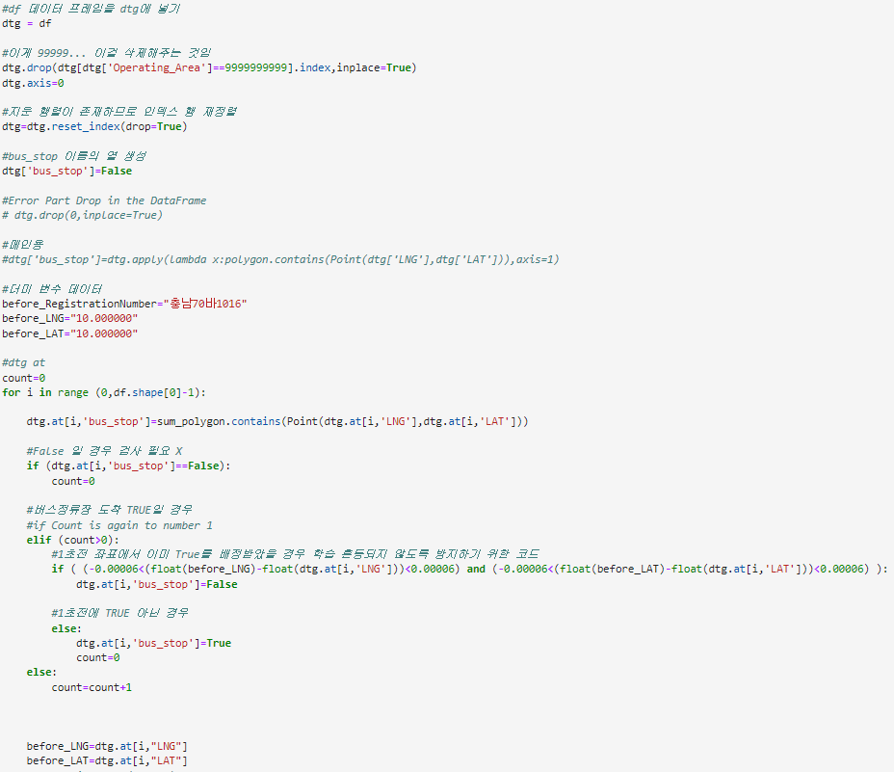
DTG- Add continuous detection check function

Slide 3
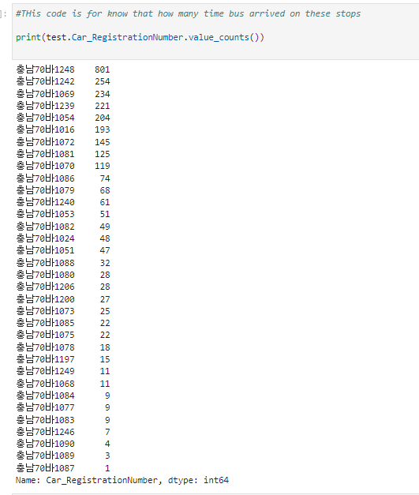
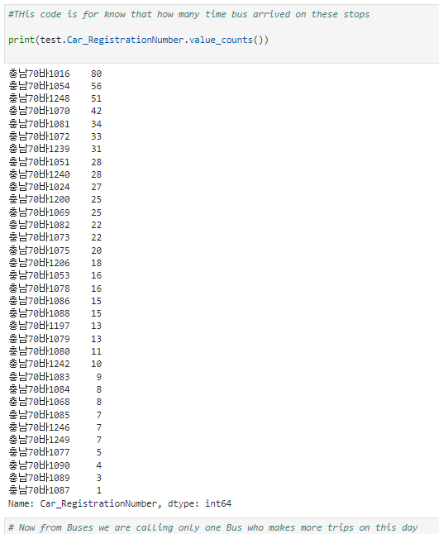
DTG- Bus Stop Detection Result

Slide 4
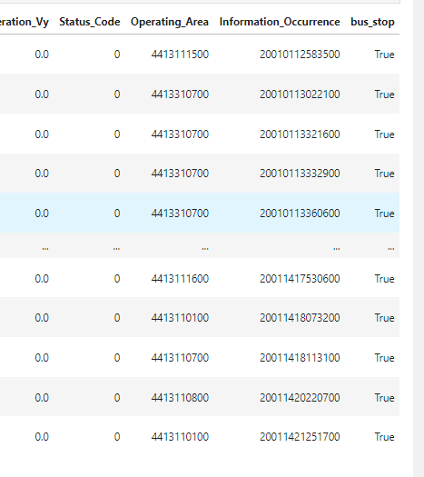
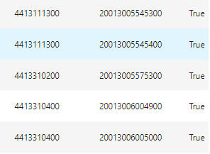
DTG- Resolving data continuity

