Slide 1
Time Prediction using dtg data
선문대학교 컴퓨터공학부-박규민
2023.05.03(수)

Slide 2

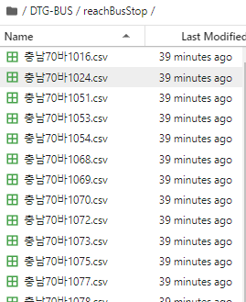
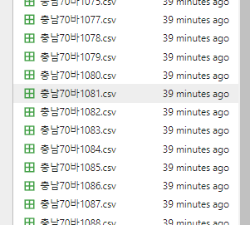
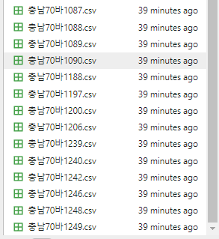
Create File of Information arriving at bus stop

Slide 3
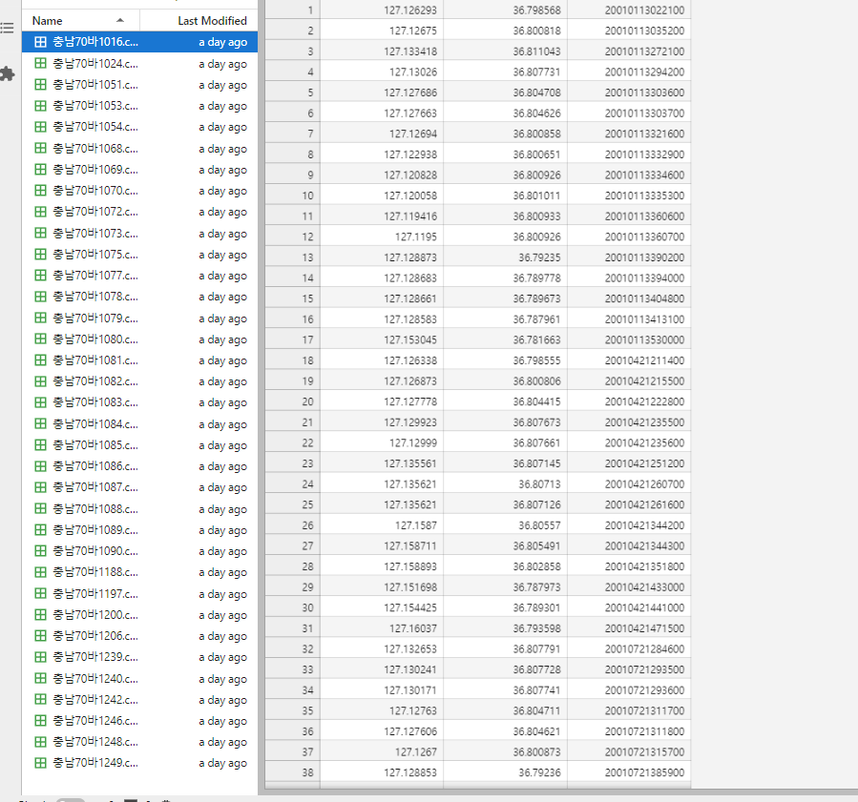
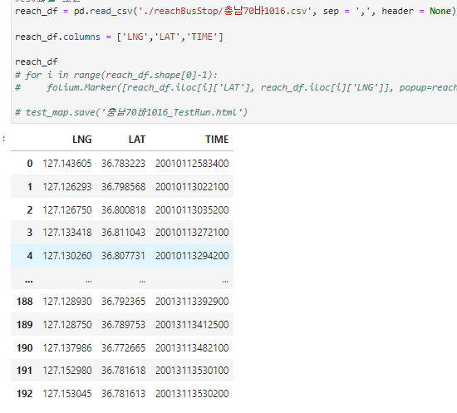
Read data- Reach Bus Stop True…

Slide 4

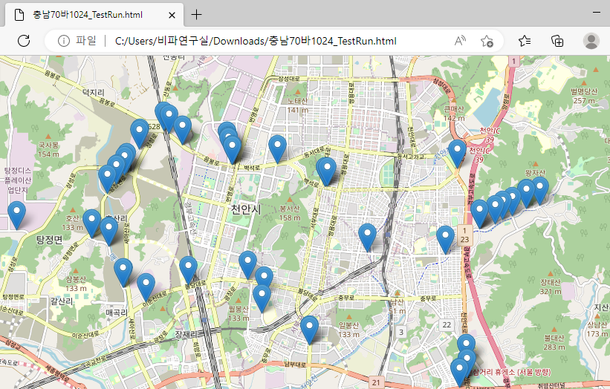
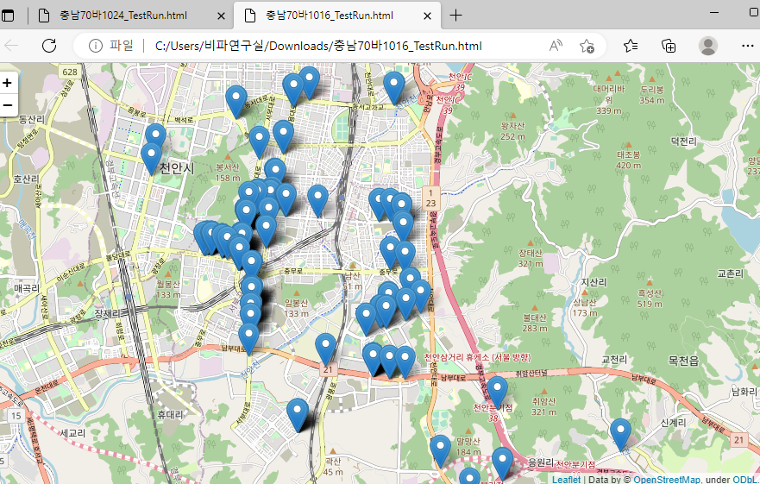
Read data & Points on the map

Slide 5
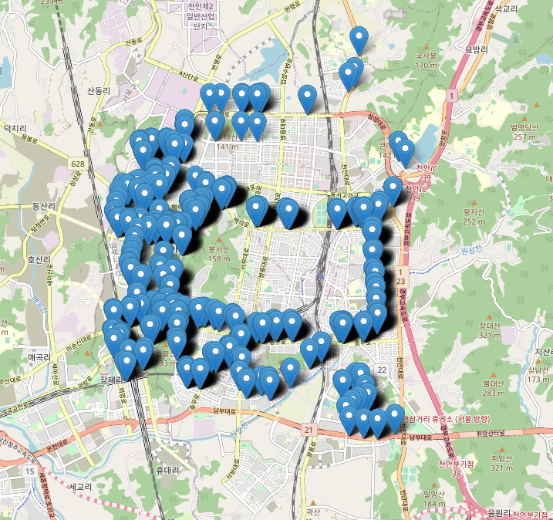
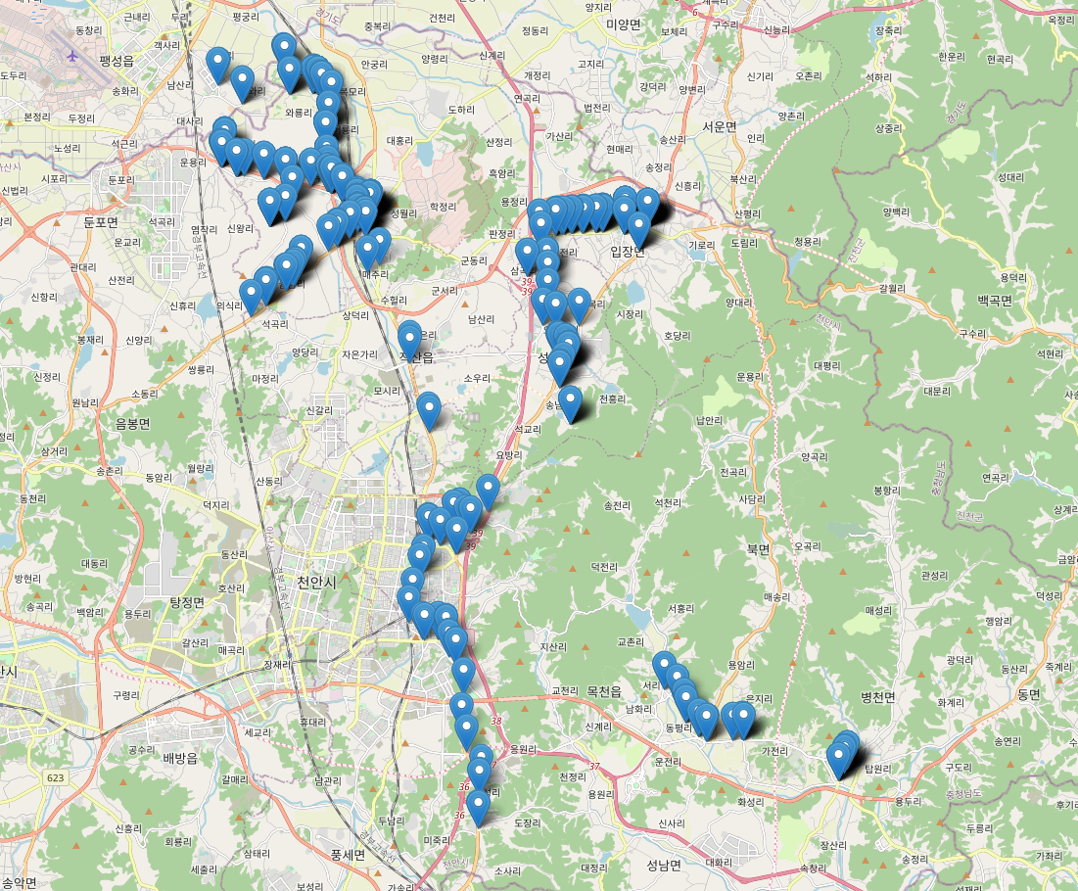
Read data & Points on the map

Slide 6
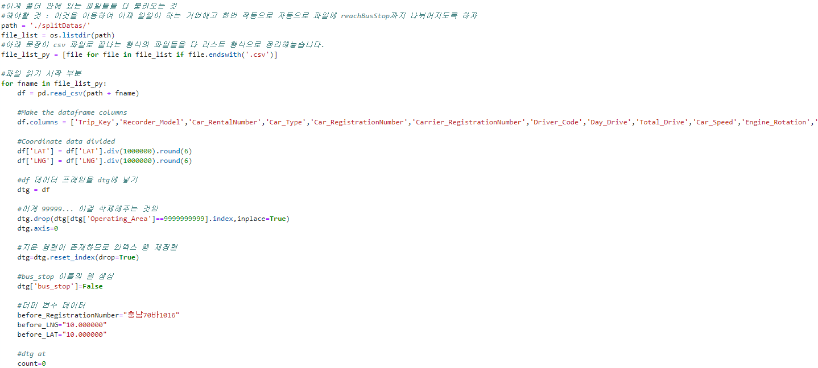
DTG-Reach Bus stop Integrated Code

Slide 7
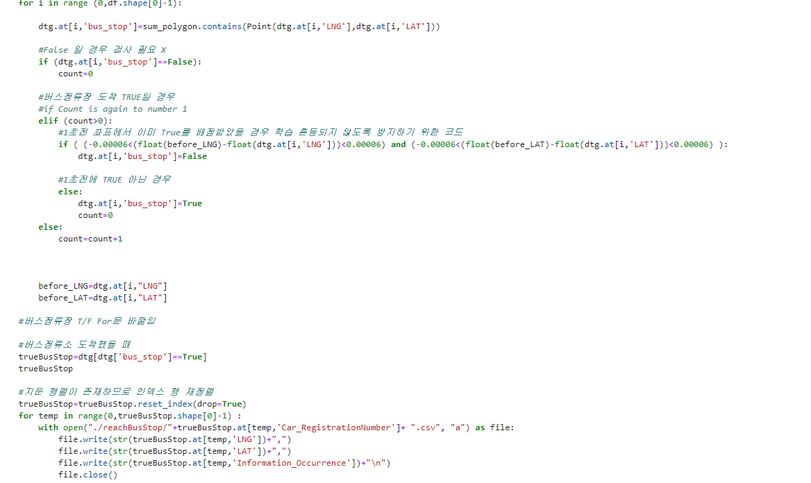
DTG-Reach Bus stop Integrated Code

Slide 8
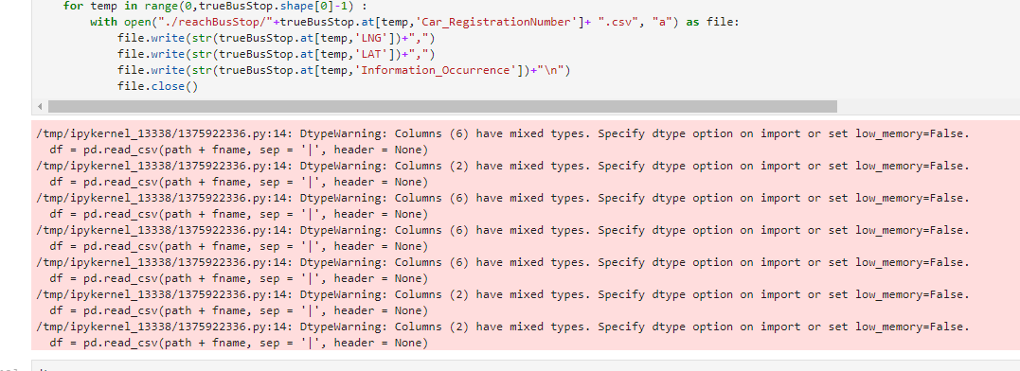
DTG-Reach Bus stop Integrated Code

