Slide 1
Time Prediction using dtg data
선문대학교 컴퓨터공학부-박규민
2023.05.24(수)

Slide 2
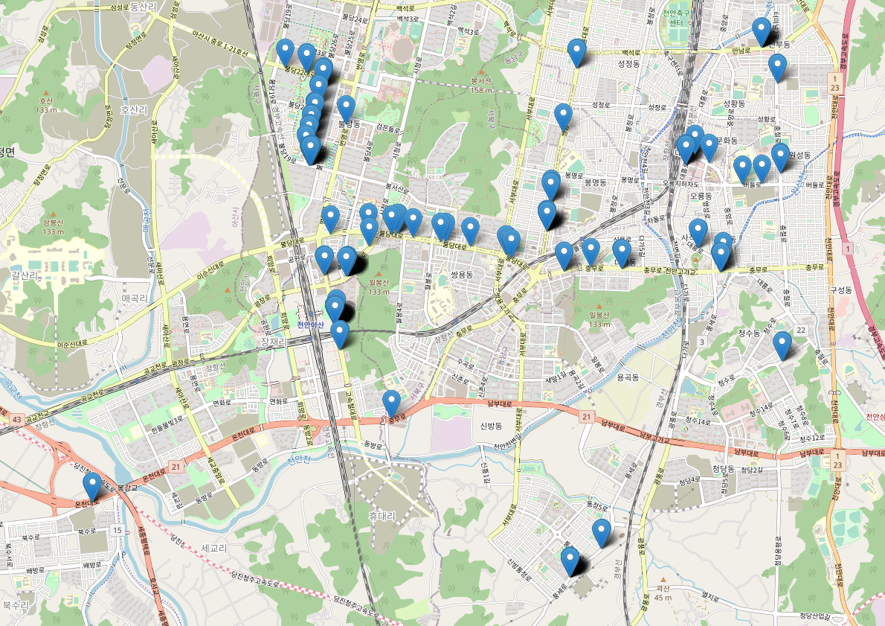
Fix the Algorithm

Slide 3
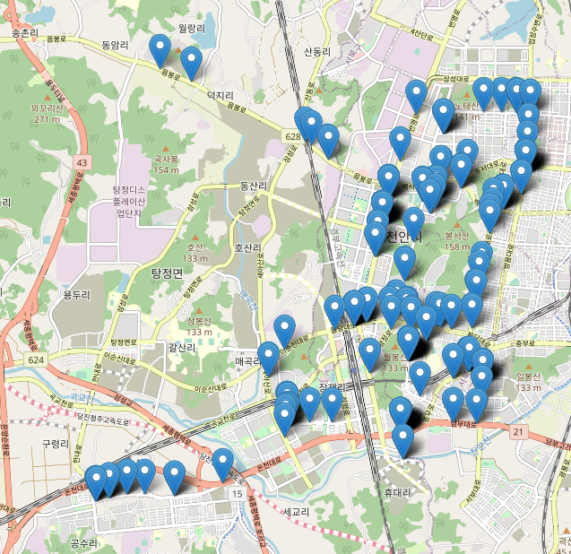
Fix the Algorithm

Slide 4
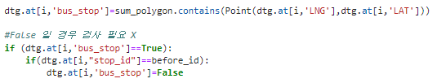
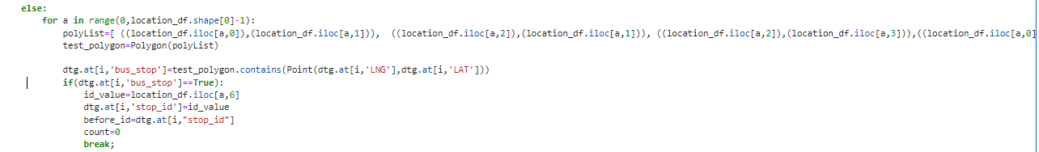
Read data- Reach Bus Stop True…

Slide 5
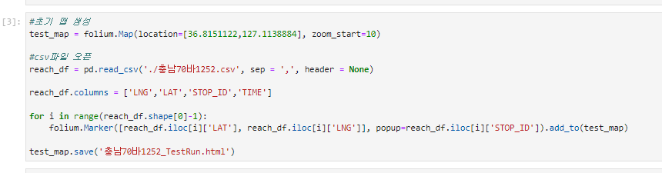
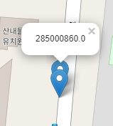
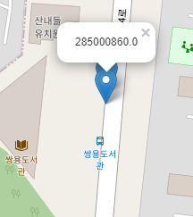
Read data & Points on the map

Slide 6
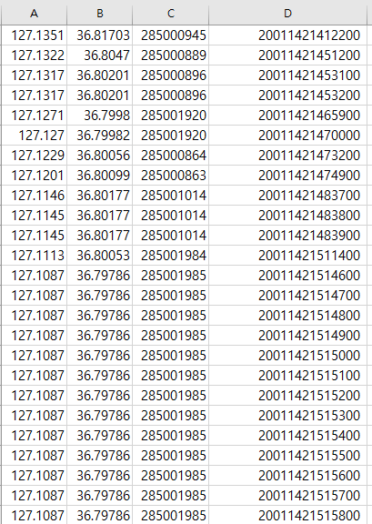
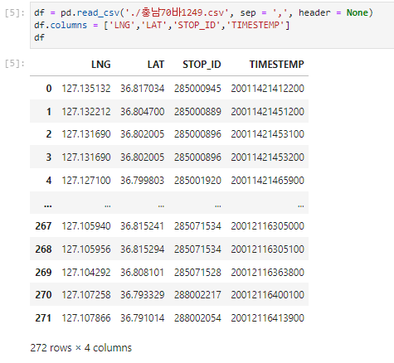
DTG-Reach Bus stop CSV
버스 정류장
ID
(Bus_Stop ID)

Slide 7
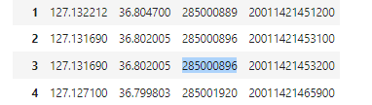

DTG-Reach Bus Check Correct data

Slide 8
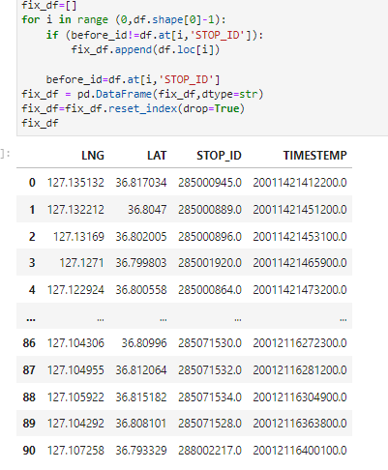
DTG-Reach Bus Check Correct data

Slide 9
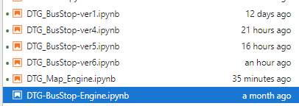
DTG-Reach Bus stop Version

