Slide 1
DTG Bus Stop algorithm
선문대학교 컴퓨터공학부-박규민
2023.04.05(수)

Slide 2
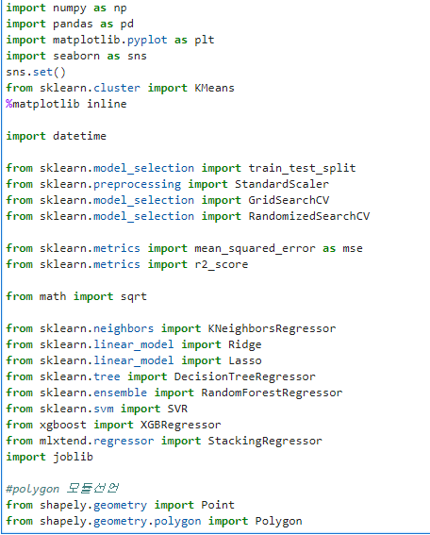
DTG- Import Library

Slide 3
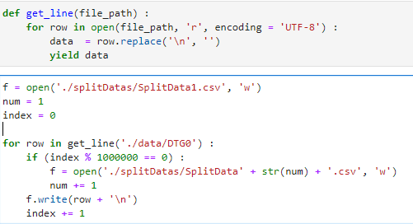
DTG- Split Original Data File

Slide 4
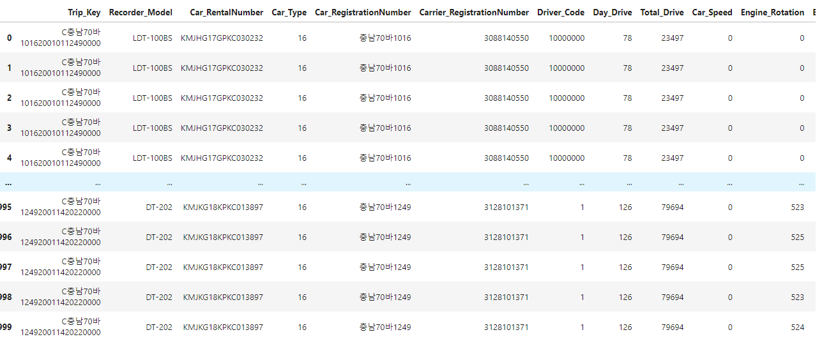
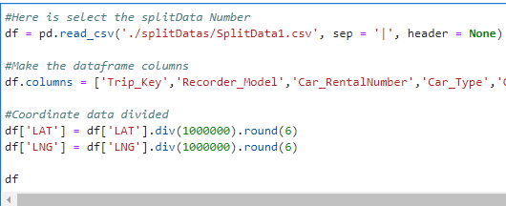
DTG- Load Split CSV File

Slide 5
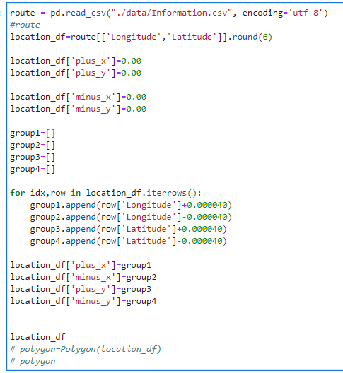
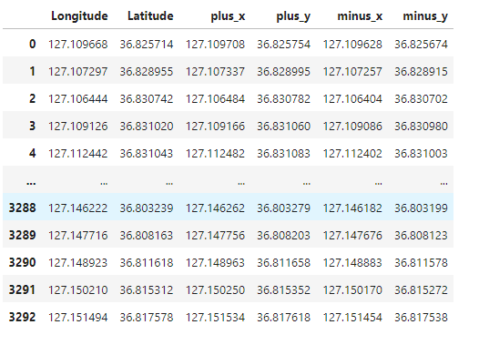
BusStopLocation – Data Prepare

Slide 6
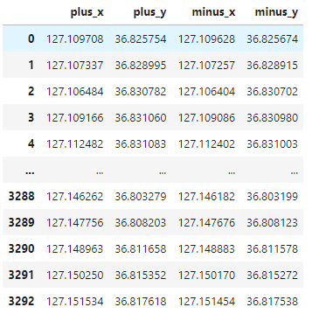
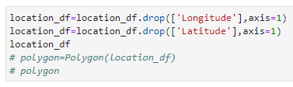
BusStopLocation – Data Prepare

Slide 7

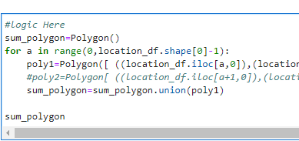
BusStopLocation – Polygon Map

Slide 8
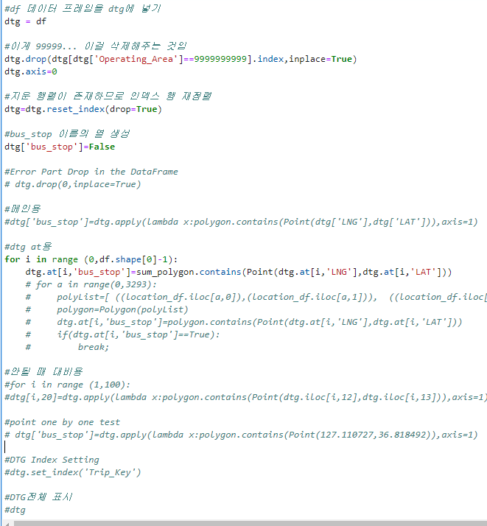
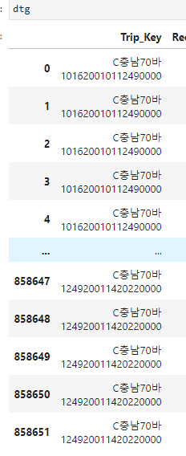
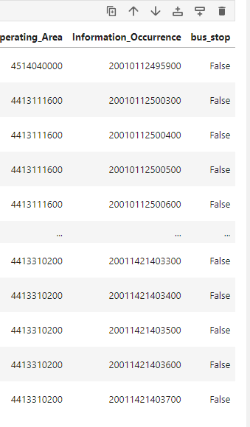
DTG – BusStop Boolean

Slide 9
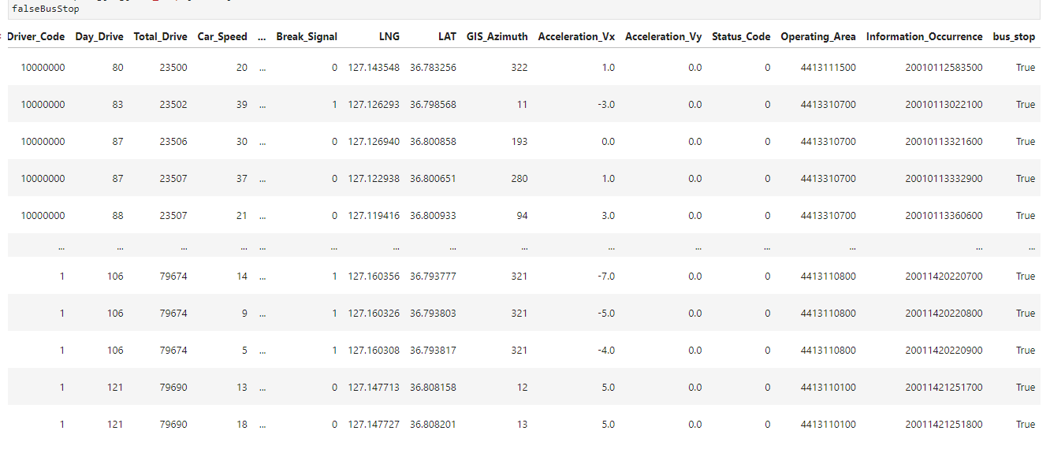

DTG – BusStop Boolean -> True

Slide 10
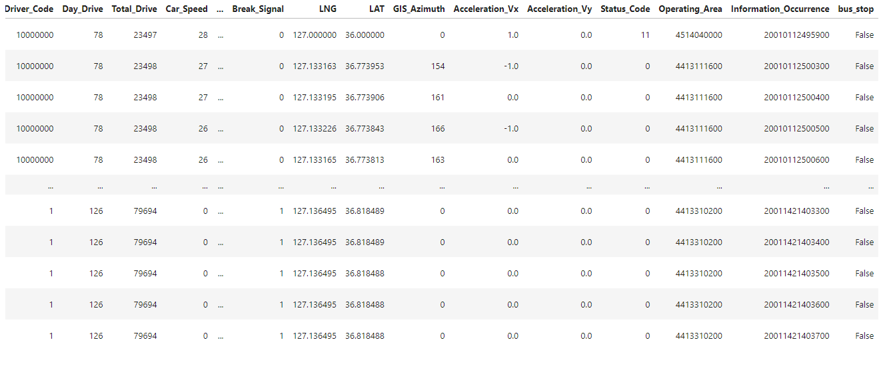

DTG – BusStop Boolean -> False

Slide 11
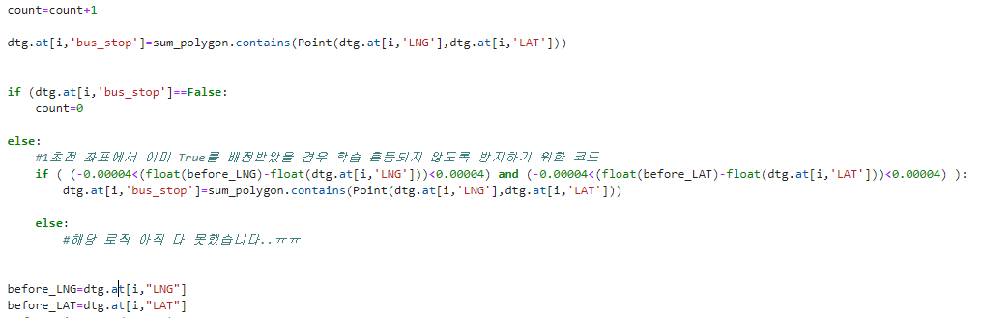
DTG – 버스 정류소 중복 방지 로직

