Slide 1
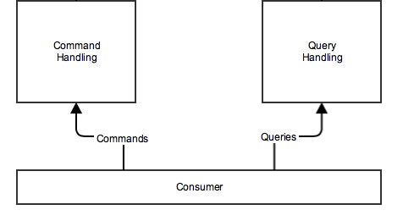
CQRS Command Query Responsibility Segregation write model & read model
Commands
Changes State
Returns void
Queries
Don’t make side effects
Returns data

Slide 2
class OrderService {
Order getOrder() { … }
void placeOrder() { … }
}
class OrderReadService {
Order getOrder() { … }
}
class OrderWriteService {
void placeOrder() { … }
}
Read - Returns state
Write – Changes State, does not returns state
GET : Query
POST : Command
PUT: Command
DELETE : Command
…

Slide 3
Pros
Horizontal scalability
High availability
Audit / tracking / tracing
domain objects and UI component separation
Cons
Complexity?

Slide 4
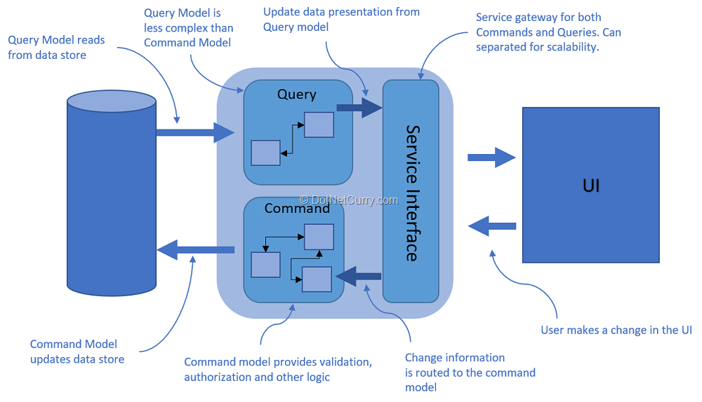

Slide 5
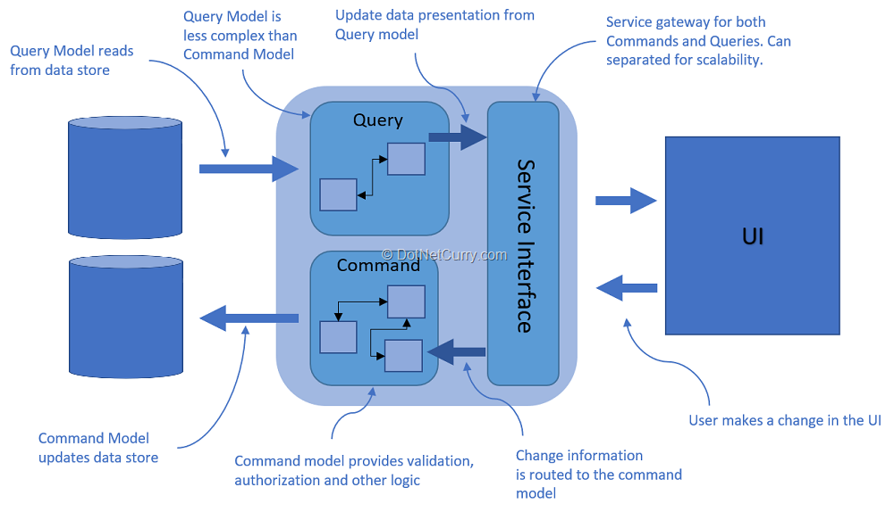

Slide 6
