Slide 1
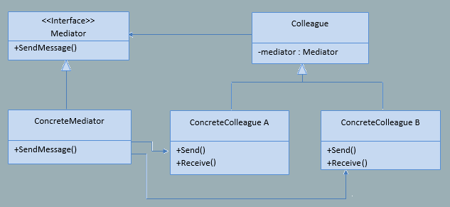
Mediator
Design Pattern

Slide 2

Tight coupling
Chaotic dependencies
Direct communication
Component reuse problem
Loose coupling
Reduce dependencies
Restricts direct communication
Component reuse
Force objects to collaborate only via mediator

Slide 3
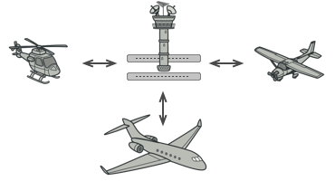

Slide 4
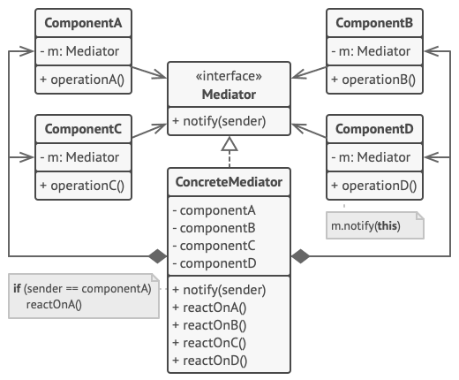

Slide 5
Pros and Cons
Single Responsibility Principle. You can extract the communications between various components into a single place, making it easier to comprehend and maintain.
Open/Closed Principle. You can introduce new mediators without having to change the actual components.
You can reduce coupling between various components of a program.
You can reuse individual components more easily.
Over time a mediator can evolve into a ”God object”.

