Slide 1
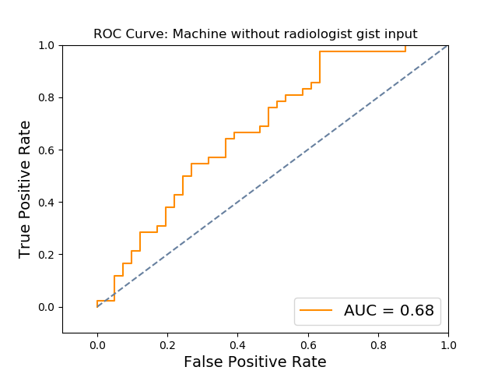
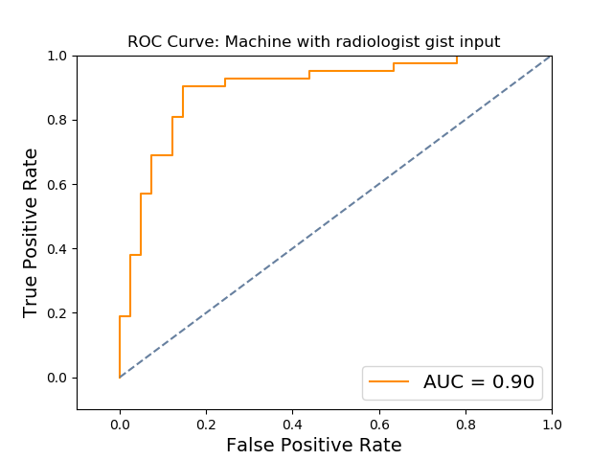
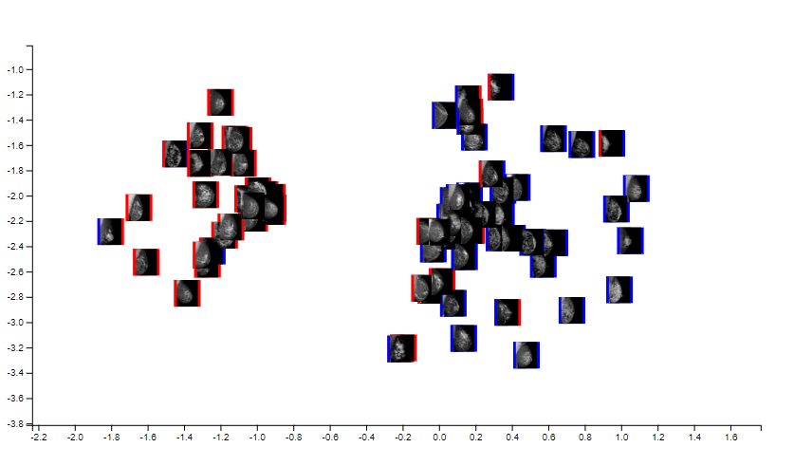
a.
b.
c.
d.
 | Accuracy | TPR | FPR | AUC | AUC stdev | 95% CI
Radiologist | 0.807 | 0.690 | 0.073 | 0.809
Machine | 0.614 | 0.667 | 0.439 | 0.681 | 0.0597 | 0.558 to 0.789
Machine with radiologist gist input | 0.855 | 0.857 | 0.146 | 0.899 | 0.0355 | 0.823 to 0.962

Slide 2
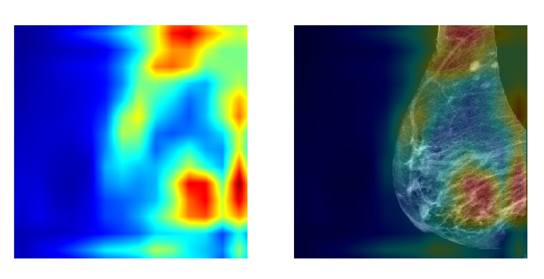
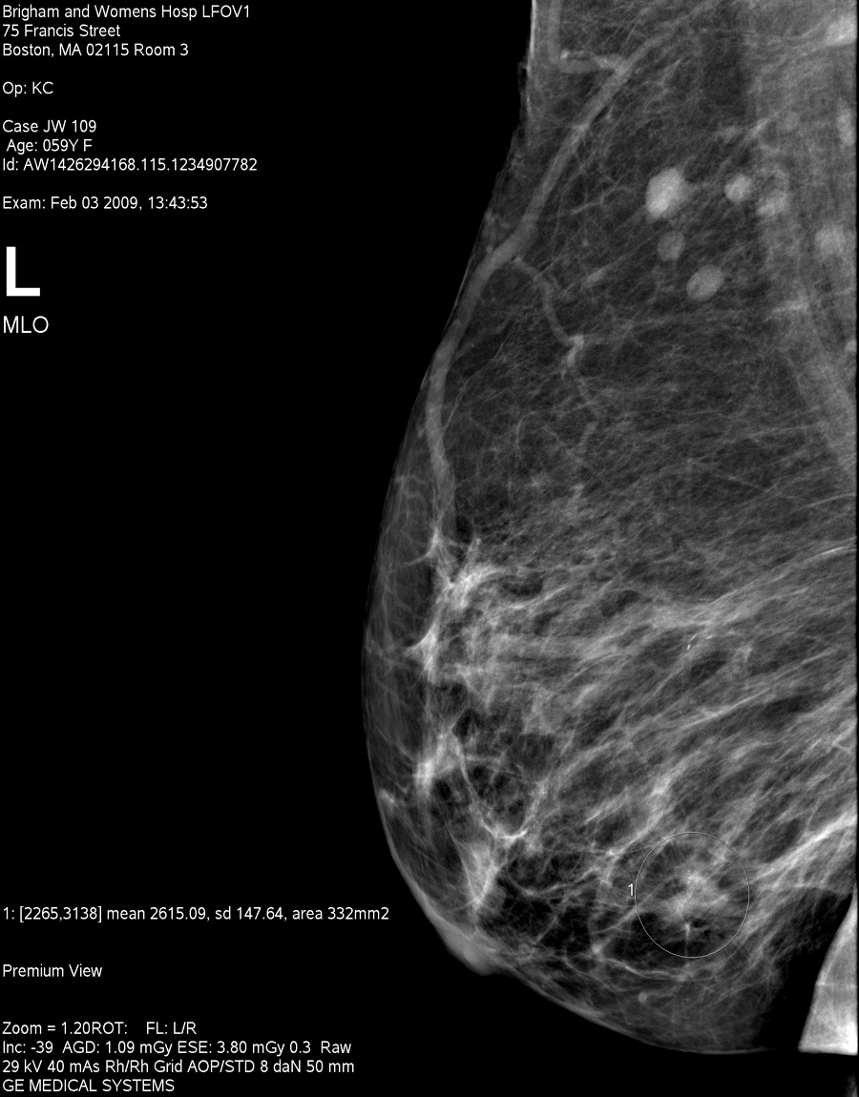
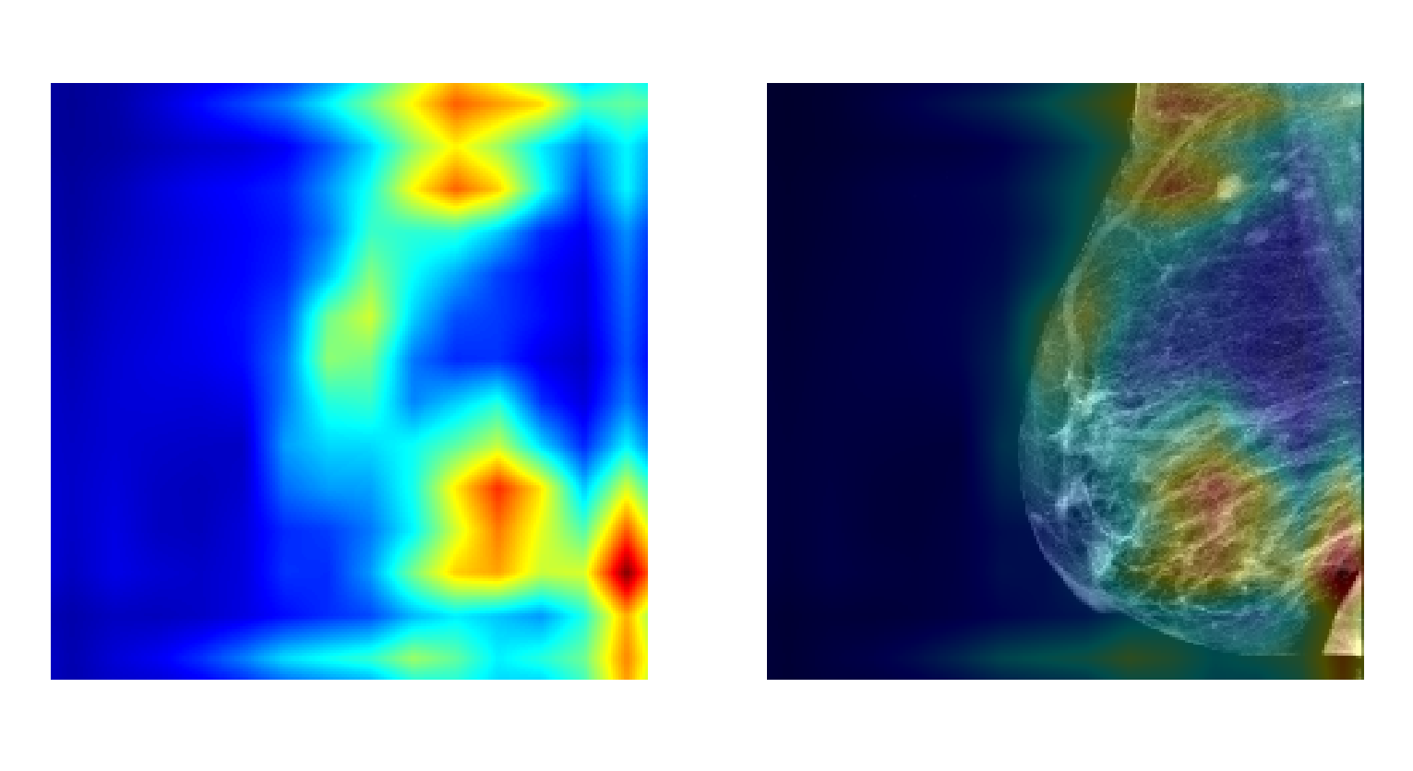
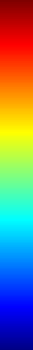
a.
b.
High
activation
c.
Low
activation

