Slide 1
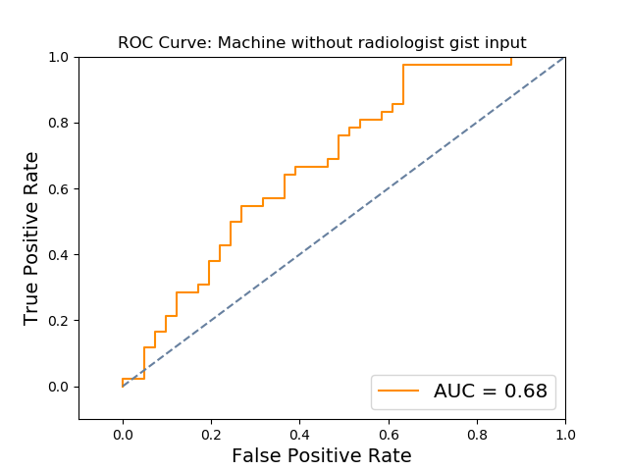
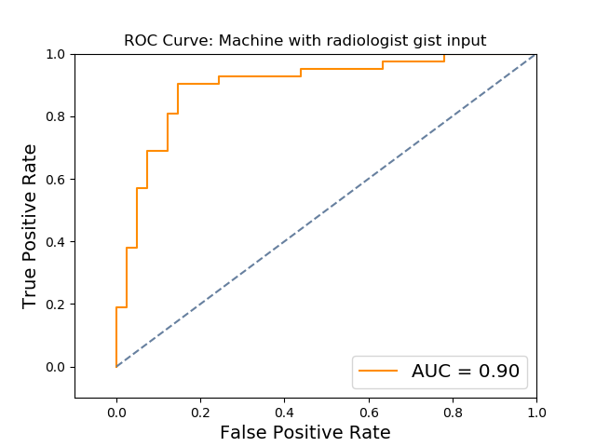
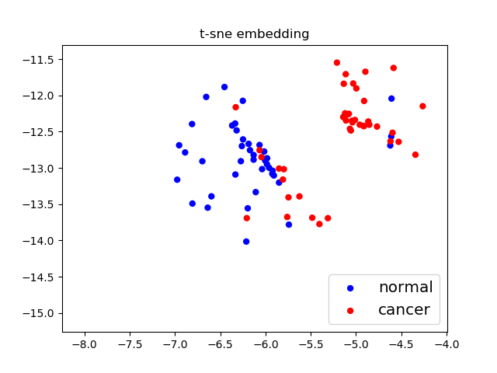
a.
b.
c.
d.
 | Accuracy | TPR | FPR | AUC | AUC stdev
Machine | 0.614457831 | 0.666666667 | 0.439024390 | 0.681184669
Radiologist | 0.807228916 | 0.690476190 | 0.073170732 | 0.808652729
Machine+Radiologist | 0.855421687 | 0.857142857 | 0.146341463 | 0.898954704 | 0.035593996

Slide 2
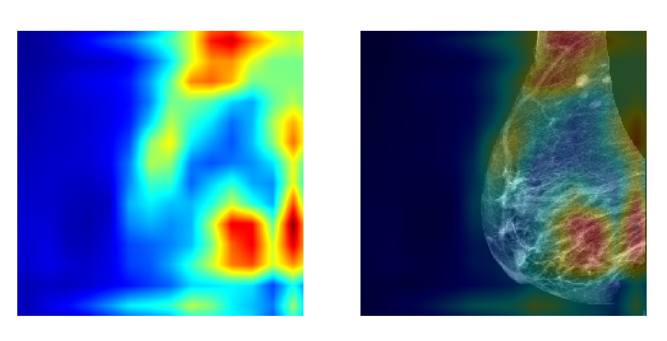
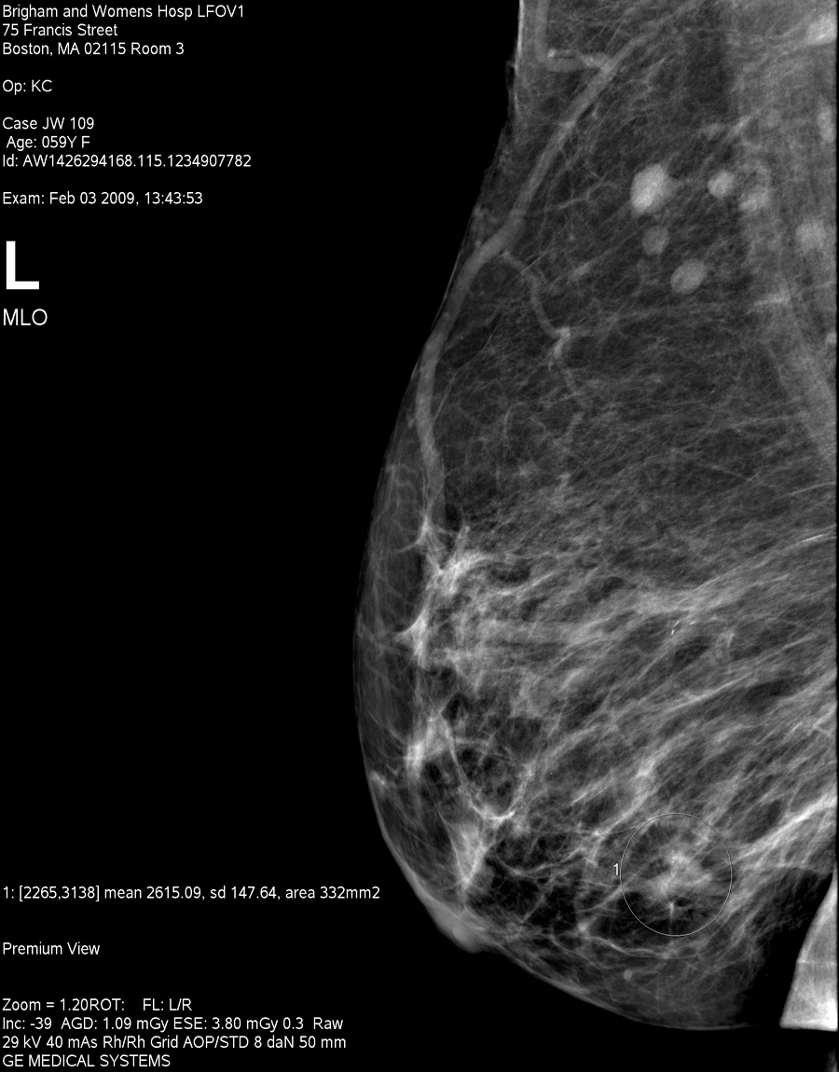
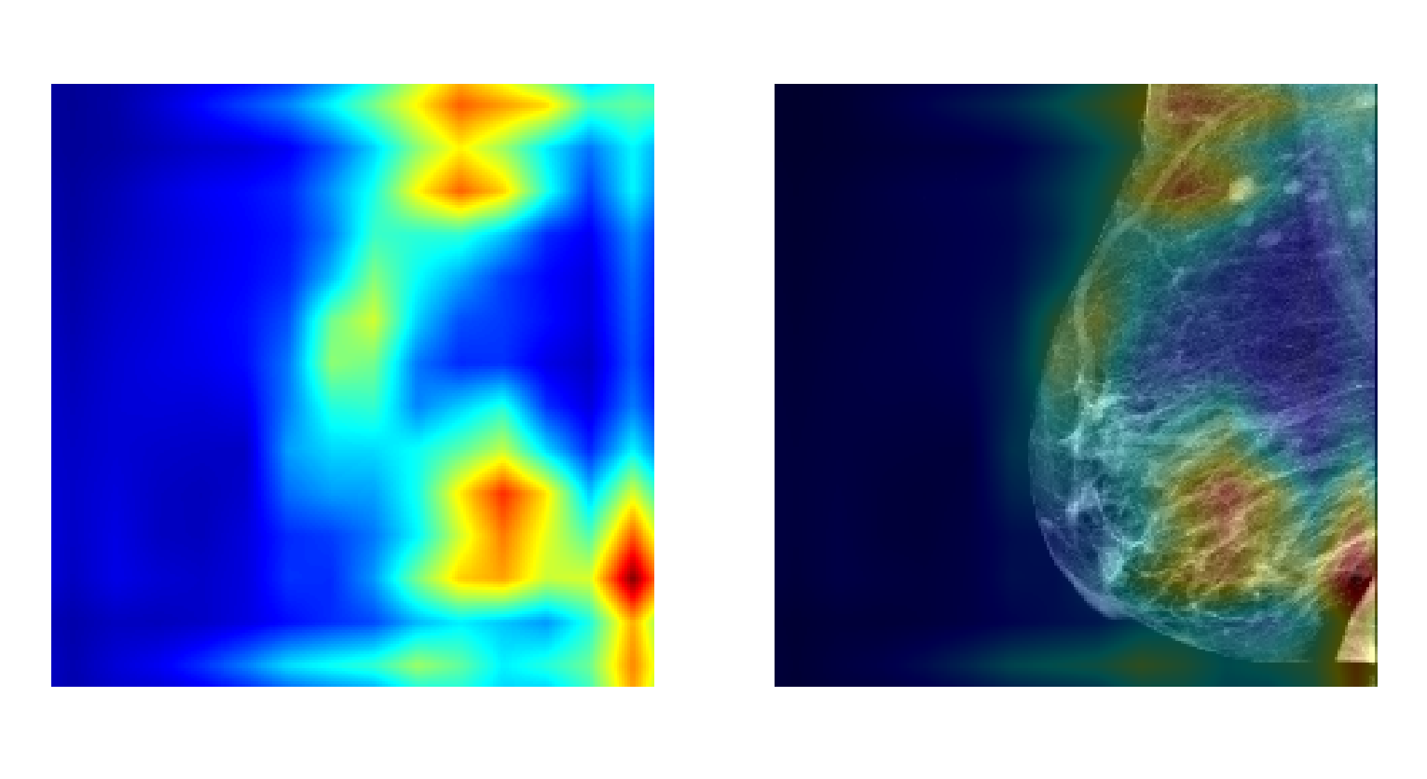
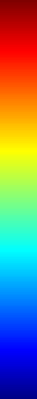
a.
b.
High
activation
c.
Low
activation

