Slide 1
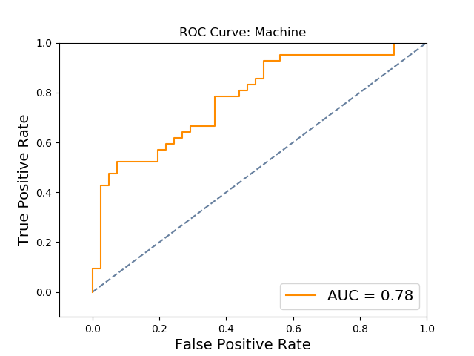
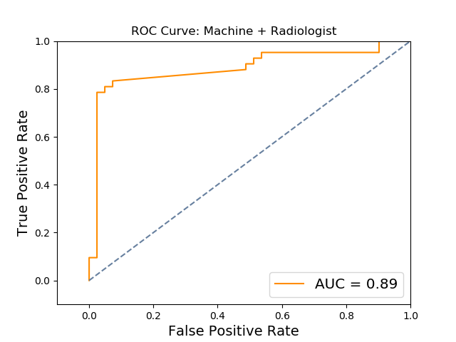
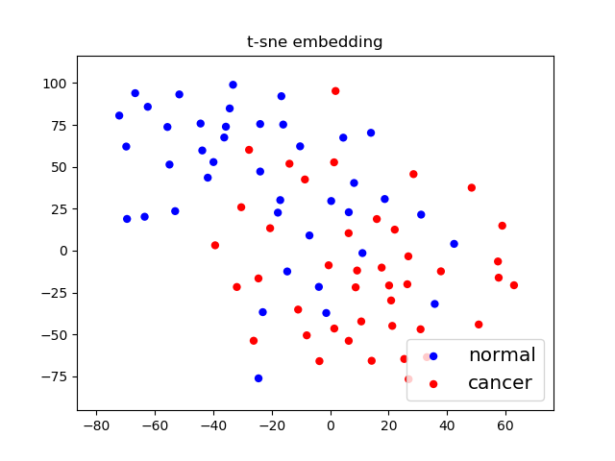
a.
b.
c.
d.
 | Accuracy | TPR | FPR | AUC | AUC stdev
Machine | 0.662650602 | 0.69047619 | 0.365853659 | 0.782810685
Radiologist | 0.807228916 | 0.69047619 | 0.073170732 | 0.808652729
Machine+Radiologist | 0.86746988 | 0.833333333 | 0.097560976 | 0.871660859 | 0.042669754

Slide 2
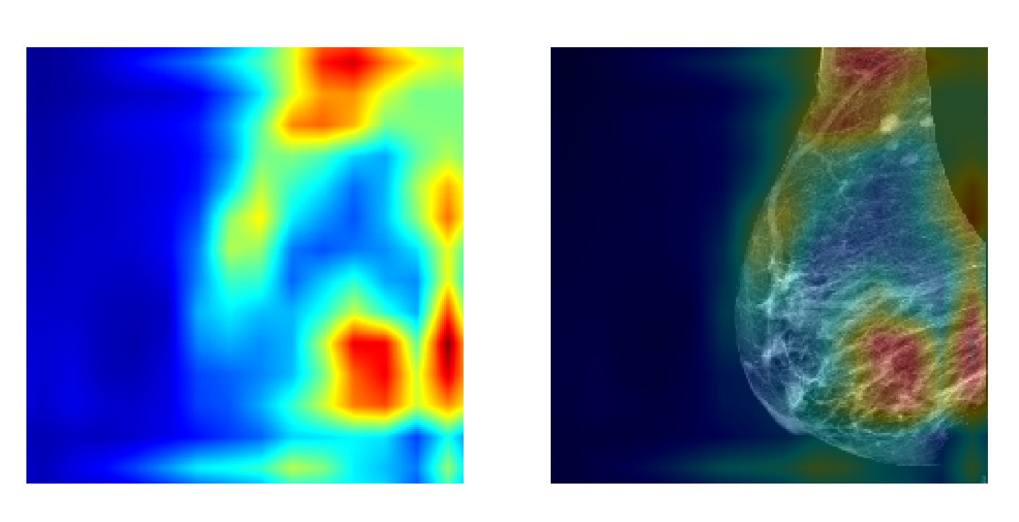
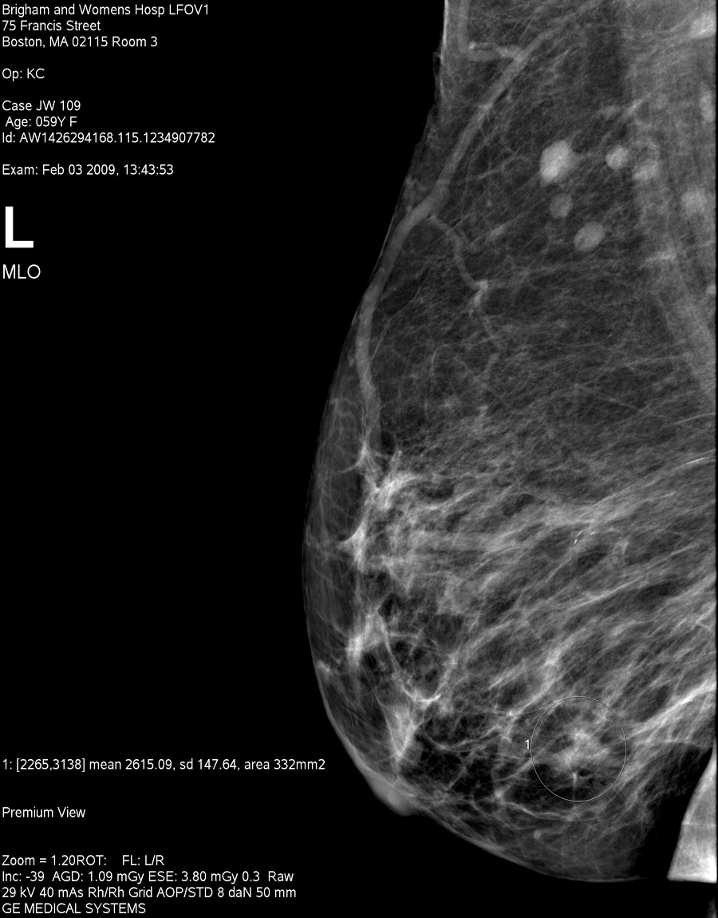
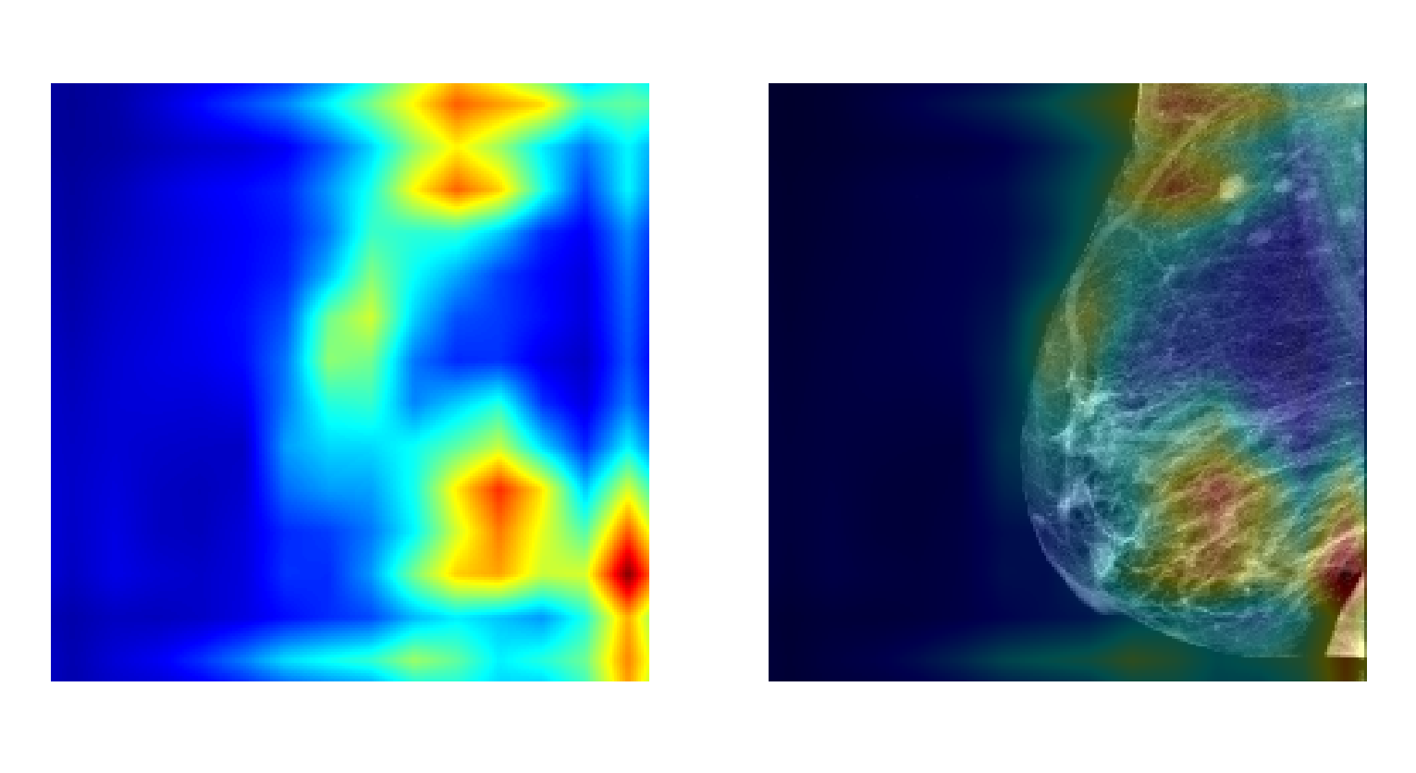
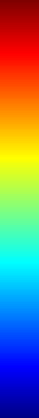
a.
b.
High
activation
c.
Low
activation

