Slide 1

INFO 5100: Application Engineering and Development
2025 Fall, Instructor: Guanzhou Ji
Classroom: Seattle Campus, 225 Terry Ave 402
Lecture Time: Tues, Thurs 9:20am-11:00am

Slide 2
How the project will be graded? (Total 50pts)
- Phase 1: Project Ideation (5pts)
(3-5 Slides)
- Phase 2: Problem statement and logical diagram (5pts)
(Latex doc)
- Phase 3: Preliminary implementation (15pts)
(Code)
- Phase 4: Final Submission Package (20pts)
(Code + Latex doc)
- Phase 5: Final Presentation (5pts)
(Slides)

Slide 3


Slide 4
Lab format
We will do hard problems together, don’t worry lab scores (*￣︶￣).

Slide 5
Qwickly Attendence

Slide 6
Example 1:
Monte Carlo Simulation
for π Approximation
We want to estimate π by throwing random points into a square

Slide 7
Monte Carlo
using random sampling to estimate results for problems that might be too complex to solve exactly.

Slide 8
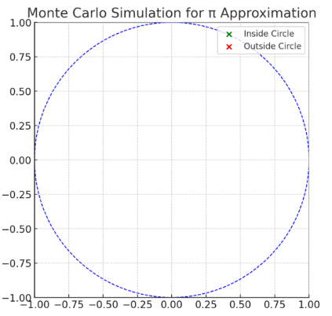
Step 1. The Setup
Draw a square that goes from –1 to +1 in both x and y directions.
Its area is 2²=4.
Inside the square, draw a circle of radius 1, centered at the origin.
Its area is 𝜋×1²=π.
So, the ratio of circle area to square area is:𝜋/4 ​

Slide 9
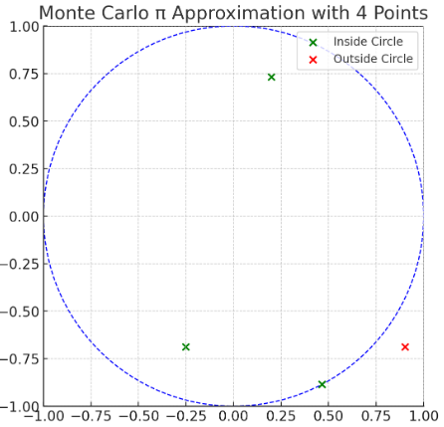
Step 2. Generate Random Points
We “throw darts” (random points) at the square.
To get a random point:
Pick a random 𝑥 between –1 and +1.
Pick a random 𝑦 between –1 and +1.
This gives us a point (𝑥,𝑦) somewhere in the square. ​

Slide 10
Step 3. Check if Point is Inside the Circle
A point is inside the circle if:
x²+y²≤1
Example:
Pt (0.2, 0.4), 0.2²+0.4²=0.2, inside
Pt (0.9, 0.9), 0.9²+0.9²=1.62, outside ​

Slide 11
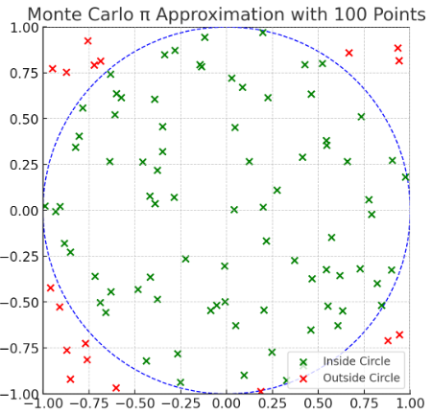

Step 4. Count Inside vs. Total
Suppose we throw 𝑛 points.
Let 𝑐 = number of points that landed inside the circle.
Then the ratio:

Slide 12
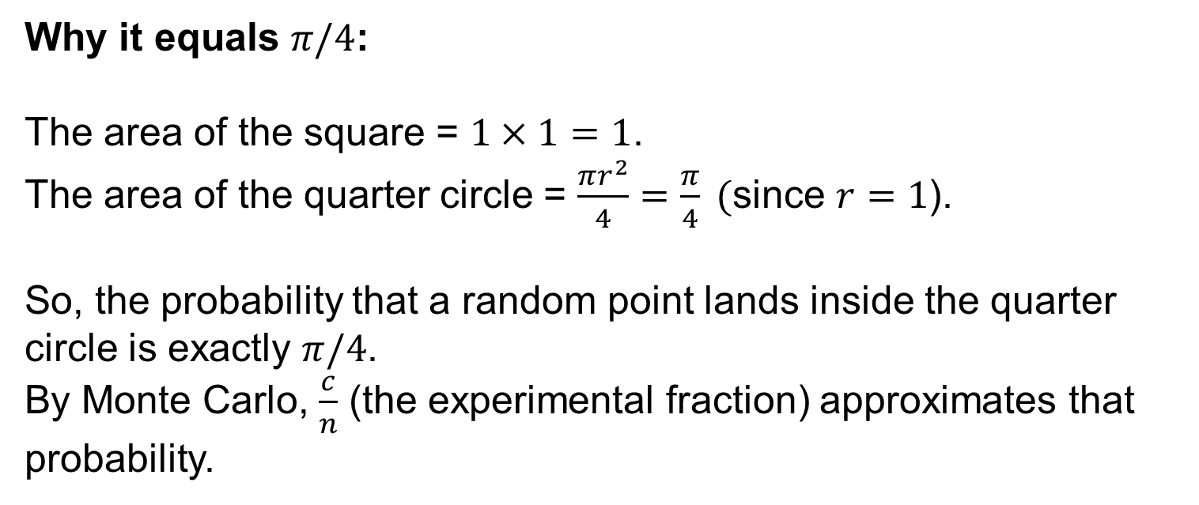
Why it equals $π/4$:
The area of the square = $1×1=1$.
The area of the quarter circle = $\frac{πr^{2}}{4}=\frac{π}{4} ($since $r=1$).
So, the probability that a random point lands inside the quarter circle is exactly $π/4$.
By Monte Carlo, $\frac{c}{n}$ (the experimental fraction) approximates that probability.

Slide 13

Step 5. Estimate π
Finally:

Slide 14
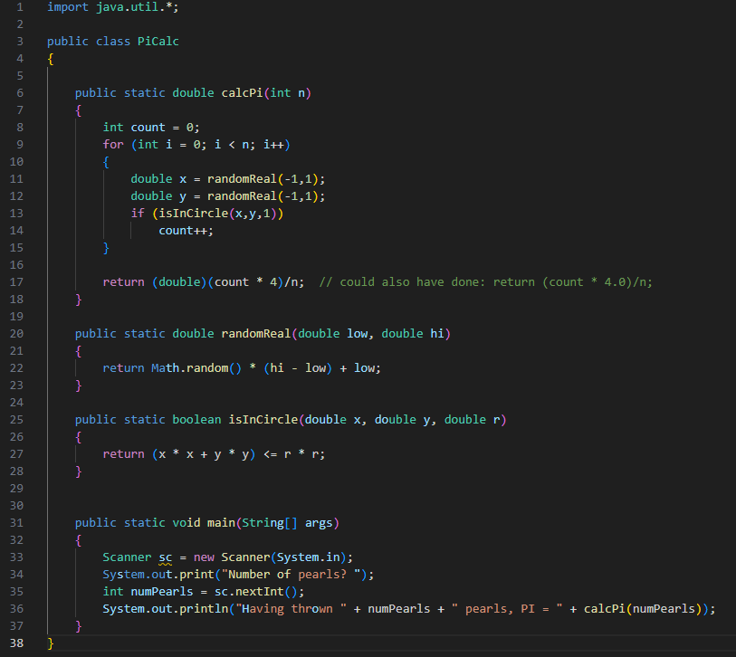
n is the number of random points
Track how many pts inside the circle
Loop runs n times

Slide 15
n is the number of random points
Track how many pts inside the circle
Loop runs n times
Generate random pts on xy plane
If the point is inside, increase count by 1

Slide 16
n is the number of random points
Track how many pts inside the circle
Loop runs n times
Generate random pts on xy plane
If the point is inside, increase count by 1
Return an approximation of π

Slide 17
Math.random()
Returns a random number between 0.0 (inclusive) and 1.0 (exclusive).
Example: 0.0, 0.234, 0.999...
* (hi - low)
Stretches that into the interval [0, hi - low).
Example: if low = -1 and hi = 1, then (hi - low) = 2.
So you get [0, 2).
+ low
Shifts the interval up so it starts at low.
With low = -1, it becomes [-1, 1).

Slide 18
It checks whether a point (𝑥,𝑦) is inside or on the boundary of a circle with radius r centered at the origin (0,0).
Returns true if the point is inside, false otherwise.

Slide 19
inside your class (PiCalc), you can call static methods directly anywhere in that class, because it’s static

Slide 20
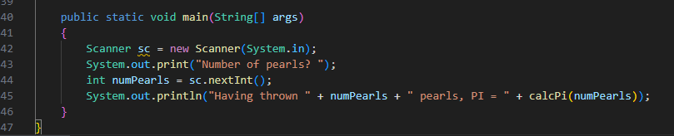
Creates a Scanner object named sc to read input from the keyboard (System.in).
Reads the next integer typed by the user in the console.
Stores it in the variable numPearls.

Slide 22
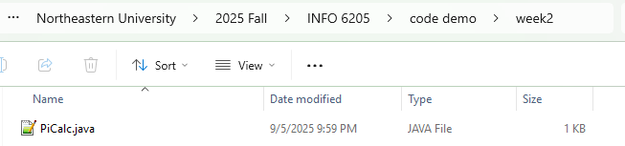
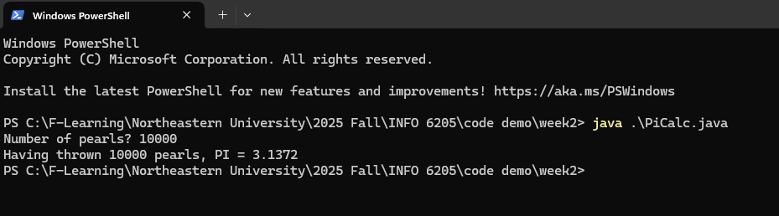

Slide 23
Is this Object Oriented Programming
(OOP)?

Slide 24
current code is procedural
(all-static helpers)

Slide 25
Lab Session
Changing this procedural code
into OOP

