Slide 1


Slide 2
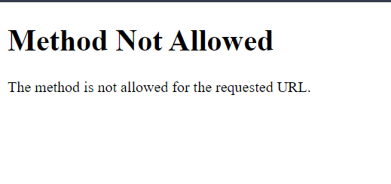
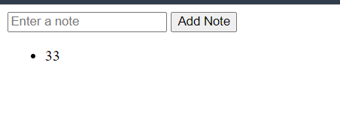
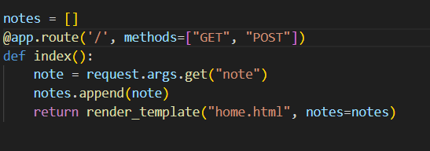
Bug_1: Incorrect representation of route definition
Solution: change method in route function

Slide 3
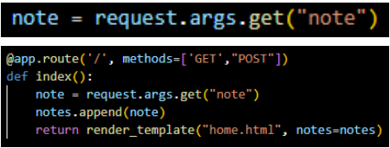
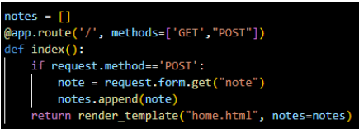
Bug_2: Incorrect request in function route in app.py.
Solution Modify the Request Method in the Route Function Definition within app.py to handle both GET and POST Requests. Update the line from request.args.get('note') to request.form.get('note').

Slide 4
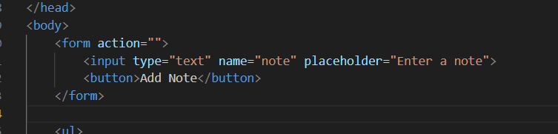
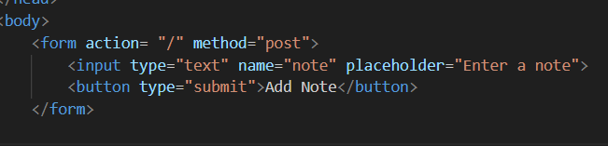
Bug_3 Attribute missing in submitting button
Solution add= type = "submit" in the tag button in home.html.

Slide 5
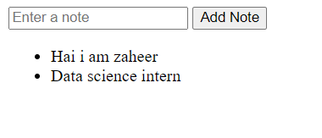
Finally the application runs successful

Slide 6


