Slide 1
Ames: Housing Sale Price
Presented by: Sophia Lian

Slide 2
contentS
A. Business Case
Sell a home
Most important considerations for highest selling price
B. Project Workflow
Data preprocessing (drop and impute variables, scaling, encoding)
Feature engineering (based on correlation matrix, domain knowledge, tree-based models)
Models (tree-based, linear)
Hyperparameter tuning
Best model
C. Considerations
Notes:
- Taking the perspective of a seller or a seller’s agent, looking at the most important predictors of saleprice, and maximizing saleprice by optimizing within those bounds
- Next I’ll go over the steps I took in data analyis in terms of preprocessing, and the variations I took in encoding and feature engineering and the rationale for those
- Lastly, we’ll consider project followup ideas and additonal variations as well as takeaways of how to apply what we learned from the models

Slide 3
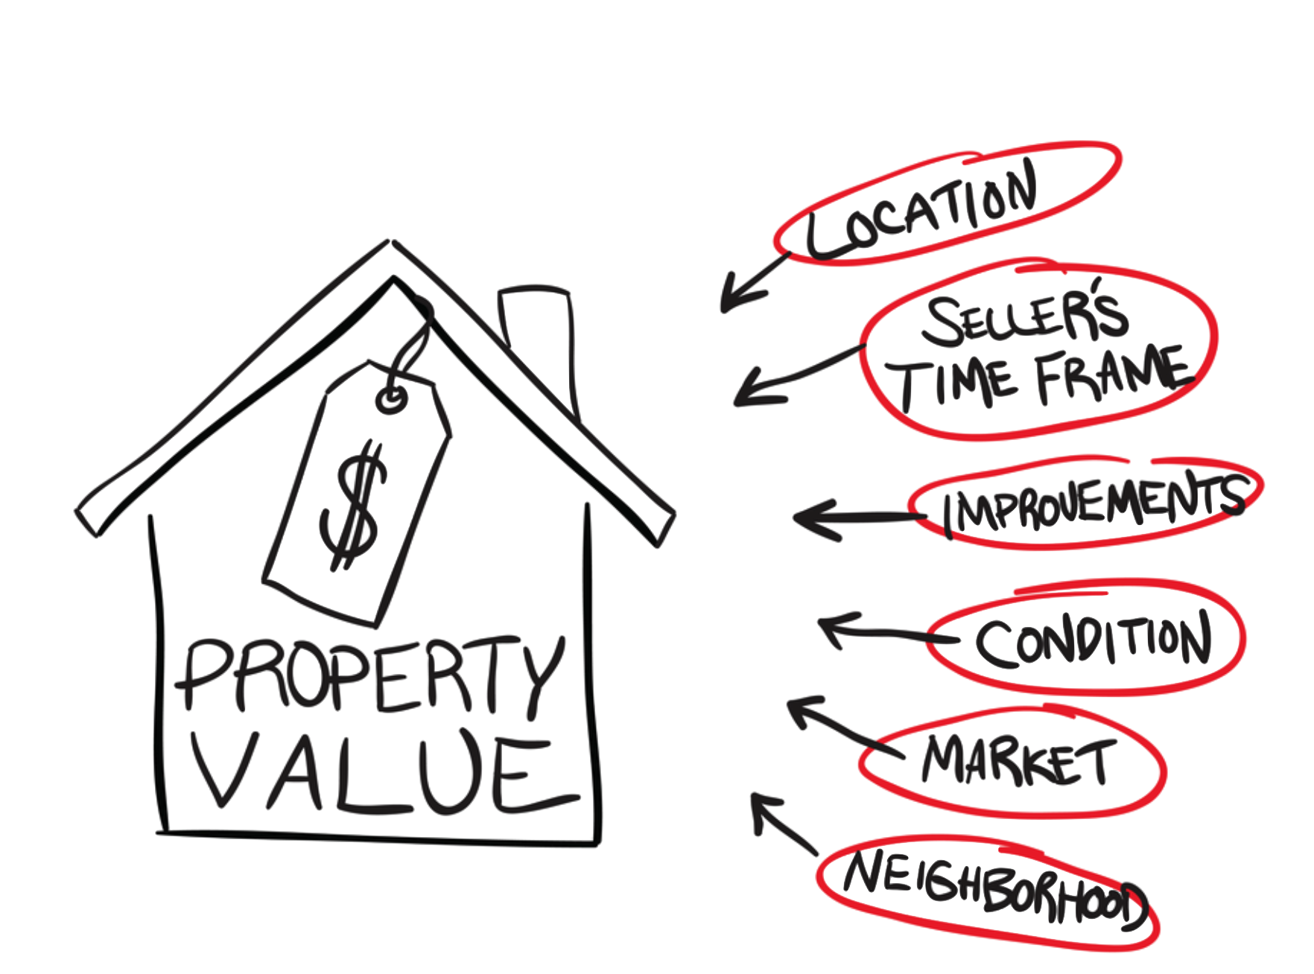
a. Business case
Most important considerations for highest selling price
Pricing
Location
Material/Quality
Notes:
-There are a lot of factors that go into a property’s values, including those that you see on the right, the less tangible ones above and beyond the physical amenties like you see In the bubbles on the right that the layperson might not be familiar with.
-One of the biggest mistakes sellers make is underestimating the business savvy of the other side, overpricing their home, looking for room to negotiate. Value of the following slides is to allow the seller to quickly identify the most impt attributes to selling their home and to put their best foot forward regarding what they have.
-In addition to that, when you get an appraisal you get one price.. with these models you would be able to better interpret the appraisal value to be able to tweak
-In order to balance getting the best possible price with budget-minded buyers, it’s important to enlisting the expertise of an experienced real estate agent.
-The purpose of this project, then is to allow the buyer to do prelim research on their own in order to gauge the expertise of their realtor who will then do the fine tuning.

Slide 4

B. Workflow
1. Preprocessing:
A. Linear models
Log Transformation, outliers
Missing values
Scale values
Encoding (dummify, ordinal)
Drop zero variance
Feature engineering -> run all models through
B. Tree-based models
Missing values
Encoding (relabel, ordinal)
Drop zero variance
Feature engineering - > run all models through
Notes:
I approached the preprocessing in two ways, one for linear models that assume gaussian distribution, and the other for tree-based models. For the linear models, I went through several iterations with transformations, removing outliers, and removing zero variance variables which progressively got marginally better scores.
For the tree-based models, I similarly tried two variations on tree-based models on the premise that tree-based models make binary split decisions, when the model is good at handling features where the main signal can be extracted by a few splits which translates to features that are as binary as possible, and I wanted to recast some of the features with multiple levels (like neighborhood, or everything used to describe garage) to binary ones. This would allow splits to occur earlier, and more samples to appear in each leaf, preventing overfitting and allowing generalization to out-of-sample data. I kept the best-scoring one.
43 categorical features, 227 features to 214 after dropped variation and high highly correlated

Slide 5
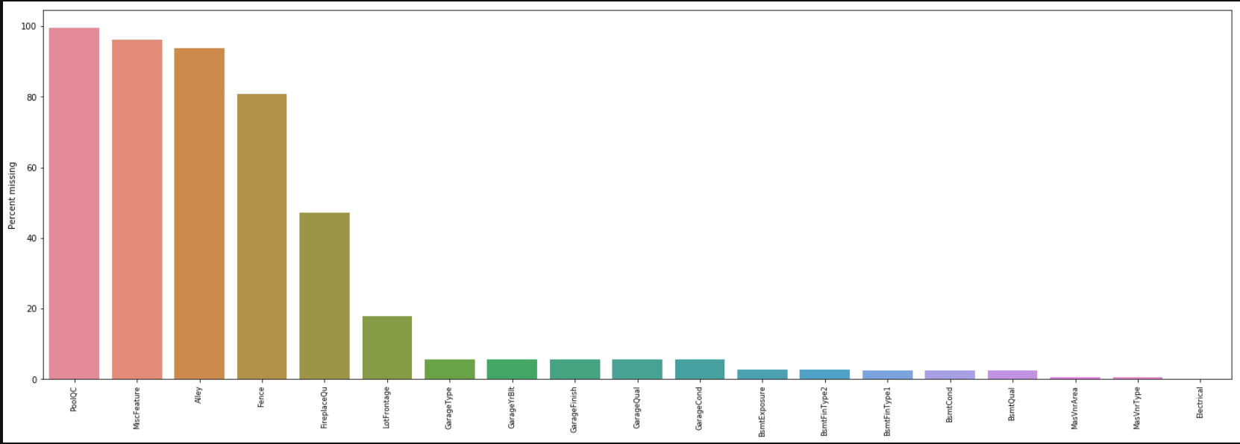
missing values: imputation & drop variables
MiscFeature: 54 count, low variance, low target correlation -> drop
Alley: low target correlation -> drop
Fence: low target correlation -> drop
PoolQC: 99% missing -> drop
Most others: fillna(mode)[0]

Slide 6
Feature engineering
Flags:
is_high_neighborhood (is_mid, is_low)
Is_good_condition
Scores:
GarageScore
BasementScore
FireplaceScore
LocationScore
Notes:
What distinguishes a great real estate agent from a mediocre one is domain knowledge, and feature engineering is where you can introduce domain knowledge to help models isolate specific information. Based on the research that I’ve done, neighborhood, being near good conditions, so I included these flags (among others) for the tree-based models to train on.
In addition to working best with features that are binary or that can be split simply, tree-based models are good at handling feature interactions and learning the relationships between features (meaning they’re not thrown off by multicollinearity), rather than assuming each feature is independent of one another, like linear models. Knowing that, I tried to aggregate into one score features that have an ordinal component and that are spread across several forms (like garage or basement), both to allow the model simpler splits, and to reduce dimensionality.

Slide 7
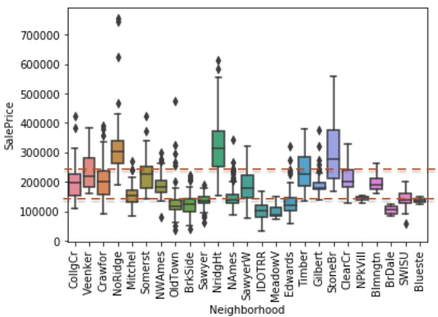
Flag: Is_high_neighborhood
Is_high_neighborhood
Saleprice > $230k
Is_mid_neighborhood
Saleprice > $150k and <= $230k
Is_low_neighborhood
Saleprice < = $150k
Notes:
To reduce dimensionality and to allow the model to focus on certain
I made three flags to divide neighborhoods into lower-tier, mid-tier, and high-tier, and I based that on… if they feel in the interquartile range of the median home price, they were given the is_mid_neighborhood flag

Slide 8
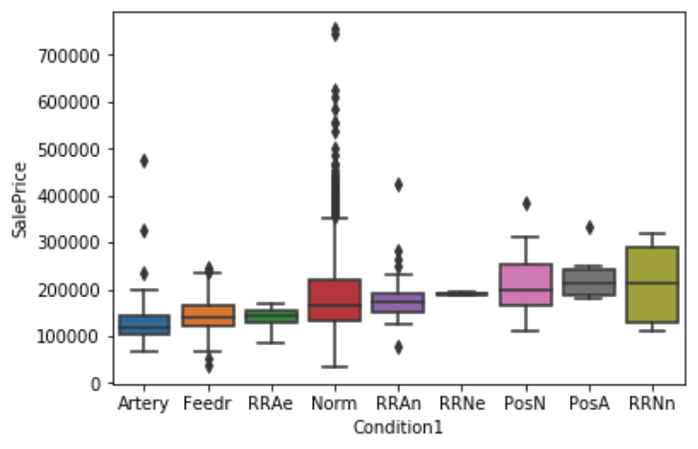
Flag: Is_good_condition
RRAn: Adjacent to North-South
Railroad
RRNe: Near (within 200’)
of East-West Railroad
PosN: Near positive off-site
features (park, greenbelt)
PosA: Adjacent to positive
off-site features
RRNn: Near (within 200’)
Of North-South Railroad
Notes:
You see that the mean home price is here, and that being adjacent or near positive features like parks and schools resulted in higher saleprices, and being near artery/feeder with heavy traffic results in lower saleprice. This helps the model to train and reduces dimensionality
9 different levels spread across two variables, condition1 and condition 2

Slide 9
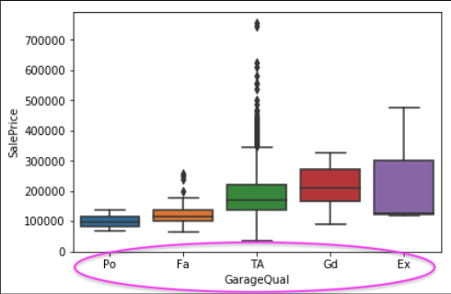
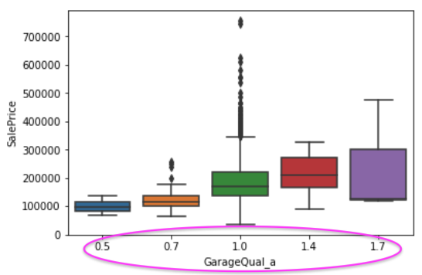
garagescore
GarageQual (original) GarageQual (target-encoded)
Notes:
I took as the baseline the TA (typical/average)
TA is the average (whose median is right at the mean price, and I mapped 1 to the mean saleprice, and the others according to the proportion greater or smaller than that mean saleprice, which was mapped to 1.

Slide 10
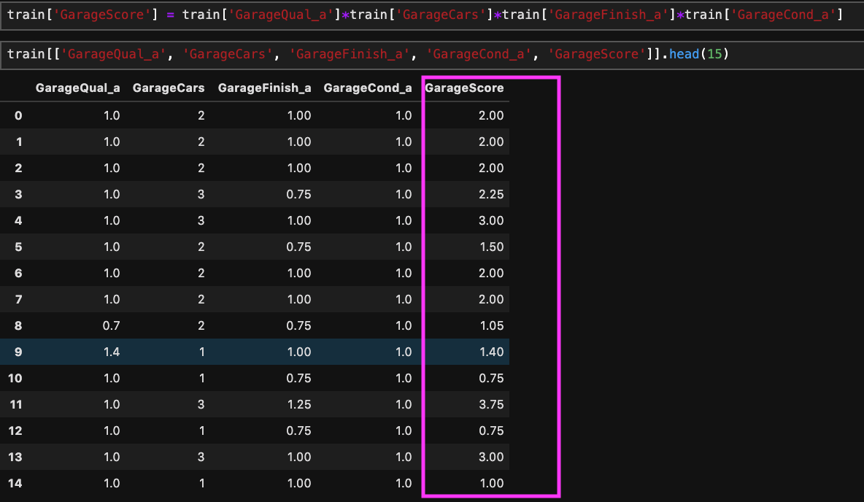
garagescore
GarageScore = GarageQual * GarageCars * GarageFinish * GarageCond

Slide 11

Models:
Ridge
Lasso
RandomForestRegressor
GradientBoostingRegressor
Support Vector Regressor (SVR)

Slide 12
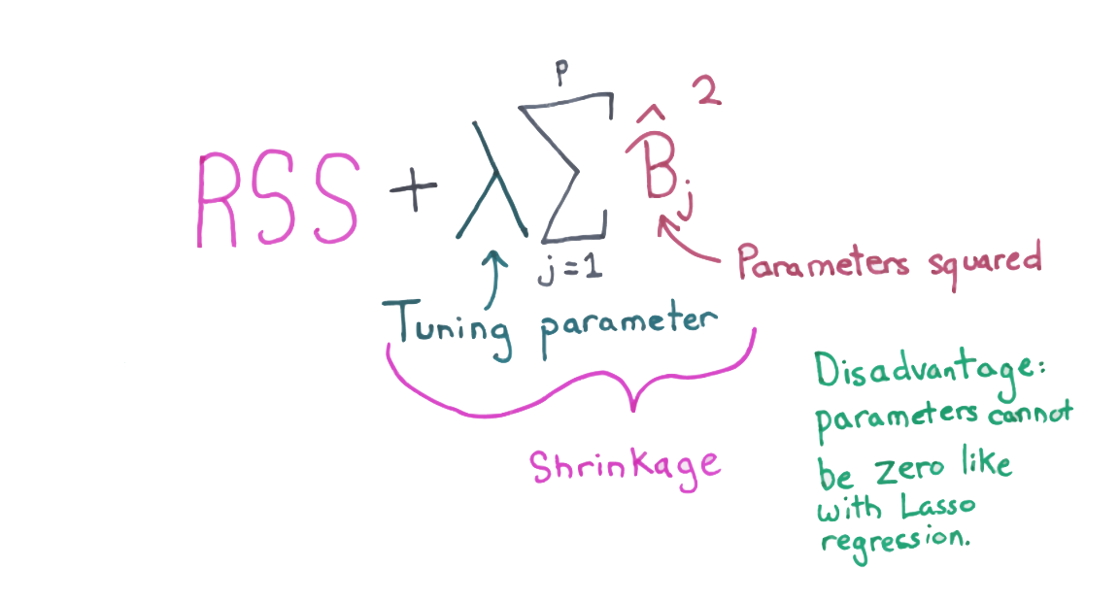
Ridge
ORIGINAL DATASET
Train score is: 0.932
Test score is 0.885
GridSearchCV best_score is 80.15%
Parameters: alpha: 1
max_iter: 10
WITH SCORES AND FLAGS
Train score is: 0.896
Test score is 0.823
GridSearchCV best_score is 82.11%
Parameters: alpha: 7
max_iter: 10
Notes:
There is moderate overfitting here with an average R2 of 80%
For the model with scores and flags, there is also moderate overfitting with a higher Gridsearch average R2 of 82%
The higher alpha, which penalizes high dimensionality and reduces distortions by by overly large coefficients might account for the higher R2.
What was interesting was that there wasn’t higher penalization for the dataset with 212 features, but higher penalization for the one with only 71.

Slide 13
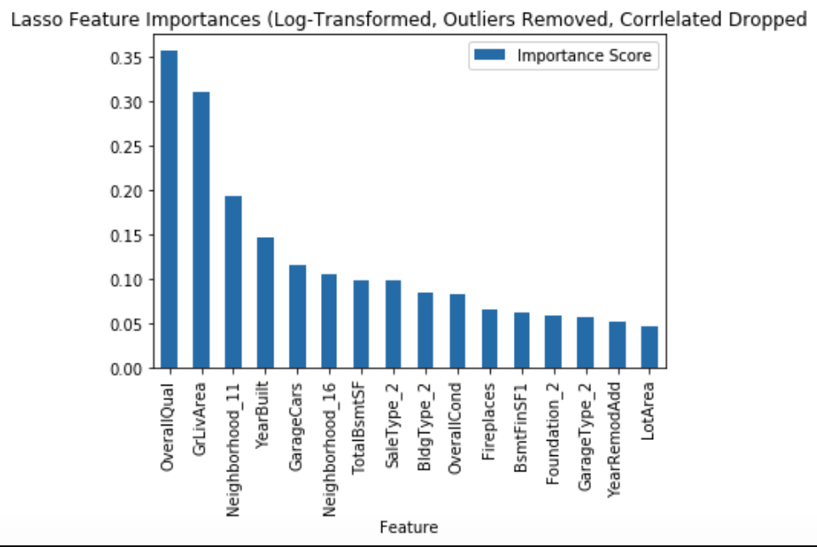
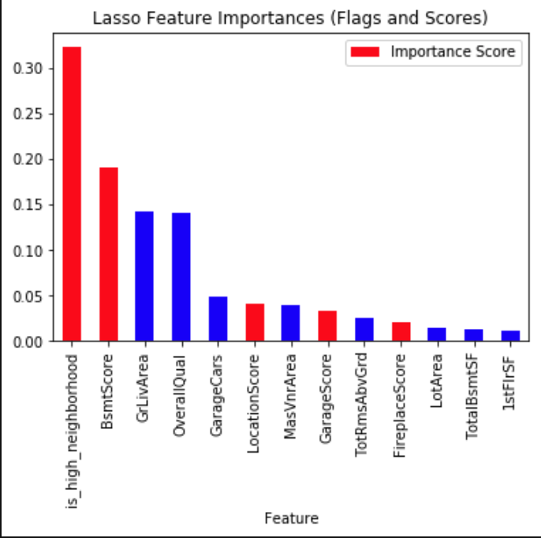
lasso
ORIGINAL DATASET
Train score is: 0.946
Test score is 0.856
GridSearchCV best_score is 80.83%
Parameters: alpha: 0
max_iter: 46
selection: cyclic
WITH SCORES AND FLAGS
Train score is: 0.884
Test score is 0.821
GridSearchCV best_score is 70.43%
Parameters: alpha: 0
max_iter: 6
selection: random
Notes:
I chose to start with Ridge and Lasso rather than normal MLR because I figured that with the high dimensionality, regularization made sense from the get-go
What was interesting was that, Gridsearch chose alpha=0, which reduces lasso to just the unpenalized version of MLR, that might account for the large coefficients and low accuracies.
In the first chart, you see how the normal MLR is sensitive to features with high dimensionality like neighborhood, buildingtype, rank high in the list of feature importance, due to the categorical variables being OHE, resulting in 212 feature space. Also the large coefficients.
In the second chart, scores and flags aggregated information as well as incorporated domain knowlege and you see that several of them appear in feature important. Neighborhood and location seem to be impt features, as well as the GrLivArea and OverallQual, whose coefs were greatly reduced.

Slide 14

Elasticnet
ORIGINAL DATASET
Train score is: 0.946
Test score is 0.856
GridSearchCV best_score is 80.83%
Parameters: alpha: 0
L1 ratio: 0.1
max_iter: 46
WITH SCORES AND FLAGS
Train score is: 0.797
Test score is 0.761
GridSearchCV best_score is 78.26%
Parameters: alpha: 1
L1 ratio: 0.1
max_iter: 11
Notes:
The performance of ElasticNet was midway, and unsurprisingly because it incorporates both ridge and lasso.
Similarly, the alpha is either zero or very low (1), so the penalization term isn’t very high, resulting in a model very close to MLR. Even though the L1 ratio is very low at 0.1, that was enough to throw off the model accuracy.

Slide 15
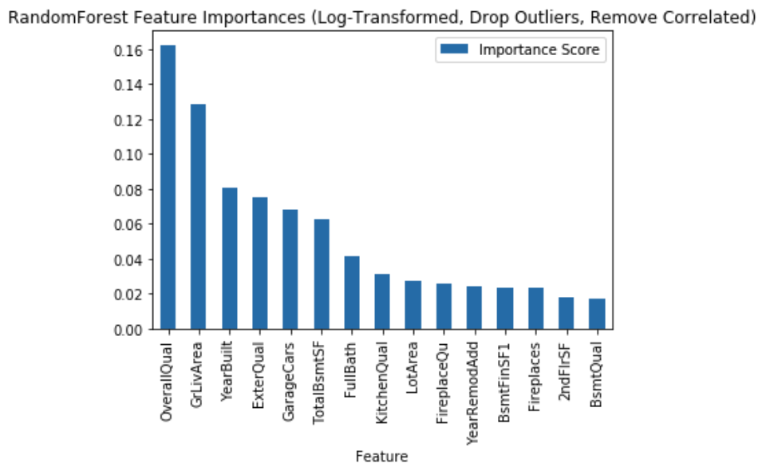
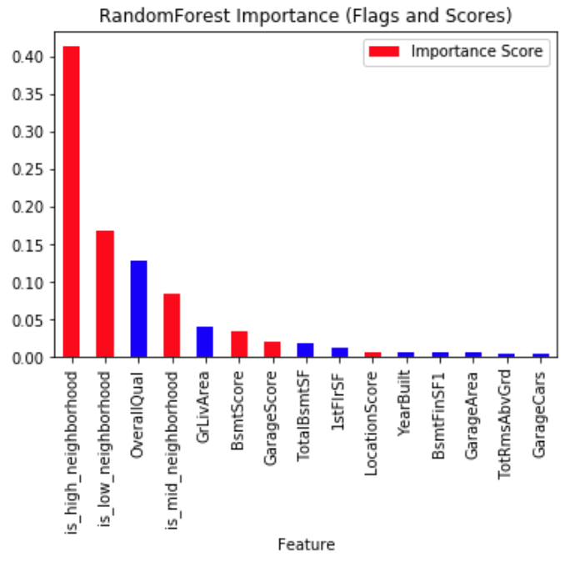
Random forest
ORIGINAL DATASET
Train score is: 0.912
Test score is 0.856
RandomizedSearchCV best_score is 85.15%
Parameters: n_estimators: 215
min_samples_split: 6
min_samples_leaf: 3
max_features: 40
max_depth: 6
WITH SCORES AND FLAGS
Train score is: 0.939
Test score is 0.872
RandomizedSearchCV best_score is 89.16%
Parameters: n_estimators: 928
min_samples_split: 4
min_samples_leaf: 8
max_features: 45
max_depth: 9
Notes:
For the original dataset there was moderate overfitting with a Randomized search best_score of 85%
For dataset with flags/scores, it was similar overfitting with a Randominzed search best_score of 89%
For both models, Ilimited the max_features so that there was less susceptibility to overfitting. For the original dataset, the number of trees RandomizedSearch CV found was much lower th
*Garage
*Basement
Kitchen
Fireplace

Slide 16
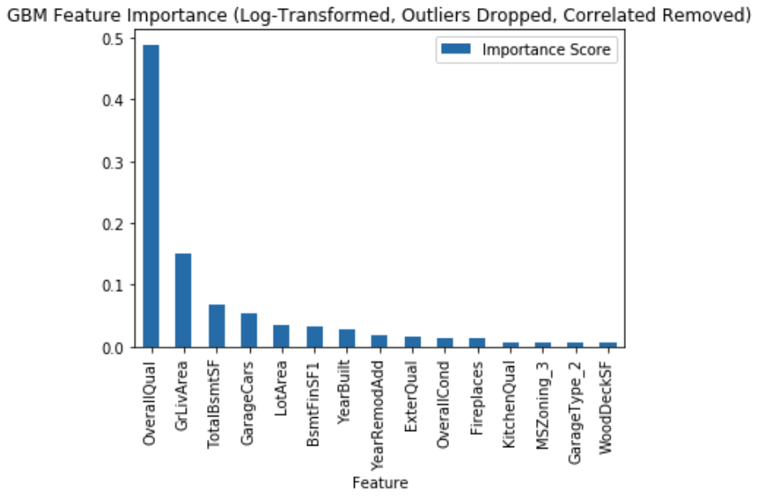
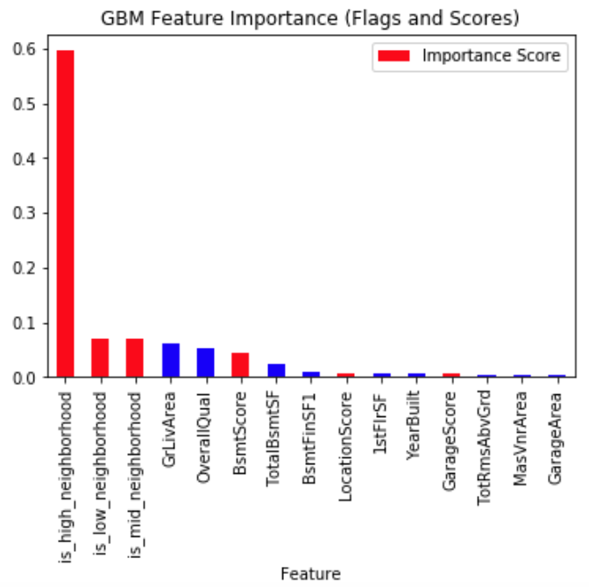
Gradient Boosting (GBM)
ORIGINAL DATASET
Train score is: 0.983
Test score is 0.899
RandomizedSearchCV best_score is 89.05%
Parameters: subsample: 0.9
n_estimators: 857
min_samples_split: 2
min_samples_leaf: 4
max_features: 35
max_depth: 4
WITH SCORES AND FLAGS
Train score is: 0.999
Test score is 0.9089
RandomizedSearchCV best_score is 90.62%
Parameters: subsample: 0.9
n_estimators: 928
min_samples_split: 12
min_samples_leaf: 1
max_features: 20
max_depth: 8
Notes:
For the original dataset there was moderate overfitting with a Randomized search best_score of 89%
For dataset with flags/scores, it was moderate overfitting with a Randominzed search best_score of 91% (tune min samples per leaf)
OverallQual, GrLivArea, BsmtSquareFoot, GarageCars, LotArea
Is_high/is_mid/is_low, GrLivArea, OverallQual, BsmtScore
*Basement
*Garage
Fireplace

Slide 17
Support vector regressor (SVR): polynomial kernel
ORIGINAL DATASET
Polynomial kernel
Train score is: 0.859
Test score is 0.903
GridSearchCV best_score is 81.899%
Parameters: C: 10
degree: 1
epsilon: 0.1
kernel: ‘poly’
WITH SCORES AND FLAGS
Polynomial kernel
Train score is: 0.873
Test score is 0.846
R-squared is 0.846
GridSearchCV best_score is 81.888%
Parameters: C: 1
degree: 1
epsilon: 0.1
kernel: ‘poly’

Slide 18
Support vector regressor (SVR): RBF kernel
ORIGINAL DATASET
RBF kernel
Train score is: 0.939
Test score is 0.92
GridSearchCV best_score is 88.572%
Parameters: C: 10
epsilon: 0.1
gamma: 0.001
kernel: ‘rbf’
WITH SCORES AND FLAGS
RBF kernel
Train score is: 0.945
Test score is 0.871
R-squared is 0.871
GridSearchCV best_score is 86.136%
Parameters: C: 10
epsilon: 0.1
gamma: 0.001
kernel: ‘rbf’
Notes:
The better performing model, has a hard margin at C=10, and is less tolerant of violations, the epsilon is relatively small, allowing many support vectors. Because gamma is so small, the peaks are fatter, and don’t capture as fine-grained detail as if gamma were larger. The smaller the gamma, the more the SVR model resembles MLR, similar to what happened with lasso, with alpha=0 for both gridsearches

Slide 19
considerations
1. Could use KNN clustering for certain columns that have distance attributes (neighborhood, condition)
2. Try binary encoding, dropping features that did not appear in lasso, random forest, and gradient boosting and rerunning models
Notes:
Utilize more domain knowledge:
Look more at valuation (comparative market analysis, CMA)
Look more at location, clustering, distance methods (SVM, KNN (neighborhoods)
Look more at seasonality (even though doesn’t show up in feature importance)

Slide 20

takeaways
is_high_neighborhood
OverallQual
GrLivArea
GarageScore
BsmtScore
Notes:
Neighborhood: But you can help boost the value and get a better asking price
-boost your curb appeal. Keep lawn mowed, tidy up your landscaping, have trees trimmed, add colorful flowers if the season permits. If the neighbors beside you have a real eyesore of a home, consider installing a fence and adding taller landscaping features such as screens with vines to diguise as much of it as you can
-Show your home at the right time: season, time of day (if streets gain a few run down parked vehicles in the evening, schedule showings during the day. If mornings and afternoons are packed with school traffic, focus on midday, if not sure, take a drive around the area at different times of day to see what might stand out to you that you didn’t notice before.
-pricing is important, so consider owner-financiing part or all of the price of the home, allow room to negotiate down
-work with the right agent. Some specialize in listing and promoting hard-to-sell properties. If he recommends working with a home stager, it’s worth giving that a shot.
OverallQual/YearBuilt/YearRemodelAdded/ExterQual: Espcially for the base models a lot of the quality predictors showed up as important. So be sure to make all necessary repairs and home improvement projects (kitchen, bathroom, window installation, etc.), any certificates of compliance like deck permits, shed permits, fence permits
SquareFootage: Doing what you can to maximize the space
GarageScore: having a Buyers view garages as an attractive addition to a home, and either building a garage or improving an existing one, yield about a 81% ROI (average a garage can cost around $27k and will increase the resale value by about $21k)
Bsmt: A finished basement can also add real estate value, but about 70% of above ground, but making the basement area a second living space could be a good investment in helping buyers envision a potential rental or in-law suite.
Business savvy of buyers and the importance of pricing a property accurately
Since ‘OverallQual’ appears across all models, under both sets of preprocessing, the overall material and finish of the house is extremely importance.. staging and open houses
Neighborhood is a very important factor in resulting Saleprice, especially in more affluent neighborhoods, where staging

Slide 21
QUESTIONS?

