Slide 1
Lendingclub project
Presented by: sophia lian & paul sprouse

Slide 2
Contents
Business Case: Help investors time when borrowers are
likely to prepay or default.. LendingClub methodology
2. Analysis:
- EDA
- Survival Analysis (competing risk): Identify timeline of
risky events
3. Simulate Scenarios w/ guidance from model
prediction and survival analysis
4. Takeaways
Notes:
LendingClub is a platform that brings together investor and customer. LendingClub makes their money from origination fees.
-We thought it would be helpful to build a dashboard to help investors identify borrowers who might be most profitable to the investor
-Investors make their money from borrowers who make on-time payments through the length of their loan
-They lose potential profit on borrowers that prepay and even more on borrowers who default/delinquent
-It turns out that the difference is behavior between the 36 month and 60 month borrowers diverge noticeably, so we wanted to capture the time dimension in the P&L potential of customers, and compared the 36mnth and 60mnth group across diff features (like fico score, grade, emp_length, etc).
-We approached this project as a case study in customer churn. How long will a customer stay a customer before they leave.. How long will a borrower make on-time payments before they either prepay or default, so we decided to use survival analysis to predict when these events would occur.

Slide 3
Lendingclub methodolgy
Base interest rate (borrower’s credit characteristics):
7 grades (A-G)
7 subgroups (1-5) of interest rates
Base interest rate + risk multiplier
Loan amount
Term

Slide 4
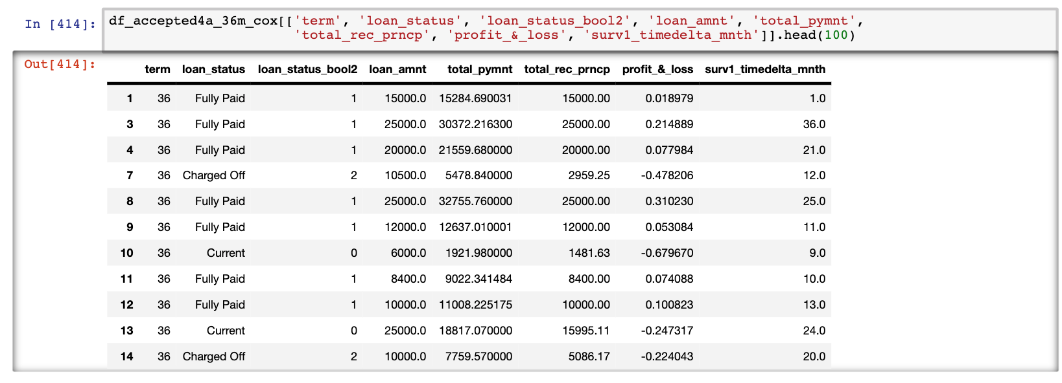
Use case: gauged by its impact to business
Spotting loans which will eventually default or prepay with higher accuracy
Learning the hazard ratios of default/prepayment for different groups over tenure of loan
Construct loan portfolios with superb return-risk profiles
Educate the lenders about the importance of loan diversification
Notes:
-gauged by its impact to business
-understanding the borrower loan repayment behavior is vital to the success of loan business
-How about loan counts stratified into years and loan purposes/loan grades?
Are loans with higher funded amounts harder to be paid-in-full?
Please analyze the percentages of non-completed loans in each loan grade/subgrade
Make sure that your analysis takes into account of **loan-term**.
Do you see major differences on the patterns with different loan-terms?
Do '60 months' (5 years) loans often get terminated at the end of the 5 years

Slide 5
Profit & Loss: loan status (36m vS. 60m)
Prepaid: 12% median profit
Default: 51% median loss

Slide 6
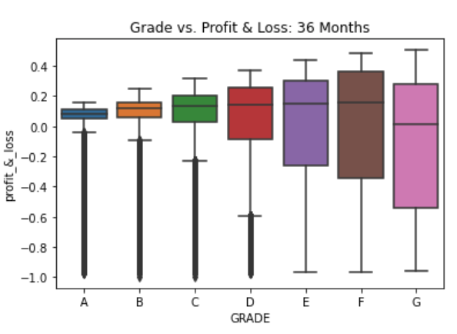
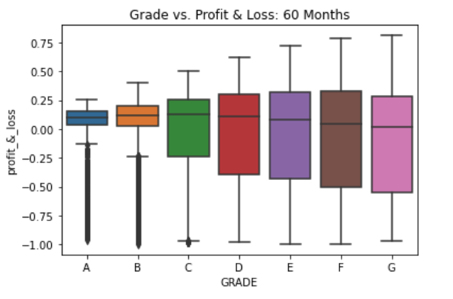
Profit & Loss: Grade (36m vS. 60m)
Notes:
Overall, the overall profit potential still trends up for F grade loans vs G grade for 36 mnths vs 60mnths
The difference is that for the 36 month borrowers the potential profitability peaks at grade F borrower and then goes down, while for the 60 mnths borrowers it stays flat and just gets worse.

Slide 7
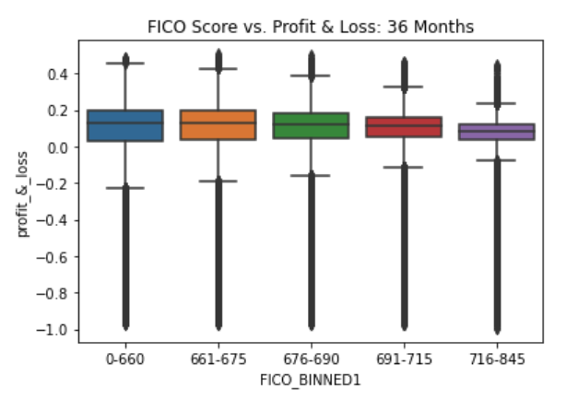
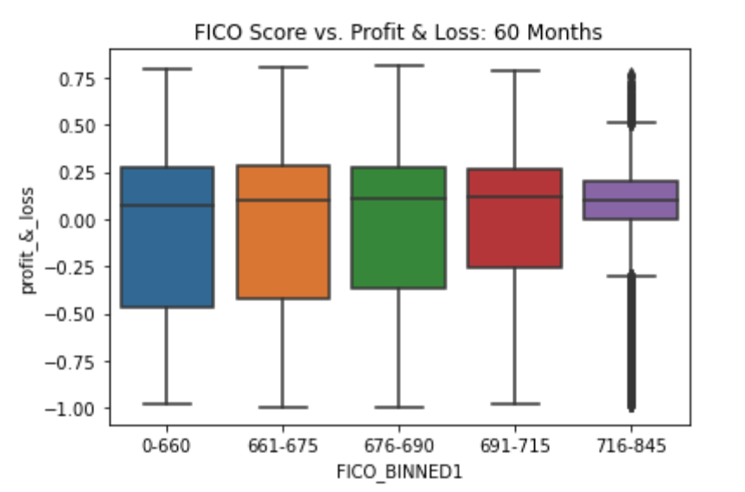
P&L: fico score (36m VS. 60m)

Slide 8
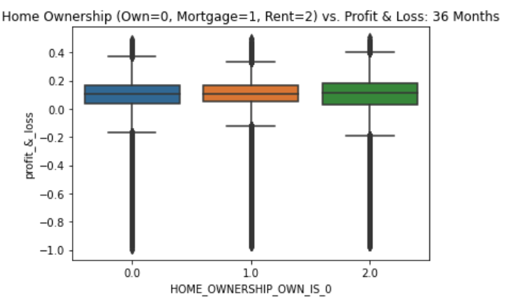
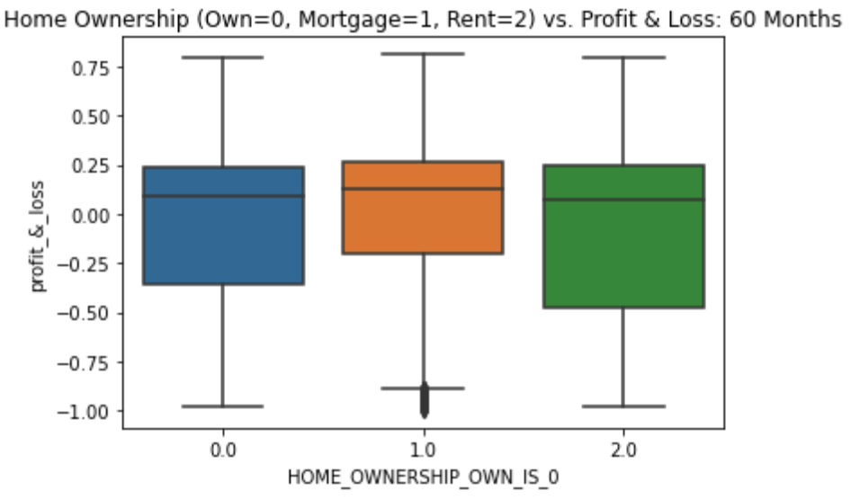
P&L: home ownership (36m vS. 60m)
Notes:
Not much variability for 36mnth borrowers, vs great variability for 60 month borrowers, with renters being least profitability

Slide 9
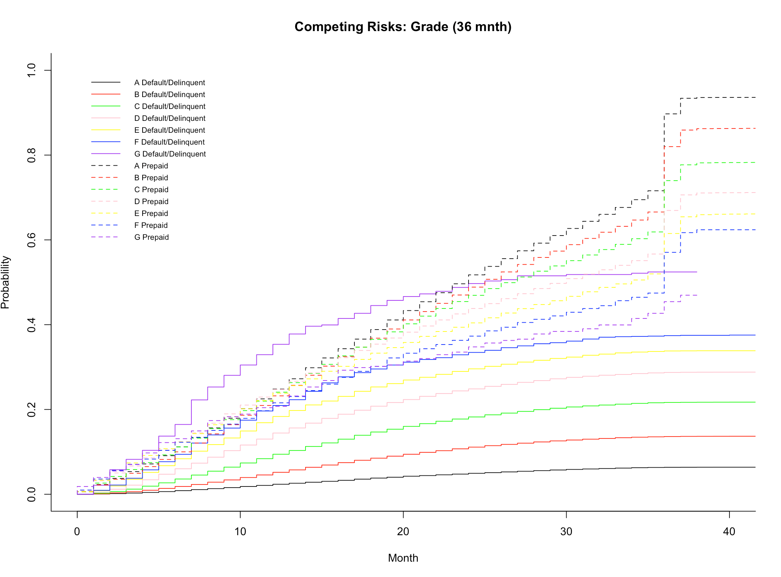
Competing risk: grade (36m)
stat pv
Default/Delinquent 11395.780 0
Prepaid 7683.197 0
Notes:
As mentioned, we approached this partly as a case in customer churn.. How long will a borrower be profitable before they default or prepay. And to determine this we used survival analysis to get the probability of either prepayment or default at a certain time.
This type of analysis is also used in epidemiology when predicting time to relapse or death, and in quality control when predicting equipment failure.
----- Meeting Notes (2/19/21 16:00) -----
-This graph shows the incidence of prepayment of default based on loan grade, divided btw 36mnth and 60mnth

Slide 10
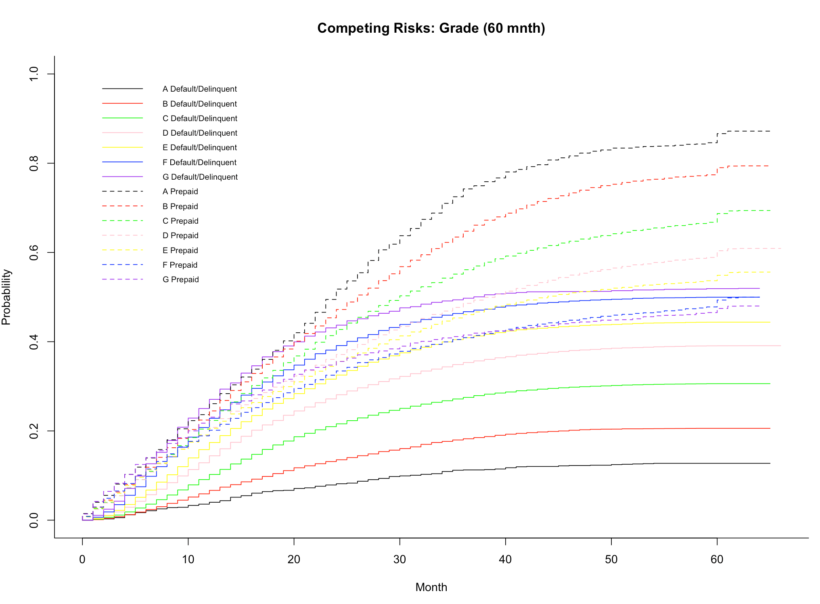
Competing risk: grade (60m)
stat pv
Default/Delinquent 3330.647 0
Prepaid 2564.992 0
Notes:
-The prepaid and default group here overlap to a much greater degree than on other features.
-You don’t see the high rate of default for the G grade riskiest borrowers that you see for the 36 mnth loan.
-By month 60 about 50% of both F and G loans have defaulted.
-Less risky borrowers prepay at much higher rate (in decreasing order), and default at much lower rate

Slide 11
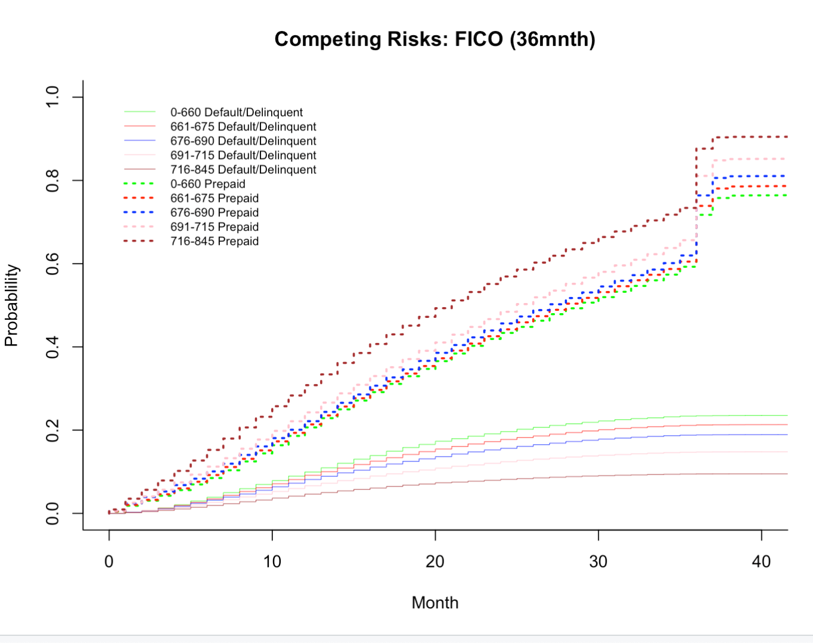
Competing risk: fico (36m)
Notes:
-Looking at the FICO score, it’s interesting that there’s the split in behavior between the prepayment group and the default group, which you don’t see with the 60 month loans.
-This translates to greater predictive power looking at the FICO score for 36M borrowers vs 60mnth
-The 50% prob of prepayment for the ones with best FICO score is 20 mnths whereas for the next best is 30 months.
-And again the predictive power of these survival curves for 36 mnts vs 60 mnth is that you see the curve for those that default is very flat, vs 60 mnth which is much steeper

Slide 12
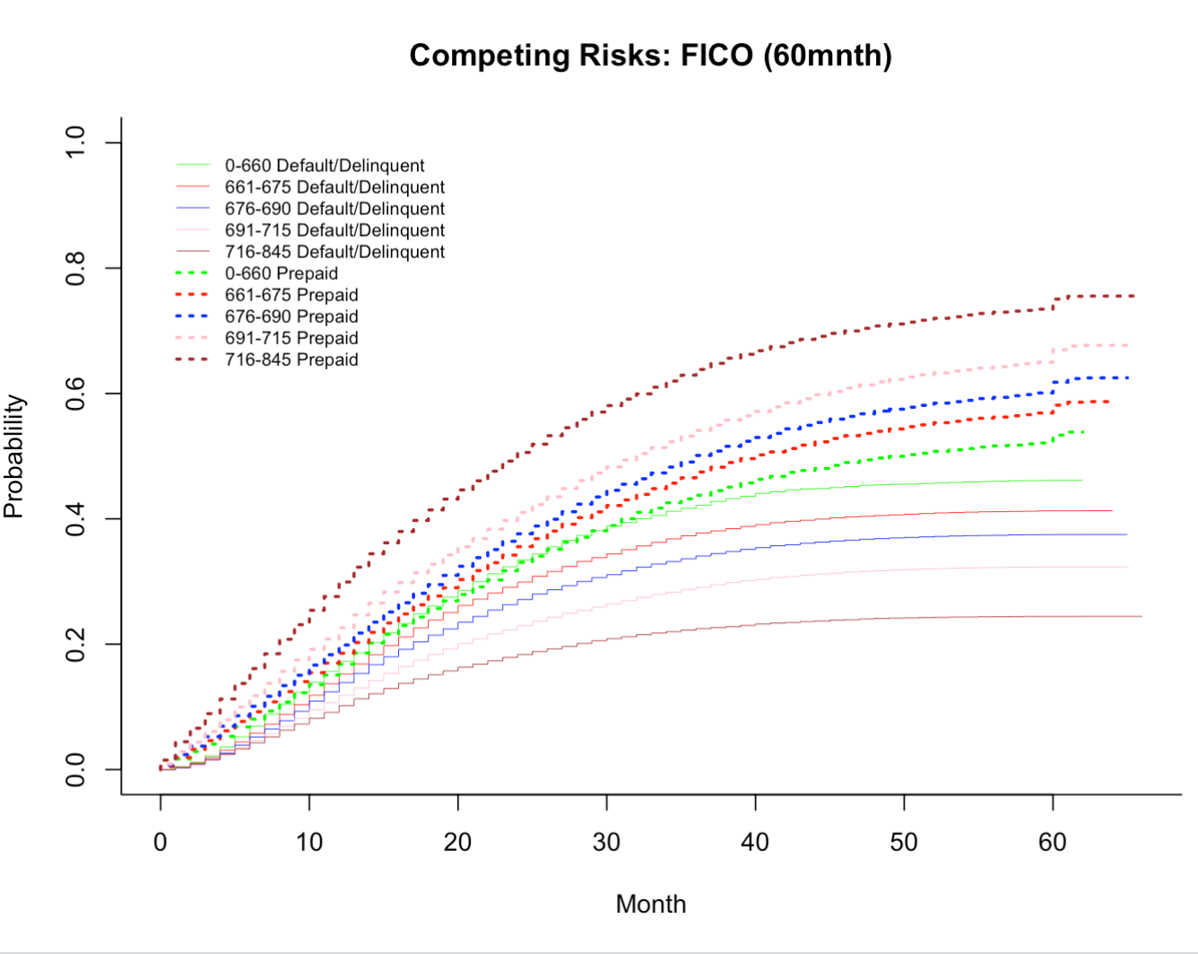
Competing risk: fico (60m)

Slide 13
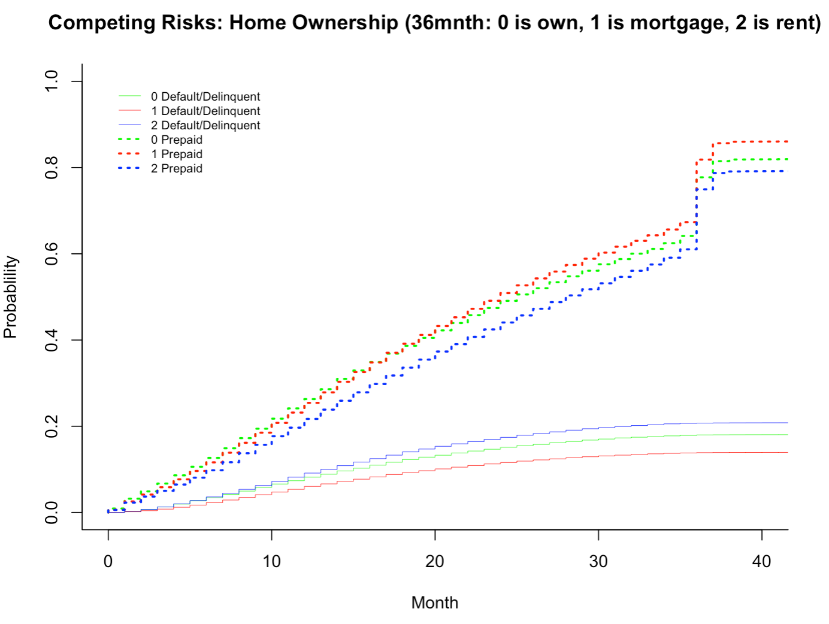
Competing risk: home ownership(36m)
Notes:
-mortgage most likely to prepay, renters least likely
-renters most likely to default, mortgage holders least likely
-Trend repeats for 60m with steeper rates of default

Slide 14
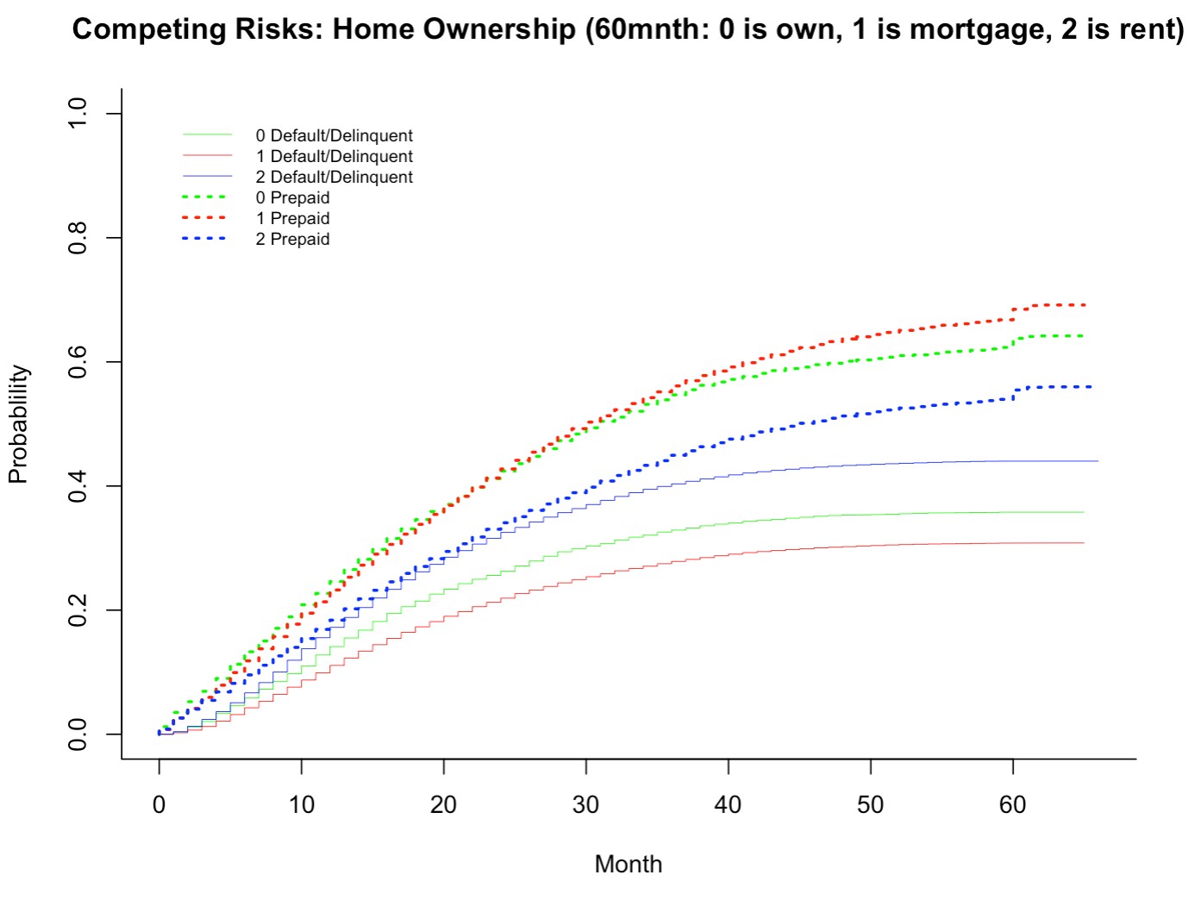
Competing risk: home ownership(60m)

Slide 15
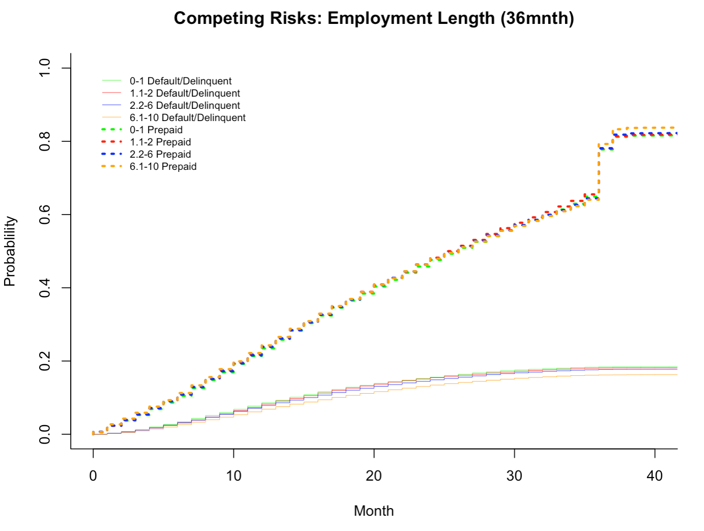
Competing risk: Employment length(36m)
Notes:
-I chose these curves to show the type of information that you can glean from them, like predicabilty power, apart from just the probability at a certain point in time.
-The employment length doesn’t really affect either the prepaid group or the default group. However, prepayment occurs much faster and steadily than default.

Slide 16
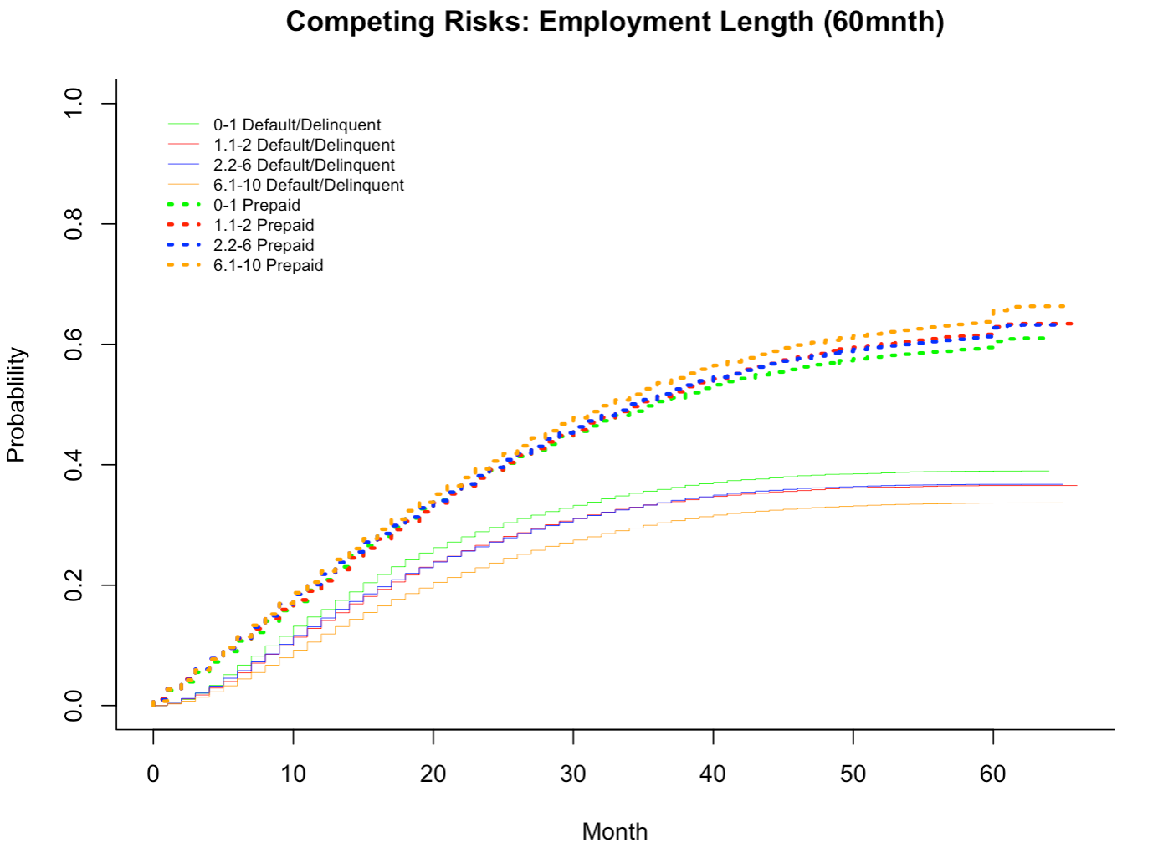
Competing risk: Employment length(60m)

Slide 17
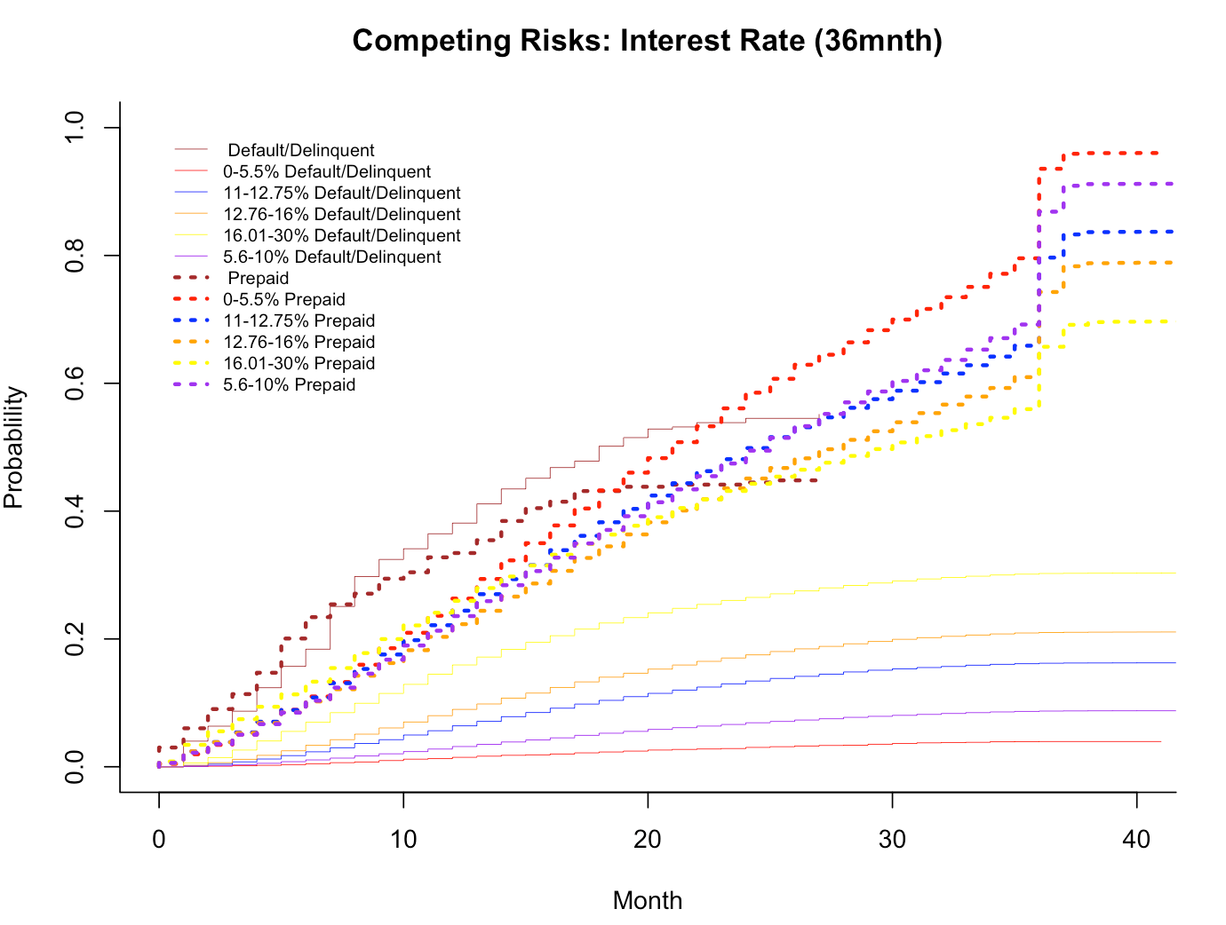
Competing risk: Interest rate (36m)

Slide 18
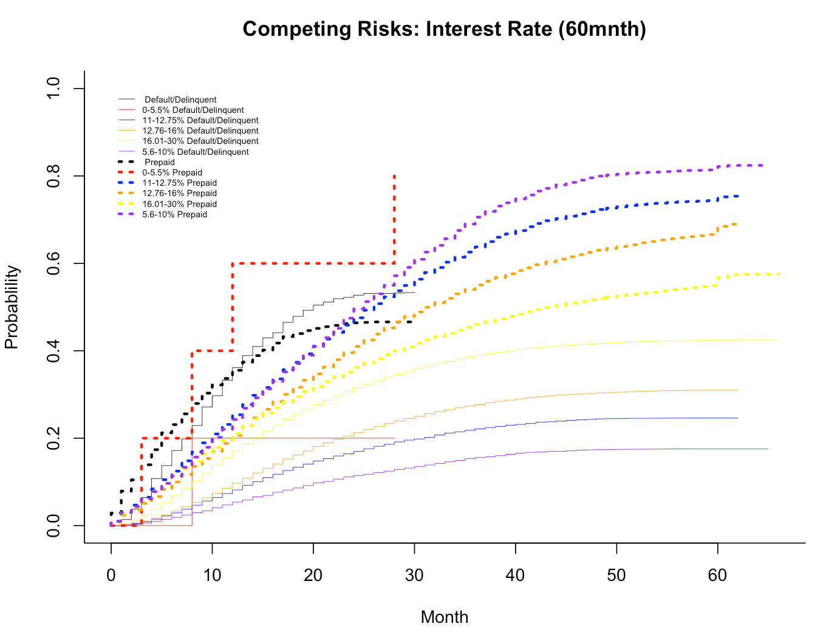
Competing risk: Interest rate (60m)

Slide 19
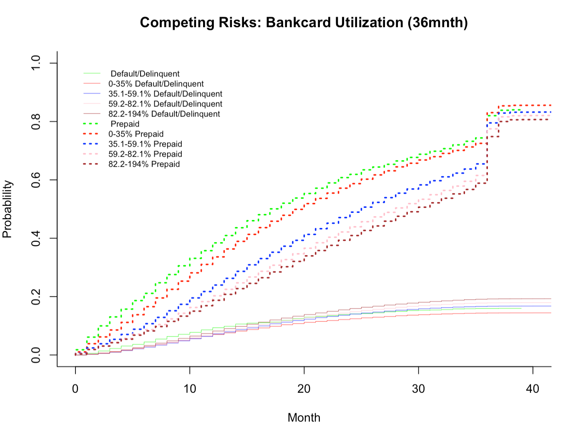
Competing risk: Bc Utilization (36m)

Slide 20
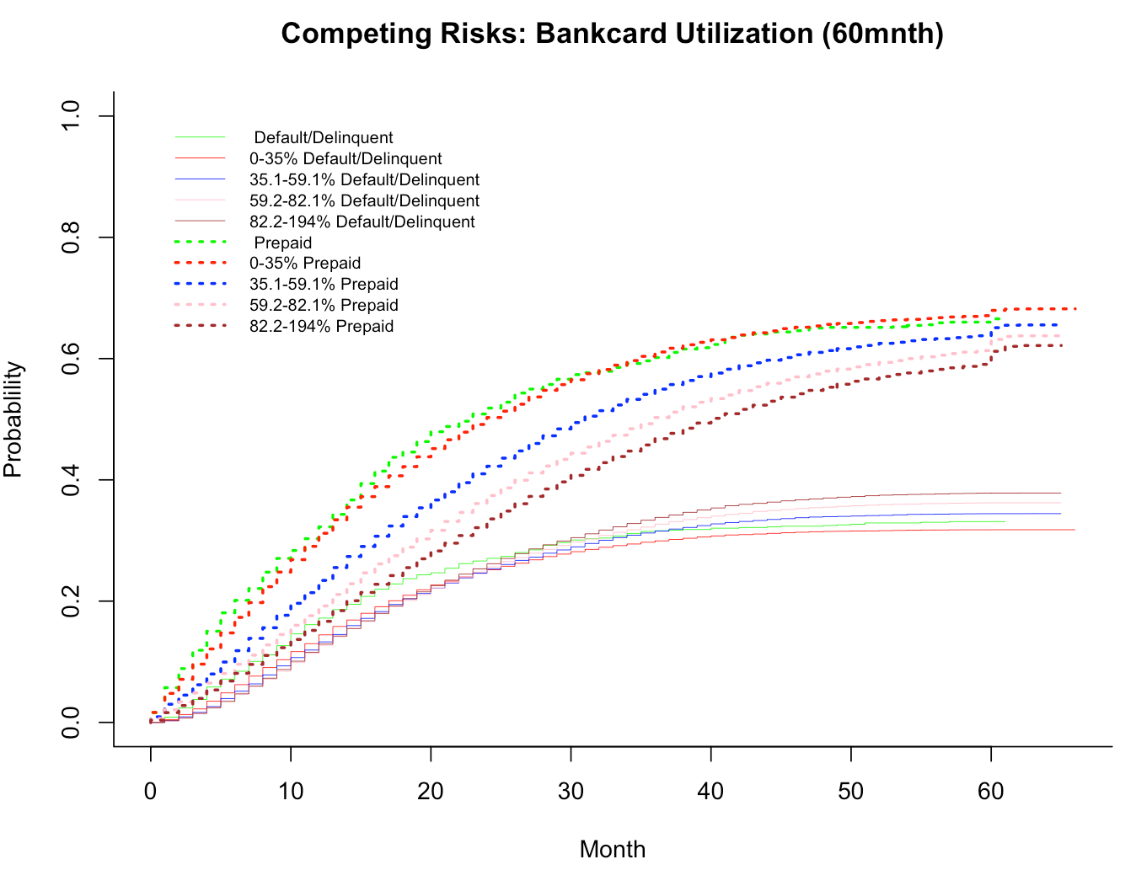
Competing risk: Bc Util (60m)
Notes:
The divergence occurs around month 20.

