Slide 1
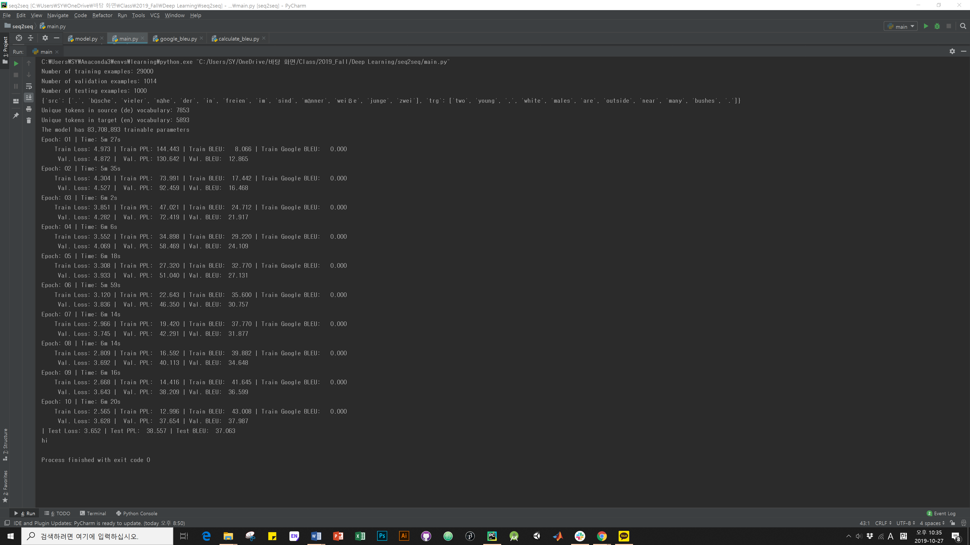
1000,1000,4,forward

Slide 2
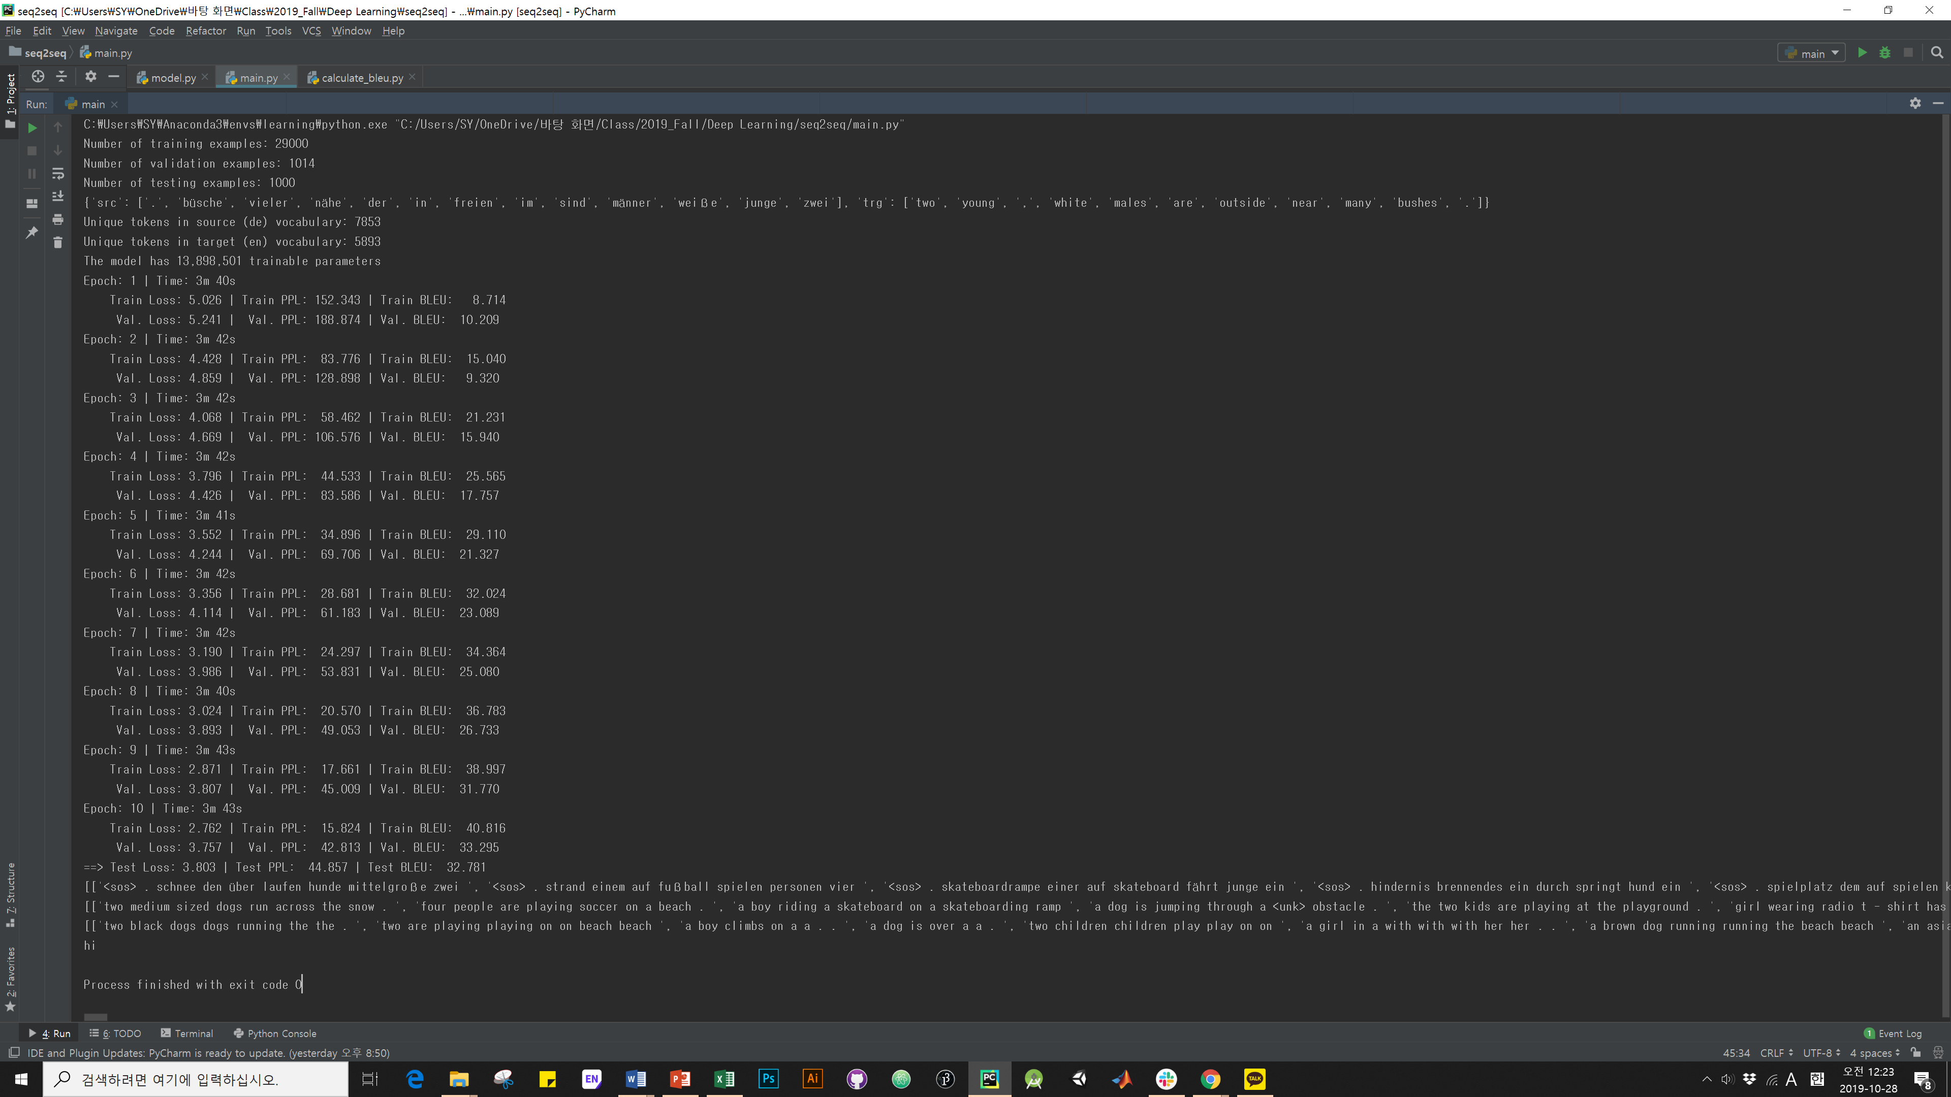
32.
512,256,2,reversed

Slide 3
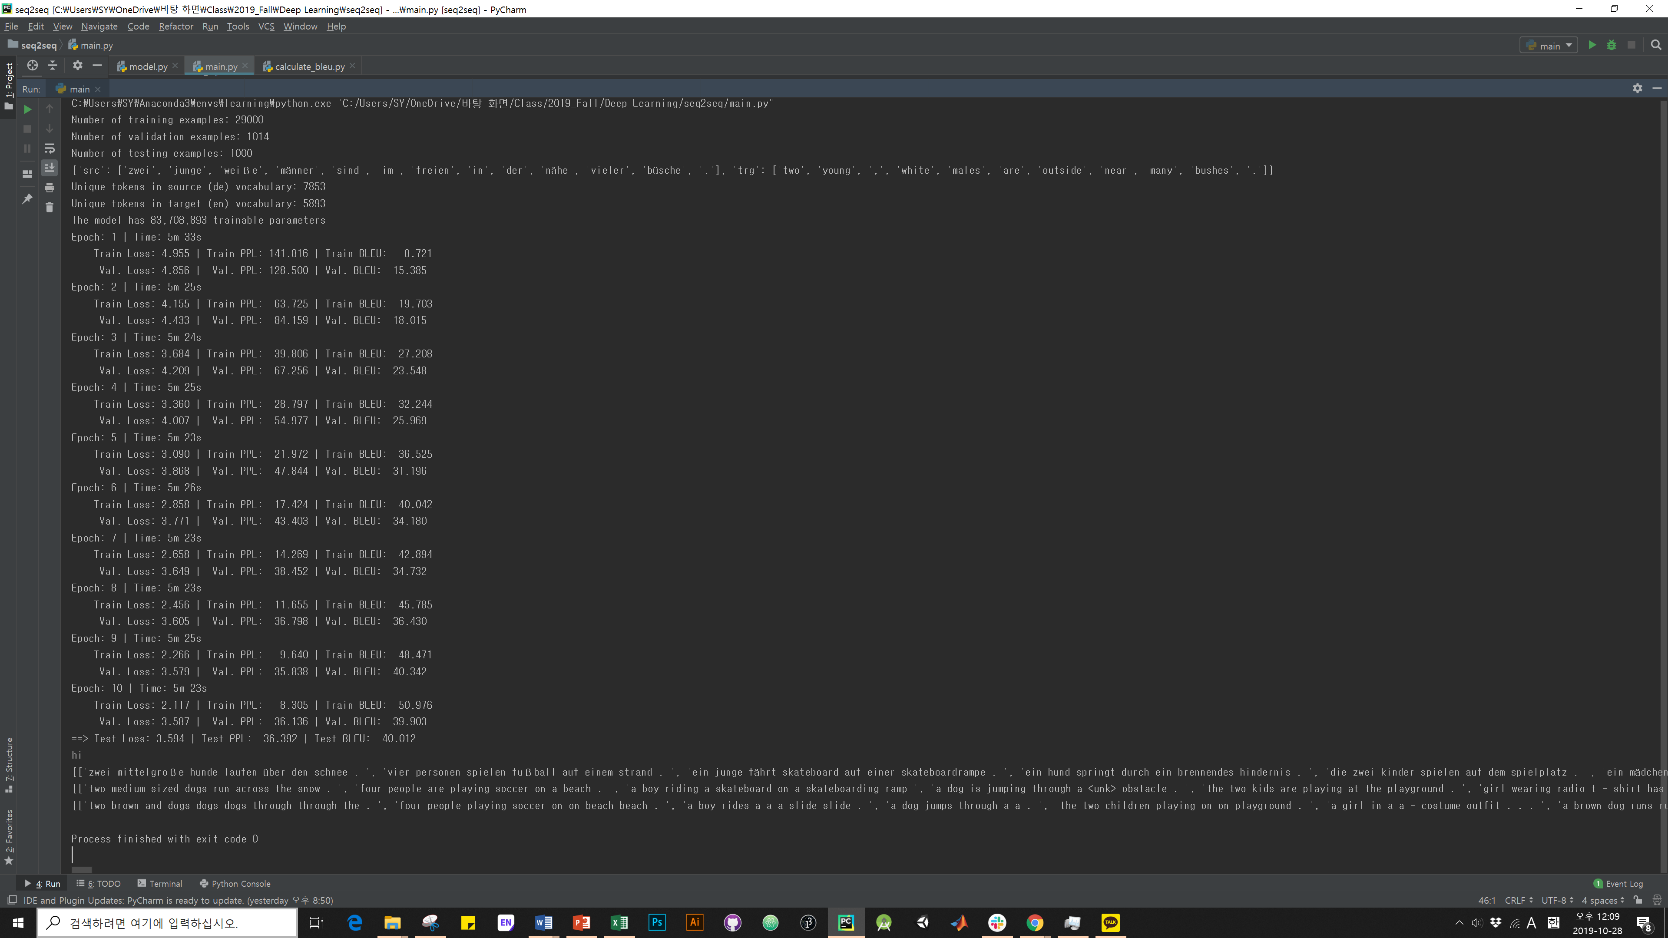
1000,1000,4,reversed

