Slide 1
Tao of Test-Driven Development
http://github.com/sl4mmy/presentations/tree/master
By Kent R. Spillner <kspillner@acm.org>
Copyright is held by the author/owner(s).
OOPSLA'09, October 25–29, 2009, Orlando, FL, USA.
ACM 09/10.
Notes:
Beginners: introduction to test-driven development
Skeptics: an opportunity to experiment away from the zealotry
Intermediates: answers to questions and guidance
Experts: practice the fundamentals

Slide 2
“Beware of bugs in the above code; I have only proved it correct, not tried it.”
-Donald Knuth
Notes:
Testing is a critical aspect of every software development process. Or at least, it should be! We need to treat testing as a first-class citizen, and we (as developers) need to learn how to think like testers.

Slide 3
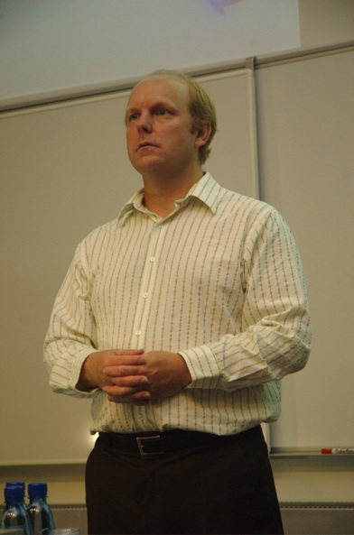

Kent Beck
Image from Improve It (http://www.flickr.com/photos/8512982@N05/1574023621/)
Licensed under the terms of the CC BY-SA 2.0 license (http://creativecommons.org/licenses/by-sa/2.0/)
Notes:
Kent Beck rediscovered test-driven development: punch-card programmers desk-checked every line of code before submitting it because feedback cycles were so long and computer time so expensive

Slide 4
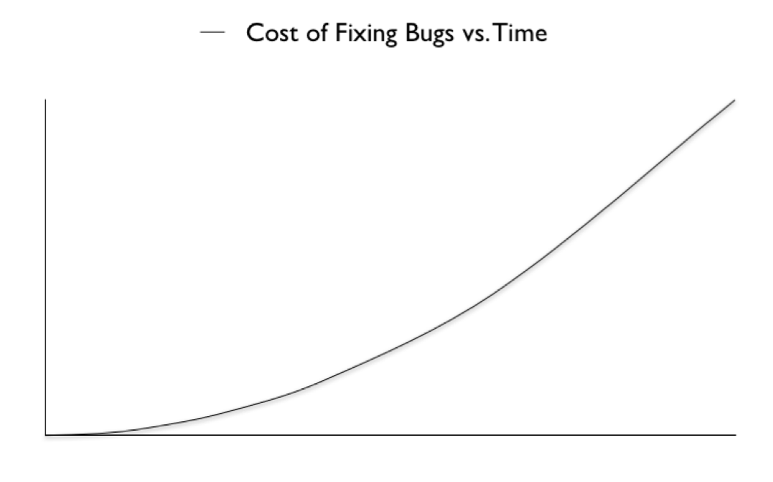
The Problem
Notes:
The longer it takes to fix bugs, the more it costs
Consider extremes: costs nothing to fix bugs immediately, but potentially millions in production

Slide 5
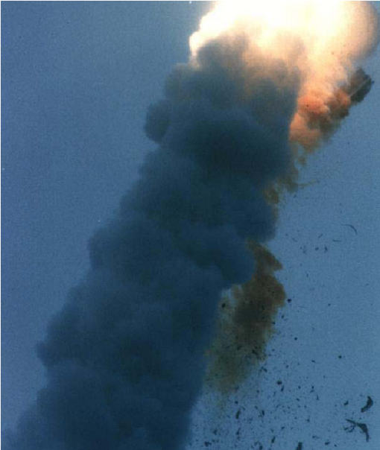
Worst-Case Scenario
Notes:
1996, software failure causes ESA’s Ariane 5 rocket to veer off course 37 seconds after launch and self-destruct. 1999, NASA’s Mars Orbiter crashes into the red planet because of bug in navigation software (metric/imperial units), 9 MONTHS after launch! ($157 million)

Slide 6
If you even test at all!
As one of the last things before releasing,
testing is usually one of the first things cut!
Notes:
Raise your hands: who has cut some testing at the end of a project in order to ship?

Slide 7
A Simple Hypothesis:
Testing first finds more bugs, more quickly
allowing you to fix them more affordably
Notes:
Ideally, every line of code will have been tested, and every bug will have been found immediately when the cost of fixing is still zero

Slide 8

Enter Test-Driven Development
Image from testdriven.com (http://www.testdriven.com)
Licensed under the terms of the CC BY-ND 3.0 license (http://creativecommons.org/licenses/by-nd/3.0/us/)
Notes:
The mantra of test-driven development: RED - GREEN - REFACTOR. Write a test, watch it fail. Write the code to make it pass, and then clean up after yourself before moving on.

Slide 9
RED
Write a test to verify the correctness of the next feature you’re about to add
Run it, watch it fail

Slide 10
“Testing shows the presence, not the absence of bugs”
-Edsger W. Dijkstra
Always, always, always run that test and watch it fail!
Notes:
You’re about to change behavior! Unless you verify the behavior actually changed, you can’t verify the correctness of the change!

Slide 11
GREEN
Do the simplest thing that can possibly work
Run it again, watch it pass

Slide 12
Hard-code values, allocate single storage instead of collections, perform single calculations instead of looping
Notes:
The goal is to make the test pass, not craft the perfect implementation! Perfection, beautiful code, performance all come later; right now we’re just focused on verifying the code works

Slide 13
REFACTOR
Refactor mercilessly to eliminate duplication and technical debt
Clean your code before continuing on
Notes:
Leave the code better than you found it. Refactoring is not an exercise in crafting perfect implementations. It is about tidying up after yourself. Always, always keep things simple.

Slide 14
LATHER, RINSE
REPEAT
Notes:
Do it over and over and over again. Don’t stop until your project is done.

Slide 15
Pleasant Surprises
Lower costs of fixing bugs is just the tip of the iceberg!
Notes:
Test-driven development doesn’t just save money, it saves A LOT of money!

Slide 16
More confident: comprehensive tests let you experiment boldly
Notes:
No more tip-toeing around landmines! Play around to your heart’s content; if you break any existing functionality, the tests will let you know immediately.

Slide 17
More productive: more time spent testing means more time spent programming, less debugging
Notes:
Writing tests is faster than stepping around in a debugger. You accomplish more in an 8 hour day writing code for 4 hours and tests for 4 hours, then writing code for 4 hours and debugging for 4 hours

Slide 18
More reliable: you’re writing regression tests that keep you from taking 2 steps forward, 1 step back
Notes:
Those tests will tell you immediately if new code breaks old code. Steady forward progress

Slide 19
More agile: you can turn on a dime at a moment’s notice!
Notes:
Well-tested code is reusable code; can be repurposed quickly and with confidence

Slide 20
More Than Just Tests
Test-driven development goes beyond traditional testing

Slide 21
Better code, simpler designs
Automated programmer tests don’t just verify behavior, they also exercise your APIs
Notes:
Tests are the first users of your code. The act of writing the tests will signal immediately if your production code is going to be complicated or error-prone to use

Slide 22
Passing tests are executable documentation that is never (rarely) out-of-date
Notes:
Of course, if tests are carelessly maintained they grow stale and out-of-date. But if you’re honest about maintaining those tests, they will tell you exactly what the system does and does not do

Slide 23
And if you give your tests descriptive names, they will also communicate why the system behaves a particular way
Notes:
You are responsible for writing two aspects of tests: the tests themselves, and their names

Slide 24
Tests as Communication Tools
Tests are the best place for new team members to start
Notes:
New members can learn about the system by studying the tests. Writing new tests is the best way for them to start contributing

Slide 25
Tests Make Good Bookmarks
Failing tests are natural stopping places
When you return to the code, pick up where you left off by turning that red test to green

Slide 26
More Bang for Your Buck

Slide 27
Red Before Green
Ensure your tests are correct
Read and re-read your tests to confirm they actually verify the correct behavior
Notes:
We’re not writing tests for the sake of writing tests, we’re writing them for a purpose! Remember to always run those brand new failing tests so you can see that red bar

Slide 28
Know What You’re Doing
Read and re-read tests before modifying or deleting them
Notes:
Assume every test exists for a reason

Slide 29
Test Everything
Nothing is “too simple” to be tested
Test any code that could break

Slide 30
Text
If code is simple to write, it should be simple to test
Don’t be lazy!
Notes:
No excuses! Save yourself and others from the headache of hours of debugging your “simple” code to find those nasty lurking bugs

Slide 31
Give your tests descriptive names that explain both what is being tested, and why

Slide 32
Tests Drive the Code
Write a test to verify the trivial “happy path”
Then verify the “sad path”
Then verify the border conditions
Notes:
Triangulation. Remember: always do the simplest thing. How do you get past those hard-coded values? With more tests that verify behavior under different conditions!

Slide 33
Keep Tests Focused
Don’t test too much at once
Prefer many short tests to a few long ones

Slide 34
Baby Steps
Short tests, simple code
Repeat, refactor
Notes:
Slow and steady wins the race. We’re moving a little slower than we might if we didn’t write the tests, but the tests are our safety net and support that keep us always moving in the right direction

Slide 35
Listen to Your Tests
Tests are the first users of production code
If tests are long and difficult to read, your APIs are probably complex and difficult to use

Slide 36
Q: What’s wrong with modifying production code to make it easier to test?
A: Nothing!
Notes:
The tests are trying to tell you something; if they look complicated, investigate. If your API is complicated, refactor!

Slide 37
Failure Doesn’t Just Happen
Tests fail for a reason
Listen to failing tests: investigate that reason!
Notes:
Don’t let failing tests linger. When tests break, that means something! Take the time to figure out what the tests are saying now, rather than ignoring those red bars and waiting until the app is in production (remember: $$$)

Slide 38
<break />

Slide 39
Dojo Time!

Slide 40
The Rules are Simple:
Using your favorite programming tools,
write tests to drive the implementation of an elevator management system which satisfies the following requirements
Notes:
For people familiar with Agile, these requirements are broken down into task-sized chunks, rather than story-sized chunks, to help you focus on the fundamentals of TDD rather than worrying about figuring out my acceptance criteria

Slide 41
You will have 10 minutes for each requirement
You may pair with another person
Notes:
After each 10 minute “iteration,” we will review and discuss some of your tests and implementations as a group. Remember: constructive criticism means attacking the idea, not the implementation or person

Slide 42
There are no “right” or “wrong” implementations

Slide 43
The goal is not to finish these examples, the goal is to challenge yourself and practice your TDD skills

Slide 44
Force yourself to follow and practice what we just learned

Slide 45
Ready... Set...

Slide 46
Stop!

Slide 47
Let’s think about elevator management systems for a moment...

Slide 48
What classes and objects might you need?

Slide 49
What behaviors might you need to implement?

Slide 50
What state might you need to represent, and how?

Slide 51
It’s always helpful to take a few moments to think about the problem domain before you begin

Slide 52
It allows you to collect your thoughts...

Slide 53
Now GO!

Slide 54
When the “call button” is pressed on a floor, the elevator should travel to that floor

Slide 55
When the “call button” is pressed and the elevator is already on that floor, it should stay where it is

Slide 56
When the passenger pushes a floor’s button inside the elevator, the elevator should travel to that floor

Slide 57
After the elevator drops off its last passenger, it should stay on that floor

Slide 58
When the elevator is traveling to a floor and another passenger pushes the call button on a different floor, the elevator should drop-off the first passenger and then go pick-up the second

Slide 59
When the elevator is traveling to a floor and another passenger pushes the call button on a different floor that is on the way to the first floor, the elevator should stop and pick-up the second passenger and then drop-off the first passenger

Slide 60
Discussion:
At this point, do you model time in your implementation? Why or why not? If you do, how do you model time?

Slide 61
When passengers push the buttons for different floors, the elevator should stop at every selected floor
(Assume all the passengers get on at the same time, and no new passengers get on until after everyone is dropped off)

Slide 62
When passengers push the buttons for different floors, the elevator should stop at every selected floor in the order which it passes them
(Assume all passengers are traveling in the same “direction,” including new passengers that get on before everyone is dropped off)

Slide 63
Discussion:
At this point, do you model floors in your implementation? Why or why not? If you do, how do you model floors?

Slide 64
When the elevator is traveling to a floor and another passenger pushes the call button on a different floor that is in the opposite direction, the elevator should drop-off all the passengers traveling in the first direction before returning to pick-up the other passengers

Slide 65
When passengers push the buttons for different floors, the elevator should continue traveling in the same direction until it has dropped everyone off before traveling in the opposite direction

Slide 66
When the elevator is traveling to a floor and another passenger pushes the call button on a different floor that is in the same direction but further away, the elevator should drop-off all the passengers traveling in both directions before returning to pick-up the new passengers

Slide 67
Discussion:
At this point, how do you model elevator “requests”? How do you track the current request? Pending requests?

Slide 68
Discussion:
What is the most challenging aspect of test-driven development? Have you experienced any benefits of test-driven development yet? If yes, what is the most surprising benefit?

Slide 69
Now let’s add support for multiple elevators...

Slide 70
When the “call button” is pressed on a floor, the closest elevator should travel to that floor

Slide 71
When the “call button” is pressed and every elevator is currently traveling to other floors to drop-off passengers, the first free elevator should travel to that floor

Slide 72
Challenge:
What does your implementation currently do in the following situation: one elevator is currently traveling to floor 2 then 3 then 4, the other elevator is currently traveling to floor 4 then 3 then 2, and a passenger on floor 1 calls an elevator and then a passenger on floor 5 calls an elevator?
Notes:
The key point here is that the first elevator is currently traveling on its way to floor 2 and the other is currently traveling on its way to floor 4, and the other drop-offs are already scheduled on each, when the two call requests come in

Slide 73
When the previous situation occurs, the first elevator (traveling to floor 2 then 3 then 4) should be scheduled to pick-up the passengers calling for the elevator on floor 4 and the other elevator (traveling to floor 4 then 3 then 2) should be scheduled to pick-up the passengers calling for the elevator on floor 1

Slide 74
Discussion:
How simple and flexible is your current design? Has test-driving this implementation improved the design? If yes, how?

Slide 75
Challenge:
The elevator manager is receiving complaints from passengers that the elevators take too long to arrive when called. How much work is involved in replacing the scheduling logic so that the manager can experiment with different scheduling algorithms?
Notes:
For example: instead of having each elevator travel as far as possible in one direction before switching directions, travel to the next closest stop

Slide 76
When an elevator is called or a floor’s button is pressed, the elevator should stop at the next closest scheduled floor

Slide 77
Discussion:
Now the elevator manager is receiving complaints from passengers that the elevators are taking too long to drop passengers off! How much work will it be this time to change scheduling algorithms again?
Notes:
Remember that we should always focus on only doing “the simplest possible thing” next, and that we should be taking lots of small steps towards our goal

Slide 78
When an elevator is called or a floor’s button is pressed, the elevator should stop at the next closest scheduled floor but should only stop at any floor a maximum of 1 time before fulfilling all other pending requests

Slide 79
When an elevator is called or a floor’s button is pressed, the elevator should stop at the next closest scheduled floor and should stop at each floor at most 1 time and should not stop at more than 3 consecutive floors
(Assume that after stopping at 3 consecutive floors, the elevator automatically falls back to the original scheduling algorithm)

Slide 80
Despite tweaking the scheduling algorithm, some passengers are still complaining about long wait times.
The elevator manager has already added extra elevator shafts, but there is not enough space to add more...

Slide 81
In desparation, they turn to you and ask:
How much work will it be to support piggy-backing multiple elevators in a single shaft?

Slide 82
When an elevator is called from the lower lobby, only the closest (or next available) lower elevator should travel to that floor if it’s not already there

Slide 83
When an elevator is called from the upper lobby, only the closest (or next available) upper elevator should travel to that floor if it’s not already there

Slide 84
When the lower elevator is traveling upwards, it should only be able to stop at odd-numbered floors

Slide 85
When the upper elevator is traveling upwards, it should only be able to stop at even-numbered floors

Slide 86
When the lower elevator is traveling upwards, it should never be able to pass the upper elevator

Slide 87
When the lower elevator is traveling downwards, it should be able to stop at any floor

Slide 88
When the upper elevator is traveling downwards, it should be able to stop at any floor except the lower lobby

Slide 89
When the upper elevator is traveling downwards, it should never be able to pass the lower elevator

Slide 90
Discussion:
How much work was it to change the details of the scheduling algorithm itself (versus the amount of work required to support changing the algorithm itself)? How did test-driven development make you more productive while implementing these changes? How did test-driven development complicate the implementation of these changes?

Slide 91
Discussion:
How much work was it to support the requirements that the upper and lower elevators never pass each other? Were you able to use your existing implementation of the “next closest available” scheduling logic? How confident are you that your software will prevent elevator crashes from happening in production?

Slide 92
What Did We Learn Today?

Slide 93
RED - GREEN - REFACTOR
Image from testdriven.com (http://www.testdriven.com)
Licensed under the terms of the CC BY-ND 3.0 license (http://creativecommons.org/licenses/by-nd/3.0/us/)

Slide 94
Don’t forget to run that new failing test you
just wrote!!!

Slide 95
Keep it simple!
(Both the tests, and the code)

Slide 96
Baby steps!
Let the tests drive the code

Slide 97
Descriptive test names are priceless!

Slide 98
And always, always, always
listen to the tests!

