Slide 1
Problem 2
(Exercise 22.1-3, page 592) The transpose of a graph G=(V,E) is the graph G^{T}=(V,E^{T}), where E^{T}={(v,u)єV x V: (u,v) є E}. Thus, G^{T} is G with all edges reversed.
Describe an efficient algorithm for computing G^{T} from G, both for the adjacency-list and adjacency-matrix representations of G.
Analyze the running time of each algorithm.

Slide 2
Problem 2 (cont’d)
Adjacency matrix
for (i=1; i<=V; i++)
for(j=i+1; j<=V; j++)
if(A[i][j] && !A[j][i]) {
A[i][j]=0;
A[j][i]=1;
}
O(V²) complexity
1
2
3
4
5
1
0
1
0
0
1
2
0
0
0
1
1
3
0
1
0
0
0
4
0
1
1
0
1
5
0
0
0
1
0

Slide 3
Problem 2 (cont’d)
Adjacency list
Allocate V list pointers for G^{T} (Adj’[])
for(i=1; i<=V, i++)
for every vertex v in Adj[i]
add vertex i to Adj’[v]
O(V)
O(E)
1
2
5 | /
Total time: O(V+E)
2
1
5
3
4 | /
3
2
4
4
2
5
3 | /
5
4
1
2

Slide 4
Problem 3
(Exercise 22.1-6, page 593) When adjacency-matrix representation is used, most graph algorithms require time Ω(V²), but there are some exceptions. Show that determining whether a directed graph G contains a universal sink – a vertex of in-degree |V|-1 and out-degree 0 – can be determined in time O(V).
Example

Slide 5
Problem 3 (cont.)
1
2
3
4
5
1
1
0
0
0
1
0
3
4
2
1
0
0
1
0
2
5
3
1
0
0
1
0
4
0
0
0
0
0
5
0
0
0
1
0

Slide 6
Problem 3 (cont.)
How many sinks could a graph have?
  0 or 1
How can we determine whether a given vertex u is a universal sink?
  The u-row must contain 0’s only
  The u-column must contain 1’s only
  A[u][u]=0
How long would it take to determine whether a given vertex u is a universal sink?
  O(V) time

Slide 7
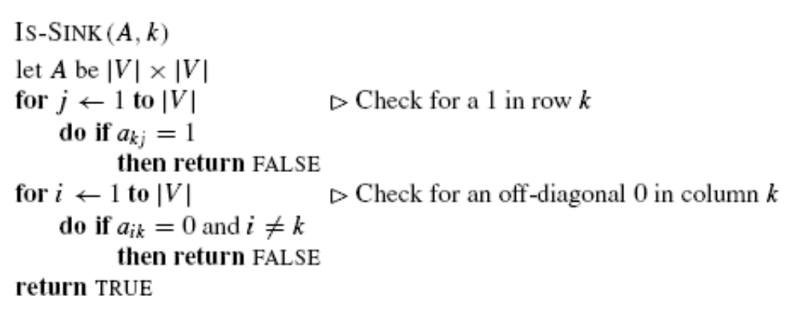
Problem 3 (cont.)
How long would it take to determine whether a given
graph contains a universal sink if you were to check
every single vertex in the graph?
- O(V²)

Slide 8
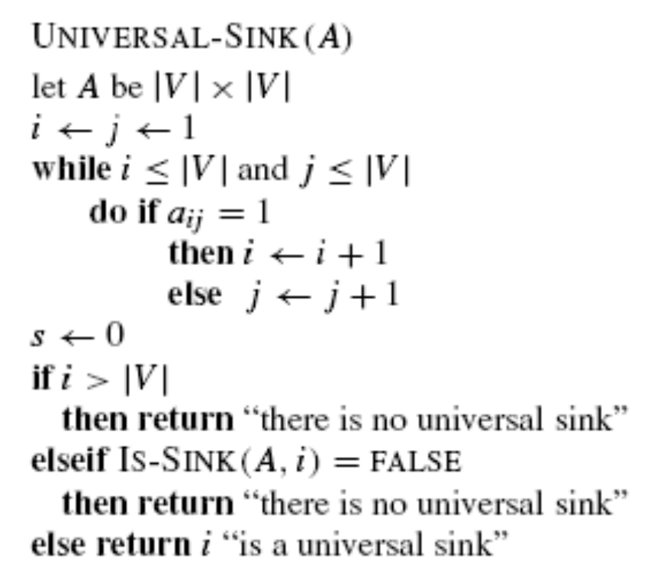
Problem 3 (cont.)
Can you come up with a O(V) algorithm?
Observations
  If A[u][v]=1, then u cannot be a universal sink
  If A[u][v]=0, then v cannot be a universal sink

Slide 9
Problem 3 (cont.)
v₁ v₂ v₃ v₄ v₅
v₁
v₂
v₁
v₂
v₃
v₄
v₅
0 1 1 1 1
0 0 0 1 1
0 1 0 1 1
0 0 0 0 1
0 0 0 0 0
v₃
v₄
v₅
Loop terminates when i>|V| or j>|V|
Upon termination, the only vertex that could be a sink is i
  If i > |V|, there is no sink
  If i < |V|, then j>|V|
  * vertices k where 1 ≤ k < i can not be sinks
    * vertices k where i < k ≤ |V| can not be sinks

Slide 10
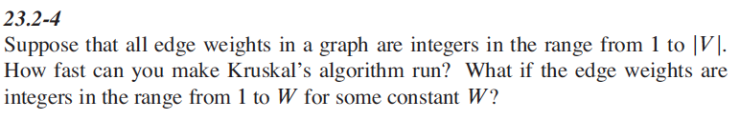
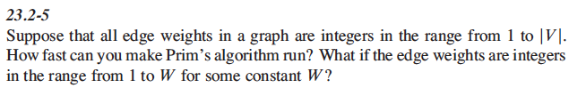
Problem 4

