Slide 1
Fibonacci numbers
1, 1, 2, 3, 5, 8, 13, 21, 34, …
What is the recurrence for the n^{th} Fibonacci number?
F(n) = F(n-1) + F(n-2)
The solution for n is defined with respect to the solution to smaller problems (n-1 and n-2)

Slide 2
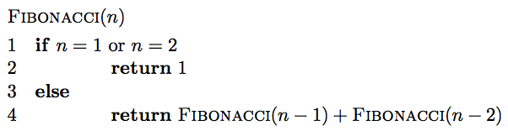
Fibonacci: a first attempt

Slide 3
Is it correct?
F(n) = F(n-1) + F(n-2)

Slide 4
Running time
Each call creates two recursive calls
Each call reduces the size of the problem by 1 or 2
Creates a full binary of depth n
O(2^{n})

Slide 5
Can we do better?
Fib(n)
Fib(n-1)
Fib(n-2)
Fib(n-2)
Fib(n-3)
Fib(n-3)
Fib(n-4)
Fib(n-3)
Fib(n-4)
Fib(n-4)
Fib(n-5)
Fib(n-4)
Fib(n-5)
Fib(n-5)
Fib(n-6)

Slide 6
A lot of repeated work!
Fib(n)
Fib(n-1)
Fib(n-2)
Fib(n-2)
Fib(n-3)
Fib(n-3)
Fib(n-4)
Fib(n-3)
Fib(n-4)
Fib(n-4)
Fib(n-5)
Fib(n-4)
Fib(n-5)
Fib(n-5)
Fib(n-6)

Slide 7
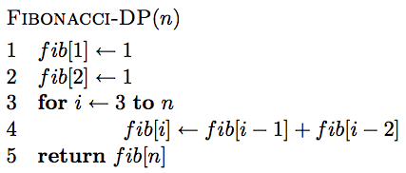
Creating a dynamic programming solution
Step 1: Identify a solution to the problem with respect to smaller subproblems (pretend like you have a solver, but it only works on smaller problems):
  F(n) = F(n-1) + F(n-2)
Step 2: bottom up - start with solutions to the smallest problems and build solutions to the larger problems
use an array to store solutions to subproblems

Slide 8
Is it correct?
F(n) = F(n-1) + F(n-2)

Slide 9
Running time?
Θ(n)

Slide 10
Counting binary search trees
How many unique binary search trees can be created using the numbers 1 through n?
4
2
5
1
3
6

Slide 11
Step 1:
What is the subproblem?
Assume we have some black box solver (call it T) that can give us the answer to smaller subproblems
How can we use the answer from this to answer our question?
How many options for the root are there?
1
2
3
n
…

Slide 12
Subproblems
i
How many trees have i as the root?

Slide 13
Subproblems
i
1, 2, …, i-1
i+1, i+2, …, n
?

Slide 14
Subproblems
i
1, 2, …, i-1
i+1, i+2, …, n
T(i-1)
?
subproblem of size i-1

Slide 15
Subproblems
i
1, 2, …, i-1
i+1, i+2, …, n
T(i-1)
Number of trees for i+1, i+2, …, i+n is the same as the number of trees from 1, 2, …, n-i

Slide 16
Subproblems
i
1, 2, …, i-1
i+1, i+2, …, n
T(i-1)
T(n-i)
Given solutions for T(i-1) and T(n-i) how many trees are there with i as the root?

Slide 17
Subproblems
i
1, 2, …, i-1
i+1, i+2, …, n
T(i-1)
T(n-i)
T(i) = T(i-1) * T(n-i)

Slide 18
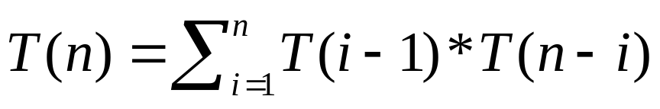
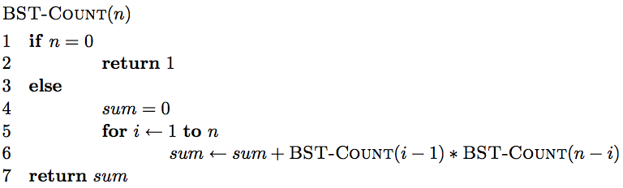
Step 1: define the answer with respect to subproblems
T(i) = T(i-1) * T(n-i)

Slide 19
Is there a problem?
As with Fibonacci, we’re repeating a lot of work

Slide 20
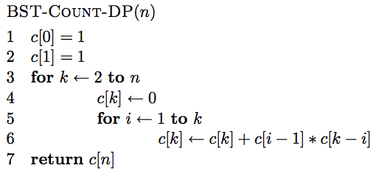
Step 2: Generate a solution from the bottom-up

Slide 21
0 1 2 3 4 5 … n

Slide 22
1 1
0 1 2 3 4 5 … n

Slide 23
c[0]*c[1] + c[1]*c[0]
1 1
0 1 2 3 4 5 … n

Slide 24
1
2
2
1
c[0]*c[1] + c[1]*c[0]
1 1
0 1 2 3 4 5 … n

Slide 25
1 1 2
0 1 2 3 4 5 … n

Slide 26
1
2
3
c[0]*c[2] + c[1]*c[1] + c[2]*c[0]
1 1 2
0 1 2 3 4 5 … n

Slide 27
1 1 2 5
0 1 2 3 4 5 … n

Slide 28
1 1 2 5 …
0 1 2 3 4 5 … n

Slide 29
Running time?
Θ(n²)

Slide 30
Longest common subsequence (LCS)
For a sequence X = x₁, x₂, …, x_{n}, a subsequence is a subset of the sequence defined by a set of increasing indices (i₁, i₂, …, i_{k}) where
1 ≤ i₁ < i₂ < … < i_{k} ≤ n
X = A B A C D A B A B
ABA?

Slide 31
Longest common subsequence (LCS)
For a sequence X = x₁, x₂, …, x_{n}, a subsequence is a subset of the sequence defined by a set of increasing indices (i₁, i₂, …, i_{k}) where
1 ≤ i₁ < i₂ < … < i_{k} ≤ n
X = A B A C D A B A B
ABA

Slide 32
Longest common subsequence (LCS)
For a sequence X = x₁, x₂, …, x_{n}, a subsequence is a subset of the sequence defined by a set of increasing indices (i₁, i₂, …, i_{k}) where
1 ≤ i₁ < i₂ < … < i_{k} ≤ n
X = A B A C D A B A B
ACA?

Slide 33
Longest common subsequence (LCS)
For a sequence X = x₁, x₂, …, x_{n}, a subsequence is a subset of the sequence defined by a set of increasing indices (i₁, i₂, …, i_{k}) where
1 ≤ i₁ < i₂ < … < i_{k} ≤ n
X = A B A C D A B A B
ACA

Slide 34
Longest common subsequence (LCS)
For a sequence X = x₁, x₂, …, x_{n}, a subsequence is a subset of the sequence defined by a set of increasing indices (i₁, i₂, …, i_{k}) where
1 ≤ i₁ < i₂ < … < i_{k} ≤ n
X = A B A C D A B A B
DCA?

Slide 35
Longest common subsequence (LCS)
For a sequence X = x₁, x₂, …, x_{n}, a subsequence is a subset of the sequence defined by a set of increasing indices (i₁, i₂, …, i_{k}) where
1 ≤ i₁ < i₂ < … < i_{k} ≤ n
X = A B A C D A B A B
DCA

Slide 36
Longest common subsequence (LCS)
For a sequence X = x₁, x₂, …, x_{n}, a subsequence is a subset of the sequence defined by a set of increasing indices (i₁, i₂, …, i_{k}) where
1 ≤ i₁ < i₂ < … < i_{k} ≤ n
X = A B A C D A B A B
AADAA?

Slide 37
Longest common subsequence (LCS)
For a sequence X = x₁, x₂, …, x_{n}, a subsequence is a subset of the sequence defined by a set of increasing indices (i₁, i₂, …, i_{k}) where
1 ≤ i₁ < i₂ < … < i_{k} ≤ n
X = A B A C D A B A B
AADAA

Slide 38
LCS problem
Given two sequences X and Y, a common subsequence is a subsequence that occurs in both X and Y
Given two sequences X = x₁, x₂, …, x_{n} and
Y = y₁, y₂, …, y_{n},
What is the longest common subsequence?
X = A B C B D A B
Y = B D C A B A

Slide 39
LCS problem
Given two sequences X and Y, a common subsequence is a subsequence that occurs in both X and Y
Given two sequences X = x₁, x₂, …, x_{n} and
Y = y₁, y₂, …, y_{n},
What is the longest common subsequence?
X = A B C B D A B
Y = B D C A B A

Slide 40
Step 1: Define the problem with respect to subproblems
X = A B C B D A B
Y = B D C A B A
Assume you have a solver for smaller problems

Slide 41
Step 1: Define the problem with respect to subproblems
X = A B C B D A ?
Y = B D C A B ?
Is the last character part of the LCS?

Slide 42
Step 1: Define the problem with respect to subproblems
X = A B C B D A ?
Y = B D C A B ?
Two cases: either the characters are the same or they’re different

Slide 43
Step 1: Define the problem with respect to subproblems
X = A B C B D A A
LCS
The characters are part of the LCS
Y = B D C A B A
What is the recursive relationship?
If they’re the same

Slide 44
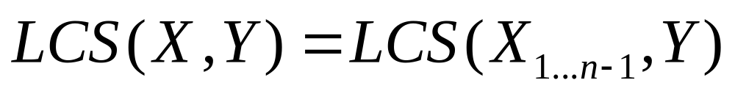
Step 1: Define the problem with respect to subproblems
X = A B C B D A B
LCS
Y = B D C A B A
If they’re different

Slide 45
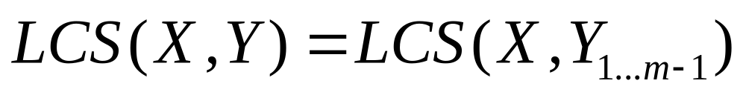
Step 1: Define the problem with respect to subproblems
X = A B C B D A B
LCS
Y = B D C A B A
If they’re different

Slide 46
Step 1: Define the problem with respect to subproblems
X = A B C B D A B
Y = B D C A B A
?
X = A B C B D A B
Y = B D C A B A
If they’re different

Slide 47
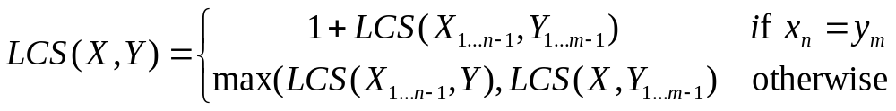
Step 1: Define the problem with respect to subproblems
X = A B C B D A B
Y = B D C A B A
(for now, let’s just worry about counting the length of the LCS)

Slide 48
Step 2: Build the solution from the bottom up
What types of subproblem solutions do we need to store?
LCS(X_{1…j}, Y_{1…k})
two different indices

Slide 49
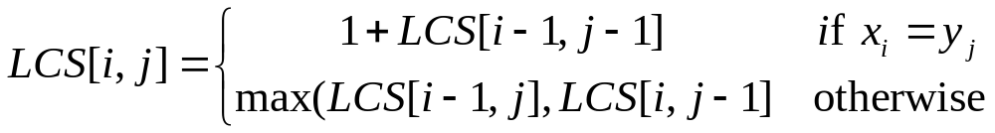
Step 2: Build the solution from the bottom up
What types of subproblem solutions do we need to store?
LCS(X_{1…j}, Y_{1…k})

Slide 50
j
0 1 2 3 4 5 6
y_{j} B D C A B A
i
0 x_{i}
1 A
2 B
3 C
4 B
5 D
6 A
7 B
For Fibonacci and tree counting, we had to initialize some entries in the array. Any here?

Slide 51
j
0 1 2 3 4 5 6
y_{j} B D C A B A
i
0 x_{i}
1 A
2 B
3 C
4 B
5 D
6 A
7 B
0 0 0 0 0 0 0
0
0
0
0
0
0
0
Need to initialize values within 1 smaller in either dimension.

Slide 52
j
0 1 2 3 4 5 6
y_{j} B D C A B A
i
0 x_{i}
1 A
2 B
3 C
4 B
5 D
6 A
7 B
0 0 0 0 0 0 0
0 ?
0
0
0
0
0
0
LCS(A, B)

Slide 53
j
0 1 2 3 4 5 6
y_{j} B D C A B A
i
0 x_{i}
1 A
2 B
3 C
4 B
5 D
6 A
7 B
0 0 0 0 0 0 0
0 0
0
0
0
0
0
0

Slide 54
j
0 1 2 3 4 5 6
y_{j} B D C A B A
i
0 x_{i}
1 A
2 B
3 C
4 B
5 D
6 A
7 B
0 0 0 0 0 0 0
0 0 0 0 ?
0
0
0
0
0
0
LCS(A, BDCA)

Slide 55
j
0 1 2 3 4 5 6
y_{j} B D C A B A
i
0 x_{i}
1 A
2 B
3 C
4 B
5 D
6 A
7 B
0 0 0 0 0 0 0
0 0 0 0 1
0
0
0
0
0
0
LCS(A, BDCA)

Slide 56
j
0 1 2 3 4 5 6
y_{j} B D C A B A
i
0 x_{i}
1 A
2 B
3 C
4 B
5 D
6 A
7 B
0 0 0 0 0 0 0
0 0 0 0 1 1 1
0 1 1 1 1 2 2
0 1 1 2 2 2 2
0 1 1 2 2 ?
0
0
0
LCS(ABCB, BDCAB)

Slide 57
j
0 1 2 3 4 5 6
y_{j} B D C A B A
i
0 x_{i}
1 A
2 B
3 C
4 B
5 D
6 A
7 B
0 0 0 0 0 0 0
0 0 0 0 1 1 1
0 1 1 1 1 2 2
0 1 1 2 2 2 2
0 1 1 2 2 3
0
0
0
LCS(ABCB, BDCAB)

Slide 58
j
0 1 2 3 4 5 6
y_{j} B D C A B A
i
0 x_{i}
1 A
2 B
3 C
4 B
5 D
6 A
7 B
0 0 0 0 0 0 0
0 0 0 0 1 1 1
0 1 1 1 1 2 2
0 1 1 2 2 2 2
0 1 1 2 2 3 3
0 1 2 2 2 3 3
0 1 2 2 3 3 4
0 1 2 2 3 4 4
Where’s the final answer?

Slide 59
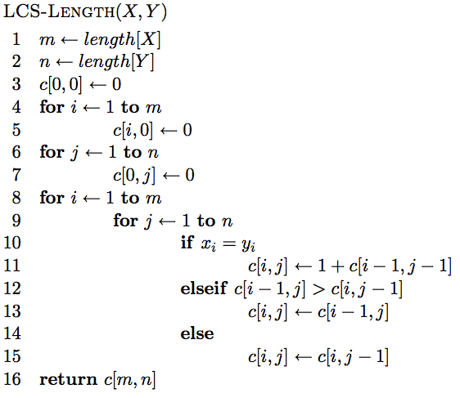
The algorithm

Slide 60
The algorithm
Base case initialization

Slide 61
The algorithm
Fill in the matrix

Slide 62
The algorithm

Slide 63
The algorithm

Slide 64
The algorithm

Slide 65
Running time?
Θ(nm)

Slide 66
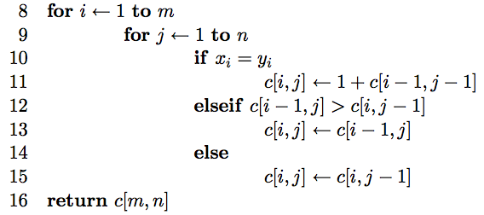
Keeping track of the solution
Our LCS algorithm only calculated the length of the LCS between X and Y
What if we wanted to know the actual sequence?
Keep track of this as well…

Slide 67
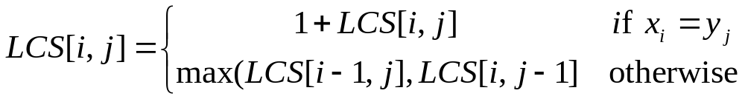
j
0 1 2 3 4 5 6
y_{j} B D C A B A
i
0 x_{i}
1 A
2 B
3 C
4 B
5 D
6 A
7 B
0 0 0 0 0 0 0
0 0 0 0 1 1 1
0 1 1 1 1 2 2
0 1 1 2 2 2 2
0 1 1 2 2 3 3
0 1 2 2 2 3 3
0 1 2 2 3 3 4
0 1 2 2 3 4 4
We can follow the arrows to generate the solution

Slide 68
j
0 1 2 3 4 5 6
y_{j} B D C A B A
i
0 x_{i}
1 A
2 B
3 C
4 B
5 D
6 A
7 B
0 0 0 0 0 0 0
0 0 0 0 1 1 1
0 1 1 1 1 2 2
0 1 1 2 2 2 2
0 1 1 2 2 3 3
0 1 2 2 2 3 3
0 1 2 2 3 3 4
0 1 2 2 3 4 4
We can follow the arrows to generate the solution
BCBA

