Slide 1
Quicksort and Randomized Algs
Thanks to David Kauchak

Slide 2






Why does the master method work?
a
a
a
a

Slide 3
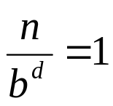
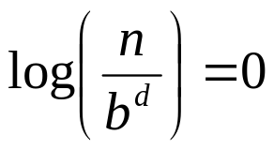



What is the depth of the tree?
At each level, the size of the data is divided by b

Slide 4
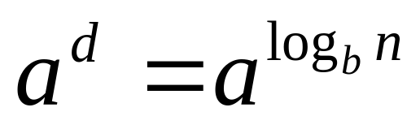
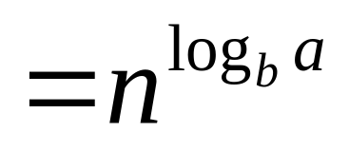
How many leaves?
How many leaves are there in a complete
a-ary tree of depth d?

Slide 5

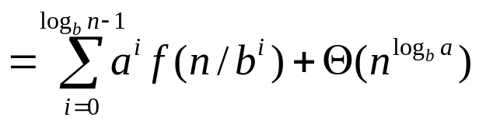

Total cost
Case 1: cost is dominated by the cost of the leaves

Slide 6
Total cost
Case 2: cost is evenly distributed across tree
As we saw with mergesort, log n levels to the tree and at each level f(n) work

Slide 7
Total cost
Case 3: cost is dominated by the cost of the root
a

Slide 8
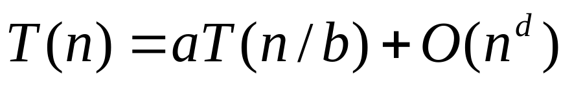
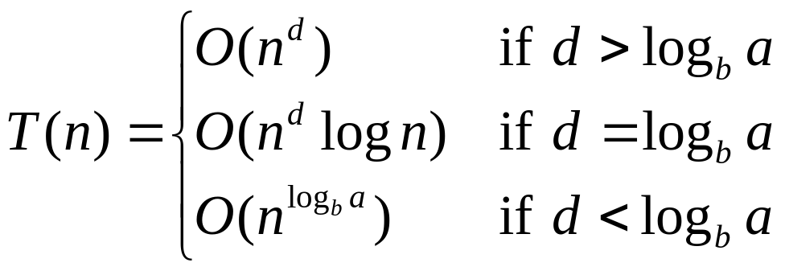
Other forms of the master method

Slide 9
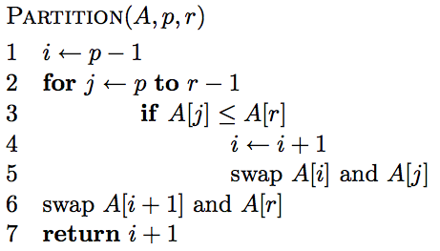
What does it do?

Slide 10
A[r] is called the pivot
Partitions the elements
A[p…r-1] in to two sets, those ≤ pivot and those > pivot
Operates in place
Final result:
p
pivot
r
A
≤ pivot
> pivot

Slide 11
… 5 7 1 2 8 4 3 6 …
p
r

Slide 12
i
… 5 7 1 2 8 4 3 6 …
p
r

Slide 13
i
j
… 5 7 1 2 8 4 3 6 …
p
r

Slide 14
i
j
… 5 7 1 2 8 4 3 6 …
p
r

Slide 15
i
j
… 5 7 1 2 8 4 3 6 …
p
r

Slide 16
i
j
… 5 7 1 2 8 4 3 6 …
p
r

Slide 17
i
j
… 5 7 1 2 8 4 3 6 …
p
r

Slide 18
i
j
… 5 7 1 2 8 4 3 6 …
p
r

Slide 19
i
j
… 5 7 1 2 8 4 3 6 …
p
r

Slide 20
i
j
… 5 1 7 2 8 4 3 6 …
p
r

Slide 21
i
j
… 5 1 7 2 8 4 3 6 …
p
r

Slide 22
i
j
… 5 1 7 2 8 4 3 6 …
p
r

Slide 23
i
j
… 5 1 2 7 8 4 3 6 …
p
r

Slide 24
i
j
… 5 1 2 7 8 4 3 6 …
p
r

Slide 25
i
j
… 5 1 2 7 8 4 3 6 …
p
r
What’s happening?

Slide 26
i
j
… 5 1 2 7 8 4 3 6 …
p
r
≤ pivot
> pivot
unprocessed

Slide 27
i
j
… 5 1 2 7 8 4 3 6 …
p
r

Slide 28
i
j
… 5 1 2 4 8 7 3 6 …
p
r

Slide 29
i
j
… 5 1 2 4 3 7 8 6 …
p
r

Slide 30
i
j
… 5 1 2 4 3 6 8 7 …
p
r

Slide 31
i
j
… 5 1 2 4 3 6 8 7 …
p
r

Slide 32
Is Partition correct?
Partitions the elements A[p…r-1] in to two sets, those ≤ pivot and those > pivot?
Loop Invariant:

Slide 33
Is Partition correct?
Partitions the elements A[p…r-1] in to two sets, those ≤ pivot and those > pivot?
Loop Invariant:
A[p…i] ≤ A[r] and A[i+1…j-1] > A[r]
proof?

Slide 34
Proof by induction
Loop Invariant: A[p…i] ≤ A[r] and A[i+1…j-1] > A[r]
Base case: A[p…i] and A[i+1…j-1] are empty
Assume it holds for j -1, two cases:
  A[j] > A[r]
    A[p…i] remains unchanged
    A[i+1…j] contains one additional element, A[j] which is > A[r]

Slide 35
Proof by induction
Loop Invariant: A[p…i] ≤ A[r] and A[i+1…j-1] > A[r]
2nd case:
  A[j] ≤ A[r]
    i is incremented
    A[i] swapped with A[j] – A[p…i] constains one additional element which is ≤ A[r]
    A[i+1…j-1] will contain the same elements, except the last element will be the old first element

Slide 36
Partition running time?
Θ(n)

Slide 37
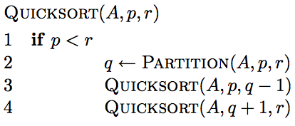
Quicksort

Slide 38
8 5 1 3 6 2 7 4

Slide 39
8 5 1 3 6 2 7 4

Slide 40
1 3 2 4 6 8 7 5

Slide 41
1 3 2 4 6 8 7 5

Slide 42
1 3 2 4 6 8 7 5

Slide 43
1 2 3 4 6 8 7 5

Slide 44
1 2 3 4 6 8 7 5

Slide 45
1 2 3 4 6 8 7 5

Slide 46
1 2 3 4 6 8 7 5

Slide 47
1 2 3 4 6 8 7 5

Slide 48
1 2 3 4 5 8 7 6
What happens here?

Slide 49
1 2 3 4 5 8 7 6

Slide 50
1 2 3 4 5 8 7 6

Slide 51
1 2 3 4 5 6 7 8

Slide 52
1 2 3 4 5 6 7 8

Slide 53
Some observations
Divide and conquer: different than MergeSort – do the work before recursing
How many times is/can an element selected for as a pivot?
What happens after an element is selected as a pivot?
1 3 2 4 6 8 7 5

Slide 54
Is Quicksort correct?

Slide 55
Is Quicksort correct?
Assuming Partition is correct
Proof by induction
  Base case: Quicksort works on a list of 1 element
  Inductive case:
    Assume Quicksort sorts arrays for arrays of smaller < n elements, show that it works to sort n elements
    If partition works correctly then we have:
    and, by our inductive assumption, we have:
pivot
A
sorted
sorted
≤ pivot
> pivot

Slide 56
Running time of Quicksort?
Worst case?
Each call to Partition splits the array into an empty array and n-1 array

Slide 57
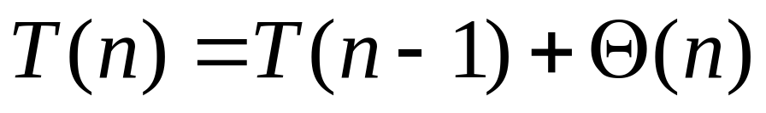
Quicksort: Worse case running time
Which is?
Θ(n²)
When does this happen?
  sorted
  reverse sorted
  near sorted/reverse sorted

Slide 58
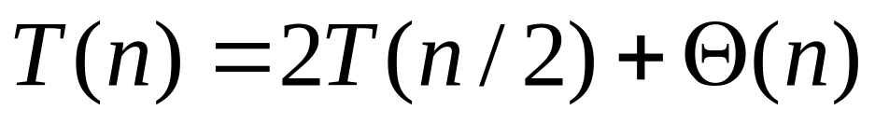
Quicksort best case?
Each call to Partition splits the array into two equal parts
O(n log n)
When does this happen?
  random data?

Slide 59
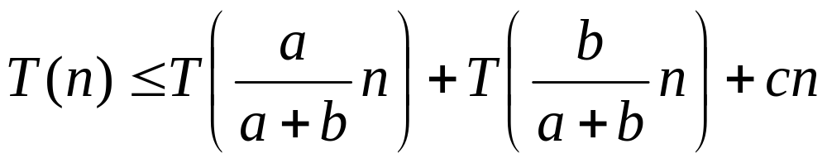
Quicksort Average case?
How close to “even” splits do they need to be to maintain an O(n log n) running time?
Say the Partition procedure always splits the array into some constant ratio b-to-a, e.g. 9-to-1
What is the recurrence?

Slide 60
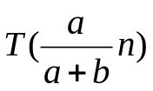
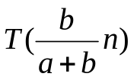
cn

Slide 61
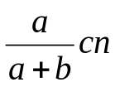
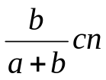
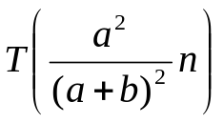
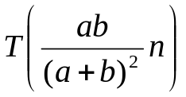
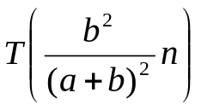
cn

Slide 62
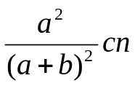
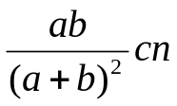
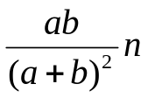
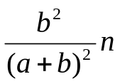





cn

Slide 63

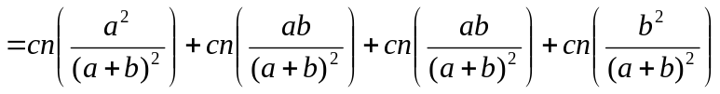
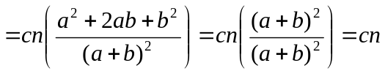
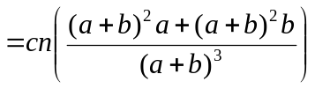
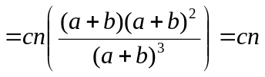
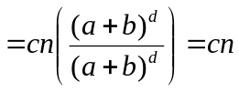
Level 0: cn
Level 1:
Level 2:
Level 3:
Level d:

Slide 64
What is the depth of the tree?
Leaves will have different heights
Want to pick the deepest leave
Assume a < b

Slide 65
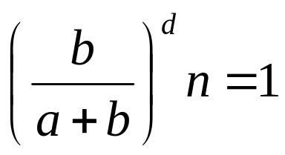
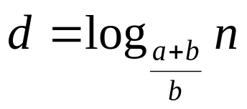
What is the depth of the tree?
Assume a < b
…

Slide 66
Cost of the tree
Cost of each level ≤ cn
?

Slide 67
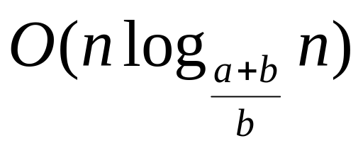
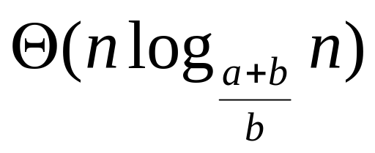
Cost of the tree
Cost of each level ≤ cn
Times the maximum depth
Why not?

Slide 68
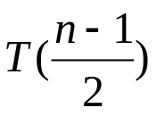
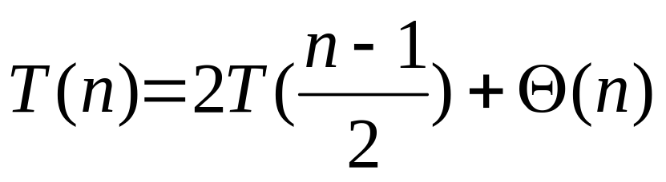
Quicksort average case: take 2
What would happen if half the time Partition produced a “bad” split and the other half “good”?
“good” 50/50 split
cn

Slide 69


Quicksort average case: take 2
cn
“bad” split

Slide 70

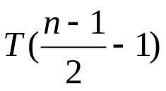
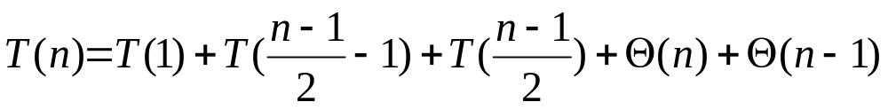
Quicksort average case: take 2
cn
“bad” split
“good” 50/50 split
recursion cost
partition cost

Slide 71
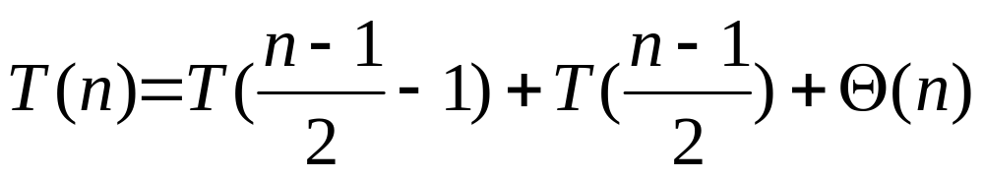
Quicksort average case: take 2
cn
“bad” split
“good” 50/50 split
We absorb the “bad” partition. In general, we can absorb any constant number of “bad” partitions

Slide 72
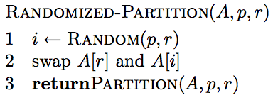
How can we avoid the worst case?
Inject randomness into the data

Slide 73
Randomizing Quicksort
Randomly permute the elements of the input array before sorting
OR ... modify the PARTITION procedure
  At each step of the algorithm we exchange element A[p] with an element chosen at random from A[p…r]
  The pivot element x = A[p] is equally likely to be any one of the r – p + 1 elements of the subarray

Slide 74
Randomized Algorithms
No input can elicit worst case behavior
  Worst case occurs only if we get “unlucky” numbers from the random number generator
Worst case becomes less likely
  Randomization can NOT eliminate the worst-case but it can make it less likely!

Slide 75
What is the running time of randomized Quicksort?
Worst case?
Still could get very unlucky and pick “bad” partitions at every step
O(n²)

Slide 76
randomized Quicksort: expected running time
How many calls are made to Partition for an input of size n?
What is the cost of a call to Partition?
Cost is proportional to the number of iterations of the for loop
n
the total number of comparisons will give us a bound on the running time

Slide 77
Counting the number of comparisons
Let z_{i} of z₁, z₂,…, z_{n} be the i th smallest element
Let Z_{ij} be the set of elements Z_{ij}= z_{i}, z_{i+1},…, z_{j}
A = [3, 9, 7, 2]
z₁ = 2
z₂ = 3
z₃ = 7
z₄ = 9
Z₂₄ =

Slide 78
Counting the number of comparisons
Let z_{i} of z₁, z₂,…, z_{n} be the i th smallest element
Let Z_{ij} be the set of elements Z_{ij}= z_{i}, z_{i+1},…, z_{j}
A = [3, 9, 7, 2]
z₁ = 2
z₂ = 3
z₃ = 7
z₄ = 9
Z₂₄ = [3, 7, 9]

Slide 79
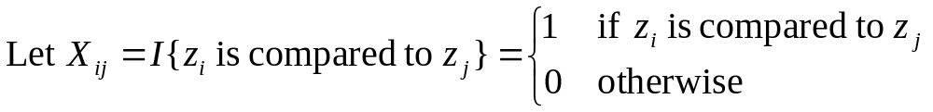
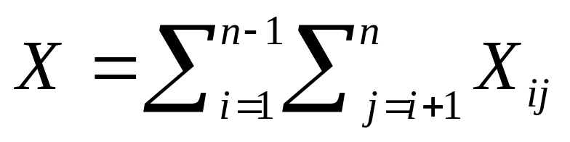
Counting comparisons
(indicator random variable)
How many times can z_{i} be compared to z_{j}?
At most once. Why?
Total number of comparisons

Slide 80
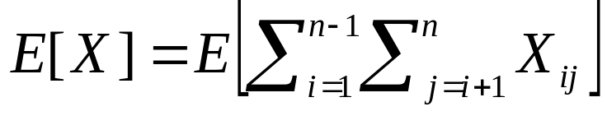
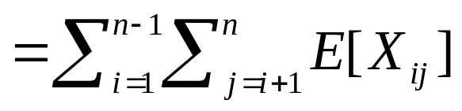
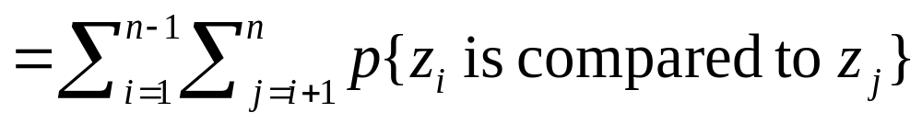
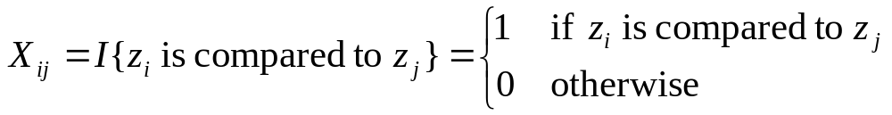
Counting comparisons: average running time
expectation of sums is the sum of expectations
remember,

Slide 81
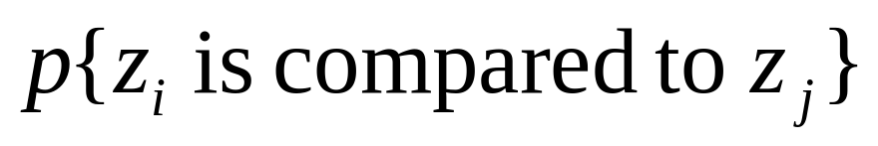
?
The pivot element separates the set of numbers into two sets (those less than the pivot and those larger). Elements from one set will never be compared to elements of the other set
If a pivot x is chosen z_{i} < x < z_{j} then z_{i} and z_{j} how many times will z_{i} and z_{j} be compared?
What is the only time that z_{i} and z_{j} will be compared?
In Z_{ij}, when will z_{i} and z_{j} will be compared?

Slide 82


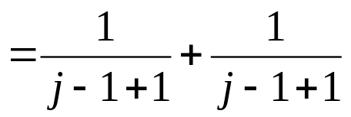
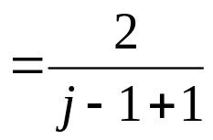
?
p(a,b) = p(a)+p(b) for independent events
pivot is chosen randomly over j-i+1 elements

Slide 83
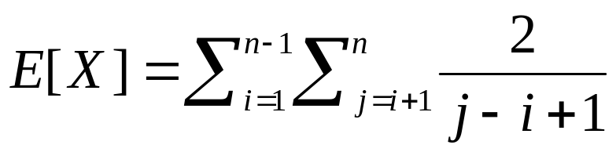
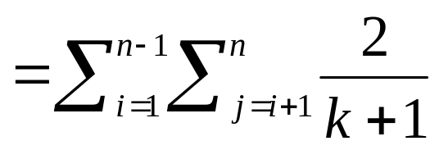
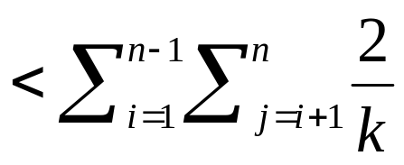



E[X] ?
Let k = j-i

Slide 84
Memory usage?
Quicksort only uses O(1) additional memory
How does randomized Quicksort compare to Mergesort?

Slide 85

Merge-Sort: Another view

Slide 86

Merge-Sort: Another view
difference?

Slide 87

Merge-Sort: Another view

Slide 88
Merge-Sort2
Running time?

Slide 89

Merge-Sort2
Running time?
Same as MergeSort except the cost to divide the arrays is constant, i.e. D(n) = c
Still results in:

Slide 90
Memory?

Slide 91



Memory?
MergeSort
MergeSort2

Slide 92
Memory?
MergeSort2

Slide 93
Memory?
MergeSort
?

Slide 94
Memory can be reused

Slide 95
Memory can be reused

Slide 96
Memory can be reused

Slide 97
Memory can be reused

Slide 98
Memory can be reused

Slide 99
Memory?
Both MergeSort and MergeSort2 are O(n) memory
In general, we’re interested in maximum memory used
  MergeSort ~3n
  MergeSort2 ~2n
We may also be interested in average memory usage
  MergeSort > MergeSort2

Slide 100


MergeSort: Another view
How difficult are the two versions to implement?

