Slide 1
Red-Black Trees
Thanks to David Kauchak

Slide 2
Red Black Trees
A BST with more complex algorithms to ensure balance
Each node is labeled as Red or Black.
Path: A unique series of links (edges) traverses from the root to each node.
  The number of edges (links) that must be followed is the path length
In Red Black trees paths from the root to elements with 0 or 1 child are of particular interest
Red Black Trees

Slide 3
Red Black Trees
1. Every node is either red or black.
2. The root is black.
3. Every leaf (NIL) is black.
4. If a node is red, then both its children are black.
5. For each node, all simple paths from the node to descendant leaves contain the same number of black nodes.
Red Black Trees

Slide 4
Paths to Single or Zero Child Nodes
How many?
19
12
35
3
16
21
56
1
Red Black Trees

Slide 5
Red Black Tree Rules
Every node is colored either Red or black
The root is black
If a node is red its two children must be black. (a.k.a. the red rule)
Every path from a node to a null link must contain the same number of black nodes (a.k.a. the path rule)
Red Black Trees

Slide 6
Example of a Red Black Tree
The root of a Red Black tree is black
Every other node in the tree follows these rules:
  Rule 3: If a node is Red, all of its children are Black
  Rule 4: The number of Black nodes must be the same in all paths from the root node to null nodes
19
12
35
3
16
21
56
30
Red Black Trees

Slide 7
Red Black Tree?
19
12
35
50
0
75
-10
135
-5
-8
100
-6
80
Red Black Trees

Slide 8
Instant Feedback Question
Is the tree on the previous slide a binary search tree? Is it a red black tree?
BST? Red-Black?
No No
No Yes
Yes No
Yes Yes
Red Black Trees

Slide 9
Red Black Tree?
19
12
35
3
16
0
Perfect?
Full?
Complete?
Red Black Trees

Slide 10
Attention Question 2
Is the tree on the previous slide a binary search tree? Is it a red black tree?
BST? Red-Black?
No No
No Yes
Yes No
Yes Yes
Red Black Trees

Slide 11
Implications of the Rules
If a Red node has any children, it must have two children and they must be Black. (Why?)
If a Black node has only one child that child must be a Red leaf. (Why?)
Due to the rules there are limits on how unbalanced a Red Black tree may become.
  on the previous example may we hang a new node off of the leaf node that contains 0?
Red Black Trees

Slide 12
Properties of Red Black Trees
If a Red Black Tree is complete, with all Black nodes except for Red leaves at the lowest level the height will be minimal, ~log N
To get the max height for N elements there should be as many Red nodes as possible down one path and all other nodes are Black
  This means the max height would be < 2 * log N
  see example on next slide
Red Black Trees

Slide 13
Max Height Red Black Tree
14
12
35
13
21
56
1
43
99
15
25
80
100
70
Red Black Trees

Slide 14
Maintaining the Red Black Properties in a Tree
Insertions
Must maintain rules of Red Black Tree.
New Node always a leaf
  can't be black or we will violate rule 4
  therefore the new leaf must be red
  If parent is black, done (trivial case)
  if parent red, things get interesting because a red leaf with a red parent violates rule 3
Red Black Trees

Slide 15
Insertions with Red Parent - Child
Must modify tree when insertion would result in
Red Parent - Child pair using color changes and
rotations.
30
15
70
20
60
85
10
80
90
50
65
5
40
55
Red Black Trees

Slide 16
Case 1
Suppose sibling of parent is Black.
  by convention null nodes are black
In the previous tree, true if we are inserting a 3 or an 8.
  What about inserting a 99? Same case?
Let X be the new leaf Node, P be its Red Parent, S the Black sibling and G, P's and S's parent and X's grandparent
  What color is G?
Red Black Trees

Slide 17
Case 1 - The Picture
G
P
S
C
D
E
X
A
B
Relative to G, X could be an inside or outside node.
Outside -> left left or right right moves
Inside -> left right or right left moves
Red Black Trees

Slide 18
Fixing the Problem
G
P
S
C
D
E
X
A
B
If X is an outside node a single
rotation between P and G fixes the problem.
A rotation is an exchange of roles between a parent
and child node. So P becomes G's parent. Also must
recolor P and G.
Red Black Trees

Slide 19
Single Rotation
P
X
G
A
B
C
S
D
E
Apparent rule violation?
Red Black Trees

Slide 20
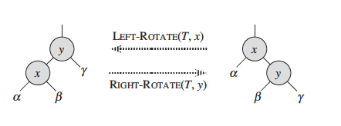
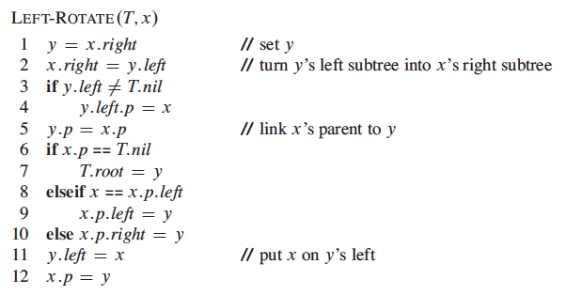
Left and Right Rotate

Slide 21
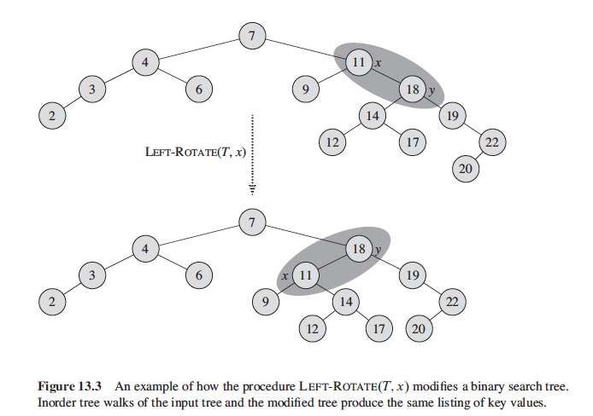
Left Rotate

Slide 22
Case 2
What if X is an inside node relative to G?
  a single rotation will not work
Must perform a double rotation
  rotate X and P
  rotate X and G
G
P
S
A
D
E
X
B
C
Red Black Trees

Slide 23
After Double Rotation
X
P
G
A
B
C
S
D
E
Apparent rule violation?
Red Black Trees

Slide 24
Case 3
Sibling is Red, not Black
G
P
S
C
D
E
X
A
B
Any problems?
Red Black Trees

Slide 25
Fixing Tree when S is Red
Must perform single rotation between parent, P and grandparent, G, and then make appropriate color changes
P
X
G
C
S
A
B
D
E
Red Black Trees

Slide 26
More on Insert
Problem: What if on the previous example G's parent had been red?
Easier to never let Case 3 ever occur!
On the way down the tree, if we see a node X that has 2 Red children, we make X Red and its two children black.
  if recolor the root, recolor it to black
  the number of black nodes on paths below X remains unchanged
  If X's parent was Red then we have introduced 2 consecutive Red nodes.(violation of rule)
  to fix, apply rotations to the tree, same as inserting node
Red Black Trees

Slide 27
Example of Inserting Sorted Numbers
Insert 1. A leaf so
red. Realize it is
root so recolor
to black.
1 2 3 4 5 6 7 8 9 10
1
1
Red Black Trees

Slide 28
Insert 2
make 2 red. Parent
is black so done.
1
2
Red Black Trees

Slide 29
Insert 3
Insert 3. Parent is red.
Parent's sibling is black
(null) 3 is outside relative
to grandparent. Rotate
parent and grandparent
1
2
3
2
1
3
Red Black Trees

Slide 30
Insert 4
On way down see
2 with 2 red children.
Recolor 2 red and
children black.
Realize 2 is root
so color back to black
2
1
3
2
When adding 4
parent is black
so done.
1
3
4
Red Black Trees

Slide 31
Insert 5
5's parent is red.
Parent's sibling is
black (null). 5 is
outside relative to
grandparent (3) so rotate
parent and grandparent then
recolor
2
1
3
4
5
Red Black Trees

Slide 32
Finish insert of 5
2
1
4
3
5
Red Black Trees

Slide 33
Insert 6
On way down see
4 with 2 red
children. Make
4 red and children
black. 4's parent is
black so no problem.
2
1
4
3
5
Red Black Trees

Slide 34
Finishing insert of 6
6's parent is black
so done.
2
1
4
3
5
6
Red Black Trees

Slide 35
Insert 7
7's parent is red.
Parent's sibling is
black (null). 7 is
outside relative to
grandparent (5) so
rotate parent and
grandparent then recolor
2
1
4
3
5
6
7
Red Black Trees

Slide 36
Finish insert of 7
2
1
4
3
6
5
7
Red Black Trees

Slide 37
Insert 8
On way down see 6
with 2 red children.
Make 6 red and
children black. This
creates a problem
because 6's parent, 4, is
also red. Must perform
rotation.
2
1
4
3
6
5
7
Red Black Trees

Slide 38
Still Inserting 8
2
Recolored now
need to
rotate
1
4
3
6
5
7
Red Black Trees

Slide 39
Finish inserting 8
Recolored now
need to
rotate
4
2
6
1
3
5
7
8
Red Black Trees

Slide 40
Insert 9
4
2
6
1
3
5
7
On way down see 4 has two red children
so recolor 4 red and children black.
Realize 4 is the root so recolor black
8
9
Red Black Trees

Slide 41
Finish Inserting 9
4
2
6
1
3
5
8
7
9
After rotations and recoloring
Red Black Trees

Slide 42
Insert 10
4
2
6
1
3
5
8
On way down see 8 has two
red children so change 8 to
red and children black
7
9
10
Red Black Trees

Slide 43
Insert 11
4
2
6
1
3
5
8
7
9
Again a rotation is
needed.
10
11
Red Black Trees

Slide 44
Finish inserting 11
4
2
6
1
3
5
8
7
10
9
11
Red Black Trees

