Slide 1
Dynamic Programming
Thanks to David Kauchak

Slide 2
Dynamic programming
One of the most important algorithm tools!
Very common interview question
Method for solving problems where optimal solutions can be defined in terms of optimal solutions to sub-problems
AND
the sub-problems are overlapping

Slide 3
Fibonacci numbers
1, 1, 2, 3, 5, 8, 13, 21, 34, …
What is the recurrence for the n^{th} Fibonacci number?
F(n) = F(n-1) + F(n-2)
The solution for n is defined with respect to the solution to smaller problems (n-1 and n-2)

Slide 4
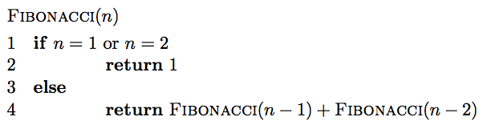
Fibonacci: a first attempt

Slide 5
Is it correct?
F(n) = F(n-1) + F(n-2)

Slide 6
Running time
Each call creates two recursive calls
Each call reduces the size of the problem by 1 or 2
Creates a full binary of depth n
O(2^{n})

Slide 7
Can we do better?
Fib(n)
Fib(n-1)
Fib(n-2)
Fib(n-2)
Fib(n-3)
Fib(n-3)
Fib(n-4)
Fib(n-3)
Fib(n-4)
Fib(n-4)
Fib(n-5)
Fib(n-4)
Fib(n-5)
Fib(n-5)
Fib(n-6)

Slide 8
A lot of repeated work!
Fib(n)
Fib(n-1)
Fib(n-2)
Fib(n-2)
Fib(n-3)
Fib(n-3)
Fib(n-4)
Fib(n-3)
Fib(n-4)
Fib(n-4)
Fib(n-5)
Fib(n-4)
Fib(n-5)
Fib(n-5)
Fib(n-6)

Slide 9
Identifying a dynamic programming problem
The solution can be defined with respect to solutions to subproblems
The subproblems created are overlapping, that is we see the same subproblems repeated

Slide 10
Overlapping sub-problems
divide and
conquer
dynamic
programming
…

Slide 11
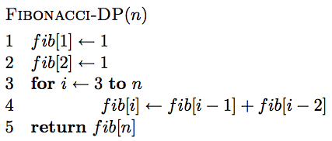
Creating a dynamic programming solution
Step 1: Identify a solution to the problem with respect to smaller subproblems (pretend like you have a solver, but it only works on smaller problems):
  F(n) = F(n-1) + F(n-2)
Step 2: bottom up - start with solutions to the smallest problems and build solutions to the larger problems
use an array to store solutions to subproblems

Slide 12
Is it correct?
F(n) = F(n-1) + F(n-2)

Slide 13
Running time?
Θ(n)

Slide 14
Memoization
Sometimes it can be a challenge to write the function in a bottom-up fashion
Memoization:
  Write the recursive function top-down
  Alter the function to check if we’ve already calculated the value
  If so, use the pre-calculate value
  If not, do the recursive call(s)

Slide 15
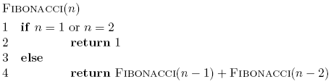
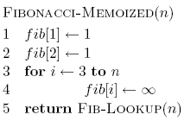
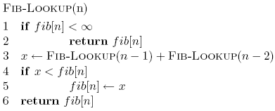
Memoized fibonacci

Slide 16
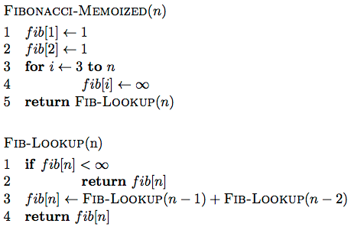
Memoized fibonacci

Slide 17
Memoized fibonacci
Use ∞ to denote uncalculated

Slide 18
Memoized fibonacci
What else could we use besides an array?
Use ∞ to denote uncalculated

Slide 19
Memoized fibonacci
Check if we already calculated the value

Slide 20
Memoized fibonacci
calculate the value

Slide 21
Memoized fibonacci
store the value

Slide 22
Memoization
Pros
  Can be more intuitive to code/understand
  Can be memory savings if you don’t need answers to all subproblems
Cons
  Depending on implementation, larger overhead because of recursion (though often the functions are tail recursive)

Slide 23
Counting binary search trees
How many unique binary search trees can be created using the numbers 1 through n?
4
2
5
1
3
6

Slide 24
Step 1:
What is the subproblem?
Assume we have some black box solver (call it T) that can give us the answer to smaller subproblems
How can we use the answer from this to answer our question?
How many options for the root are there?
1
2
3
n
…

Slide 25
Subproblems
i
How many trees have i as the root?

Slide 26
Subproblems
i
1, 2, …, i-1
i+1, i+2, …, n
?

Slide 27
Subproblems
i
1, 2, …, i-1
i+1, i+2, …, n
T(i-1)
?
subproblem of size i-1

Slide 28
Subproblems
i
1, 2, …, i-1
i+1, i+2, …, n
T(i-1)
Number of trees for i+1, i+2, …, i+n is the same as the number of trees from 1, 2, …, n-i

Slide 29
Subproblems
i
1, 2, …, i-1
i+1, i+2, …, n
T(i-1)
T(n-i)
Given solutions for T(i-1) and T(n-i) how many trees are there with i as the root?

Slide 30
Subproblems
i
1, 2, …, i-1
i+1, i+2, …, n
T(i-1)
T(n-i)
T(i) = T(i-1) * T(n-i)

Slide 31
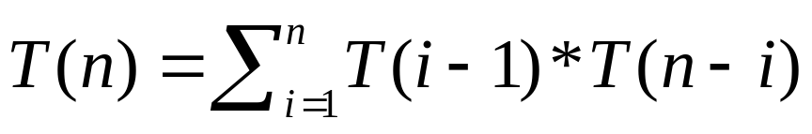
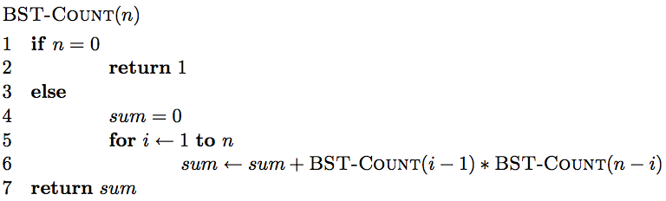
Step 1: define the answer with respect to subproblems
T(i) = T(i-1) * T(n-i)

Slide 32
Is there a problem?
As with Fibonacci, we’re repeating a lot of work

Slide 33
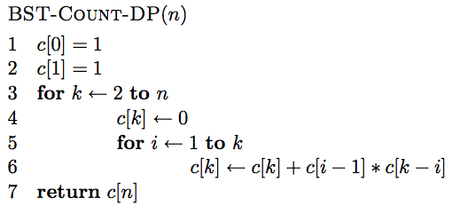
Step 2: Generate a solution from the bottom-up

Slide 34
0 1 2 3 4 5 … n

Slide 35
1 1
0 1 2 3 4 5 … n

Slide 36
c[0]*c[1] + c[1]*c[0]
1 1
0 1 2 3 4 5 … n

Slide 37
1
2
2
1
c[0]*c[1] + c[1]*c[0]
1 1
0 1 2 3 4 5 … n

Slide 38
1 1 2
0 1 2 3 4 5 … n

Slide 39
1
2
3
c[0]*c[2] + c[1]*c[1] + c[2]*c[0]
1 1 2
0 1 2 3 4 5 … n

Slide 40
1 1 2 5
0 1 2 3 4 5 … n

Slide 41
1 1 2 5 …
0 1 2 3 4 5 … n

Slide 42
Running time?
Θ(n²)

Slide 43
Longest common subsequence (LCS)
For a sequence X = x₁, x₂, …, x_{n}, a subsequence is a subset of the sequence defined by a set of increasing indices (i₁, i₂, …, i_{k}) where
1 ≤ i₁ < i₂ < … < i_{k} ≤ n
X = A B A C D A B A B
ABA?

Slide 44
Longest common subsequence (LCS)
For a sequence X = x₁, x₂, …, x_{n}, a subsequence is a subset of the sequence defined by a set of increasing indices (i₁, i₂, …, i_{k}) where
1 ≤ i₁ < i₂ < … < i_{k} ≤ n
X = A B A C D A B A B
ABA

Slide 45
Longest common subsequence (LCS)
For a sequence X = x₁, x₂, …, x_{n}, a subsequence is a subset of the sequence defined by a set of increasing indices (i₁, i₂, …, i_{k}) where
1 ≤ i₁ < i₂ < … < i_{k} ≤ n
X = A B A C D A B A B
ACA?

Slide 46
Longest common subsequence (LCS)
For a sequence X = x₁, x₂, …, x_{n}, a subsequence is a subset of the sequence defined by a set of increasing indices (i₁, i₂, …, i_{k}) where
1 ≤ i₁ < i₂ < … < i_{k} ≤ n
X = A B A C D A B A B
ACA

Slide 47
Longest common subsequence (LCS)
For a sequence X = x₁, x₂, …, x_{n}, a subsequence is a subset of the sequence defined by a set of increasing indices (i₁, i₂, …, i_{k}) where
1 ≤ i₁ < i₂ < … < i_{k} ≤ n
X = A B A C D A B A B
DCA?

Slide 48
Longest common subsequence (LCS)
For a sequence X = x₁, x₂, …, x_{n}, a subsequence is a subset of the sequence defined by a set of increasing indices (i₁, i₂, …, i_{k}) where
1 ≤ i₁ < i₂ < … < i_{k} ≤ n
X = A B A C D A B A B
DCA

Slide 49
Longest common subsequence (LCS)
For a sequence X = x₁, x₂, …, x_{n}, a subsequence is a subset of the sequence defined by a set of increasing indices (i₁, i₂, …, i_{k}) where
1 ≤ i₁ < i₂ < … < i_{k} ≤ n
X = A B A C D A B A B
AADAA?

Slide 50
Longest common subsequence (LCS)
For a sequence X = x₁, x₂, …, x_{n}, a subsequence is a subset of the sequence defined by a set of increasing indices (i₁, i₂, …, i_{k}) where
1 ≤ i₁ < i₂ < … < i_{k} ≤ n
X = A B A C D A B A B
AADAA

Slide 51
LCS problem
Given two sequences X and Y, a common subsequence is a subsequence that occurs in both X and Y
Given two sequences X = x₁, x₂, …, x_{n} and
Y = y₁, y₂, …, y_{n},
What is the longest common subsequence?
X = A B C B D A B
Y = B D C A B A

Slide 52
LCS problem
Given two sequences X and Y, a common subsequence is a subsequence that occurs in both X and Y
Given two sequences X = x₁, x₂, …, x_{n} and
Y = y₁, y₂, …, y_{n},
What is the longest common subsequence?
X = A B C B D A B
Y = B D C A B A

Slide 53
Step 1: Define the problem with respect to subproblems
X = A B C B D A B
Y = B D C A B A
Assume you have a solver for smaller problems

Slide 54
Step 1: Define the problem with respect to subproblems
X = A B C B D A ?
Y = B D C A B ?
Is the last character part of the LCS?

Slide 55
Step 1: Define the problem with respect to subproblems
X = A B C B D A ?
Y = B D C A B ?
Two cases: either the characters are the same or they’re different

Slide 56
Step 1: Define the problem with respect to subproblems
X = A B C B D A A
LCS
The characters are part of the LCS
Y = B D C A B A
What is the recursive relationship?
If they’re the same

Slide 57
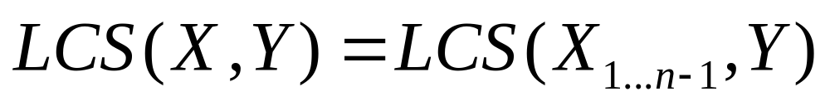
Step 1: Define the problem with respect to subproblems
X = A B C B D A B
LCS
Y = B D C A B A
If they’re different

Slide 58
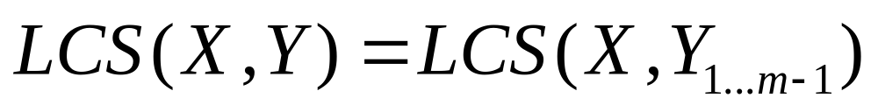
Step 1: Define the problem with respect to subproblems
X = A B C B D A B
LCS
Y = B D C A B A
If they’re different

Slide 59
Step 1: Define the problem with respect to subproblems
X = A B C B D A B
Y = B D C A B A
?
X = A B C B D A B
Y = B D C A B A
If they’re different

Slide 60
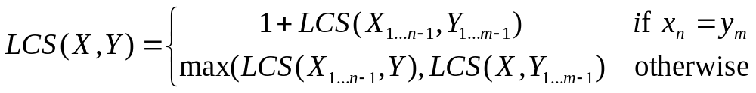
Step 1: Define the problem with respect to subproblems
X = A B C B D A B
Y = B D C A B A
(for now, let’s just worry about counting the length of the LCS)

Slide 61
Step 2: Build the solution from the bottom up
What types of subproblem solutions do we need to store?
LCS(X_{1…j}, Y_{1…k})
two different indices

Slide 62
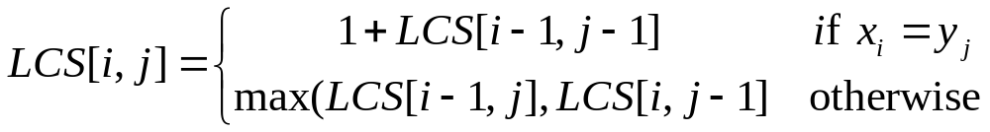
Step 2: Build the solution from the bottom up
What types of subproblem solutions do we need to store?
LCS(X_{1…j}, Y_{1…k})

Slide 63
j
0 1 2 3 4 5 6
y_{j} B D C A B A
i
0 x_{i}
1 A
2 B
3 C
4 B
5 D
6 A
7 B
For Fibonacci and tree counting, we had to initialize some entries in the array. Any here?

Slide 64
j
0 1 2 3 4 5 6
y_{j} B D C A B A
i
0 x_{i}
1 A
2 B
3 C
4 B
5 D
6 A
7 B
0 0 0 0 0 0 0
0
0
0
0
0
0
0
Need to initialize values within 1 smaller in either dimension.

Slide 65
j
0 1 2 3 4 5 6
y_{j} B D C A B A
i
0 x_{i}
1 A
2 B
3 C
4 B
5 D
6 A
7 B
0 0 0 0 0 0 0
0 ?
0
0
0
0
0
0
LCS(A, B)

Slide 66
j
0 1 2 3 4 5 6
y_{j} B D C A B A
i
0 x_{i}
1 A
2 B
3 C
4 B
5 D
6 A
7 B
0 0 0 0 0 0 0
0 0
0
0
0
0
0
0

Slide 67
j
0 1 2 3 4 5 6
y_{j} B D C A B A
i
0 x_{i}
1 A
2 B
3 C
4 B
5 D
6 A
7 B
0 0 0 0 0 0 0
0 0 0 0 ?
0
0
0
0
0
0
LCS(A, BDCA)

Slide 68
j
0 1 2 3 4 5 6
y_{j} B D C A B A
i
0 x_{i}
1 A
2 B
3 C
4 B
5 D
6 A
7 B
0 0 0 0 0 0 0
0 0 0 0 1
0
0
0
0
0
0
LCS(A, BDCA)

Slide 69
j
0 1 2 3 4 5 6
y_{j} B D C A B A
i
0 x_{i}
1 A
2 B
3 C
4 B
5 D
6 A
7 B
0 0 0 0 0 0 0
0 0 0 0 1 1 1
0 1 1 1 1 2 2
0 1 1 2 2 2 2
0 1 1 2 2 ?
0
0
0
LCS(ABCB, BDCAB)

Slide 70
j
0 1 2 3 4 5 6
y_{j} B D C A B A
i
0 x_{i}
1 A
2 B
3 C
4 B
5 D
6 A
7 B
0 0 0 0 0 0 0
0 0 0 0 1 1 1
0 1 1 1 1 2 2
0 1 1 2 2 2 2
0 1 1 2 2 3
0
0
0
LCS(ABCB, BDCAB)

Slide 71
j
0 1 2 3 4 5 6
y_{j} B D C A B A
i
0 x_{i}
1 A
2 B
3 C
4 B
5 D
6 A
7 B
0 0 0 0 0 0 0
0 0 0 0 1 1 1
0 1 1 1 1 2 2
0 1 1 2 2 2 2
0 1 1 2 2 3 3
0 1 2 2 2 3 3
0 1 2 2 3 3 4
0 1 2 2 3 4 4
Where’s the final answer?

Slide 72
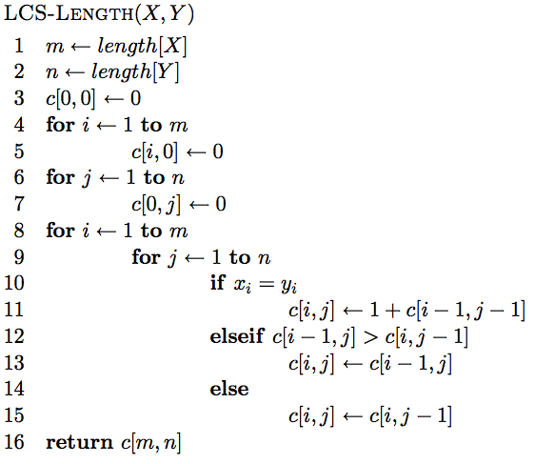
The algorithm

Slide 73
The algorithm
Base case initialization

Slide 74
The algorithm
Fill in the matrix

Slide 75
The algorithm

Slide 76
The algorithm

Slide 77
The algorithm

Slide 78
Running time?
Θ(nm)

Slide 79
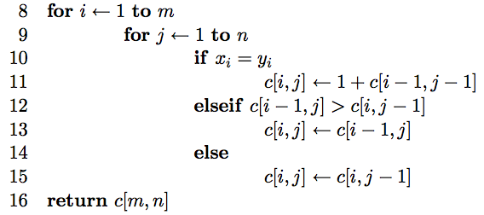
Keeping track of the solution
Our LCS algorithm only calculated the length of the LCS between X and Y
What if we wanted to know the actual sequence?
Keep track of this as well…

Slide 80
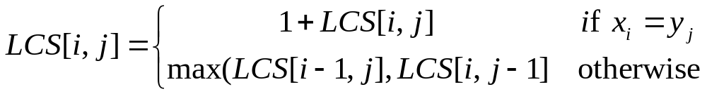
j
0 1 2 3 4 5 6
y_{j} B D C A B A
i
0 x_{i}
1 A
2 B
3 C
4 B
5 D
6 A
7 B
0 0 0 0 0 0 0
0 0 0 0 1 1 1
0 1 1 1 1 2 2
0 1 1 2 2 2 2
0 1 1 2 2 3 3
0 1 2 2 2 3 3
0 1 2 2 3 3 4
0 1 2 2 3 4 4
We can follow the arrows to generate the solution

Slide 81
j
0 1 2 3 4 5 6
y_{j} B D C A B A
i
0 x_{i}
1 A
2 B
3 C
4 B
5 D
6 A
7 B
0 0 0 0 0 0 0
0 0 0 0 1 1 1
0 1 1 1 1 2 2
0 1 1 2 2 2 2
0 1 1 2 2 3 3
0 1 2 2 2 3 3
0 1 2 2 3 3 4
0 1 2 2 3 4 4
We can follow the arrows to generate the solution
BCBA

