Slide 1

Minimum Spanning Trees
Implementation & Comparison of Prim's vs. Kruskal's Algorithms
CPCS 324: Algorithms and Data Structures (II) - Group Project
Abdelrahman Soliman (2343174) | Sultan Yasir Alasami (2339663)

Slide 2
Project Introduction

Slide 3
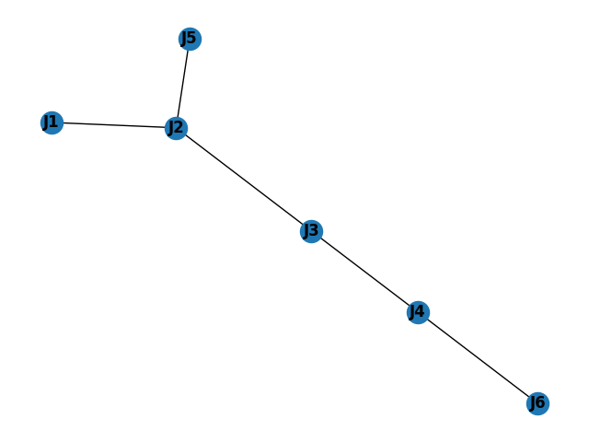

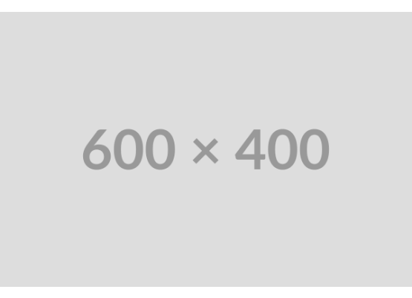
The Water Network Problem
Project Objective
The goal is to design an efficient water distribution network, connecting multiple junctions (stations, tanks) with the minimum possible construction cost.
✓
Model: The network is modeled as an undirected, weighted graph.
✓
Vertices: Represent the water junctions (e.g., J1, J2).
✓
Edges: Represent potential pipeline connections.
✓
Weights: Represent the construction cost of each pipeline.
✓
Solution: Find the Minimum Spanning Tree (MST) to connect all junctions with the lowest total cost.

Slide 4


Core Algorithms: The Greedy Approach
Prim's Algorithm (Min-Heap)
Kruskal's Algorithm (Union-Find)
Prim's is a "tree-growing" algorithm. It starts from an arbitrary source vertex and progressively "grows" the MST.
Kruskal's is a "forest-growing" algorithm. It starts with each vertex as its own separate tree (a "forest").
It sorts all edges in the graph by weight. It then iterates through the sorted edges, adding an edge if and only if it connects two previously disconnected components. We used a Union-Find data structure to detect cycles.
In each step, it adds the cheapest possible edge that connects a vertex *inside* the MST to a vertex *outside* the MST. We used a Min-Heap to efficiently find this cheapest edge.

Slide 5
Requirement 1
Computing the MST for the Provided Graph

Slide 6
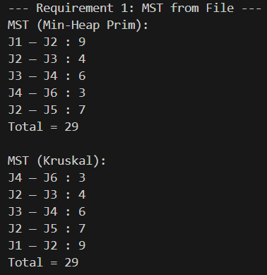

Requirement 1: Results
Implementation & Verification
We first implemented `readGraphFromFile` to parse the `graph.txt` (6 Vertices, 15 Edges) as specified.
Both algorithms were run on this graph to verify their correctness against the project's expected output.
✓
Prim's Algorithm Result: Total = 29
✓
Kruskal's Algorithm Result: Total = 29
The identical results confirm our implementations are correct and successfully find the Minimum Spanning Tree.

Slide 7
Requirement 2
Random Graph Generation & Experimental Comparison

Slide 8






Requirement 2: Experimental Setup
Graph Generation
Time Measurement
Graph Sizes Tested
We built a `make_graph(n, m)` function. To guarantee connectivity, it first builds a random spanning tree using Union-Find, then adds the remaining edges.
Runtime was measured in milliseconds (ms) using `time.perf_counter()`. We averaged the results over 3 runs for each graph size to reduce variance.
We tested 7 combinations of vertices (n) and edges (m), with n up to 10,000 and m up to 25,000, as specified in the project.

Slide 9
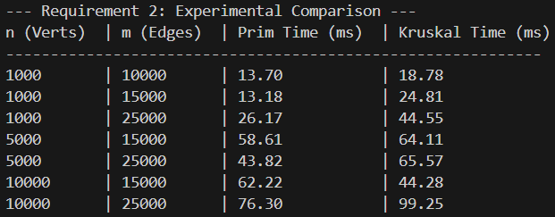
Requirement 2: Experimental Results (Time in ms)
Prim's Was Faster in Most Cases, Especially on Denser Graphs

Slide 10
Analysis & Key Challenges
Performance Analysis Performance Analysis: Prim's (O(E log V)) outperformed Kruskal's (O(E log E)) in most tests, but Kruskal's was faster on the 10k/15k sparse graph.
UML Compliance A key challenge was refactoring the code to strictly follow the UML diagram, implementing `Junction` and `Pipe` classes inheriting from `Vertex` and `Edge`.
Ensuring Connectivity Our `make_graph` function had to guarantee a connected graph. We solved this by first building a random spanning tree using Union-Find before adding extra edges.
Handling Duplicates To prevent errors in Kruskal's algorithm and the graph generator, we used a `set` to track unique edge pairs (e.g., (min_label, max_label)) to avoid duplicates.

Slide 11
Conclusion
Both algorithms successfully solve the MST problem. Prim's (Min-Heap) is demonstrably faster for dense networks, making it a better choice for this scenario.

Slide 12
Thank You
Questions?

