Slide 1
Comparison Between Newton's Method and Steffensen's Method
Prepared by: Rayan Abdullah AlShehri, Sultan Yasir Alasami, Osama Khaled Bayounis
Prepared for: Dr. Ahmed Harbawi
This presentation covers an introduction to Newton's and Steffensen's methods, their formulas, potential issues, MATLAB implementations, and a comparative conclusion.
Page 1

Slide 2
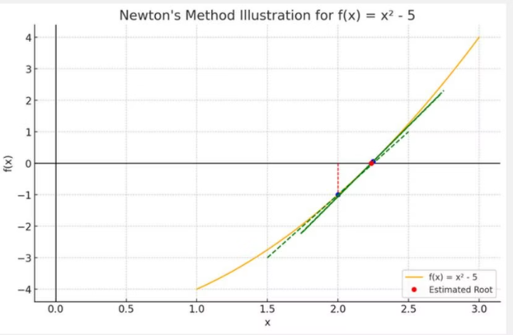
Introduction to Newton's Method and Its Formula
Iteration (n)
x(n)
f(x(n))
f’(x(n))
x(n+1)
0
2
-1
4
2.25
1
2.25
0.0625
4.5
2.236111111
2
2.236111111
0.000192902
4.472222222
2.236067978
3
2.236067978
3.71689×10^-9
4.472135955
2.236067978
Newton's Method approximates roots by iteratively using tangent lines on the function curve. Starting with an initial guess close to the root, the next estimate is calculated by:
For example, with f(x) = x² - 5 and initial guess x₀ = 2, iterations quickly converge to the root. The method stops when estimates stabilize to the desired accuracy.
xn+1 = xn - f(xn) / f'(xn)
Page 2

Slide 3
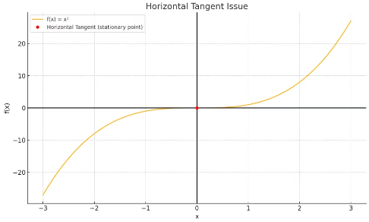
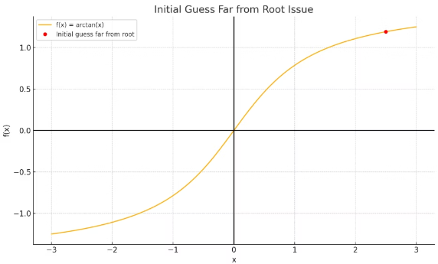
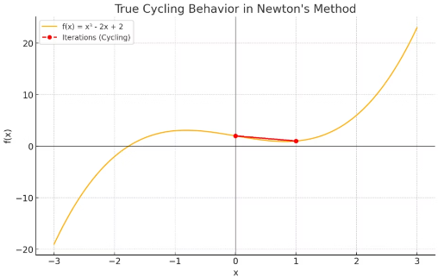
Potential Issues with Newton's Method
Horizontal Tangent Issue
Initial Guess Far from Root
Cycling Behavior
If the initial guess is at a point where f′(x) = 0, the tangent is horizontal and the method fails to proceed.
A distant initial guess can cause divergence or convergence to the wrong root due to tangent lines not leading correctly.
The method can get stuck in cycles near inflection points, oscillating without converging.
Page 3

Slide 4
MATLAB Implementation of Newton's Method
1
Inputs and Assumptions
2
Procedure
3
Output
Iteratively compute xn+1 = xn - f(xn)/f′(xn) until |f(xn)| is below tolerance or max iterations reached.
Approximate root with printed iteration details and graphical plot of function and root.
Function f(x), its derivative f′(x), and initial guess x₀. The derivative must not be zero and f(x) must be continuous.
Page 4

Slide 5
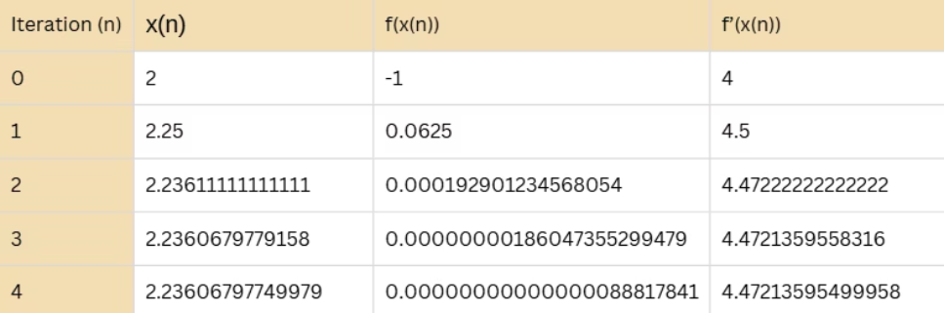
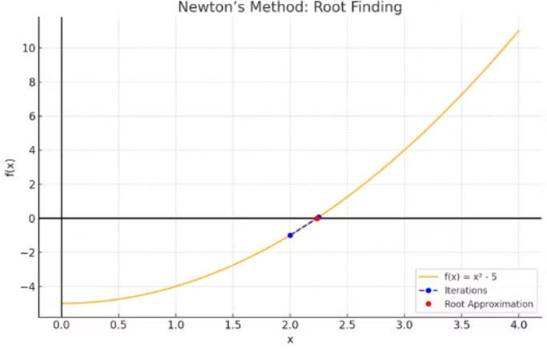
MATLAB Script Output (Newton's Method)
Iteration Table: Newton’s Method Numerical Output
Displays the progression of x(n), F(x(n)), F'(x(n)) for each step until convergence is achieved.
Graphical Convergence of Newton’s Method
Visual representation of how each iteration approaches the root using tangent-line approximations.
Page 5

Slide 6
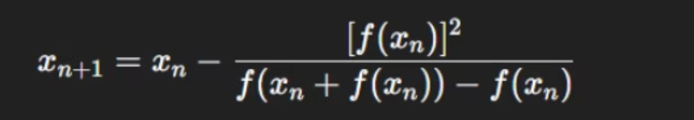
Introduction to Steffensen's Method and It's Formula
Steffensen's Method is a root-finding algorithm with quadratic convergence like Newton's, but it does not require the derivative. It approximates the derivative using forward finite differences.
This formula assumes the function F(x) is continuous and behaves smoothly near the root. Although the method can sometimes still work with a less accurate initial guess, for best performance, the starting value x(0)​ should be close to the true root.
The iterative formula is:
Page 6

Slide 7
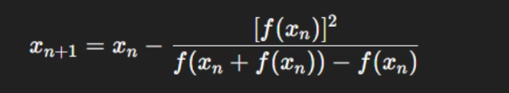
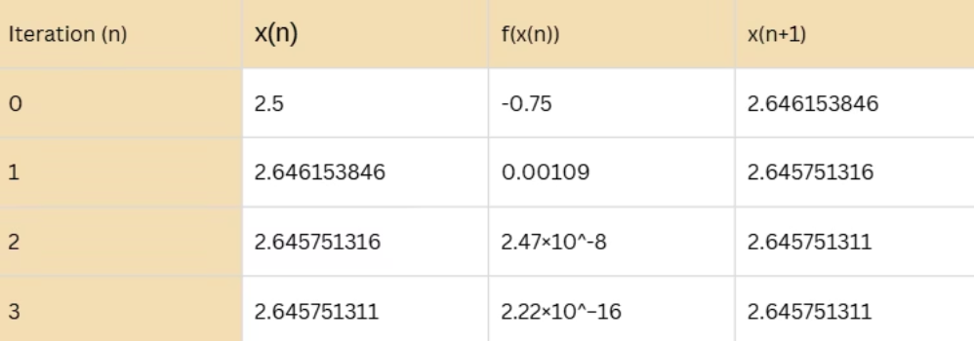
Iteration Results and Graphical Convergence of Steffensen’s Method
Steffensen’s Method Formula
This formula assumes the function F(x) is continuous and behaves smoothly near the root.
F(x) = x^2-7 Using the initial approximation X(0) = 2.5. The exact root of F(x) = x^2-7 is √7=2.645751311 which Steffensen’s Method successfully converges to with high precision.
Page 7

Slide 8
Potential Issues with Steffensen's Method
Sensitivity to Initial Guess
Susceptibility to Cycles
Double Function Evaluation Overhead
Points of inflection can cause cycling behavior where iterations bounce without converging.
Like Newton's Method, Steffensen's success depends on a close initial guess. Poor guesses may cause failure to converge, oscillations, or divergence.
Each iteration requires two function evaluations, potentially making it slower for complex functions.
Page 8

Slide 9
MATLAB Implementation of Steffensen's Method
1
Inputs and Assumptions
2
Procedure
3
Output
Iteratively compute x(n+1) using the Steffensen formula until the error is below tolerance or max iterations reached.
Prints iteration details and plots the function with the found root.
Function f(x) and initial guess x0. The function must be continuous and the initial guess close to the root for quadratic convergence.
Page 9

Slide 10
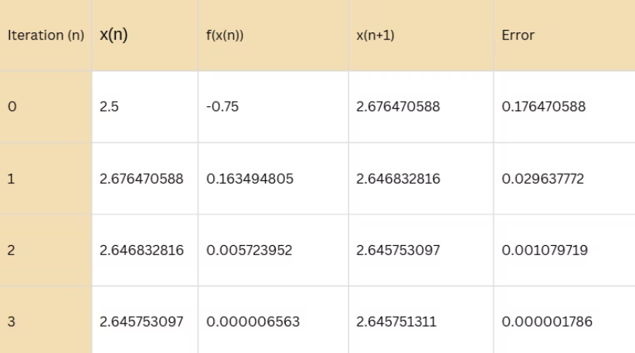
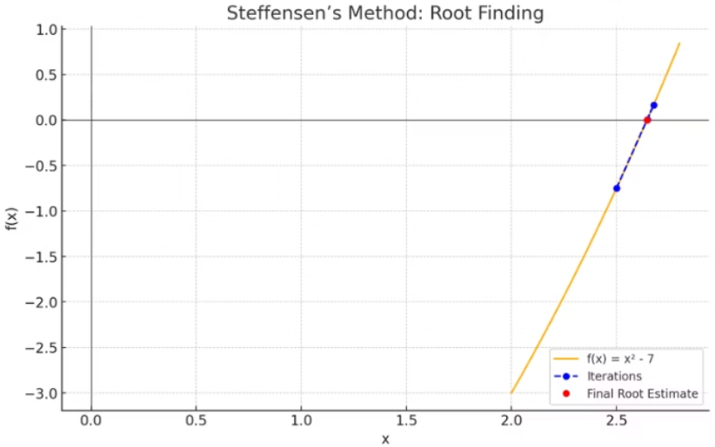
MATLAB Script Output (Steffensen’s Method)
Iteration Table: Steffensen’s Method Step-by-Step Results
Graphical Convergence of Steffensen’s Method
Shows how each approximation X(n), function value F(x(n)), next estimate X(n+1), and error evolve over each iteration.
Visualizes the rapid convergence of the method toward the root, highlighting the iterative steps and final estimate
Page 10

Slide 11

Both Newton's and Steffensen's methods rapidly converge to roots when starting near the true root.
Newton's Method requires the derivative, which may not always be available, but is computationally cheaper per iteration.
Steffensen's Method avoids derivatives, making it useful when derivatives are hard to compute, but requires double function evaluations per iteration.
Both methods can suffer from cycling and sensitivity to initial guesses. The choice depends on derivative availability and computational cost.
Page 11

Slide 12
Feature Comparison: Newton's vs Steffensen's Method
Feature
Newton's Method
Steffensen's Method
Convergence Rate
Quadratic
Quadratic
Requires Derivative?
Yes
No
Iteration Formula
xn+1 = xn - f(xn)/f'(xn)
xn+1 = xn - [f(xn)]² / (f(xn + f(xn)) - f(xn))
Function Calls per Iteration
1 function + 1 derivative
2 function evaluations
Computation Cost
Lower if derivative known
Slightly higher due to double evaluations
Susceptible to Cycles
Yes
Yes
Sensitivity to Initial Guess
High
High
Best Use Case
Derivative Available & Simple
Derivative Unknown or Complex
Page 12

