Slide 1
Connect 4
Intro CS 17’F -- Final Project
Jack Language App:
Jan. 15th 2018
CSIE B06902062 陳法熏
CSIE B06902080 吳士綸
CSIE B06902124 黃柏豪

Slide 2
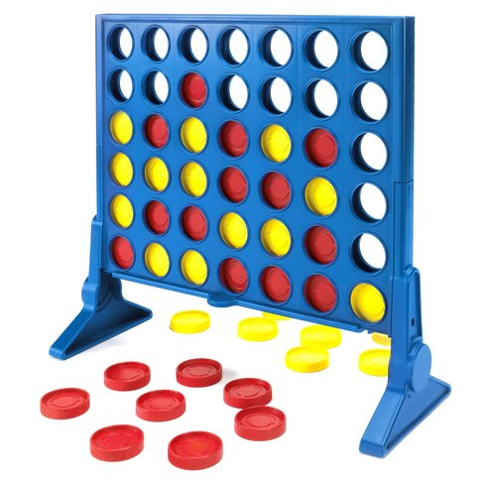
The Game
Setup
7 * 6 Stand-up Grid
2 Players dropping discs in turn
Target
Form a Horizontal, Vertical,
or Diagonal connection of 4 discs first
Image Source: https://image.smythstoys.com/original/desktop/134269_4.jpg

Slide 3
Variations We Implemented
Classic -- straightforward
1P mode: Play with our carefully-crafted AI (oh, edge man)
2P mode: Play with your friend (if you have one)
Pop-Out -- more fun, but hard
Can remove one of your own disc from the bottom
in one turn, complicating the game

Slide 4
Code Structure: Classes
Main
ConnectGame
Grid
Disc
AI
Record each move,
Judge winning connections
Draw & erase discs,
Winning animation
Homepage,
Menu options
Game Procedures:
Switching players,
Changing columns
etc…
Place winning disc,
Block player’s winning move, Form advantage….

Slide 5
Demo Time, Have Fun!!!

Slide 6
Appendix A: AI Strategies
First Turn: Always place in the middle
Priorities:
a. Connect 4 discs then WIN!!
b. Block the opponent from winning
c. Avoid doing favor for the opponent
(simply, don’t let him/her win in the next turn because of this move)
Forming Advantage:
a. Extend the existing connections
b. Find the place where the AI has most
surrounding discs of its own (the adjacent 3*3 grid)

