Slide 1
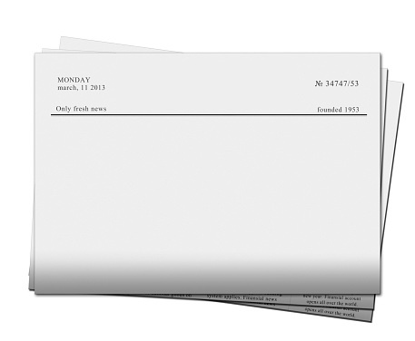

REPORT
NEWS
HARRY STYLES SCAMS FANS
JAN 28
FANS SOLD OUT AT MEDIAMARKT
JAN 28

