Slide 1
SPOT Tutorial Slides
2021 ECP Annual Meeting
Matthew LeGendre
April 12, 2021

Slide 2
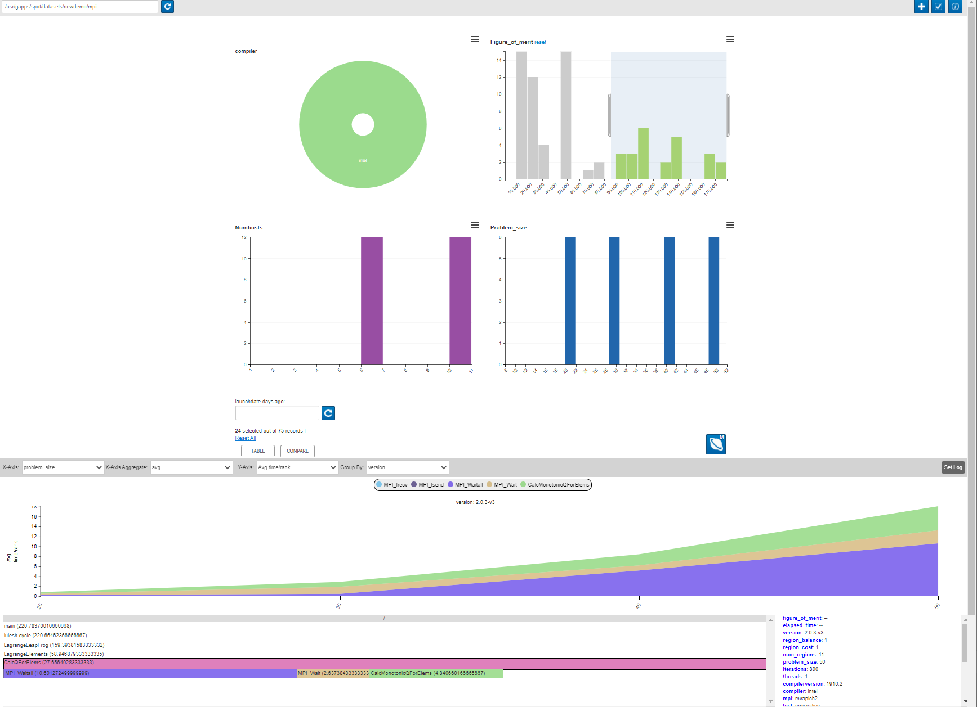
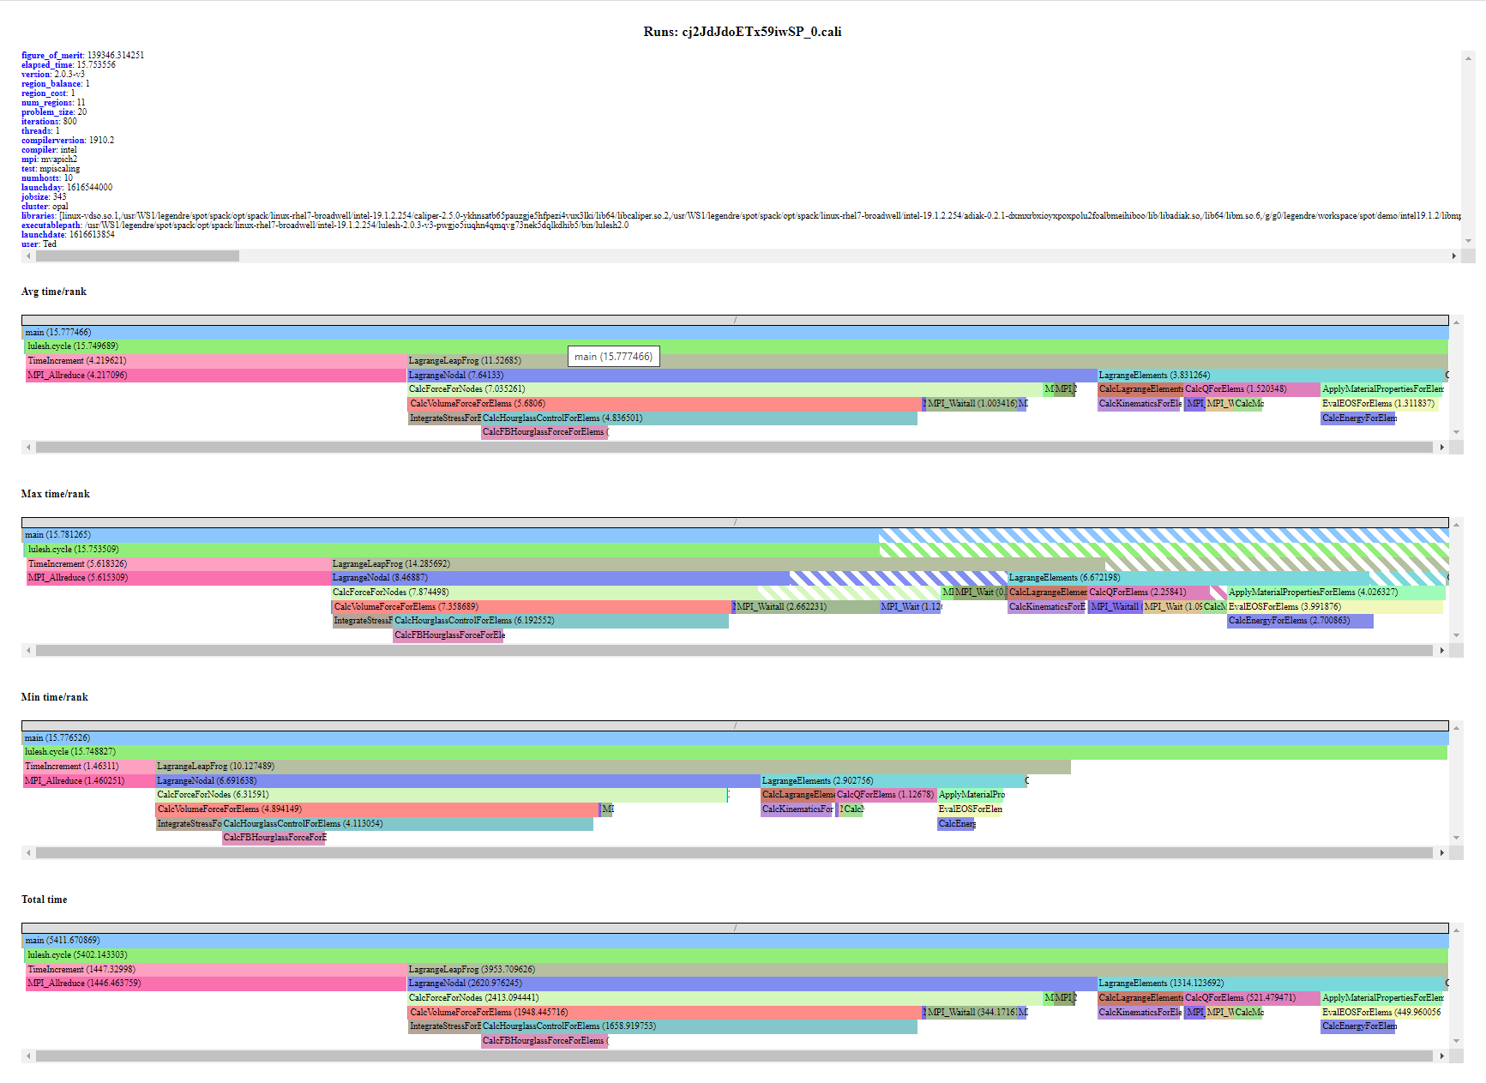
SPOT: Software Performance and Analysis Tracking
SPOT is visualization for collections of performance profiles. Common uses cases are:
Performance comparison of nightly tests. Look for performance regressions.
Performance tracking of developer changes. Run an MPI scaling study.
Collect performance profiles from users. Understand how users run and hit performance issues.

Slide 3
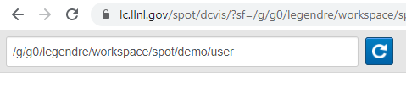
SPOT’s Workflow
Point SPOT webpage at directory containing *.cali files.
Select “interesting” sets of runs to analyze
Don’t compare performance of 1d test run. vs 3d multi-physics run.
Run common analysis with SPOT.
i.e., Graph history of performance changes
i.e., View performance context trees
Run advanced analysis with Hatchet.

Slide 4
SPOT’s Landing Page
Data Source
Config
Meta- data
Perf. Compare

Slide 5
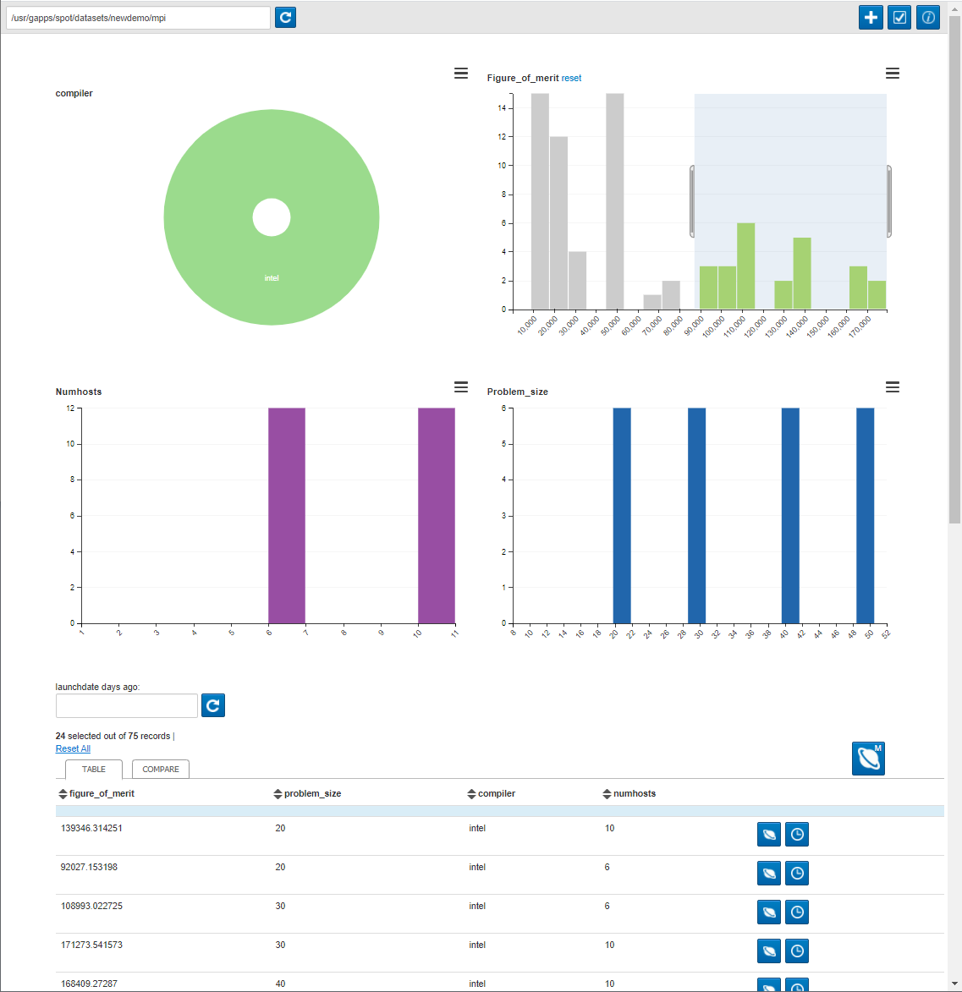
SPOT’s Landing Page
Table View

Slide 6
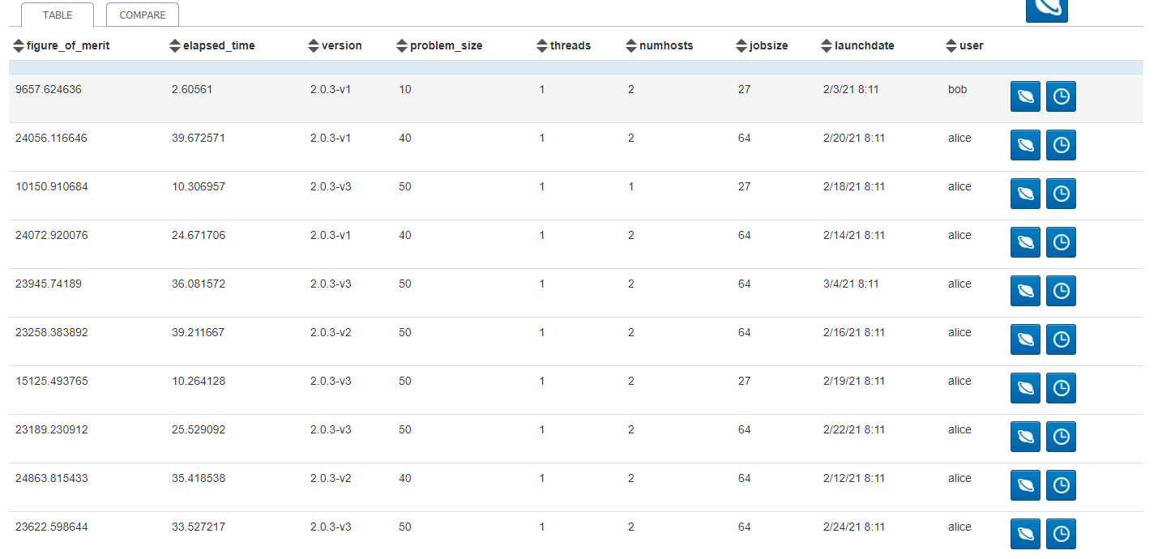
SPOT is Based on CrossFilter
SPOT’s Crossfilter: https://dc-js.github.io/dc.js/ D3-Based Crossfilter: https://square.github.io/crossfilter/
CrossFilter is good at finding correlations in data.
Crossfilter helps you manage/slice your data to make interesting comparisons.

Slide 7
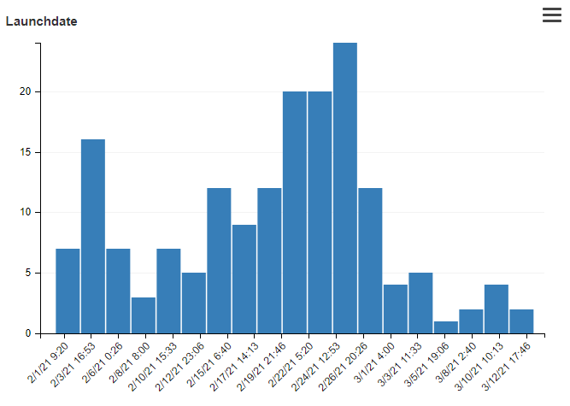
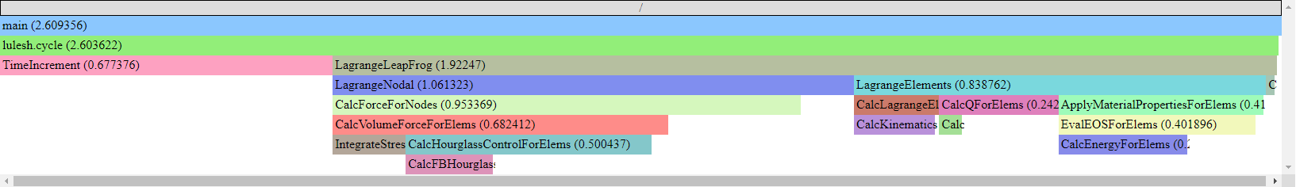
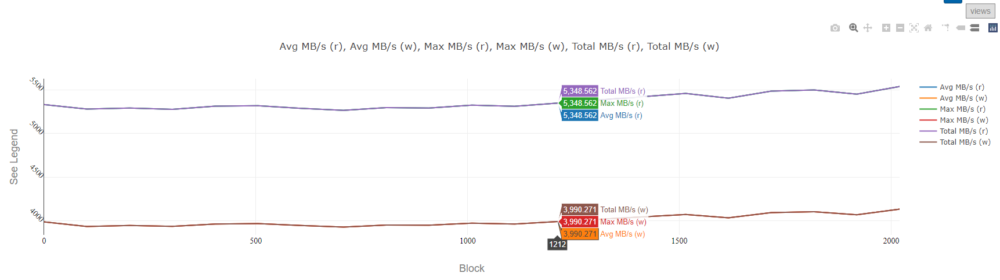
Each App Run has Two Types of Data
Metadata
Name/value data about job.
User, host, FOM, input parameters, …
Displayed as histograms
Performance Data
Can be different metrics.
Avg Time/Rank, Max Time/Rank, bandwidth, …
Displayed as a flame graph or timeseries.

Slide 8
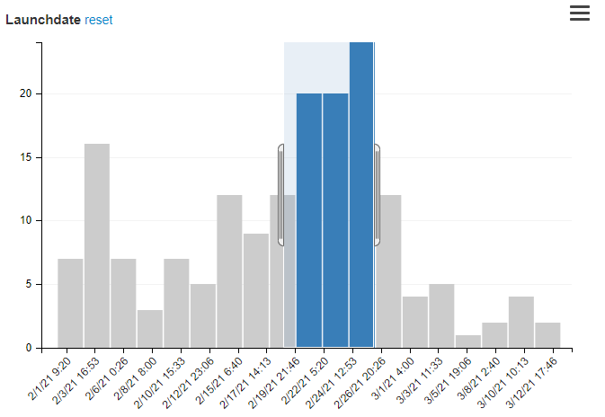
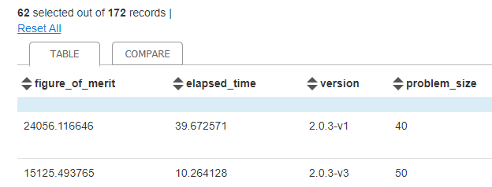
Metadata Can be Filtered
Select regions of metadata histograms to filter.
Filtering in one histogram updates all histograms range.
E.g., Filtering Launchdate to ‘Feb 19-Feb26’ will update the ‘Users’ histogram to only show users who ran between those dates.
While filtered, comparisons and Jupyter notebooks will operate on the filtered data.

Slide 9
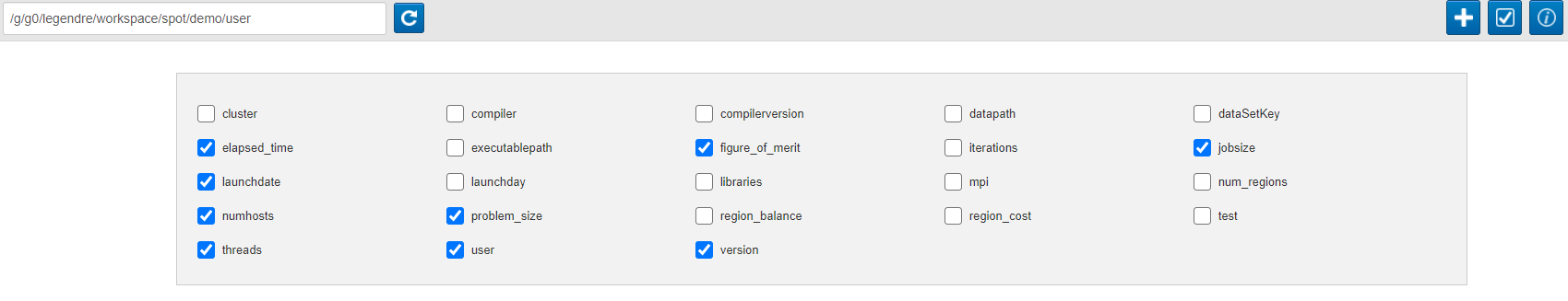
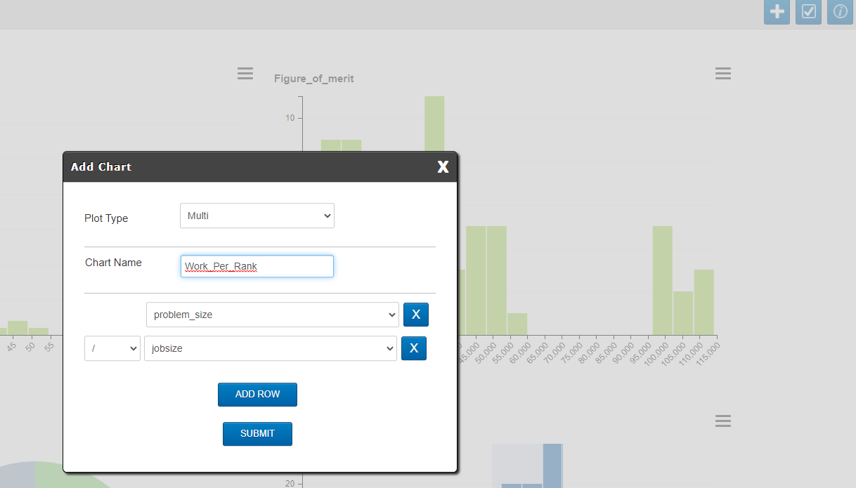
Metadata is Configurable
Can show/hide metadata:
Can create composite metadata:

Slide 10
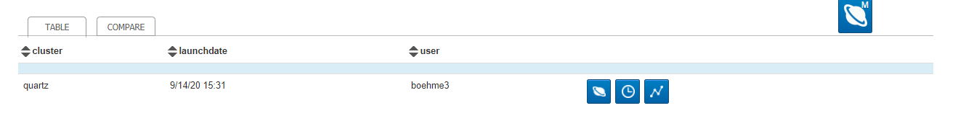
Performance Data can be Visualized Per-Run
FlameGraph: performance against code
Timeseries: performance against time

Slide 11
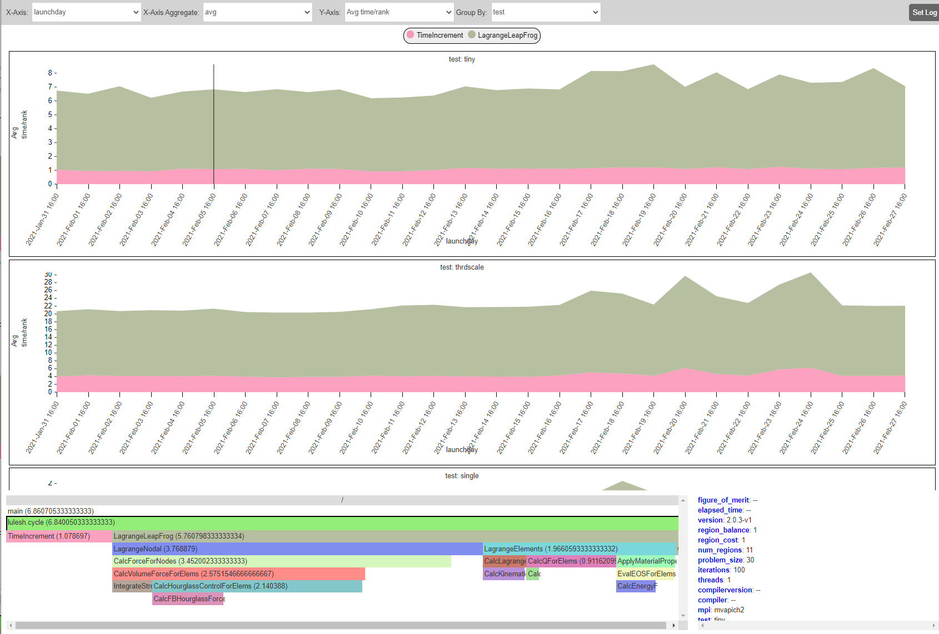
Performance Data can be Compared Across Runs
1
2
3
4
5
Metadata value on x-axis
Aggregation (min/max/avg…) if multiple runs at same point.
Metric to graph on y-axis.
Grouping metadata. Each unique value is a graph.
Stacked performance graph. Click to drill-down.
Flame graph for runs currently under cursor.
Metadata for runs currently under cursor.
6
7

Slide 12
Live Demo

Slide 13
Disclaimer
This document was prepared as an account of work sponsored by an agency of the United States government. Neither the United States government nor Lawrence Livermore National Security, LLC, nor any of their employees makes any warranty, expressed or implied, or assumes any legal liability or responsibility for the accuracy, completeness, or usefulness of any information, apparatus, product, or process disclosed, or represents that its use would not infringe privately owned rights. Reference herein to any specific commercial product, process, or service by trade name, trademark, manufacturer, or otherwise does not necessarily constitute or imply its endorsement, recommendation, or favoring by the United States government or Lawrence Livermore National Security, LLC. The views and opinions of authors expressed herein do not necessarily state or reflect those of the United States government or Lawrence Livermore National Security, LLC, and shall not be used for advertising or product endorsement purposes.

