Slide 1
Driver for LeCroy Scope with Ethernet interface
vxWorks driver:
General
Fast (not implemented)
EPICS device support

Slide 2

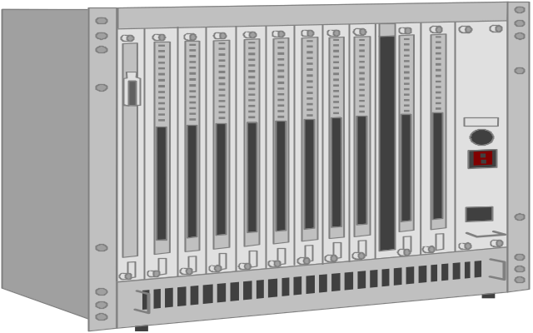
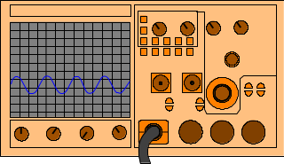
MEDM
Application
Ethernet
IOC
LeCroy Scopes
CPU Board
Ethernet

Slide 3
Benefit
  Fast. Normally we control scope via GPIB interface, Ethernet interface is faster;
  Easy to use. We have Ethernet everywhere and length limitation of cable is much longer then GPIB;
  Easy to port. Driver is only based on BSD 4.3 compatible socket, so it’s easy to port. We don’t need to ask manufacturer to support particular platform.

Slide 4
Performance (general)
We tested our driver (version 1.5), it can reach 60Hz refresh rate in particular case (1000 points);
Estimate for one IOC to multi scopes mode:
We did a simple test to our IOC (MV2302) by ftp a file to RamDisk in IOC, the throughput could be 26Mbps. For one scope ( EPICS record scan rates is 10HZ, and 1000 points per waveform ) we need 10*1k*8=80kbps. And we measured CPU time for one channel 1000 points read@40Hz on MV2100, it takes 2~3% CPU time. So I believe one IOC can support at least 10 scopes(40 channels) at same time;

Slide 5
Performance (fast)
The format of response from LT364:
…
The header is 8 bytes. First byte indicates if it’s last block, second byte indicates in data block is good, last four byte is length of following data block.
General driver reads head each time then data.
Fast driver read fixed length, it will save times to call read,
so it could be much faster, but not flexible, we don’t support
it now;
Enlarge socket buffer may be helpful;
The actual rates is up to load of scope’s CPU;
header
data
header
data
header
data

Slide 6
Function definition
LeCroyID LeCroy_Open(char * ipaddr, int channels, BOOL auto_link_recover);
STATUS LeCroy_Close(LeCroyID lecroyid);
STATUS LeCroy_Get_LinkStat(LeCroyID lecroyid, int *plinkstat);
STATUS LeCroy_Recover_Link(LeCroyID lecroyid, int intervalsec, int toutsec);
STATUS LeCroy_Get_Model(LeCroyID lecroyid, char * model);
STATUS LeCroy_Get_IPAddr(LeCroyID lecroyid, char * ipaddr);
STATUS LeCroy_Get_LastTrgTime(LeCroyID lecroyid, int chnl, char * time);
STATUS LeCroy_Print_Lasterr(LeCroyID lecroyid);
int LeCroy_Read(LeCroyID lecroyid,int chnl,float *pwaveform,int pts);
STATUS LeCroy_Ioctl(LeCroyID lecroyid,int chnl,int op, void *parg);

Slide 7
How to Use
At beginning,you should call
LeCroy_Open (char * ipaddr, int channels, BOOL auto_link_recover);
ipaddr is IP address of your scope.And return is a structure pointer if succeeded or NULL if failed. This pointer will be first parameter for all other functions. channels means how many channels your scope has, it has to be either 2 or 4, auto_link_recover will tell driver to monitor and recover link automatically or not.
When you finished using scope, you should call
LeCroy_Close (LeCroyID lecroyid);
Return OK if succeed, or else return ERROR.

Slide 8
How to Use (con’d)
LeCroy_Get_LinkStat(LeCroyID lecroyid, int *plinkstat);
is to check your TCP link status, status will be put into *plinkstat, there are four status: LINK_OK, LINK_DOWN, LINK_RECOVER ( it is trying to reconnect scope), LINK_UNSUPPORTED ( the peer is an unsupported network device). Return OK if succeed, or else return ERROR. It could be called synchronized.
LeCroy_Recover_Link(LeCroyID lecroyid, int intervalsec, int toutsec);
will check your link every intervalsec (if intervalsec is –1, we just do it once), if LINK_DOWN or LINK_UNSUPPORTED, it will try to reconnect it with timeout toutsec. intervalsec (except –1) should be bigger than toutsec. Return OK if succeed, or else return ERROR.

Slide 9
How to Use (con’d)
LeCroy_Get_Model(LeCroyID lecroyid, char * model);
is to read scope mode name like LT364, LT374, LT264. Model name will be store in model, model should be a char array bigger than 41 bytes. Return OK if succeed, or else return ERROR.
LeCroy_Get_IPAddr(LeCroyID lecroyid, char * ipaddr);
will put scope’s IP address to ipaddr, ipaddr should be a char array bigger than 21 bytes. Return OK if succeed, or else return ERROR.
LeCroy_Print_Lasterr(LeCroyID lecroyid);
will print out last error driver encountered to console. Return OK if succeed, or else return ERROR.
LeCroy_Get_LastTrgTime(LeCroyID lecroyid, int chnl, char * time);
will read out last trigger time of specified chnl(1~8 for 4 channel scope and 1,2,5,6 for 2 channel scope), and store in time as mm/dd/yyyy,hh:mm:ss.ssssssssss. Return OK if succeed, or else return ERROR.
(All these four functions can be called synchronized)

Slide 10
How to Use (con’d)
LeCroy_Read(LeCroyID lecroyid,int chnl,float *pwaveform,int pts);
is to read waveform from specified channel(chnl) of scope. chnl should be between 1 and 8 (C1-C4, TA-TD) for 4 channel scope or 1,2,5,6 (C1,C2,TA,TB) for 2 channel scope. Waveform will be put into pwaveform. pts is the number of points caller requests. For more efficient read, this had better to be close to the MEMSIZE(see LeCroy_Ioctl) value of scope. Return the number of points function really got if succeed, or else return ERROR.
LeCroy_Ioctl(LeCroyID lecroyid,int chnl,int op,void *parg);
Using this function to set or read the configuration of scope. If it’s channel related setting, chnl should be channel number (1~8) for 4 channel scope or 1,2,5,6 for 2 channel scope, if it’s not channel related, chnl could be 0. Before you do any channel related read/write, enable that channel first.

Slide 11
Supported op
RESET:
Not channel-related, doesn’t need parg.
ENABLECHAN:
Enable channel chnl, doesn’t need parg.
DISABLECHAN:
Disable channel chnl, doesn’t need parg.
GETCHANSTAT:
Get channel chnl status (ON or OFF), store to *parg as integer.

Slide 12
Supported op (con’d)
SETMEMSIZE
Not channel-related, set waveform length. parg should point to an integer.
*parg length *parg length
0 500 1 1K
2 2.5K 3 5K
4 10K 5 25K
6 50K 7 100K
8 250K 9 500K
10 1M 11 2.5M
12 5M 13 10M
Sample rates = memsize/(timediv*10);
Which is longest one for your scope is up to how much memory your scope has.

Slide 13
Supported op (con’d)
GETMEMSIZE
Not channel-related, get waveform length and store to *parg as integer.
SETTIMEDIV
Not channel-related, set time div. parg should point to a float. Unit is second.
GETTIMEDIV
Not channel-related, get time div and store to *parg as float. Unit is second.

Slide 14
Supported op (con’d)
SETVOLTDIV
Channel-related, set Volt div of channel chnl (1~4 only). parg should point to a float. Unit is volt.
GETVOLTDIV
Channel-related, get Volt div of channel chnl(1~4 only) and store to *parg as float. Unit is volt.
SETTRGMODE
Not channel-related, set trigger mode. parg should point to a integer. *parg means:
0: AUTO 1:NORMAL 2: SINGLE 3: STOP
GETTRGMODE
Not channel-related, get trigger mode and store to *parg as integer.

Slide 15
Supported op (con’d)
SETTRGSRC
Not channel-related, set trigger source. parg should point to a integer. *parg means:
0: Ext 1:C1 2: C2 (3: C3 4: C4 4 channel scope only)
GETTRGSRC
Not channel-related, get trigger source and store to *parg as integer.

Slide 16
Supported op (con’d)
LDPNLSTP
Not channel-related, load panel_setup from nvmem in scope. parg should point a integer.
*parg means nvmem number(0-4). *parg equal 0 means load default panel_setup.
SVPNLSTP
Not channel-related, save panel_setup to nvmem in scope. parg should point to a integer. *parg means nvmem number(1-4).

Slide 17
Supported op (con’d)
ENABLEACAL:
Not channel-related, enable auto recalibration, doesn’t need parg.
DISABLEACAL:
Not channel-related, disable auto recalibration, doesn’t need parg.
GETACALSTAT:
Not channel-related, get auto recalibration status (ON or OFF), store to *parg as integer.

