Slide 1

A Reproducible Validation of Algorithms for Estimating Array Tilt and Azimuth from Photovoltaic Power Time Series
Kirsten Perry¹, Bennet Meyers², Matthew Muller¹, Kevin Anderson¹
National Renewable Energy Laboratory
SLAC National Accelerator Laboratory
PVSC 50—San Juan, Puerto Rico
June 14, 2023

Slide 2
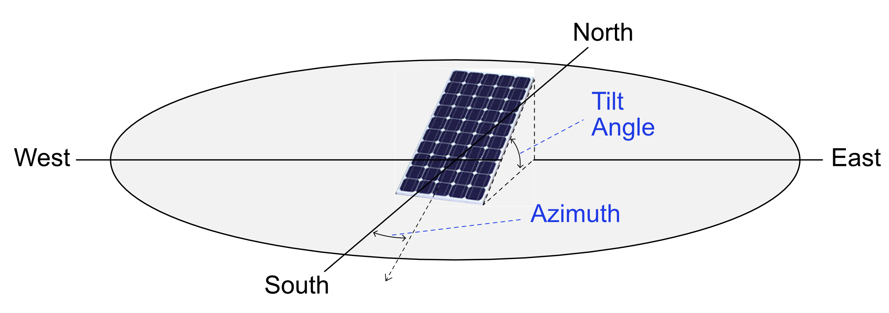
Background
Average 33% annual growth in solar industry [1]
Solar metadata lost during acquisitions
Leading residential installer: 500,000 systems
Metadata: tilt, azimuth, mounting configuration, etc
Manual entry OR costly site inspections
Why is having accurate metadata important?
Expected energy yield and degradation rates
Azimuth and tilt on a solar installation
Image courtesy of Design Solar Guide (https://solardesignguide.com/solar-panel-tilt-and-azimuth/)
[1] “US Solar Market Insight,” Solar Energy Industries Association (SEIA), 2022
Notes:
As we all know the photovoltaic industry has experienced unprecedented growth over the past 10 years, with an average of 33% annual growth as of 2022. With this rise in solar comes a rise in pv-related acquisitions. During utility and commercial solar acquisitions, a lot of the time data is lost when transferred between owners; or generally, organizations can lose track of important metadata associated with their systems. This includes important metadata such as system azimuth, tilt and mounting configuration. In order to accurately get this information, operators may rely on manual entry which can be erroneous, or on expensive site inspections. Accurate metadata such as azimuth and tilt is incredibly important for modelling system performance, including estimating system energy yield and degradation.

Slide 3
Motivations
Several time series algorithms exist to estimate the azimuth and tilt of a PV system [1,2,3]
A lot of existing research but it’s disjointed
Difficult to replicate results
No standardized data sets, process, or results
Benchmark 4 algorithms in Python open-source packages
Solar-Data-Tools: https://github.com/slacgismo/solar-data-tools
PVAnalytics: https://github.com/pvlib/pvanalytics
[1] Saint-Drenan et al, “An empirical approach to parameterizing photovoltaic plants for power forecasting and simulation,” Solar Energy, 2015.
[2] N. Haghdadi et al, “A method to estimate the location and orientation of distributed photovoltaic systems from their generation output data,” Renewable Energy, 2017.
[3] A. Londono-Hurtado et al, “Estimation of photovoltaic system location and orientation from power signals,” PVSC 2021
Notes:
Now that I’ve given a little bit of background, let’s talk about motivations for this particular research.

Slide 4
Methods
Solar-Data-Tools (SDT): Signal decomposition framework [1,2]. Needs measured PV power signal but not lat-long coordinates. 2 variations
PVAnalytics: 2 algorithms, require lat-long coordinates and measured PV power signal
PVWatts 5-based method: Compares measured power to PVWatts simulated power at varying az/tilt
PV-Peak method: Compares daily peak irradiance point (quadratic) to simulated clearsky POA peak irradiance at varying az/tilt
[1] A. Londono-Hurtado et al, “Estimation of photovoltaic system location and orientation from power signals,” PVSC 2021
[2] B. Meyers, “PVInsight final technical report,” Sep 2021.
Notes:
Let’s talk about our methodology. First, I will briefly describe the algorithms that we tested, followed by a summary of the datasets and framework that we used for validation.
The first algorithm that we tested was from the Solar-Data-tools package, and has been previously published on. This particular algorithm relies on a signal decomposition framework for estimating azimuth and tilt. It requires a PV power signal but can estimate with or without latitude-longitude coordinates. Both variations of this algorithm, with and without latitude-longitude, were tested.
The second set of algorithms tested were from the Python Pvanalytics package. Both of these algorithms have been published on before, and both require latitude-longitude coordinates and a measured PV power signal. The first, which I’ll refer to as the PVWatts 5 algorithm, compares measured PV power to simulated power using the PVWAtts 5 model at varying azimuth tilt combinations. Azimuth and tilt are determined based on the closest match.
The second algorithm tested was the PV-Peak algorithm. For this algorithm, daily PV power is fit to a quadratic and the peak point is determined. This peak is then compared to daily peak irradiance simulated at different azimuth-tilts. The closest match is then taken.

Slide 5
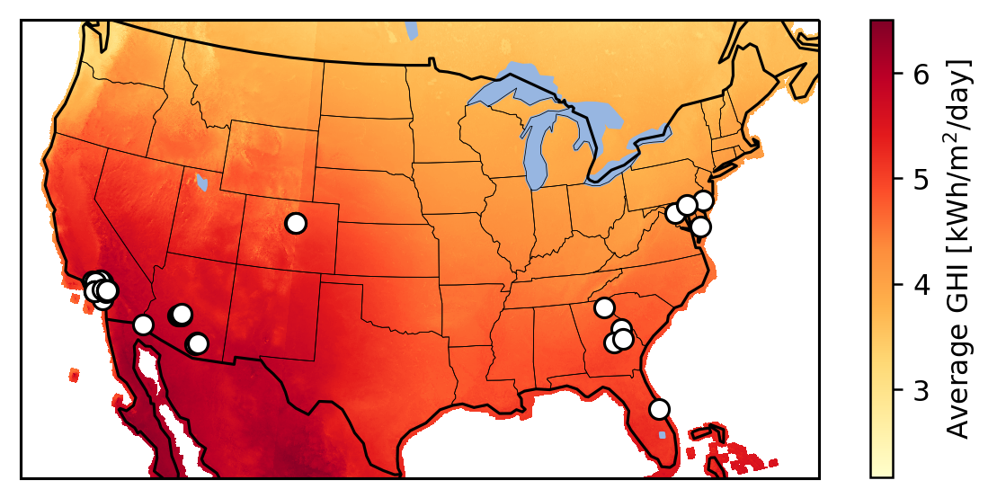
Methods Continued
Validation data set
275 AC power inverter data streams
44 fixed-tilt PV systems
Wide geographic distribution
Validated using Google Earth
Data stream issues: clipping, shading
Standardized test runner for executing algorithms
Same computer for consistency
Map of PV systems used in the validation data set.
Notes:
Now that I’ve briefly described our algorithms, let’s talk about our testing framework. In particular, our validation set consisted on 275 AC power data streams associate with 44 fixed-tilt PV systems. These systems are either from the public NREL PVDAQ database or the NDA-protected NREL PV Fleets database. Systems are from a wide geographic distribution to ensure algorithm robustness. Azimuth and tilt for each system were manually validated using Google Earth to ensure accuracy of the ground truth set.
Additionally, test cases with heavy clipping and soiling were identified for further case studies.
We built a standardized test runner in Python, with each algorithm submitted as a module to an overarching framework. All testing was performed on the same computer for consistency.

Slide 6
Results
Median absolute error: predicted vs actual tilt and azimuth
PVWatts-based and SDT (unknown lat-long) top performers
SDT algorithm fastest by a factor ~5x
PVWatts-based method requires pulling NSRDB PSM3 data
Algorithm | Median Azimuth Error (degrees) | Median Tilt Error (degrees) | Median Run Time (seconds)
SDT (lat-long known) | 10.12 | 6.24 | 6.02
SDT (lat-long unknown) | 4.94 | 1.66 | 8.64
PVAnalytics PVWatts-5 | 5.19 | 1.21 | 30.87
PVAnalytics PV-Peak | 8 | 7.51 | 25.66
Notes:
Now let’s take a look at our benchmarking results.

Slide 7
Case Study: Clipping
System with heavy inverter clipping
Azimuth/tilt error below
Most algorithms relatively robust to clipping
Clipped data periods removed in pre-processing
PV-Peak: high tilt error
Algorithm | Azimuth Absolute Error (degrees) | Tilt Absolute Error (degrees)
SDT (lat-long known) | 5.32 | 9.49
SDT (lat-long unknown) | 4.57 | 2.52
PVAnalytics PVWatts | 7.33 | 2.08
PVAnalytics PV-Peak | 0 | 23
AC power signal of heavily clipped system

Slide 8
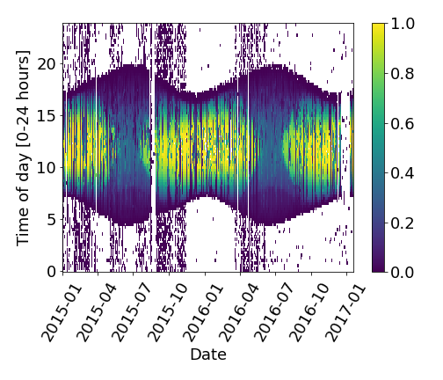
Case Study: Shading
Heavily shaded system
Located on side of parking garage on NREL campus
High tilt: 60 degrees
All algorithms robust at estimating azimuth (low error)
High tilt error for PVWatts model (~22 degrees)
Higher tilt error for most algos compared to median
Algorithm | Azimuth Absolute Error (degrees) | Tilt Absolute Error (degrees)
SDT (lat-long known) | 0.88 | 7.99
SDT (lat-long unknown) | 0.45 | 5.72
PVAnalytics PVWatts-5 | 0.41 | 22.44
PVAnalytics PV-Peak | 0 | 5
PV power heatmap for an inverter stream in heavily shaded system

Slide 9
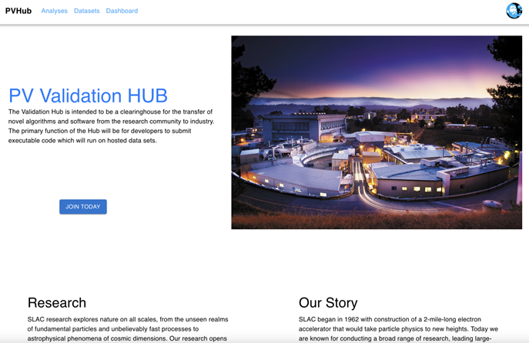
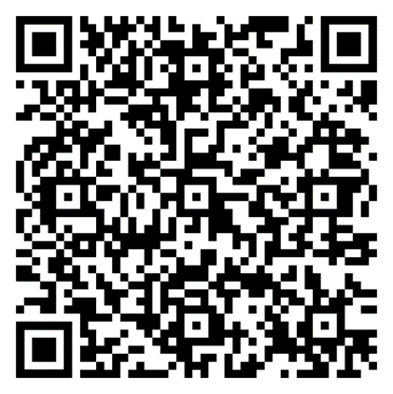
Integration into PV Validation Hub
PV Validation Hub main web page
How does this research play into the bigger picture?
Analysis and data sets incorporated into the PV Validation Hub
Website for validating PV analytics algorithms
Degradation, soiling, time shift estimation, etc.
Well-curated validation data sets and procedures
Side-by-side comparison of different algorithms
Public leaderboards and documentation
Expected public launch date: end of 2023
Take PV Validation Hub survey here:

Slide 10

Thank you!
This work was authored in part by Alliance for Sustainable Energy, LLC, the manager and operator of the National Renewable Energy Laboratory for the U.S. Department of Energy (DOE) under Contract No. DE-AC36-08GO28308. Funding provided by the U.S. Department of Energy’s Office of Energy Efficiency and Renewable Energy (EERE) under Solar Energy Technologies Office (SETO) Agreement Numbers 38258 and 38529. The views expressed in the article do not necessarily represent the views of the DOE or the U.S. Government. The U.S. Government retains and the publisher, by accepting the article for publication, acknowledges that the U.S. Government retains a nonexclusive, paid-up, irrevocable, worldwide license to publish or reproduce the published form of this work, or allow others to do so, for U.S. Government purposes.

