Slide 1
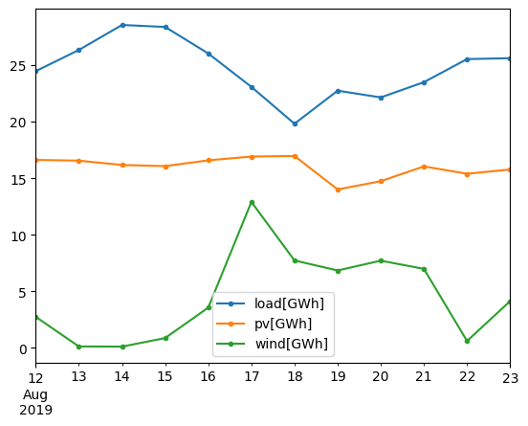
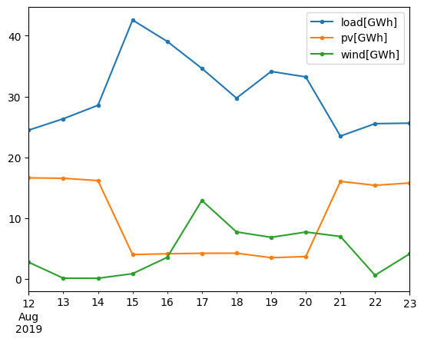
Case study: Synthetic heatwave/wildfire
Load increased by 50%
PV reduced by 75%
More extreme than actual Aug2020 event
Total shortfall 8/15/2019 – 8/20/2019
Before adding event: 3.13 GWh
After adding event: 32.52 GWh
Prescient, one-shot battery, generators, and renewables scheduling
Original data (daily integrals)
Modified data (daily integrals)

Slide 2
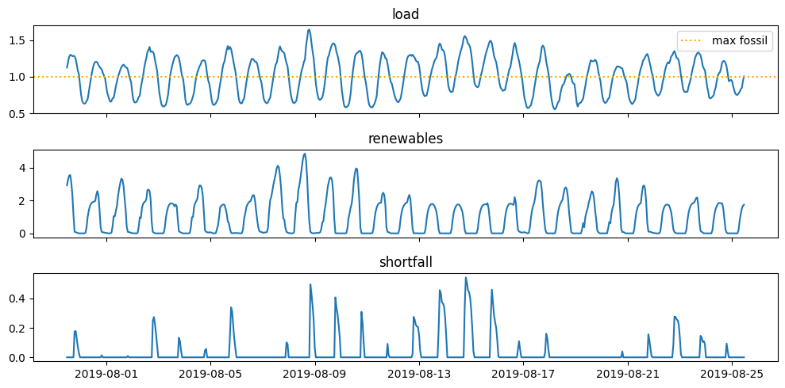
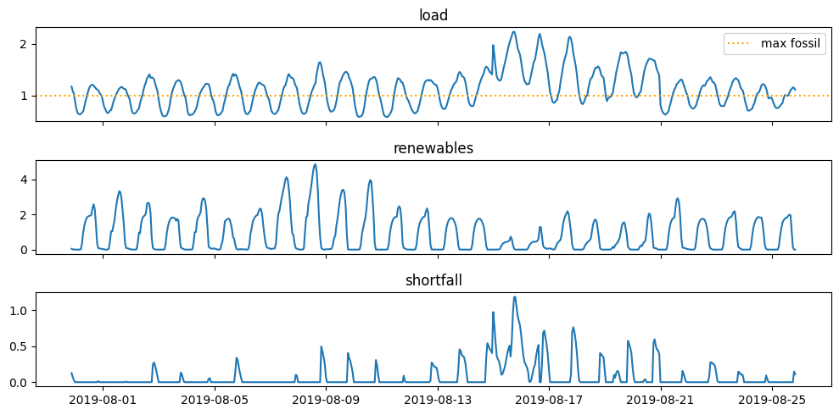
Load, renewables, and shortfall with and without synthetic heatwave/smoke event
Shortfall is the positive part of load minus max fossil and renewables

Slide 3
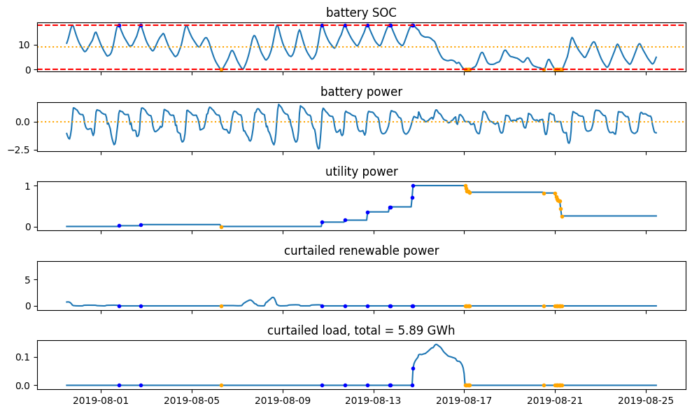
Optimal battery control: Example trace
Q=18GWh
Undersupply runs just over two days
Batter capacity changes the magnitude of the under supply, but not the timing
Renewable shifting / fossil minimization
preparation
stressed
Renewable shifting / fossil minimization
undersupply

Slide 4
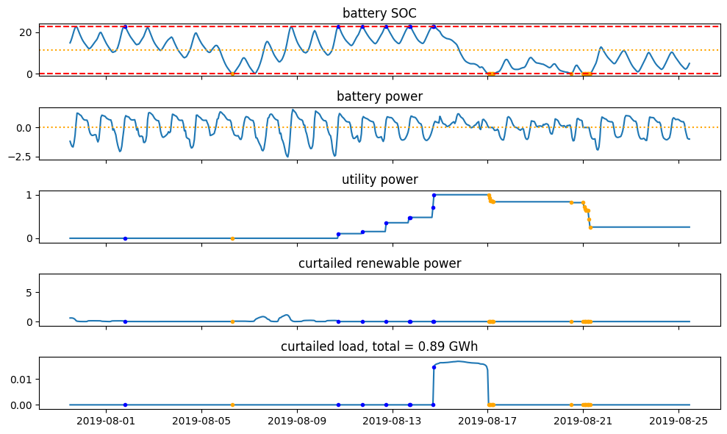
Optimal battery control: Example trace
Q=23GWh
Undersupply runs just over two days
Batter capacity changes the magnitude of the under supply, but not the timing
Renewable shifting / fossil minimization
preparation
stressed
Renewable shifting / fossil minimization
undersupply

Slide 5
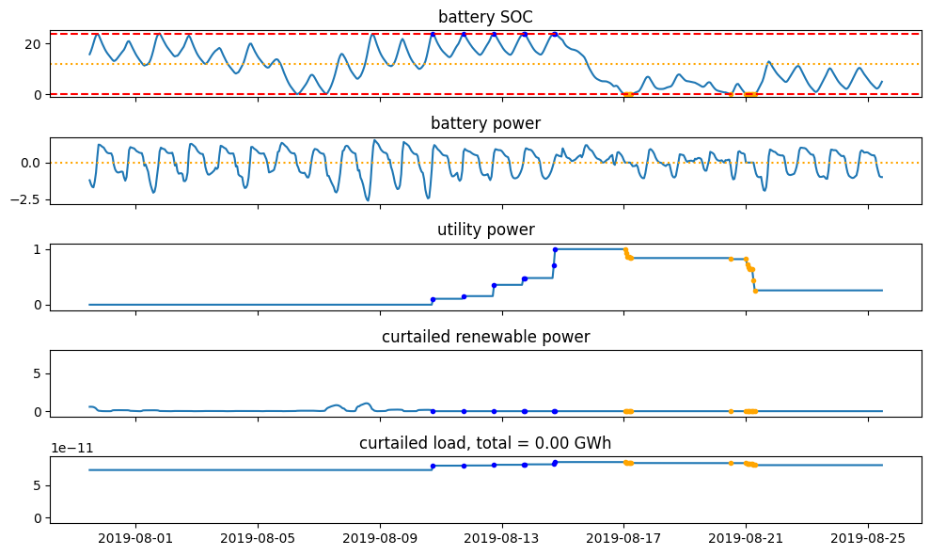
Optimal battery control: Example trace
Q=24GWh
Undersupply now eliminated
Batter capacity changes the magnitude of the under supply, but not the timing
Until the undersupply time is eliminated
Renewable shifting / fossil minimization
preparation
stressed
Renewable shifting / fossil minimization

Slide 6
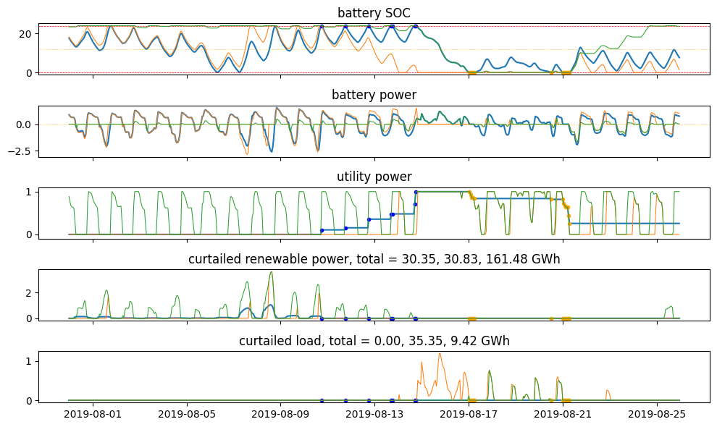
Compare to naïve controllers
Q=24GWh
Thin orange is battery priority
Thin green is utility priority
At this battery size, neither naïve controller can avoid blackouts completely
Totals ordering: optimal, battery priority, utility priority

Slide 7
Capacity needed to cover event

