Slide 1
Update on WECC node renewable generation
Bennet Meyers 11/18/25

Slide 2
Background
We are working with the “WECC 240” model of the electrical grid in the western United States
This model defines 243 buses, corresponding to 126 unique locations (nodes)
To model the western grid, we need to know the power generation and load at each bus/node
Must select subset of 126 unique locations to place generation
The focus here is on assigning solar (PV) and wind (WT) generation at WECC 240 nodes

Slide 3
Summary
Information on renewable generation mix at nodes prior to 11/17/25 was incorrect—not based on any previous model or newly acquired data set
We now have 7 estimates of the solar and wind generation mix at each node:
Published 2011 WECC model
Published 2020 WECC model
2018 USPVDB & USWTDB data
2019 US{PV,WT}DB data
2020 US {PV,WT} DB data
2021 US {PV,WT} DB data
2022 US {PV,WT} DB data
Final selection will be based on US {PV,WT}DB data for each year, plus manual additions (Vancouver, BC)

Slide 4
Timeline of recent events
Nov 6–7: began fusing renewable, load, and forecast data streams at nodes, for use in forecaster development
Nov 10: sent email asking questions regarding association of PV generators in Antelope Valley/Mojave Desert to David C. and Kirsten P., kicked off review of data and methods for assigning generation to load
Nov 12: discussed ongoing inconsistencies between input, intermediate, and final results of node mix estimation at REGROW project meeting
Nov 12–13: identified errors in existing logic, code, and data
Nov 14: clarified state of generation mix on existing, published WECC-240 models (2011 and 2018)
Nov 17: finalized-data driven methods and comparisons

Slide 5
Previous WECC models
240 WECC model we are using is derived from 2020 paper, which itself is derived from a 2011 model, which first establishes 240 nodes as the basis for a model of WECC
Both previous models include configurations (estimates) of the generation mix at each of the 240 nodes
The 2011 model is based on available data in 2011
The 2020 model is updated with new power plant data through 2018
We’re referring to these as “2011m” and “2018m” for the 240-WECC model generation as of 2011 and 2018, respectively

Slide 6
USGS US{PV,WT}DB based approach
Query databases by space and time, using custom code
Locations in WECC zip codes
Built in or before 2018, 2019, 2020, 2021, 2022
Find closest WECC node location to each generator
Haversine distance
Does not consider actual grid topology
Add PV, WT generation to nodes that are closest to some generator

Slide 7
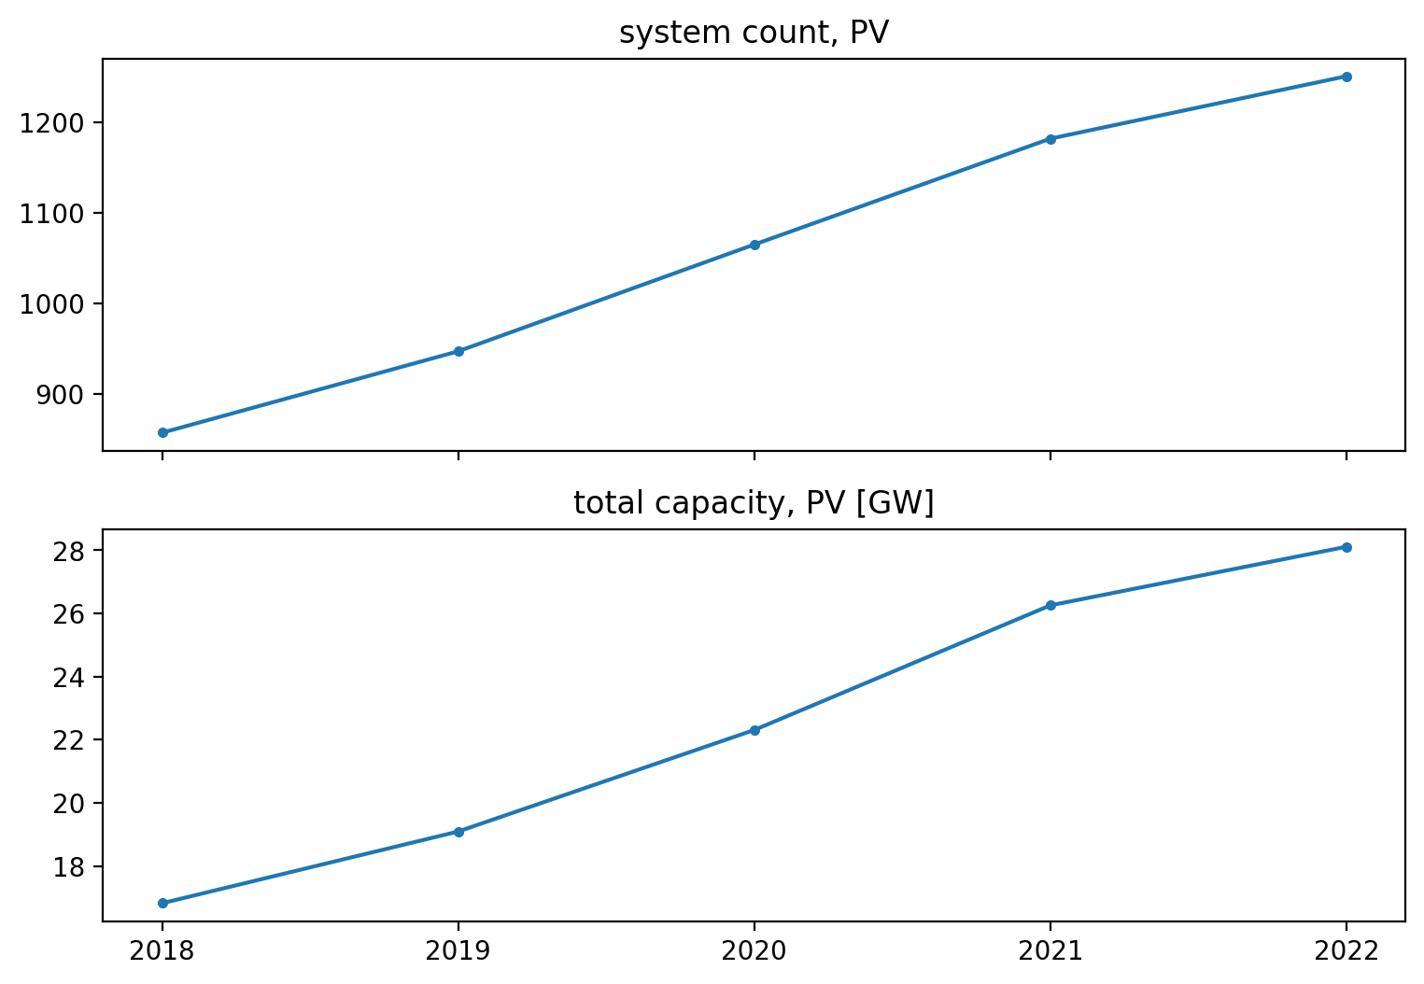
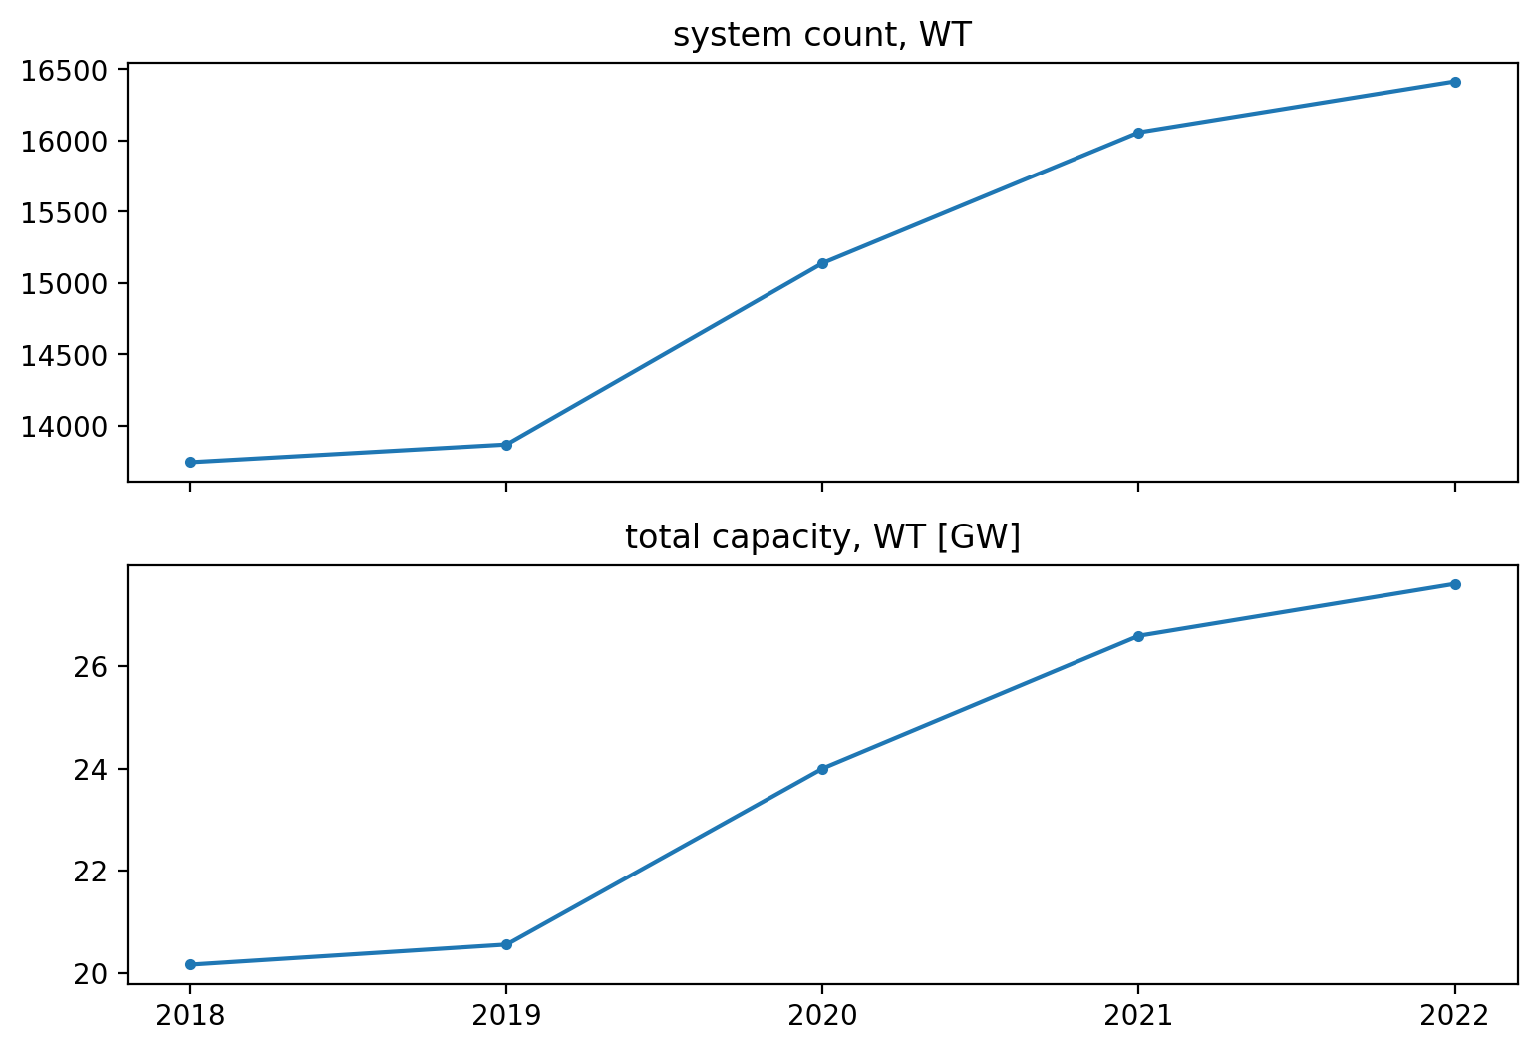
PV and WT growth in WECC based on USPVDBD and USWTDB
Count is by power plant site (aggregates inverters)
Count is by individual turbine

Slide 8
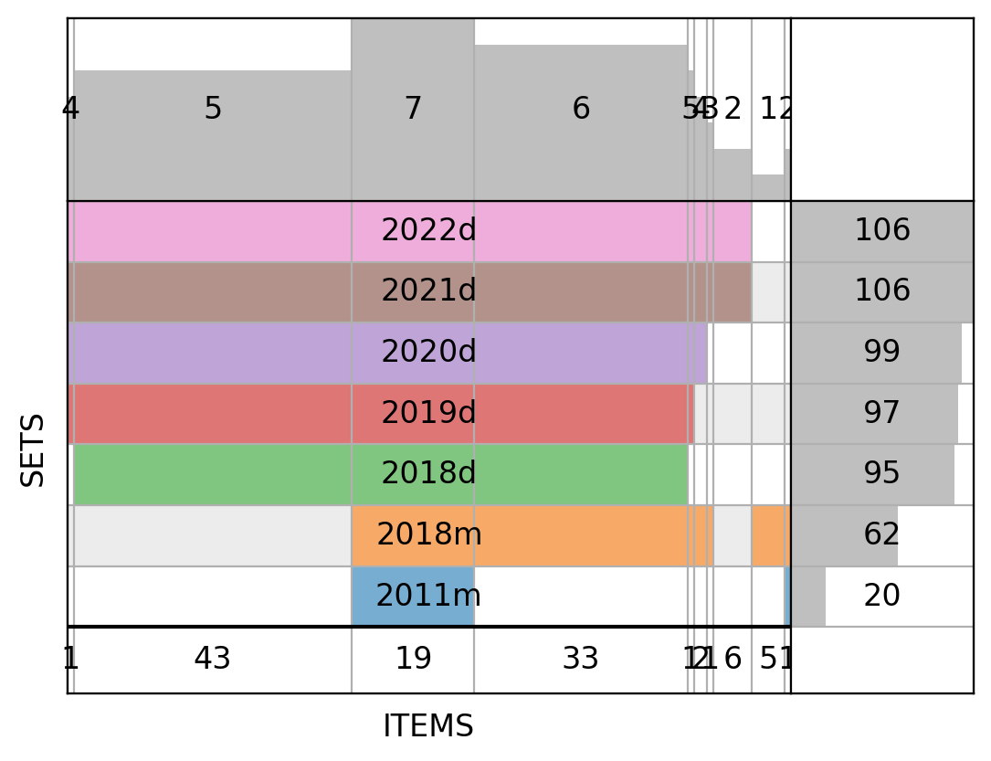
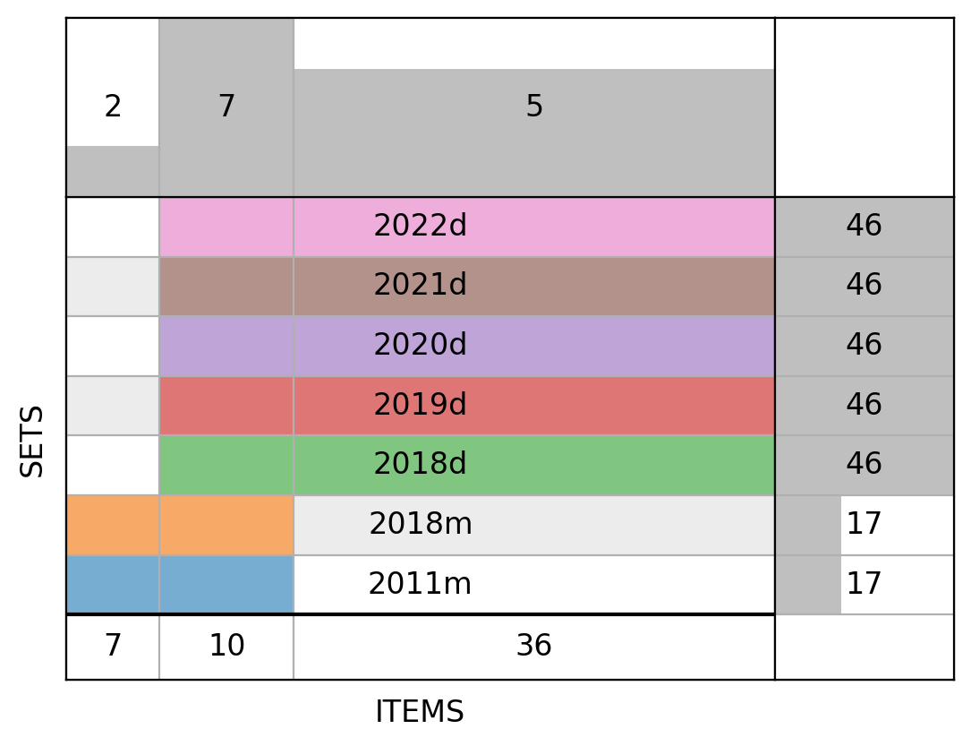
“Supervenn” diagram of seven mix estimates
Top numbers: count of sets with each intersection
Bottom numbers: count of items in each intersection
Right numbers: count of items in each set (7 in total)
WECC PV nodes
WECC WT nodes

Slide 9
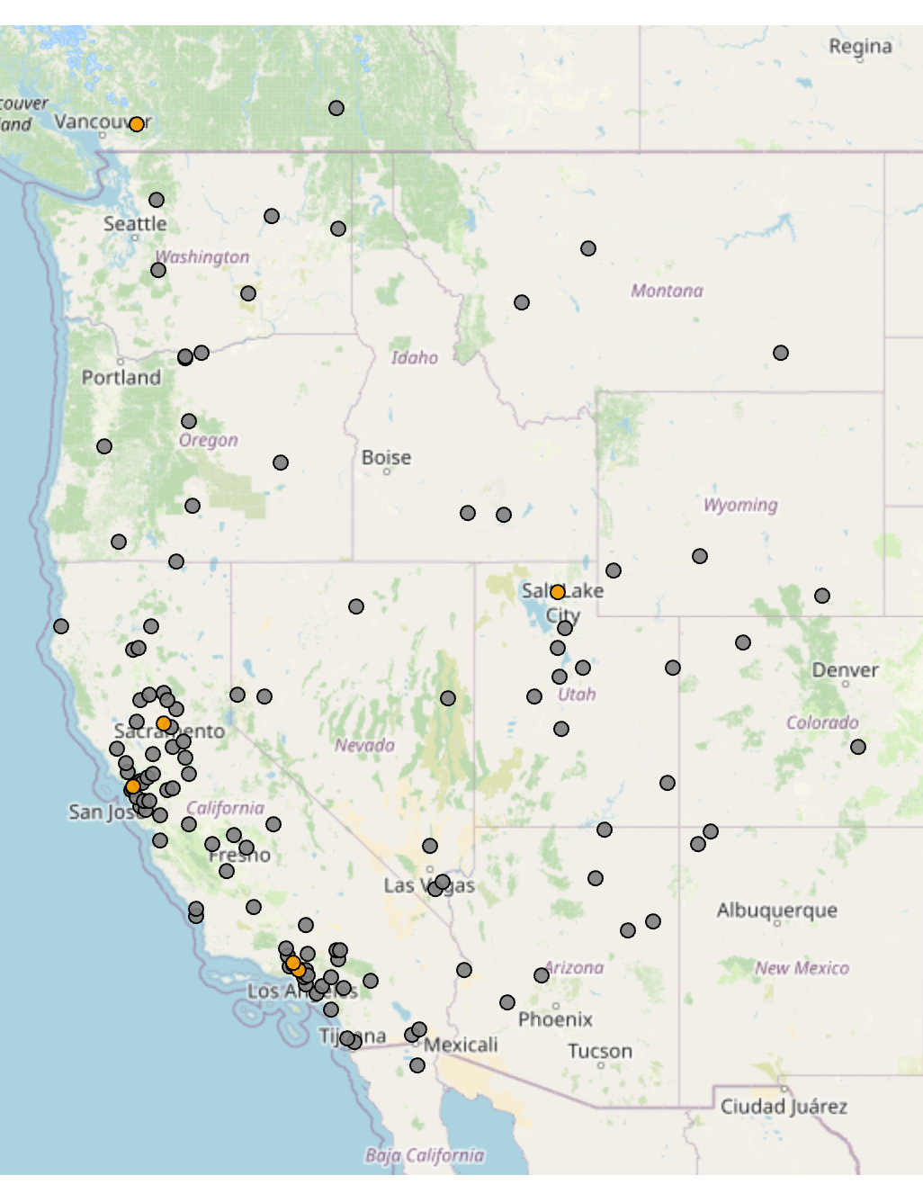

Locations in 2018m but not 2022d
126 in total (unique node locations)
Orange dots are nodes included in 2018m but not 2022d
These require more investigation
Would potentially be removing generation from these nodes
PV
WT

Slide 10
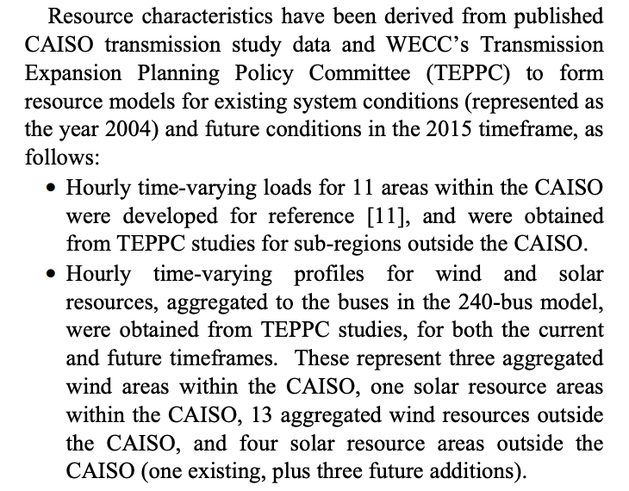
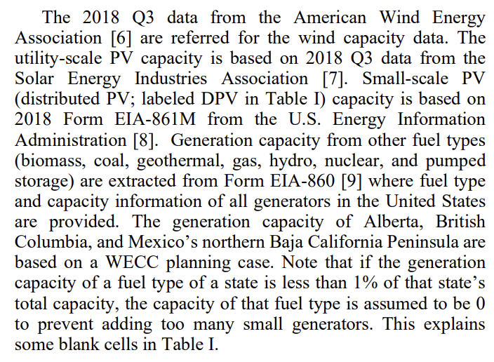
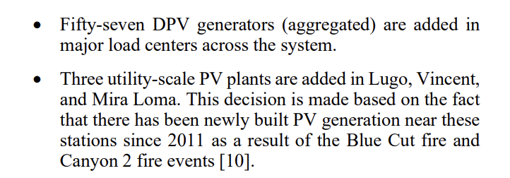
Approach from previous papers/models
2011
2020
[…]

Slide 11
Comments on previous papers/models
Very much a “by hand” process previously
The available data was limited
Basically, having set a model size and topology, they figured out generation mix from public disclosures, utility studies, and figuring out what was nearby
It is reasonable to update these models based on new, better data

Slide 12
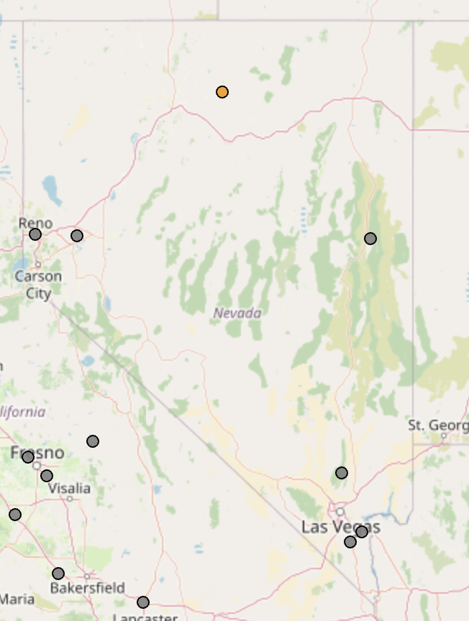
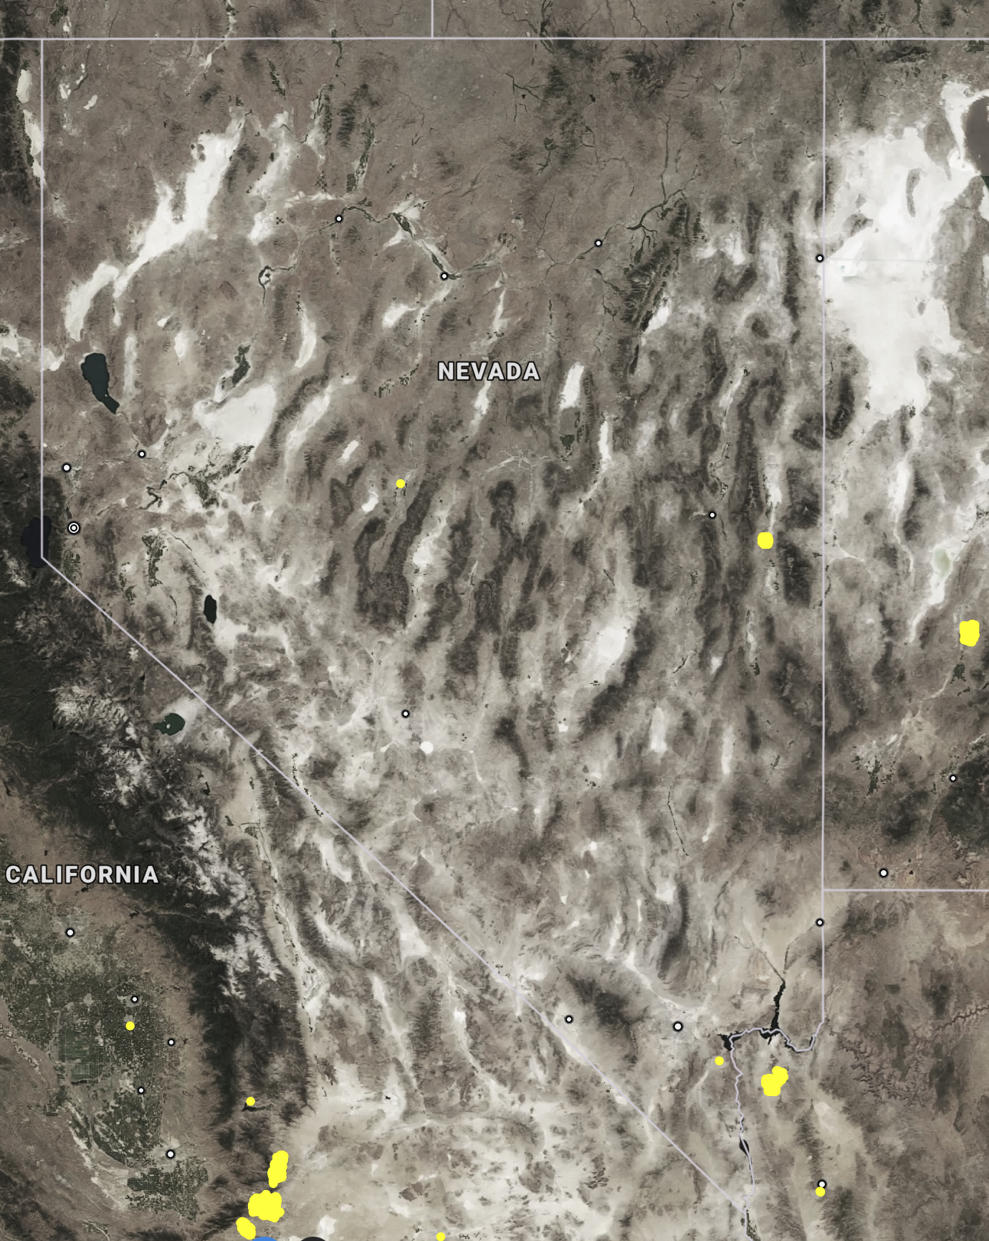
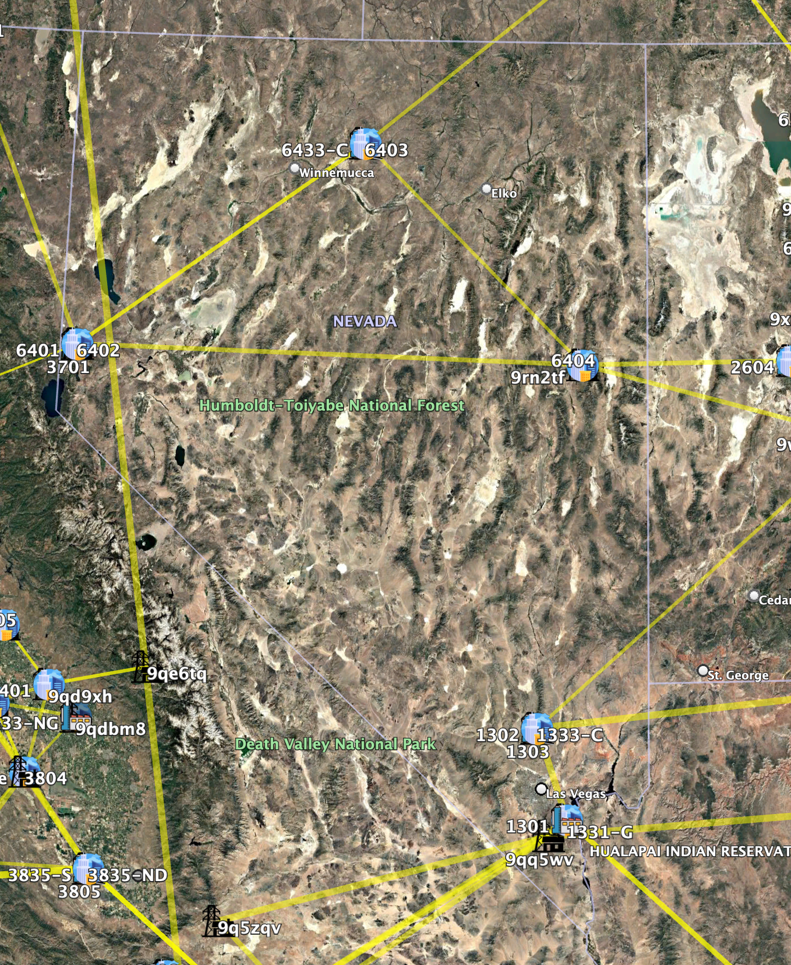
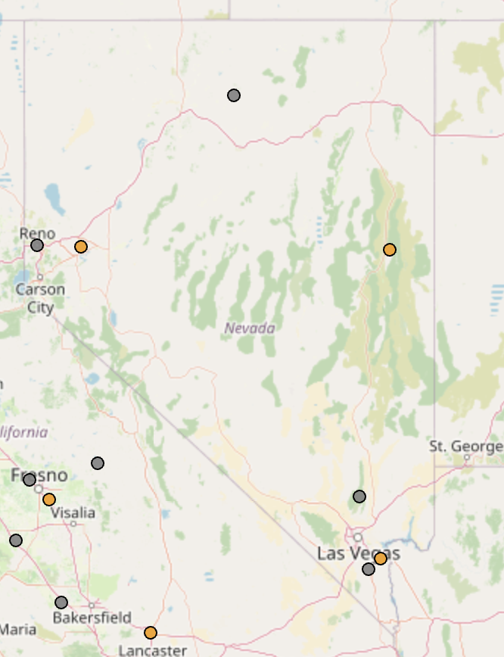
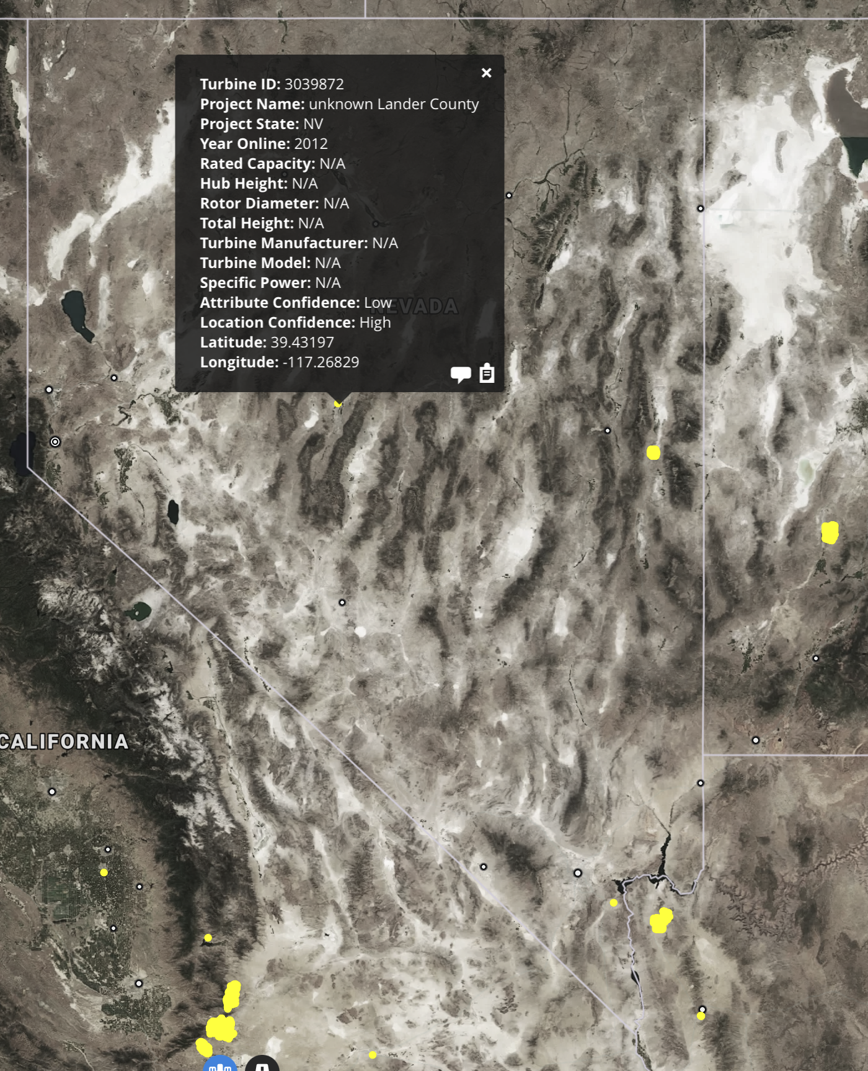
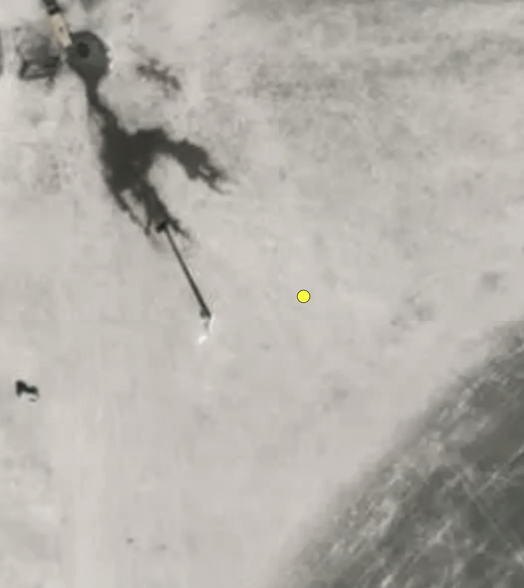
Case study: Wind in NV
2018m
USWTDB locations
local network
2020d
Original model seems to select node closest to the middle of Nevada to represent all Nevada generation
USWTDB GIS data proves that generation is actually near the edges of the state
New, data-driven approach seems to be a better match of reality than the original model
(note the one, single turbine in the middle of the state ➡️)

Slide 13
Case study PV+WT in BC
Both 2011m and 2018m place PV and WT generation at the Vancouver, BC WECC node in Canada
The United States Photovoltaic and Wind Turbine Databases do not cover this region!
New data-driven method does not place generation here (because there are no Canadian systems in the DB)
Need to manually add generation to this node

Slide 14
Changes to CA nodes
Discrepancies in wind and solar generation in California between old models and new method will be resolved in favor of the new method
Nodes that are “removed” from the old models have one or more neighboring nodes “added in”
More or less the same logic from the NV case study applies

Slide 15
New process for generation mix modeling
Load PV/WT generator data from database (USPVDB, USWTDB)
Load WECC county information
Join generators on county data to find generators in WECC service area
Calculate Haversine distance between each generator and each 126 unique WECC node locations
Associate generators to closest nodes
Add PV and WT generation to Vancouver, BC
Final caveat/detail: 20kV substations?

